Slide 1
Chapter 6: Scheduling Algorithms

Slide 2
Process Scheduling
Process execution consists of a CPU burst followed by I/O burst
CPU burst distribution is of main concern
Goal is to maximize CPU utilization
Quickly switch processes onto CPU for time sharing
Select among available processes for next execution on CPU

Slide 3
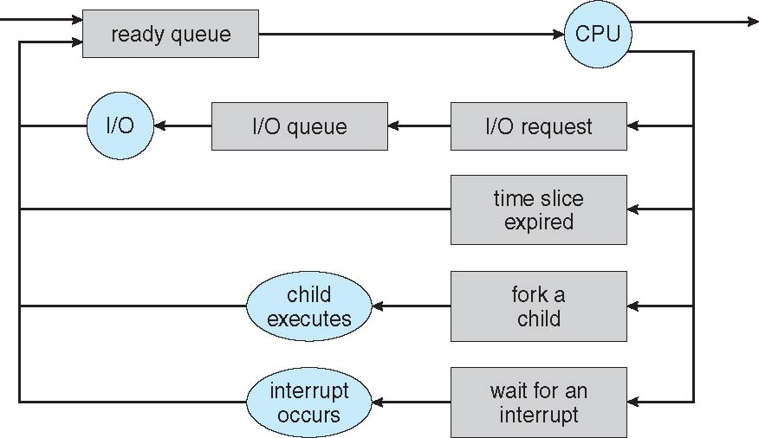
Process Scheduling Diagram
OS maintains scheduling queues of processes
Job queue – set of all processes in the system
Ready queue – set of all processes residing in main memory, ready and waiting to execute
Device queues – set of processes waiting for an I/O device
Processes migrate among the various queues

Slide 4
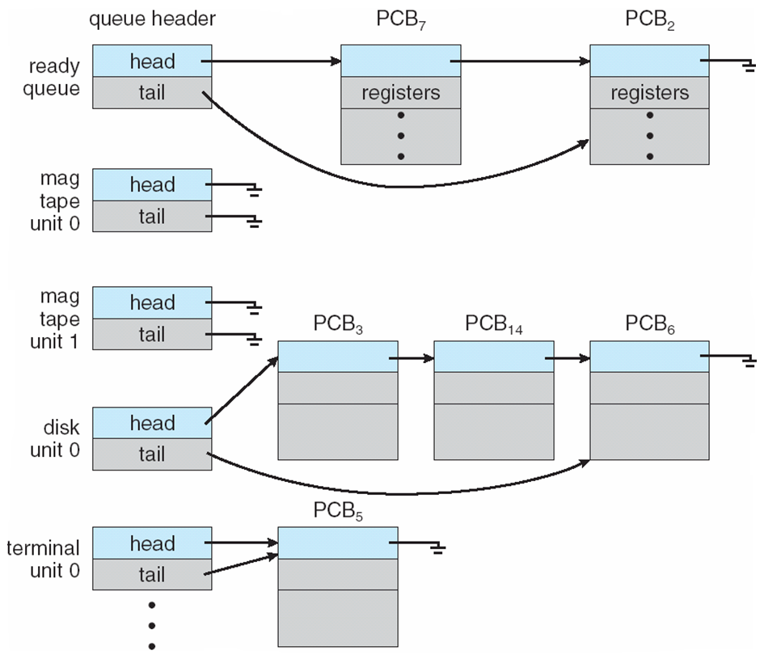
Ready Queue And Various I/O Device Queues

Slide 5
Schedulers
Short-term scheduler (or CPU scheduler)
Selects which process should be executed next and allocates CPU
Sometimes the only scheduler in a system
Invoked frequently (milliseconds) ⇒ (must be fast)
Dispatcher module gives control of the CPU to the process selected by the short-term scheduler
Dispatch latency is the time it takes for the dispatcher to stop one process and start another running
Long-term scheduler (or job scheduler)
Selects which processes should be brought into the ready queue
Invoked infrequently (seconds, minutes) ⇒ (may be slow)
Controls the degree of multiprogramming
Strives for good process mix (I/O and. CPU bound processes)

Slide 6
Physical Memory & Multiprogramming
Memory is scarce resource
Want to run many programs
Programs need memory to run
What happens when M(a) + M(b) + M(c) > physical memory?

Slide 7
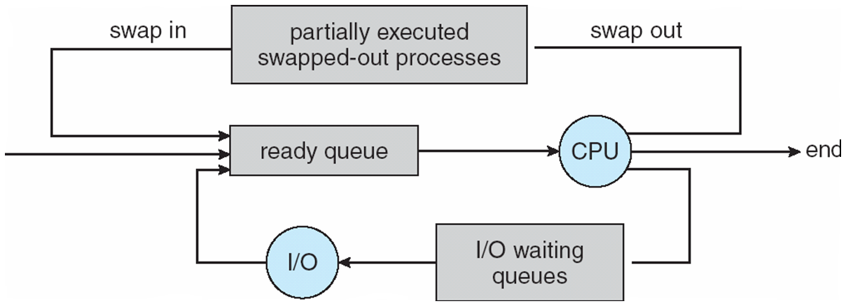
Medium Term Scheduler
Medium-term scheduler can be added if degree of multiple programming needs to decrease
Remove process from memory, store on disk, bring back in from disk to continue execution: known as job swapping

Slide 8
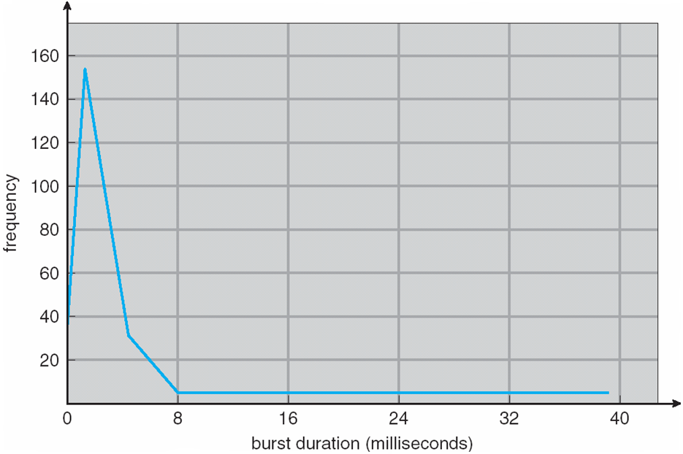
Histogram of CPU-burst Times

Slide 9
Types of Scheduling
Types of process scheduling
Preemptive
Can be taken out from the processor after the time slice gets expire
Non-preemptive
Cannot be taken out unless a process completes its execution

Slide 10
Scheduling Criteria
CPU utilization – keep the CPU as busy as possible
Throughput – # of processes that complete their execution per unit time
Turn around time – amount of time to execute a particular process
Waiting time – amount of time a process has been waiting in the ready queue
Response time – amount of time it takes from when a request was submitted until the first response is produced, not output (for time-sharing environment)

Slide 11
Scheduling Algorithm Optimization Criteria
Maximize CPU utilization
Maximize throughput
Minimize turnaround time
Minimize waiting time
Minimize response time

Slide 12
Process Scheduling
Multiprogramming needs CPU scheduling
Without any hardware support, what can the OS do to a running process?
System calls that triggers Scheduler
Block – wait on some event/resource
Network packet arrival (e.g. recv( ))
Keyboard, mouse input (e.g. getchar( ))
Disk activity completion (e.g. read( ))
Yield – give up running for now

Slide 13
Non-Preemptive Scheduler
A non-preemptive scheduler invoked by explicit block/yield calls or terminations
Only method when there is no timer!
The simplest form
Scheduler:
save current process state (into PCB)
choose next process to run
dispatch (load PCB and run)
Used in Windows 3.1, Mac OS

Slide 14
Timesharing Systems
Timesharing systems support interactive use
Each user feel he/she has the entire machine
Optimize response time
Based on time-slicing
Without hardware support, can we do anything other than non-preemptive scheduling?
Timer interrupt
Generated by the hardware
Setting requires privilege
Delivered to the OS

Slide 15
Preemptive Scheduler
Using interrupts for scheduling
Basic Idea
Before moving process to running, OS sets timer
If process yields/blocks, clear timer, go to scheduler
If timer expires, go to scheduler
Recall Context Switching!
Considerations: Timer granularity
Finer timers = more responsive
Coarser timers = more efficient

Slide 16
OS as a Resource Manager: Allocation vs. Scheduling
Allocation (spatial)
Who gets what? Given a set of requests for resources, which processes should be given which resources for best utilization?
Scheduling
How long can they keep it? When more resources are requested than can be granted, in what order can they be serviced?

Slide 17
[Lecture 1] Separating Policy from Mechanism
A fundamental design principle in Computer Science
Mechanism – tool/implementation to achieve some effect
Policy – decisions on what effect should be achieved
Examples:
All users treated equally
All programs instances treated equally
Preferred users treated better
Separation leads to flexibility

Slide 18
Preemptive CPU Scheduling
What is in it?
Mechanism + Policy
Mechanisms fairly simple
Policy choices harder

Slide 19
Challenges in Policy
Flexibility – variability in job types
Long vs. short
Interactive vs. non-interactive
I/O bound vs. compute-bound
Issues?
Short jobs shouldn’t suffer
Users shouldn’t be annoyed

Slide 20
Challenges in Policy (cont.)
Fairness
All users should get access to CPU
Amount of CPU should be roughly even?
Issues?
Short-term vs. long-term fairness

Slide 21
Goals and Assumptions
Goals (Performance metric)
Minimize turnaround time: average time to complete a job
Maximize throughput: operations (jobs) per second
Minimize overhead of context switches: large quanta
Efficient utilization (CPU, memory, disk etc.)
Short response time: type on a keyboard
Small quanta
Fairness (fair, no starvation, no deadlock)
Goals often conflict
Fairness vs. average turnaround time?
Assumptions
One process/program per user
Programs are independent

Slide 22
Scheduling Policies
Is there an optimal scheduling policy?
Even if we narrow down to one goal?
But we don’t know about future
Offline vs. online

Slide 23
Scheduling Algorithms
Non-preemptive
First Come First Served
Shortest Job First
Priority Scheduling
Preemptive
Round Robin
Shortest Remaining Time First
Priority Scheduling

Slide 24
Example: FCFS Scheduling Policy
Process Burst Time
P₁ 24
P₂ 3
P₃ 3
Suppose that the processes arrive in the order: P₁ , P₂ , P₃ The Gantt Chart for the schedule is:
Waiting time for P₁ = 0; P₂ = 24; P₃ = 27
Average waiting time: (0 + 24 + 27)/3 = 17
P₁
P₂
P₃
0
24
27
30

Slide 25
Example: FCFS Scheduling Policy
Suppose that the processes arrive in the order:
P₂ , P₃ , P₁
The Gantt chart for the schedule is:
Waiting time for P₁ = 6; P₂ = 0; P₃ = 3
Average waiting time: (6 + 0 + 3)/3 = 3
Much better than previous case
Convoy effect - short process behind long process
Consider one CPU-bound and many I/O-bound processes
P₂
P₃
P₁
0
3
6
30

Slide 26
Class Exercise : FCFS with Arrival Time
Process | Execution Time
P1 | 6
P2 | 3
P3 | 8
P4 | 3
Arrival Time
2
5
1
0

Slide 27
FCFS advantages and disadvantages
Advantages
Simple and easy to program
Disadvantages
Non-Preemptive scheduling algorithm so after the process has been allocated to the CPU, it will never release the CPU until it finishes executing or blocked.
The Average Waiting Time is high.
Short processes at the back wait for the long process at the front.
Not an ideal technique for time-sharing systems.

Slide 28
Shortest-Job-First (SJF) Scheduling Policy
Associate with each process the length of its next CPU burst
Use these lengths to schedule the process with the shortest time
Non-preemptive
Advantage
SJF is optimal – gives minimum average waiting time and turnaround time for a given set of processes
Disadvantage
Can cause starvation if there is a steady supply of shorter processes
Difficult to know the future (length of the next CPU request)

Slide 29
Example: SJF Scheduling Policy
Process Burst Time
P₁ 6
P₂ 8
P₃ 7
P₄ 3
SJF scheduling chart
Average waiting time = (3 + 16 + 9 + 0) / 4 = 7
P₄
P₁
P₃
P₂
0
3
9
16
24

Slide 30
Class Exercise : SJF Scheduling Policy
Process | Execution Time
P1 | 7
P2 | 8
P3 | 4
P4 | 3

Slide 31
Class Exercise : SJF Scheduling Policy
Process | Execution Time
P1 | 7
P2 | 8
P3 | 4
P4 | 3
P₄
P₃
P₁
P₂
0
3
7
14
22
Average waiting time = (7 + 14 + 3 + 0) / 4 = 6

Slide 32
SJF with Arrival time
Process Time Burst Time
P₁ 0.0 6
P₂ 2.0 8
P₃ 4.0 7
P₄ 7.0 3

Slide 33
SJF with Arrival time
Process Time Burst Time
P₁ 0.0 6
P₂ 2.0 8
P₃ 4.0 7
P₄ 7.0 3
P₁
P₃
P₄
P₂
0
6
13
16
22

Slide 34
SJF with Arrival time
Process Time Burst Time
P₁ 0.0 6
P₂ 2.0 8
P₃ 4.0 7
P₄ 7.0 3
P₁
P₃
P₄
P₂
0
6
13
16
22
Average waiting time = (0 + 14 + 2 + 6) / 4 = 5.5

Slide 35
Determining Length of Next CPU Burst
Can only estimate the length – should be similar to the previous one
Then pick process with shortest predicted next CPU burst
Can be done by using the length of previous CPU bursts, using exponential averaging
Commonly, α set to ½
α =0
τ_{n+1} = τ_{n} (recent history does not count)
α =1
τ_{n+1} = α t_{n} (only the actual last CPU burst counts)

Slide 36
Prediction of the Length of the Next CPU Burst

Slide 37
SRTF Scheduling Policy
Shortest Remaining Time First scheduling
The preemptive version of SJF.
Calculate the remaining execution time for each process
Schedule the process with the minimum remaining time
Advantage
Minimal average waiting and turnaround time for a given set of processes
Disadvantage
Like SJF, can cause starvation for longer processes

Slide 38
Example: SRTF Scheduling Policy
Now we add the concepts of varying arrival times and preemption to the analysis
Process Arrival Time Burst Time
P₁ 0 8
P₂ 1 4
P₃ 2 9
P₄ 3 5
Preemptive SJF Gantt Chart
Average waiting time = [(10-1)+(1-1)+(17-2)+5-3)]/4 = 26/4 = 6.5 msec
P₁
P₂
P₄
P₁
P₃
0
1
5
10
17
26

Slide 39
Class Exercise: SRTF Scheduling Policy
Process | Arrival Time | Execution Time
P1 | 0 | 7
P2 | 1 | 3
P3 | 2 | 8
P4 | 3 | 4

Slide 40
Class Exercise: SRTF Scheduling Policy
Process | Arrival Time | Execution Time
P1 | 0 | 7
P2 | 1 | 3
P3 | 2 | 8
P4 | 3 | 4
P₁
P₂
P₄
P₁
P₃
0
1
4
8
14
22
P1 = 8 – 1 = 7
P2 = 1 – 1 = 0
P3 = 14 – 2 = 12
P4 = 4 – 3 = 1
Average waiting time = (7 + 0 + 12 + 1) / 4 = 5

Slide 41
Priority Scheduling
Assign each process a priority (integer) number (smallest integer ≡ highest priority)
Run the process with highest priority in the ready queue first
Preemptive
Non-preemptive
Use FIFO for processes with equal priority
SJF is priority scheduling where priority is the inverse of predicted next CPU burst time
Advantage
Flexibility: Not all processes are born equal
Problem ≡ Starvation – low priority processes may never execute
Solution ≡ Aging – adjust priority dynamically (increase priority over time)

Slide 42
Example: Priority Scheduling
Process Burst Time Priority
P₁ 10 3
P₂ 1 1
P₃ 2 4
P₄ 1 5
P₅ 5 2
Priority scheduling Gantt Chart
Average waiting time = 8.2 msec
P₂
P₅
P₁
P₃
P₄
0
1
6
16
18
19

Slide 43
Priority (preemptive)
A number is assigned to each process that indicates its priority level.
If a newer process arrives,
having higher priority than the currently running process,
then the currently running process is preempted.

Slide 44
Important Points
The waiting time for the process having the highest priority
will always be zero in preemptive mode.
may not be zero in non-preemptive mode.
Preemptive and non-preemptive mode behaves exactly same, if
The arrival time of all the processes is same
All the processes become available

Slide 45
Exercise
Process Id | Arrival time | Burst time | Priority
P1 | 0 | 4 | 4
P2 | 1 | 3 | 3
P3 | 2 | 1 | 2
P4 | 3 | 5 | 1
P5 | 4 | 2 | 1

Slide 46
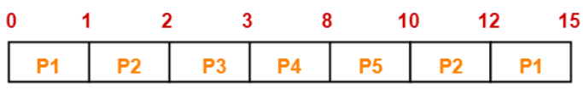
Exercise
Process Id | Arrival time | Burst time | Priority
P1 | 0 | 4 | 4
P2 | 1 | 3 | 3
P3 | 2 | 1 | 2
P4 | 3 | 5 | 1
P5 | 4 | 2 | 1

Slide 47
Exercise
Process Id | Arrival time | Burst time | Priority
P1 | 0 | 4 | 4
P2 | 1 | 3 | 3
P3 | 2 | 1 | 2
P4 | 3 | 5 | 1
P5 | 4 | 2 | 1
P1=11 P2=8 P3=0 P4=0 P5=4
Avg. waiting time=4.6

Slide 48
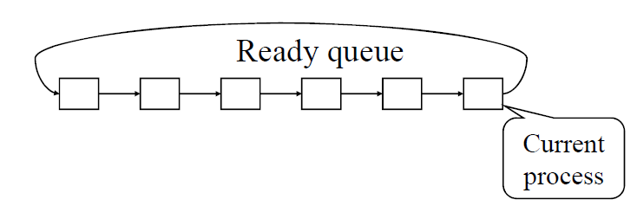
Round Robin (RR) Scheduling Policy
Each process runs a time slice or quantum q.
For n processes in the ready queue and time quantum is q, each process gets 1/n of the CPU time in chunks of at most q time units. Each process waits no longer than (n-1)q time units until its next time quantum.
Timer interrupts every quantum to schedule next process
Performance
q large ⇒ FIFO
q small ⇒ q must be large with respect to context switch, otherwise overhead is too high

Slide 49
Example: RR Scheduling Policy
Process Burst Time
P₁ 24
P₂ 3
P₃ 3
Time slice = 4
The Gantt chart is:
Typically, higher average turnaround time than SJF, but better response time
q should be large compared to context switch time
q usually 10ms to 100ms, context switch < 10 usec
P₁
P₂
P₃
P₁
P₁
P₁
P₁
P₁
0
4
7
10
14
18
22
26
30

Slide 50
RR
Advantages
best performance in terms of average response time.
best suited for
time sharing system,
client server architecture and
interactive system.
Disadvantages
leads to starvation for processes with larger burst time
as they have to repeat the cycle many times.
Its performance heavily depends on time quantum.

Slide 51
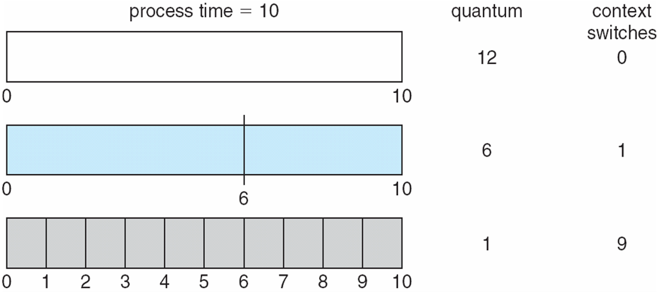
Important Notes
With decreasing value of time quantum,
Number of context switch increases
Response time decreases
Chances of starvation decreases
When time quantum tends to infinity, Round Robin Scheduling becomes FCFS Scheduling.
The value of time quantum should be
neither too big nor too small.

Slide 52
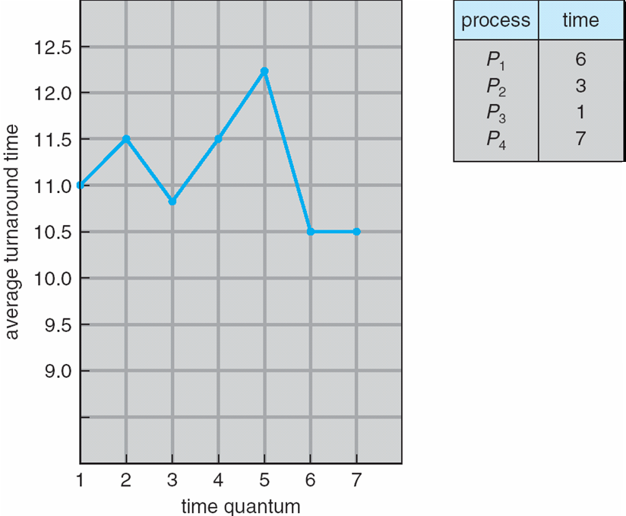
Turnaround Time Varies With The Time Quantum
80% of CPU bursts should be shorter than q.

Slide 53
Exercise
Process Id | Arrival time | Burst time
P1 | 0 | 5
P2 | 1 | 3
P3 | 2 | 1
P4 | 3 | 2
P5 | 4 | 3
Time slice = 2 sec

Slide 54

Exercise
Process Id | Arrival time | Burst time
P1 | 0 | 5
P2 | 1 | 3
P3 | 2 | 1
P4 | 3 | 2
P5 | 4 | 3
Time slice = 2 sec
Average waiting time = (8 + 8 + 2 + 4 + 7) / 5 = 29 / 5 = 5.8

Slide 55
Multilevel Queue Scheduling
When processes can be readily categorized
then multiple separate queues can be established
each implementing whatever scheduling algorithm is most appropriate for that type of job, and/or with different parametric adjustments.
Scheduling must also be done between queues

Slide 56
Multilevel Queue Scheduling
Two common options are
strict priority
no job in a lower priority queue runs until all higher priority queues are empty
round-robin
each queue gets a time slice in turn, possibly of different sizes
Note that under this algorithm jobs cannot switch from queue to queue
Once they are assigned a queue, that is their queue until they finish.

Slide 57
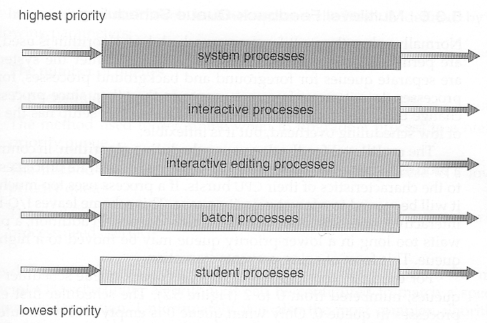

Slide 58
Multilevel Feedback-Queue Scheduling

Slide 59
Multilevel Feedback-Queue Scheduling
Similar to the multilevel queue scheduling
except jobs may be moved from
one queue to another for a variety of reasons
Most flexible
because it can be tuned for any situation.
Most complex to implement
because of all the adjustable parameters.

Slide 60
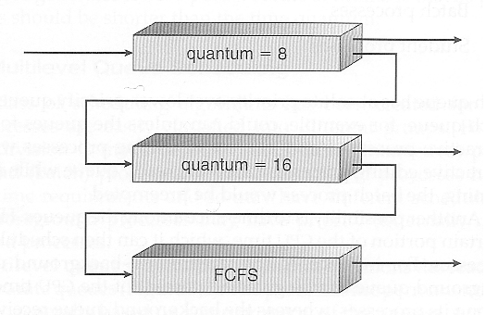

Slide 61
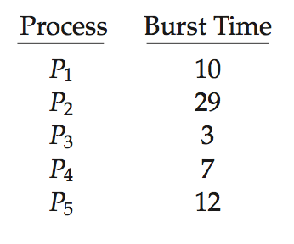
Evaluation of Scheduling Policies
How to select CPU-scheduling policy for an OS?
Determine criteria, then evaluate algorithms
Deterministic modeling
Type of analytic evaluation
Takes a particular predetermined workload and defines the performance of each algorithm for that workload
Consider 5 processes arriving at time 0:
FCFS, SJF, and RR

Slide 62
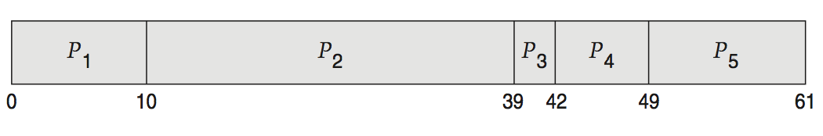
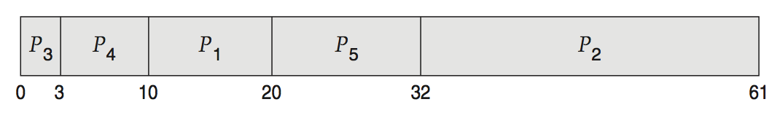
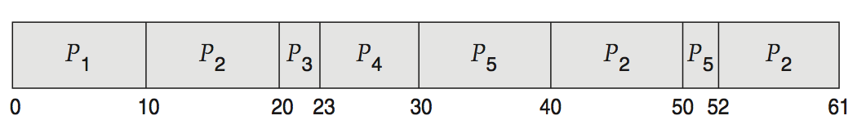
Deterministic Evaluation
For each algorithm, calculate minimum average waiting time
Simple and fast, but requires exact numbers for input, applies only to those inputs
FCFS is 28ms:
Non-preemptive SJF is 13ms:
RR is 23ms:

