Slide 1
Chapter 7: Deadlocks

Slide 2
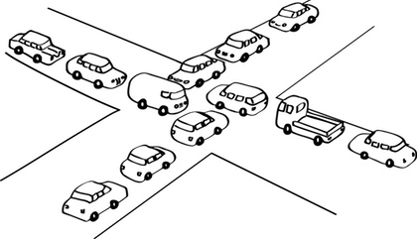
Deadlock
Deadlock – A condition where two or more processes are waiting indefinitely for an event that can only be generated by these same threads
Deadlocks can occur via system calls, locking, etc.
Let S and Q be two semaphores initialized to 1
P₀ P₁
wait(S); wait(Q);
wait(Q); wait(S);
... ...
signal(S); signal(Q);
signal(Q); signal(S);

Slide 3
Deadlock: Terminology
Deadlock can occur when several threads compete for a finite number of resources simultaneously
Deadlock prevention algorithms check resource requests and possibly availability to prevent deadlock
Deadlock detection finds instances of deadlock when threads stop making progress and tries to recover
Starvation occurs when a thread waits indefinitely for some resource, but other threads are actually using it (making progress)
Starvation is a different condition from deadlock

Slide 4
Necessary Conditions for Deadlock
Deadlock can happen if all the following conditions hold simultaneously:
Mutual Exclusion: at least one process must hold a resource in non-sharable mode, i.e. the resource may only be used by one process at a time
Hold and wait: at least one process holds a resource and is waiting for additional resource(s) to become available, held by other processes
No preemption: a process can only release a resource voluntarily; another process or the OS cannot force the process to release the resource
Circular wait: a set of waiting processes {P₀, P₁, …, P_{n}} where P_{i} is waiting on P_{i+1} (i = 1 to n), and P_{n} is waiting on P₀

Slide 5
Methods for Handling Deadlocks
Ensure that the system will never enter a deadlock state
Deadlock prevention
One of the conditions never hold
Deadlock avoidance
Ensuring that the system is always in a safe state.
Allow the system to enter a deadlock state and then recover
Ignore the problem and pretend that deadlocks never occur in the system; leave it to the programmer/application
Used by most operating systems, including UNIX

Slide 6
Deadlock Prevention
Ensure that at least one of the necessary conditions doesn’t hold.
Mutual Exclusion – not required for sharable resources; must hold for non-sharable resources
Hold and Wait – must guarantee that whenever a process requests a resource, it does not hold any other resources
Require processes to request all the resources they need at once and make the process release all resources before requesting a new set
Low resource utilization; starvation possible
No Preemption –
If a process requests a resource that cannot be immediately allocated to it, then all resources currently being held are released by the OS
Process will be restarted only when it can regain its old resources, as well as the new ones that it is requesting
Problem: not all resources can be easily preempted, like printers.
Circular Wait – impose a total ordering of all resource types, and require that each process requests resources in an increasing order of enumeration

Slide 7
Deadlock Avoidance
The system requires additional apriori information regarding the overall potential use of each resource for each process.
Deadlock avoidance ensures that a system will never enter an unsafe state.
Simplest and most useful model requires that each process declare the maximum number of resources of each type that it may need
The deadlock-avoidance algorithm dynamically examines the resource-allocation state to ensure that there can never be a circular-wait condition
Resource-allocation state is defined by the number of available and allocated resources, and the maximum demands of the processes
Deadlock Avoidance Algorithms
Single instance of a resource type
Use a resource-allocation graph
Multiple instances of a resource type
Use the banker’s algorithm

Slide 8
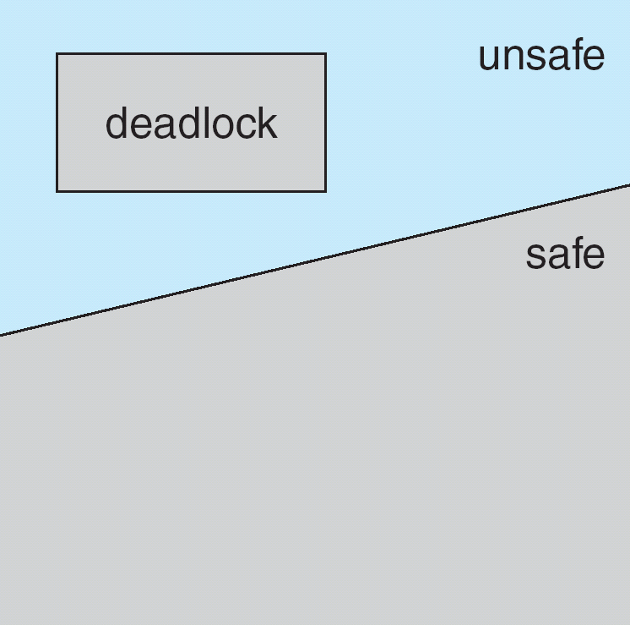
Safe State
When a process requests an available resource, system must decide if immediate allocation leaves the system in a safe state
System is in safe state if there exists a sequence <P₁, P₂, …, P_{n}> of ALL the processes in the systems such that for each P_{i}, the resources that P_{i} can still request can be satisfied by currently available resources plus the resources held by all the P_{j}, with j < i
An unsafe state is not equivalent to deadlock, it just may lead to deadlock, since some processes might not actually use the maximum resources that they have declared
Grant a resource to a process if the new state is safe. If the new state is unsafe, process must wait even if the resource is currently available
This algorithm ensures no circular-wait condition exists

Slide 9
Deadlock Avoidance Algorithms
Single instance of a resource type
Use a resource-allocation graph
Multiple instances of a resource type
Use the banker’s algorithm

Slide 10
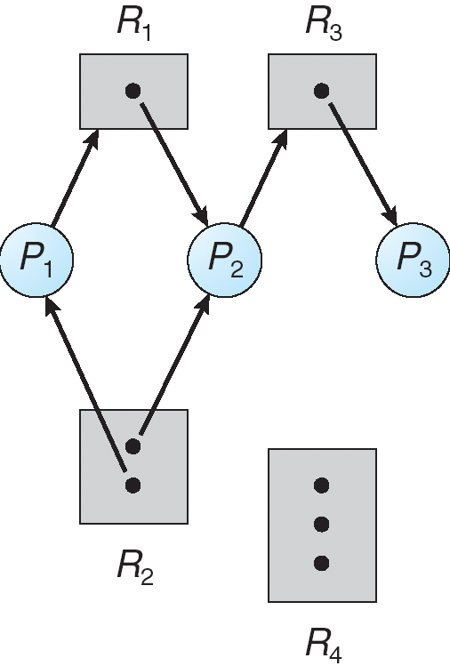
Resource-Allocation Graph
We define a directed graph with vertices that represent both resources R = {R₁, R₂, …, R_{m}} and processes P = {P₁, P₂, …, P_{n}} in a system
Request Edge – A directed edge from a process to a resource, P_{i} → R_{j,} indicates that P_{i} has requested that resource, but has not yet acquired it
Assignment Edge – A directed edge from a resource to a process R_{j} → P_{i} indicates that the OS has allocated R_{j} to P_{i}
If the graph has no cycles, no deadlock exists
If the graph has a cycle, deadlock might exist
if only one instance per resource type, then deadlock
if several instances per resource type, possibility of deadlock
If any instance of a resource involved in the cycle is held by a process not in the cycle, then we can make progress when the resource is released.

Slide 11
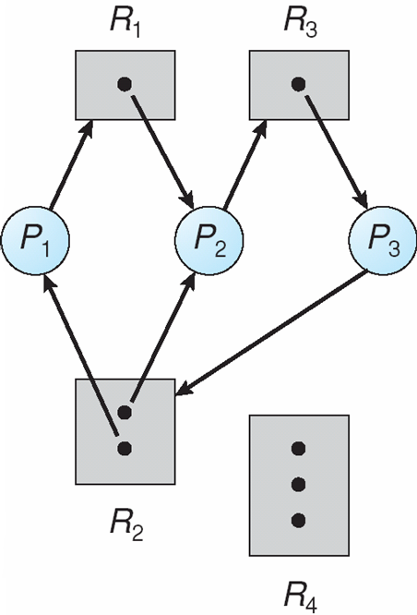
Example of a Resource Allocation Graph
DEADLOCK !
P3->R2(1st instance)->P2->R3->P3
P3->R2(2nd instance)->P1->R1->P2->R3->P3

Slide 12
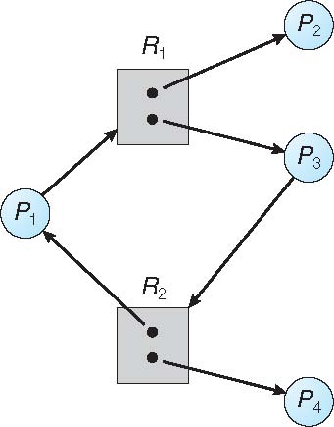
Example of a Resource Allocation Graph
NO DEADLOCK !
P2 may release R1 after completion
P4 may release R2 after completion

Slide 13
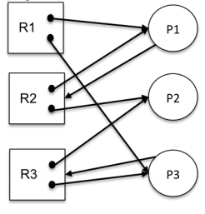
Example
A system has three processes (P1, P2, P3) and three reusable resources (R1, R2, R3). There are two instances of R1, R2 and R3. P1 holds an R1 and an R2 and is requesting another instance of an R2. P2 holds an R2 and an R3. P3 holds an R1 and an R3 and is requesting another instance of R3.
Draw the resource allocation graph for this situation.
Does the above allocation graph contain a deadlock? If yes, write all the cycles in the graph.

Slide 14
Example
Assume now that P2 also demands resource R1. Does this allocation graph contain a deadlock? If yes, write all the cycles in the graph.
Assume the allocation graph at point c), and, in addition, assume that R2 has now three instances. Does this allocation graph contain a deadlock? If yes, write all the cycles in the graph.
Add to the original allocation graph an additional process P4 that demands an instance of R1. Does this allocation graph contain a deadlock? If yes, write all the cycles in the graph.

Slide 15
Resource Allocation Graph Scheme
Claim edges: an edge P_{i} → R_{j} from a process to a resource that may be requested in the future; represented by a dashed line (Resources must be claimed a priori in the system).
Satisfying a process request results in converting a claim edge to an assignment edge and changing its direction.
A cycle in this extended resource allocation graph indicates an unsafe state
If the allocation would result in unsafe state, the allocation is denied even if the resource is available
The claim edge is converted to a request edge and the process waits
This solution does not work for multiple instances of the same resource.
When a process releases a resource, assignment edge reconverts to a claim edge

Slide 16
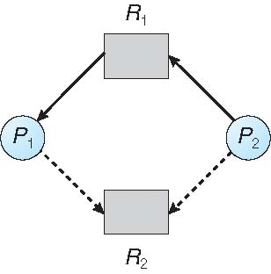
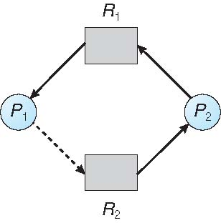
Resource Allocation Graph
Example:
P2 requests R1, which is already been allocated to P1
P2 requests R2
Although R2 is currently free, we cannot allocate it to P2 as it may create a cycle in graph. A cycle indicates that the system is in unsafe state

Slide 17
Banker’s Algorithm
This algorithm handles multiple instances of each resource type
When a new process enters the system, it must declare the maximum number of instances of each resource type that it may need.
The resources requested may not exceed the total available in the system
When a process requests a resource, the system must determine whether the allocation will leave the system in a safe state.
If it will, the resources are allocated, otherwise, the process must wait until some other process releases enough resources.
When a process gets all its resources it must return them in a finite amount of time

Slide 18
Example of Banker’s Algorithm
5 processes P₀ through P₄;
3 resource types:
A (10 instances), B (5 instances), and C (7 instances)
Snapshot at time T₀:
Allocation Max Available
A B C A B C A B C
P₀ 0 1 0 7 5 3 3 3 2
P₁ 2 0 0 3 2 2
P₂ 3 0 2 9 0 2
P₃ 2 1 1 2 2 2
P₄ 0 0 2 4 3 3

Slide 19
Data Structures for the Banker’s Algorithm
Let n = number of processes, and m = number of resources types.
Available: Vector of length m. If available [j] = k, there are k instances of resource type R_{j} available
Max: n x m matrix. If Max [i,j] = k, then process P_{i} may request at most k instances of resource type R_{j}
Allocation: n x m matrix. If Allocation[i,j] = k then P_{i} is currently allocated k instances of R_{j}
Need: n x m matrix. If Need[i,j] = k, then P_{i} may need k more instances of R_{j} to complete its task
Need [i,j] = Max[i,j] – Allocation [i,j]

Slide 20
Example of Banker’s Algorithm
5 processes P₀ through P₄;
3 resource types:
A (10 instances), B (5 instances), and C (7 instances)
Snapshot at time T₀:
Allocation Max Available Need
A B C A B C A B C A B C
P₀ 0 1 0 7 5 3 3 3 2 7 4 3
P₁ 2 0 0 3 2 2 1 2 2
P₂ 3 0 2 9 0 2 6 0 0
P₃ 2 1 1 2 2 2 0 1 1
P₄ 0 0 2 4 3 3 4 3 1

Slide 21
Safety Algorithm
1. Let Work and Finish be vectors of length m and n, respectively. Initialize:
Work = Available
Finish [i] = false for i = 0, 1, …, n- 1
2. Find an i such that both:
(a) Finish [i] = false
(b) Need_{i} ≤ Work
If no such i exists, go to step 4
3. Work = Work + Allocation_{i} Finish[i] = true go to step 2
4. If Finish [i] == true for all i, then the system is in a safe state

Slide 22
Resource-Request Algorithm for Process P_{i}
Request_{i} = request vector for process P_{i}. If Request_{i} [j] = k then process P_{i} wants k instances of resource type R_{j}
1. If Request_{i} ≤ Need_{i} go to step 2. Otherwise, raise error condition, since process has exceeded its maximum claim
2. If Request_{i} ≤ Available, go to step 3. Otherwise P_{i} must wait, since resources are not available
3. Pretend to allocate requested resources to P_{i} by modifying the state as follows:
Available = Available – Request_{i};
Allocation_{i} = Allocation_{i} + Request_{i};
Need_{i} = Need_{i} – Request_{i};
If safe ⇒ the resources are allocated to P_{i}
If unsafe ⇒ P_{i} must wait, and the old resource-allocation state is restored

Slide 23
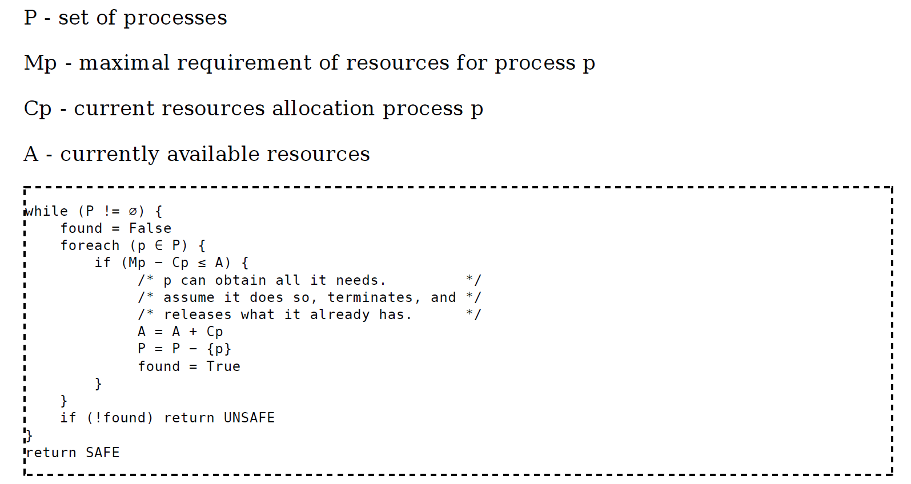
Banker’s Algorithm Pseudocode

Slide 24
Safety check
5 processes P₀ through P₄;
3 resource types:
A (10 instances), B (5 instances), and C (7 instances)
Snapshot at time T₀:
Allocation Max Available Need
A B C A B C A B C A B C
P₀ 0 1 0 7 5 3 3 3 2 7 4 3
P₁ 2 0 0 3 2 2 1 2 2
P₂ 3 0 2 9 0 2 6 0 0
P₃ 2 1 1 2 2 2 0 1 1
P₄ 0 0 2 4 3 3 4 3 1

Slide 25
Safety check (P1)
5 processes P₀ through P₄;
3 resource types:
A (10 instances), B (5 instances), and C (7 instances)
Snapshot at time T₀:
Allocation Max Available Need
A B C A B C A B C A B C
P₀ 0 1 0 7 5 3 3 3 2/ 2 1 0 7 4 3
P₁ 2 0 0 3 2 2 1 2 2/ 0 0 0
P₂ 3 0 2 9 0 2 6 0 0
P₃ 2 1 1 2 2 2 0 1 1
P₄ 0 0 2 4 3 3 4 3 1

Slide 26
Safety check (P1)
5 processes P₀ through P₄;
3 resource types:
A (10 instances), B (5 instances), and C (7 instances)
Snapshot at time T₀:
Allocation Max Available Need
A B C A B C A B C A B C
P₀ 0 1 0 7 5 3 3 3 2/ 2 1 0 7 4 3
P₁ 2 0 0/ 3 2 2 3 2 2 1 2 2/ 0 0 0
P₂ 3 0 2 9 0 2 6 0 0
P₃ 2 1 1 2 2 2 0 1 1
P₄ 0 0 2 4 3 3 4 3 1

Slide 27
Safety check (P1)
5 processes P₀ through P₄;
3 resource types:
A (10 instances), B (5 instances), and C (7 instances)
Snapshot at time T₀:
Allocation Max Available Need
A B C A B C A B C A B C
P₀ 0 1 0 7 5 3 3 3 2/ 2 1 0 7 4 3
P₁ 2 0 0/ 3 2 2 3 2 2 5 3 2 1 2 2/ 0 0 0
P₂ 3 0 2 9 0 2 6 0 0
P₃ 2 1 1 2 2 2 0 1 1
P₄ 0 0 2 4 3 3 4 3 1

Slide 28
Safety check (?)
5 processes P₀ through P₄;
3 resource types:
A (10 instances), B (5 instances), and C (7 instances)
Snapshot at time T₀:
Allocation Max Available Need
A B C A B C A B C A B C
P₀ 0 1 0 7 5 3 3 3 2/ 2 1 0 7 4 3
P₁ 2 0 0/ 3 2 2 3 2 2 5 3 2 1 2 2/ 0 0 0
P₂ 3 0 2 9 0 2 6 0 0
P₃ 2 1 1 2 2 2 0 1 1
P₄ 0 0 2 4 3 3 4 3 1

Slide 29
Safety check (P3)
5 processes P₀ through P₄;
3 resource types:
A (10 instances), B (5 instances), and C (7 instances)
Snapshot at time T₀:
Allocation Max Available Need
A B C A B C A B C A B C
P₀ 0 1 0 7 5 3 3 3 2/ 2 1 0 7 4 3
P₁ 2 0 0/ 3 2 2 3 2 2 5 3 2/5 2 1 1 2 2/ 0 0 0
P₂ 3 0 2 9 0 2 6 0 0
P₃ 2 1 1 2 2 2 0 1 1/0 0 0
P₄ 0 0 2 4 3 3 4 3 1

Slide 30
Safety check (P3)
5 processes P₀ through P₄;
3 resource types:
A (10 instances), B (5 instances), and C (7 instances)
Snapshot at time T₀:
Allocation Max Available Need
A B C A B C A B C A B C
P₀ 0 1 0 7 5 3 3 3 2/ 2 1 0 7 4 3
P₁ 2 0 0/ 3 2 2 3 2 2 5 3 2/5 2 1 1 2 2/ 0 0 0
P₂ 3 0 2 9 0 2 6 0 0
P₃ 2 1 1/2 2 2 2 2 2 0 1 1/0 0 0
P₄ 0 0 2 4 3 3 4 3 1

Slide 31
Safety check (P3)
5 processes P₀ through P₄;
3 resource types:
A (10 instances), B (5 instances), and C (7 instances)
Snapshot at time T₀:
Allocation Max Available Need
A B C A B C A B C A B C
P₀ 0 1 0 7 5 3 3 3 2/ 2 1 0 7 4 3
P₁ 2 0 0/ 3 2 2 3 2 2 5 3 2/5 2 1 1 2 2/ 0 0 0
P₂ 3 0 2 9 0 2 7 4 3 6 0 0
P₃ 2 1 1/2 2 2 2 2 2 0 1 1/0 0 0
P₄ 0 0 2 4 3 3 4 3 1

Slide 32
Safety check (?)
5 processes P₀ through P₄;
3 resource types:
A (10 instances), B (5 instances), and C (7 instances)
Snapshot at time T₀:
Allocation Max Available Need
A B C A B C A B C A B C
P₀ 0 1 0 7 5 3 3 3 2/ 2 1 0 7 4 3
P₁ 2 0 0/ 3 2 2 3 2 2 5 3 2/5 2 1 1 2 2/ 0 0 0
P₂ 3 0 2 9 0 2 7 4 3 6 0 0
P₃ 2 1 1/2 2 2 2 2 2 0 1 1/0 0 0
P₄ 0 0 2 4 3 3 4 3 1

Slide 33
Safety check (P4)
5 processes P₀ through P₄;
3 resource types:
A (10 instances), B (5 instances), and C (7 instances)
Snapshot at time T₀:
Allocation Max Available Need
A B C A B C A B C A B C
P₀ 0 1 0 7 5 3 3 3 2/ 2 1 0 7 4 3
P₁ 2 0 0/ 3 2 2 3 2 2 5 3 2/5 2 1 1 2 2/ 0 0 0
P₂ 3 0 2 9 0 2 7 4 3/ 3 1 2 6 0 0
P₃ 2 1 1/2 2 2 2 2 2 0 1 1/0 0 0
P₄ 0 0 2 4 3 3 4 3 1/ 0 0 0

Slide 34
Safety check (P4)
5 processes P₀ through P₄;
3 resource types:
A (10 instances), B (5 instances), and C (7 instances)
Snapshot at time T₀:
Allocation Max Available Need
A B C A B C A B C A B C
P₀ 0 1 0 7 5 3 3 3 2/ 2 1 0 7 4 3
P₁ 2 0 0/ 3 2 2 3 2 2 5 3 2/5 2 1 1 2 2/ 0 0 0
P₂ 3 0 2 9 0 2 7 4 3/ 3 1 2 6 0 0
P₃ 2 1 1/2 2 2 2 2 2 0 1 1/0 0 0
P₄ 0 0 2/4 3 3 4 3 3 4 3 1/ 0 0 0

Slide 35
Safety check (P4)
5 processes P₀ through P₄;
3 resource types:
A (10 instances), B (5 instances), and C (7 instances)
Snapshot at time T₀:
Allocation Max Available Need
A B C A B C A B C A B C
P₀ 0 1 0 7 5 3 3 3 2/ 2 1 0 7 4 3
P₁ 2 0 0/ 3 2 2 3 2 2 5 3 2/5 2 1 1 2 2/ 0 0 0
P₂ 3 0 2 9 0 2 7 4 3/ 3 1 2 6 0 0
P₃ 2 1 1/2 2 2 2 2 2 7 4 5 0 1 1/0 0 0
P₄ 0 0 2/4 3 3 4 3 3 4 3 1/ 0 0 0

Slide 36
Safety check (?)
5 processes P₀ through P₄;
3 resource types:
A (10 instances), B (5 instances), and C (7 instances)
Snapshot at time T₀:
Allocation Max Available Need
A B C A B C A B C A B C
P₀ 0 1 0 7 5 3 3 3 2/ 2 1 0 7 4 3
P₁ 2 0 0/ 3 2 2 3 2 2 5 3 2/5 2 1 1 2 2/ 0 0 0
P₂ 3 0 2 9 0 2 7 4 3/ 3 1 2 6 0 0
P₃ 2 1 1/2 2 2 2 2 2 7 4 5 0 1 1/0 0 0
P₄ 0 0 2/4 3 3 4 3 3 4 3 1/ 0 0 0

Slide 37
Safety check (P1)
5 processes P₀ through P₄;
3 resource types:
A (10 instances), B (5 instances), and C (7 instances)
Snapshot at time T₀:
Allocation Max Available Need
A B C A B C A B C A B C
P₀ 0 1 0 7 5 3 3 3 2/ 2 1 0 7 4 3/ 0 0 0
P₁ 2 0 0/ 3 2 2 3 2 2 5 3 2/5 2 1 1 2 2/ 0 0 0
P₂ 3 0 2 9 0 2 7 4 3/ 3 1 2 6 0 0
P₃ 2 1 1/2 2 2 2 2 2 7 4 5/ 0 0 2 0 1 1/0 0 0
P₄ 0 0 2/4 3 3 4 3 3 4 3 1/ 0 0 0

Slide 38
Safety check (P1)
5 processes P₀ through P₄;
3 resource types:
A (10 instances), B (5 instances), and C (7 instances)
Snapshot at time T₀:
Allocation Max Available Need
A B C A B C A B C A B C
P₀ 0 1 0/ 7 5 3 7 5 3 3 3 2/ 2 1 0 7 4 3/ 0 0 0
P₁ 2 0 0/ 3 2 2 3 2 2 5 3 2/5 2 1 1 2 2/ 0 0 0
P₂ 3 0 2 9 0 2 7 4 3/ 3 1 2 6 0 0
P₃ 2 1 1/2 2 2 2 2 2 7 4 5/ 0 0 2 0 1 1/0 0 0
P₄ 0 0 2/4 3 3 4 3 3 4 3 1/ 0 0 0

Slide 39
Safety check (P1)
5 processes P₀ through P₄;
3 resource types:
A (10 instances), B (5 instances), and C (7 instances)
Snapshot at time T₀:
Allocation Max Available Need
A B C A B C A B C A B C
P₀ 0 1 0/ 7 5 3 7 5 3 3 3 2/ 2 1 0 7 4 3/ 0 0 0
P₁ 2 0 0/ 3 2 2 3 2 2 5 3 2/5 2 1 1 2 2/ 0 0 0
P₂ 3 0 2 9 0 2 7 4 3/ 3 1 2 6 0 0
P₃ 2 1 1/2 2 2 2 2 2 7 4 5/ 0 0 2 0 1 1/0 0 0
P₄ 0 0 2/4 3 3 4 3 3 7 5 5 4 3 1/ 0 0 0

Slide 40
Safety check (?)
5 processes P₀ through P₄;
3 resource types:
A (10 instances), B (5 instances), and C (7 instances)
Snapshot at time T₀:
Allocation Max Available Need
A B C A B C A B C A B C
P₀ 0 1 0/ 7 5 3 7 5 3 3 3 2/ 2 1 0 7 4 3/ 0 0 0
P₁ 2 0 0/ 3 2 2 3 2 2 5 3 2/5 2 1 1 2 2/ 0 0 0
P₂ 3 0 2 9 0 2 7 4 3/ 3 1 2 6 0 0
P₃ 2 1 1/2 2 2 2 2 2 7 4 5/ 0 0 2 0 1 1/0 0 0
P₄ 0 0 2/4 3 3 4 3 3 7 5 5 4 3 1/ 0 0 0

Slide 41
Safety check (P2)
5 processes P₀ through P₄;
3 resource types:
A (10 instances), B (5 instances), and C (7 instances)
Snapshot at time T₀:
Allocation Max Available Need
A B C A B C A B C A B C
P₀ 0 1 0/ 7 5 3 7 5 3 3 3 2/ 2 1 0 7 4 3/ 0 0 0
P₁ 2 0 0/ 3 2 2 3 2 2 5 3 2/5 2 1 1 2 2/ 0 0 0
P₂ 3 0 2 9 0 2 7 4 3/ 3 1 2 6 0 0/ 0 0 0
P₃ 2 1 1/2 2 2 2 2 2 7 4 5/ 0 0 2 0 1 1/0 0 0
P₄ 0 0 2/4 3 3 4 3 3 7 5 5/ 1 5 5 4 3 1/ 0 0 0

Slide 42
Safety check (P2)
5 processes P₀ through P₄;
3 resource types:
A (10 instances), B (5 instances), and C (7 instances)
Snapshot at time T₀:
Allocation Max Available Need
A B C A B C A B C A B C
P₀ 0 1 0/ 7 5 3 7 5 3 3 3 2/ 2 1 0 7 4 3/ 0 0 0
P₁ 2 0 0/ 3 2 2 3 2 2 5 3 2/5 2 1 1 2 2/ 0 0 0
P₂ 3 0 2/ 9 0 2 9 0 2 7 4 3/ 3 1 2 6 0 0/ 0 0 0
P₃ 2 1 1/2 2 2 2 2 2 7 4 5/ 0 0 2 0 1 1/0 0 0
P₄ 0 0 2/4 3 3 4 3 3 7 5 5/ 1 5 5 4 3 1/ 0 0 0

Slide 43
Safety check (P2)
5 processes P₀ through P₄;
3 resource types:
A (10 instances), B (5 instances), and C (7 instances)
Snapshot at time T₀:
Allocation Max Available Need
A B C A B C A B C A B C
P₀ 0 1 0/ 7 5 3 7 5 3 3 3 2/ 2 1 0 7 4 3/ 0 0 0
P₁ 2 0 0/ 3 2 2 3 2 2 5 3 2/5 2 1 1 2 2/ 0 0 0
P₂ 3 0 2/ 9 0 2 9 0 2 7 4 3/ 3 1 2 6 0 0/ 0 0 0
P₃ 2 1 1/2 2 2 2 2 2 7 4 5/ 0 0 2 0 1 1/0 0 0
P₄ 0 0 2/4 3 3 4 3 3 7 5 5/ 1 5 5 4 3 1/ 0 0 0
10 5 7

Slide 44
Safety check
5 processes P₀ through P₄;
3 resource types:
A (10 instances), B (5 instances), and C (7 instances)
Snapshot at time T₀:
Allocation Max Available Need
A B C A B C A B C A B C
P₀ 0 1 0/ 7 5 3 7 5 3 3 3 2/ 2 1 0 7 4 3/ 0 0 0
P₁ 2 0 0/ 3 2 2 3 2 2 5 3 2/5 2 1 1 2 2/ 0 0 0
P₂ 3 0 2/ 9 0 2 9 0 2 7 4 3/ 3 1 2 6 0 0/ 0 0 0
P₃ 2 1 1/2 2 2 2 2 2 7 4 5/ 0 0 2 0 1 1/0 0 0
P₄ 0 0 2/4 3 3 4 3 3 7 5 5/ 1 5 5 4 3 1/ 0 0 0
10 5 7
The system is in a safe state since the sequence < P₁, P₃, P₄, P₂, P₀> satisfies safety criteria

Slide 45
Resource request
5 processes P₀ through P₄;
3 resource types:
A (10 instances), B (5 instances), and C (7 instances)
Snapshot at time T₀:
Allocation Max Available Need
A B C A B C A B C A B C
P₀ 0 1 0 7 5 3 3 3 2 7 4 3
P₁ 2 0 0 3 2 2 1 2 2
P₂ 3 0 2 9 0 2 6 0 0
P₃ 2 1 1 2 2 2 0 1 1
P₄ 0 0 2 4 3 3 4 3 1
P₁ Request (1,0,2) = ?

Slide 46
Example: P₁ Request (1,0,2)
Check that Request ≤ Available (that is, (1,0,2) ≤ (3,3,2) ⇒ true
Allocation Need Available
A B C A B C A B C
P₀ 0 1 0 7 4 3 2 3 0
P₁ 3 0 2 0 2 0
P₂ 3 0 2 6 0 0
P₃ 2 1 1 0 1 1
P₄ 0 0 2 4 3 1
Executing safety algorithm shows that sequence < P₁, P₃, P₄, P₀, P₂> satisfies safety requirement

Slide 47
Example: P₁ Request (1,0,2)
Check that Request ≤ Available (that is, (1,0,2) ≤ (3,3,2) ⇒ true
Allocation Need Available
A B C A B C A B C
P₀ 0 1 0 7 4 3 2 3 0
P₁ 3 0 2 0 2 0
P₂ 3 0 2 6 0 0
P₃ 2 1 1 0 1 1
P₄ 0 0 2 4 3 1
Executing safety algorithm shows that sequence < P₁, P₃, P₄, P₀, P₂> satisfies safety requirement
Can request for (3,3,0) by P₄ be granted?

Slide 48
Example: P₁ Request (1,0,2)
Check that Request ≤ Available (that is, (1,0,2) ≤ (3,3,2) ⇒ true
Allocation Need Available
A B C A B C A B C
P₀ 0 1 0 7 4 3 2 3 0
P₁ 3 0 2 0 2 0
P₂ 3 0 2 6 0 0
P₃ 2 1 1 0 1 1
P₄ 0 0 2 4 3 1
Executing safety algorithm shows that sequence < P₁, P₃, P₄, P₀, P₂> satisfies safety requirement
Can request for (3,3,0) by P₄ be granted?
Can request for (0,2,0) by P₀ be granted?
Can request for (0,0,2) by P₃ be granted?

Slide 49
Exercise
Is the following system safe, under banker's algorithm? Justify your answer?
Allocation Max Available
A B C A B C A B C
P₀ 1 1 0 2 8 0 3 4 1
P₁ 4 1 1 5 2 2
P₂ 1 1 7 4 3 9
P₃ 2 1 1 2 2 3
P₄ 2 0 0 2 1 3
Need
A B C
1 7 0
1 1 1
3 2 2
0 1 2
0 1 3
The system IS SAFE.
The processes can complete in the order < P₁, P₂, P₃, P₄, P₀>

Slide 50
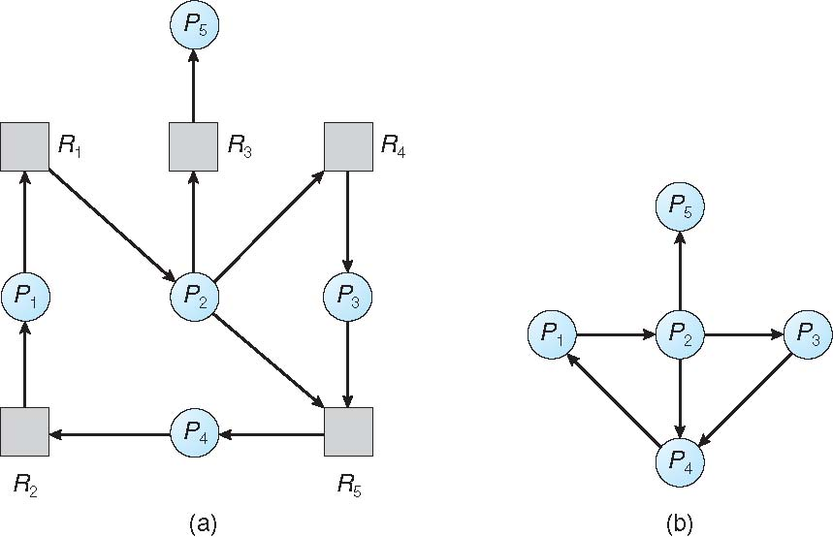
Single Instance of Each Resource Type
Maintain wait-for graph
Nodes are processes
P_{i} → P_{j} if P_{i} is waiting for P_{j}
Periodically invoke an algorithm that searches for a cycle in the graph. If there is a cycle, there exists a deadlock
An algorithm to detect a cycle in a graph requires an order of n² operations, where n is the number of vertices in the graph
Resource-Allocation Graph
Corresponding wait-for Graph

Slide 51
Multiple Instances of Each Resource Type
Available[m]: A vector indicating the number of available resources of each type
Allocation[n, m]: A matrix defining the number of resources of each type currently allocated to each process
Request[n, m]: A matrix indicating the current request of each process. If Request [i, j] = k, then P_{i} is requesting k more instances of resource type R_{j}.

Slide 52
Deadlock Detection Algorithm
Let Work and Finish be vectors of length m and n, respectively Initialize:
Work = Available
for i = 1,2, …, n,
if Allocation_{i} ≠ 0,
Finish[i] = false;
else
Finish[i] = true
Find a process i that can complete its work now:
while (Finish[i] == false && Request_{i} ≤ Work)
Work = Work + Allocation_{i} Finish[i] = true
if (Finish[i] == false, for some i)
return false; //system is in deadlock state
(Moreover if Finish[i] == false, then P_{i} is deadlocked)
Algorithm requires an order of O(m x n²) operations to detect whether the system is in deadlocked state

Slide 53
Example of Deadlock Detection Algorithm
Five processes P₀ through P₄; three resource types A (7 instances), B (2 instances), and C (6 instances)
Snapshot at time T₀:
Allocation Request Available
A B C A B C A B C
P₀ 0 1 0 0 0 0 0 0 0
P₁ 2 0 0 2 0 2
P₂ 3 0 3 0 0 0
P₃ 2 1 1 1 0 0
P₄ 0 0 2 0 0 2
Sequence <P₀, P₂, P₃, P₁, P₄> will result in Finish[i] = true for all i

Slide 54
Example (Cont.)
P₂ requests an additional instance of type C
Request
A B C
P₀ 0 0 0
P₁ 2 0 2
P₂ 0 0 1
P₃ 1 0 0
P₄ 0 0 2
State of system?
Can reclaim resources held by process P₀, but insufficient resources to fulfill other processes; requests
Deadlock exists, consisting of processes P₁, P₂, P₃, and P₄

Slide 55
Detection-Algorithm Usage
Detecting cycles in a graph takes O(n²) time, where n is the |P| + |R|. When, and how often should we execute this algorithm?
Just before granting a resource, check if granting it would lead to a cycle? O(n²)
Whenever a resource request can’t be filled? (Each failed request is O(n²).)
On a regular schedule (hourly or …)? (May take a long time to detect deadlock)
When CPU utilization drops below some threshold? (May take a long time to detect deadlock)
When, and how often, to invoke depends on:
How often a deadlock is likely to occur?
How many processes will need to be rolled back?
one for each disjoint cycle
If detection algorithm is invoked arbitrarily, there may be many cycles in the resource graph and so we would not be able to tell which of the many deadlocked processes “caused” the deadlock.

Slide 56
Recovery from Deadlock
Scan the resource allocation graph for cycles, and then break the cycles.
Different way of breaking a cycle:
Kill all the processes in the cycle (deadlocked processes)
Kill the processes one at a time, until deadlock cycle is eliminated (give up resources)
Preempt resources one at a time (selecting a victim e.g. minimize cost), rolling back the state of the process holding resource to the state it was prior to getting the resource. Starvation could occur if same process may always be picked as victim. Number of rollbacks should be included in the cost factor. This technique is common in database transactions.
In which order should we choose to abort?
Priority of the process
How long process has computed, and how much longer to completion
Resources the process has used
Resources process needs to complete
How many processes will need to be terminated
Is process interactive or batch?

Slide 57
Summary
Deadlock: Situation in which a set of threads/processes cannot proceed because each requires resources held by another member of the set.
Detection and recovery: Recognize deadlock after it has occurred and break it
Avoidance: Don’t allocate a resource if it would introduce a cycle
Prevention: Design resource allocation strategies that guarantee that one of the necessary conditions never holds
Code concurrent programs very carefully. This only helps prevent deadlock over resources managed by the program, not OS resources
Ignore the possibility! (Most OS use this option!!)

