Slide 1

Data Link Layer
Computer Networks Research Center (CNRC)
Computer Science Department, CIIT, Lahore.
http://research.ciitlahore.edu.pk/Groups/CNRC/
Imran Raza

Slide 2
Agenda
Link Layer Review
Link Layer Services
Error Detection
Error Correction
Multiple Access Control Protocols

Slide 3
Link Layer: Review
hosts and routers are nodes
communication channels that connect adjacent nodes along communication path are links
wired links
wireless links
LANs
layer-2 PDU is a frame, encapsulates datagram
“link”
data-link layer has responsibility of
transferring datagram from one node
to adjacent node over a link

Slide 4
Link layer: Review…
Datagram transferred by different link protocols over different links:
e.g., Ethernet on first link, frame relay on intermediate links, 802.11 on last link
Each link protocol provides different services
e.g., may or may not provide reliable data transfer over link

Slide 5
Link Layer Services: Review
Framing, link access
Reliable delivery between adjacent nodes
Flow Control
Error Detection
Error Correction
Half-duplex and full-duplex

Slide 6
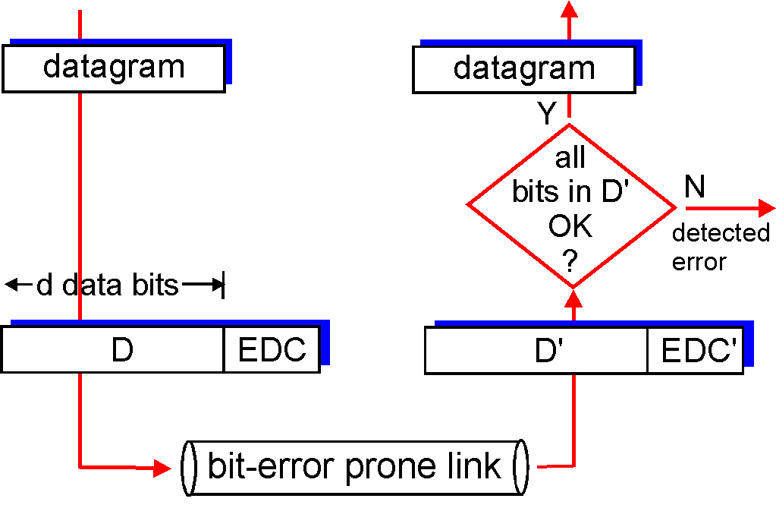
Error Detection
EDC= Error Detection and Correction bits (redundancy)
D = Data protected by error checking, may include header fields
Error detection not 100% reliable!
protocol may miss some errors, but rarely
larger EDC field yields better detection and correction

Slide 7
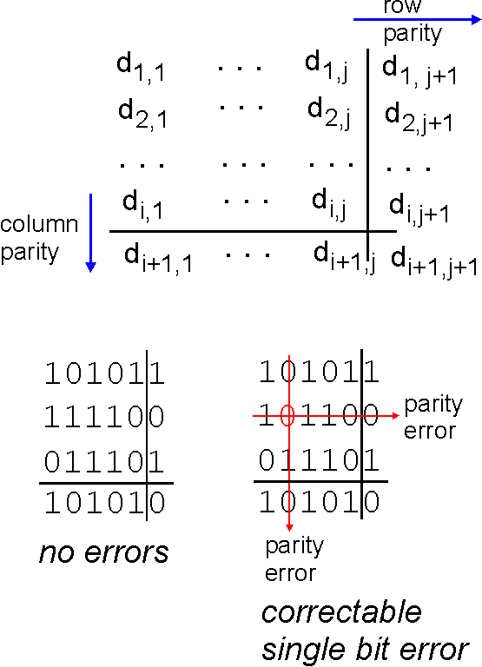
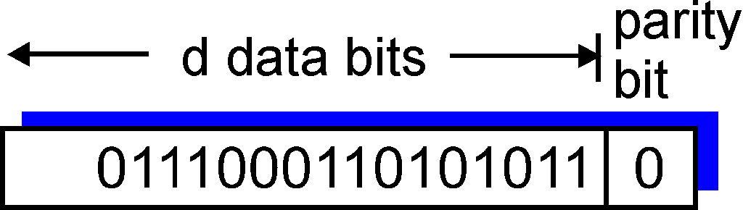
Parity Checking
Single Bit Parity:
Detect single bit errors
Two Dimensional Bit Parity:
Detect and correct single bit errors
0
0

Slide 8
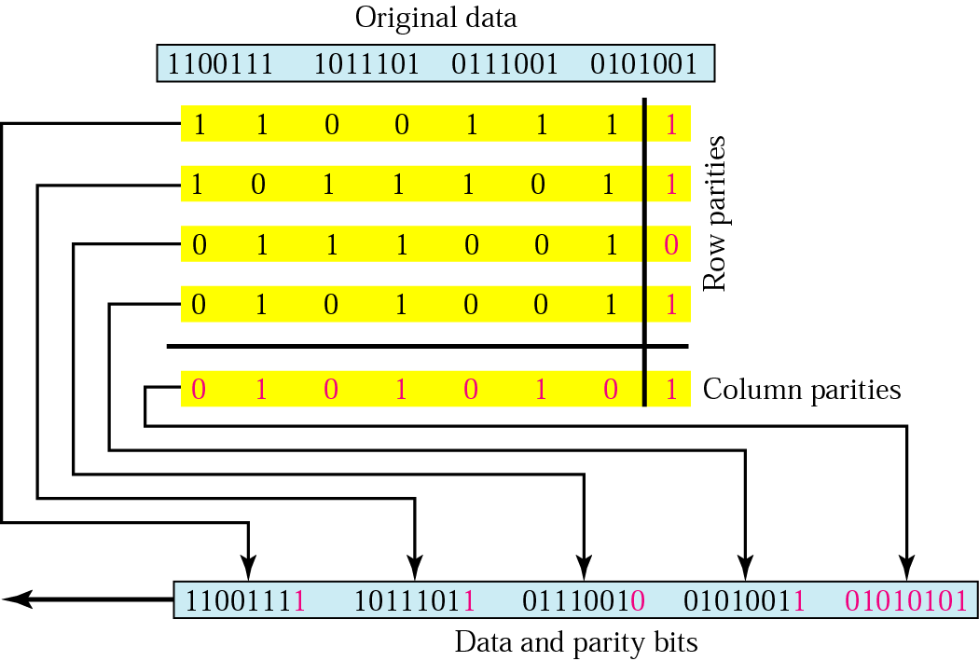
Two Dimensional Parity

Slide 9
Example
Suppose the following block is sent:
10101001 00111001 11011101 11100111 10101010
However, it is hit by a burst noise of length 8, and some bits are corrupted.
10100011 10001001 11011101 11100111 10101010
When the receiver checks the parity bits, some of the bits do not follow the even-parity rule and the whole block is discarded.
10100011 10001001 11011101 11100111 10101010

Slide 10
Cyclic Redundancy Check/Polynomial Codes
A (n+1)-bit message can be represented as a polynomial of degree n. For example,
X = 10011010;
M(X) =
So, a sender and receiver can be considered to exchange polyns.
Choose k+1 bit pattern (divisor), C(X), a polyn of degree k
goal: choose k CRC bits, R, such that
<M,R> exactly divisible by C (modulo 2)
receiver knows C, divides <M,R> by C. If non-zero remainder: error detected!
can detect all burst errors less than k+1 bits

Slide 11
CRC continued …
Goal: design P(X) such that it is exactly divisible by C(X)
Multiply M(X) by x^{k} (add k zero’s to the end of the message) to get T(X)
Divide T(X) by C(X) and find the remainder R(X)
Subtract the remainder from T(X) to get P(X). P(X) is now exactly divisible by C(X).
Remember – all addition/subtract use modulo-2 arithmetic.

Slide 12
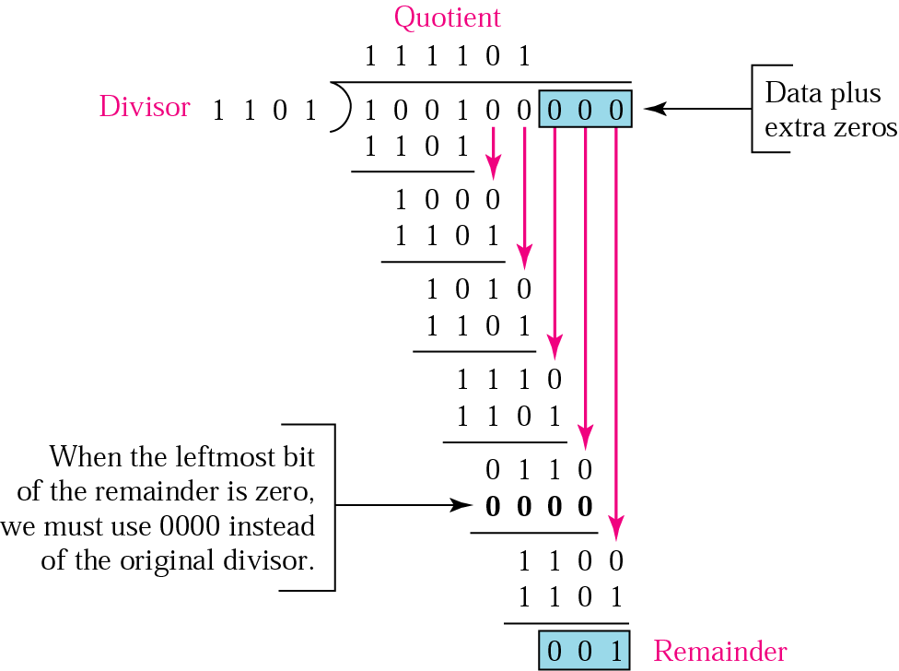
CRC- example

Slide 13
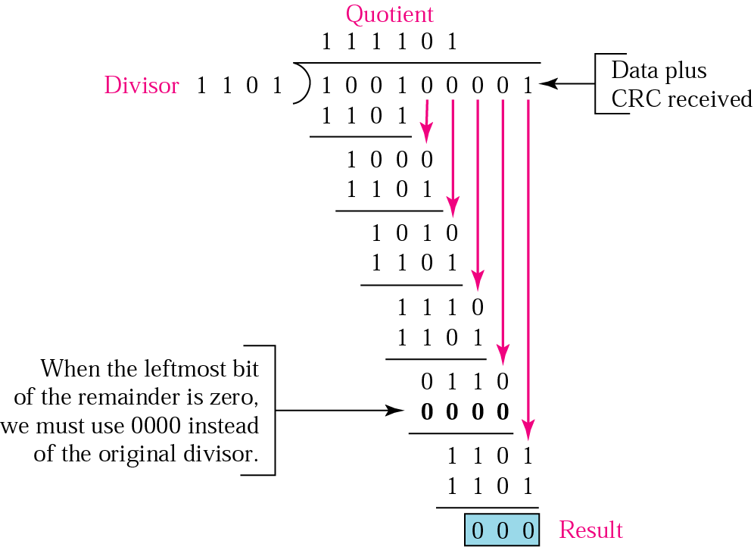
CRC- example…

Slide 14
Standard Polynomials
Name | Polynomial | Application
CRC-8 | x⁸ + x² + x + 1 | ATM header
CRC-10 | x¹⁰ + x⁹ + x⁵ + x⁴ + x ² + 1 | ATM AAL
ITU-16 | x¹⁶ + x¹² + x⁵ + 1 | HDLC
ITU-32 | x³² + x²⁶ + x²³ + x²² + x¹⁶ + x¹² + x¹¹ + x¹⁰ + x⁸ + x⁷ + x⁵ + x⁴ + x² + x + 1 | LANs

Slide 15
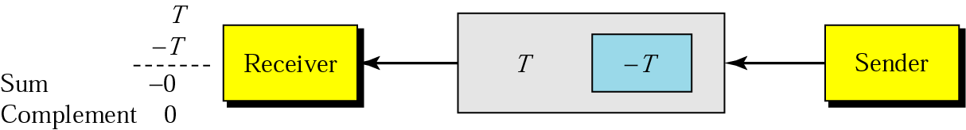
Checksum

Slide 16
Checksum-example
Suppose the following block of 16 bits is to be sent using a checksum of 8 bits.
10101001 00111001
The numbers are added using one’s complement
10101001
00111001 ------------ Sum 11100010
Checksum 00011101
The pattern sent is 10101001 00111001 00011101

Slide 17
Checksum-example (receiver side)
Now suppose the receiver receives the pattern sent in Example 7 and there is no error.
10101001 00111001 00011101
When the receiver adds the three sections, it will get all 1s, which, after complementing, is all 0s and shows that there is no error.
10101001
00111001
00011101
Sum 11111111
Complement 00000000 means that the pattern is OK.

Slide 18
Error Correction
Retransmission
Forward Error Correction

Slide 19
Forward Error Correction
Number of data bits m | Number of redundancy bits r | Total bits m + r
1 | 2 | 3
2 | 3 | 5
3 | 3 | 6
4 | 3 | 7
5 | 4 | 9
6 | 4 | 10
7 | 4 | 11

Slide 20
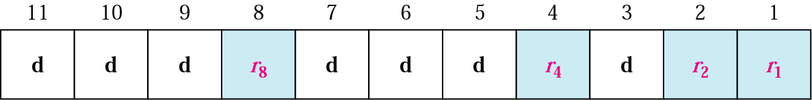
Forward Error Correction –Hamming Code

Slide 21
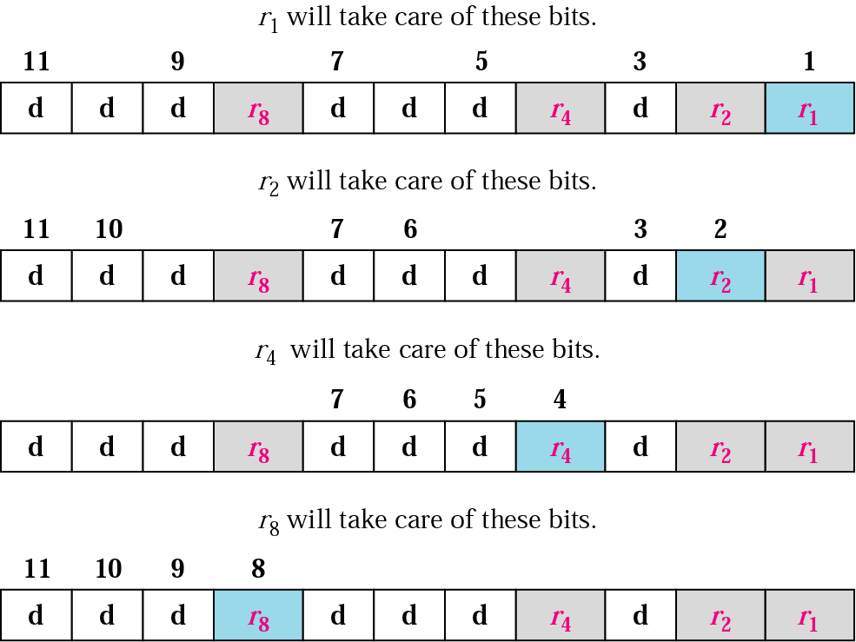
Hamming Code-redundancy bits calculations

Slide 22
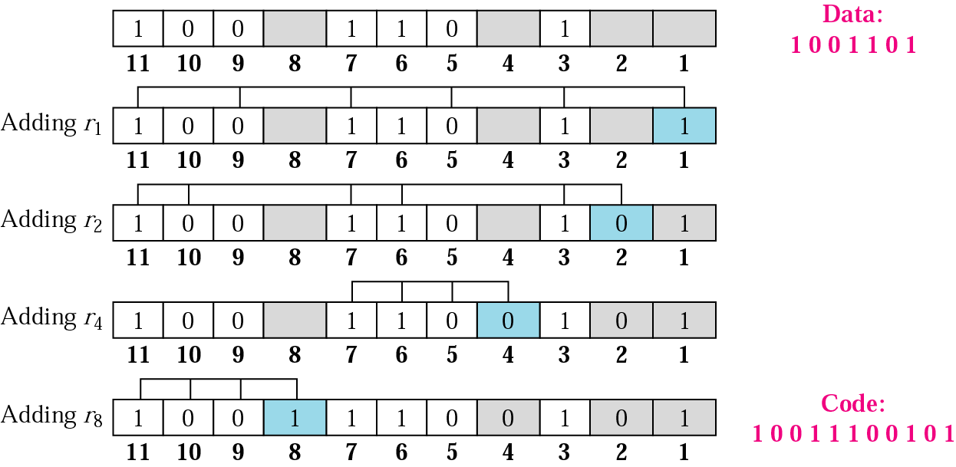
Hamming Code-redundancy bits calculations…

Slide 23
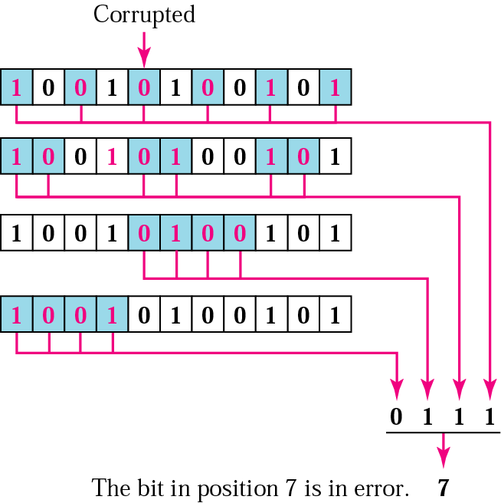
Error detection using hamming code

Slide 24
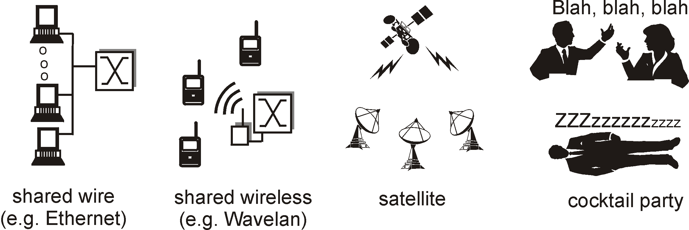
Multiple Access Links and Protocols
Two types of “links”:
point-to-point
PPP for dial-up access
point-to-point link between Ethernet switch and host
broadcast (shared wire or medium)
traditional Ethernet
upstream HFC
802.11 wireless LAN

Slide 25
When are Multiple Access Protocols Required?
single shared broadcast channel
two or more simultaneous transmissions by nodes: interference
collision if node receives two or more signals at the same time (examples, LANs, Wireless-LANs)
multiple access protocol
distributed algorithm that determines how nodes share channel, i.e., determine when node can transmit
communication about channel sharing must use channel itself!
no out-of-band channel for coordination

Slide 26
Ideal Multiple Access Protocol
Broadcast channel of rate R bps
1. When one node wants to transmit, it can send at rate R.
2. When M nodes want to transmit, each can send at average rate R/M
3. Fully decentralized:
no special node to coordinate transmissions
no synchronization of clocks, slots
4. Simple and easy to implement

Slide 27
Taxonomy of Multiple Access Control Protocols
Three broad classes:
Channel Partitioning
divide channel into smaller “pieces” (TDM, FDM, Code Division Multiple Access) – TDM, FDM covered in previous lec.
allocate piece to node for exclusive use
Random Access
channel not divided, allow collisions
“recover” from collisions
“Taking turns”
Nodes take turns, but nodes with more to send can take longer turns

Slide 28
Random Access Protocols
When node has packet to send
transmit at full channel data rate R.
no a priori coordination among nodes
two or more transmitting nodes ➜ “collision”,
random access MAC protocol specifies:
how to detect collisions
how to recover from collisions (e.g., via delayed retransmissions)
Examples of random access MAC protocols:
slotted ALOHA
ALOHA
CSMA, CSMA/CD, CSMA/CA

Slide 29
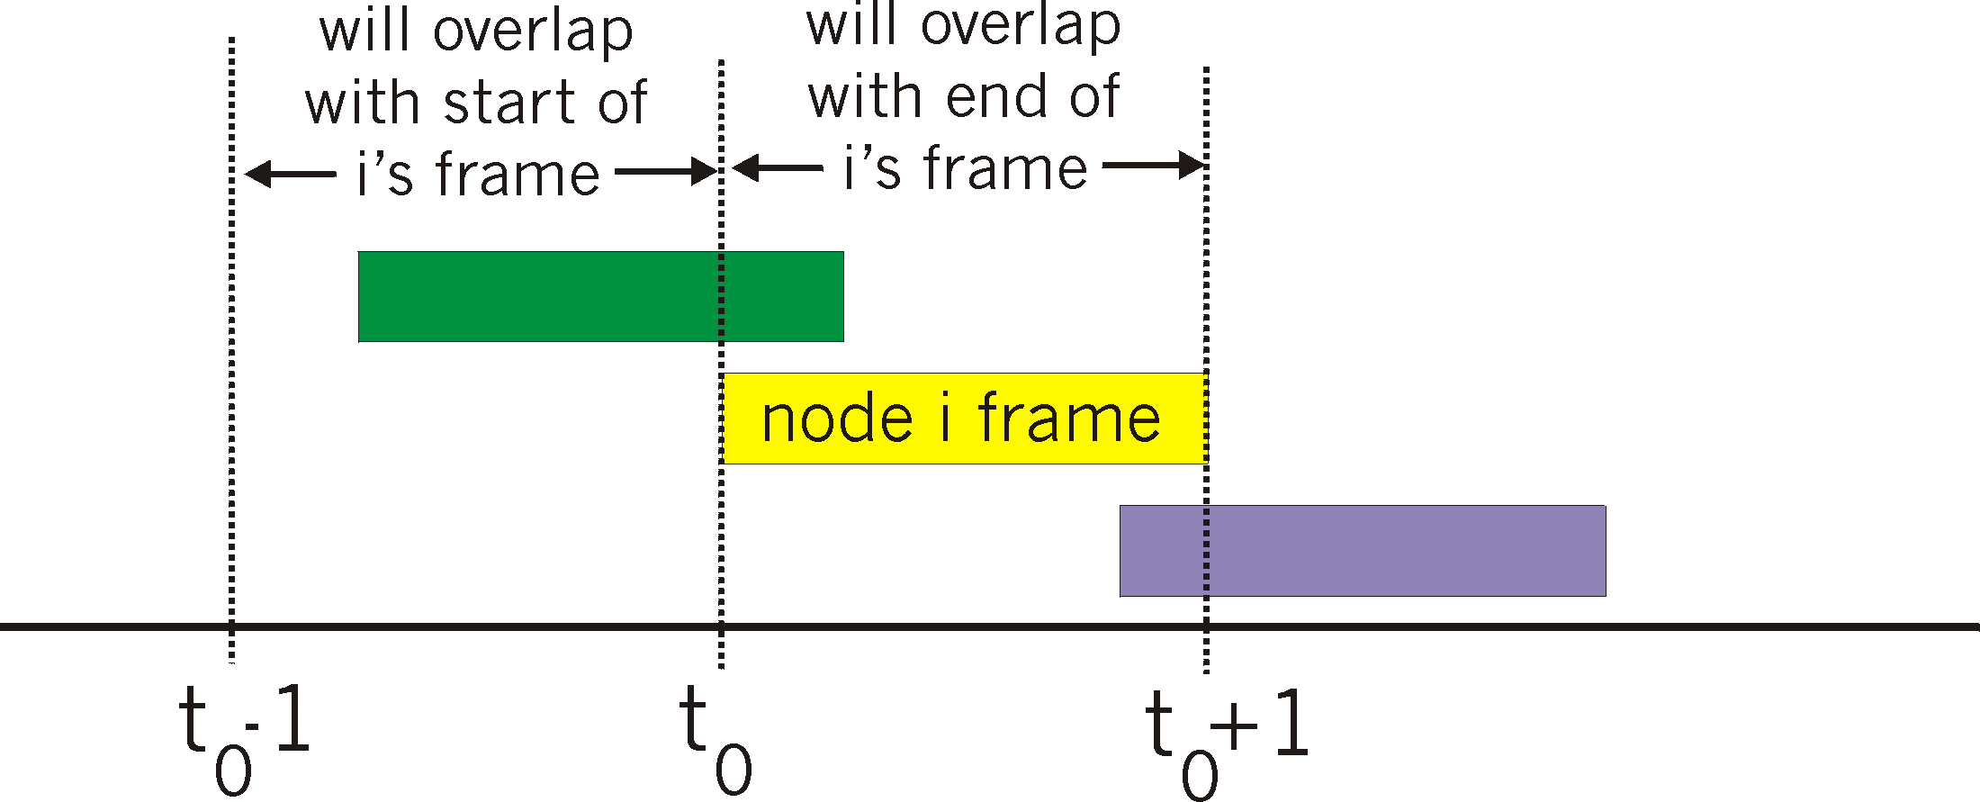
Pure ALOHA
Let nodes transmit whenever a frame arrives
No synchronization among nodes
If collision, retransmit after random delay
collision probability increases:
frame sent at t₀ collides with other frames sent in [t₀-1,t₀+1]

Slide 30
Pure Aloha efficiency
P(success by given node) = P(node transmits) .
P(no other node transmits in [p₀-1,p₀] .
P(no other node transmits in [p₀-1,p₀]
= p . (1-p)^{N-1 .} (1-p)^{N-1}
= p . (1-p)^{2(N-1)}
… choosing optimum p and then letting n -> infty ...
^{= 1/(2e) = .18}

Slide 31
Slotted ALOHA
Assumptions
all frames same size
time is divided into equal size slots, time to transmit 1 frame
nodes start to transmit frames only at beginning of slots
nodes are synchronized
if 2 or more nodes transmit in slot, all nodes detect collision
Operation
when node obtains fresh frame, it transmits in next slot
no collision, node can send new frame in next slot
if collision, node retransmits frame in each subsequent slot with prob. p until success

Slide 32
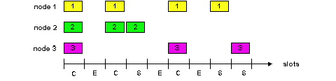
Slotted ALOHA
Pros
single active node can continuously transmit at full rate of channel
highly decentralized: only slots in nodes need to be in sync
simple
Cons
collisions, wasting slots
idle slots
clock synchronization

Slide 33
Slotted Aloha efficiency
Efficiency is the long-run fraction of successful slots when there are many nodes, each with many frames to send
For max efficiency with N nodes, find p* that maximizes Np(1-p)^{N-1}
For many nodes, take limit of Np*(1-p*)^{N-1} as N goes to infinity, gives 1/e = .37
Suppose N nodes with many frames to send, each transmits in slot with probability p
prob that node 1 has success in a slot = p(1-p)^{N-1}
prob that any node has a success = Np(1-p)^{N-1}
At best: channel
used for useful
transmissions 37%
of time!

Slide 34
Carrier Sense Multiple Access (CSMA)
First listen; transmit only if channel sensed to be idle
Can collisions occur in this scheme?
One possibility: two nodes might attempt to transmit a frame at the same time
Another possibility?

Slide 35
CSMA/CD (Collision Detection)
CSMA/CD: carrier sensing, deferral as in CSMA
collisions detected within short time
colliding transmissions aborted, reducing channel wastage
collision detection:
easy in wired LANs: measure signal strengths, compare transmitted, received signals
difficult in wireless LANs: receiver shut off while transmitting

Slide 36
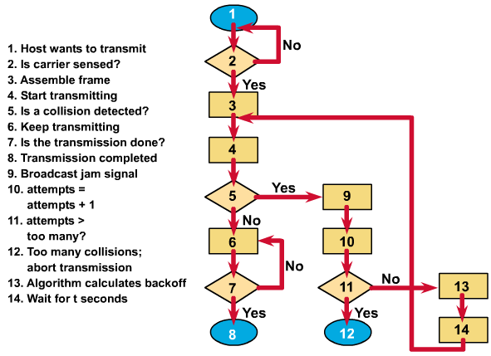

Slide 37
CSMA\CD-Efficiency
t_{prop} = max prop between 2 nodes in LAN
t_{trans} = time to transmit max-size frame
Efficiency goes to 1 as t_{prop} goes to 0
Goes to 1 as t_{trans} goes to infinity
Much better than ALOHA, but still decentralized, simple, and cheap

Slide 38
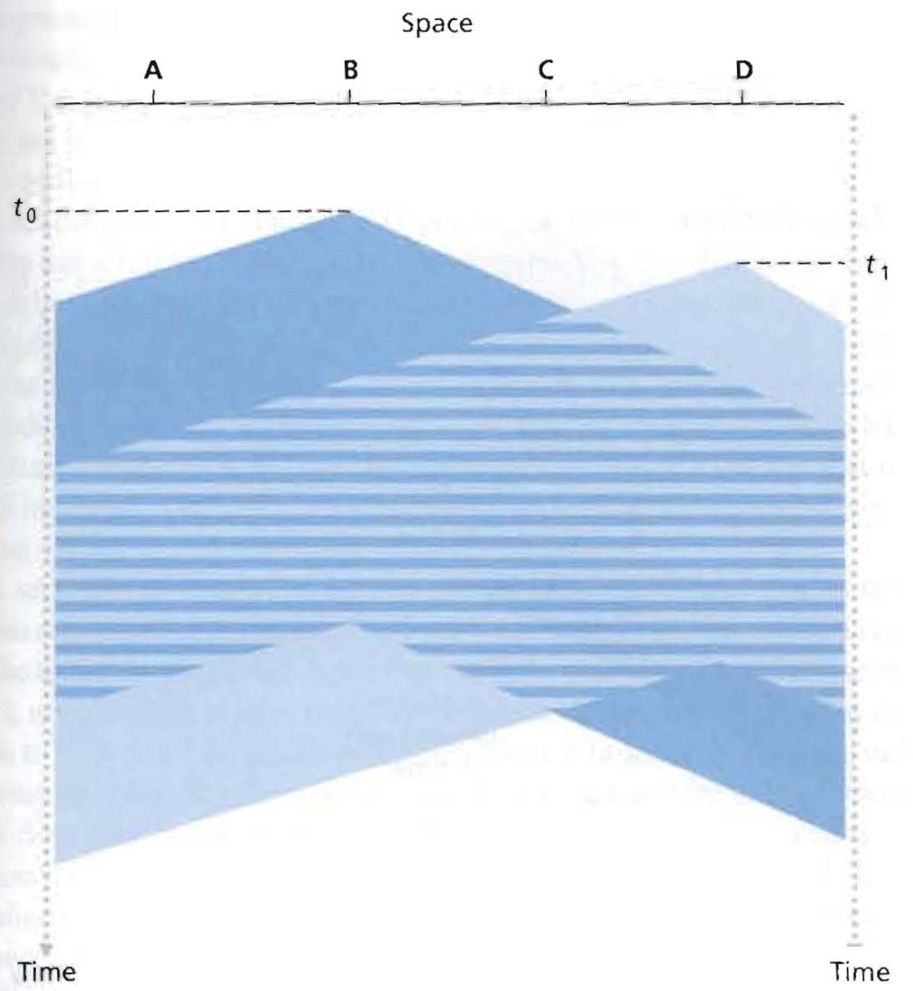
Time-Space Diagram of Two CSMA nodes

Slide 39
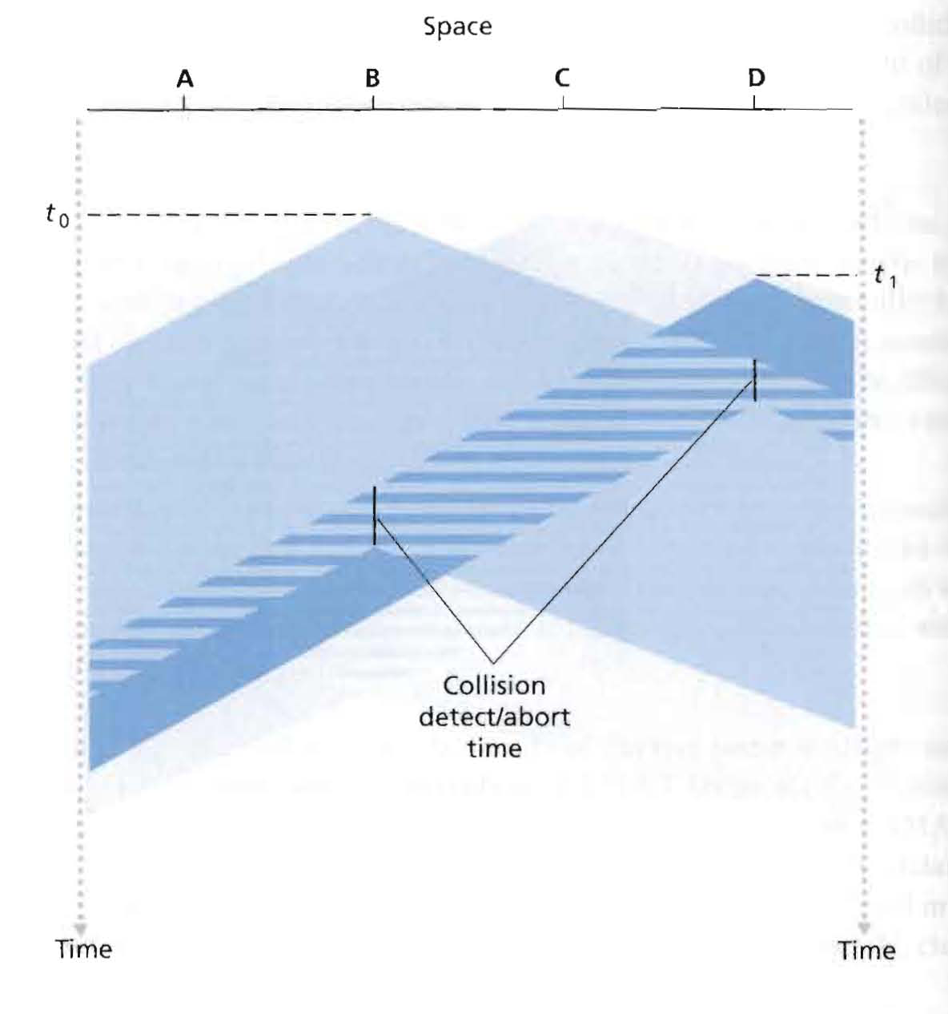
CSMA with collision detection

Slide 40
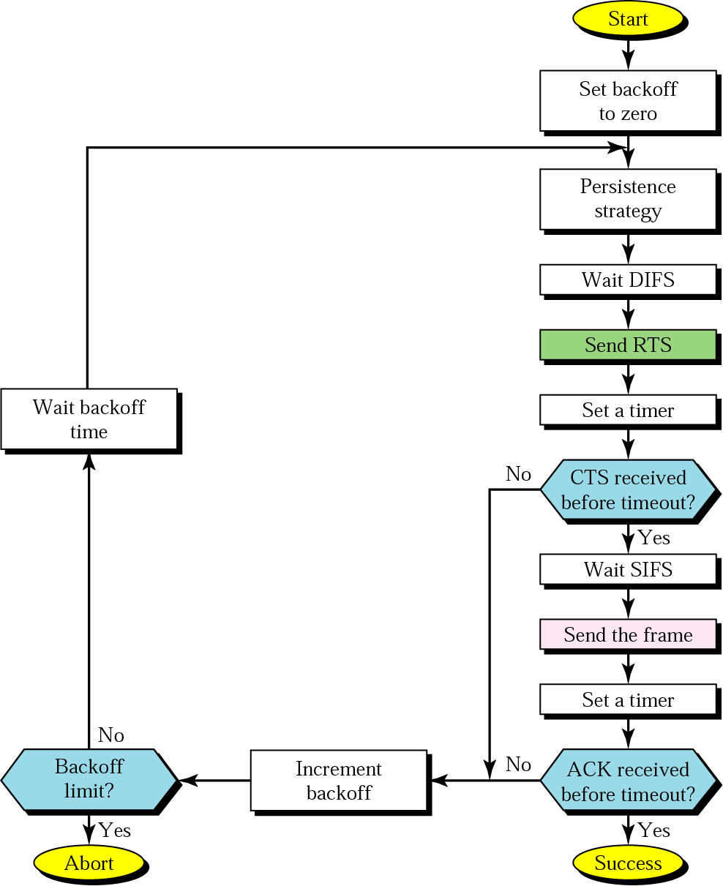
CSMA/CA flowchart

Slide 41
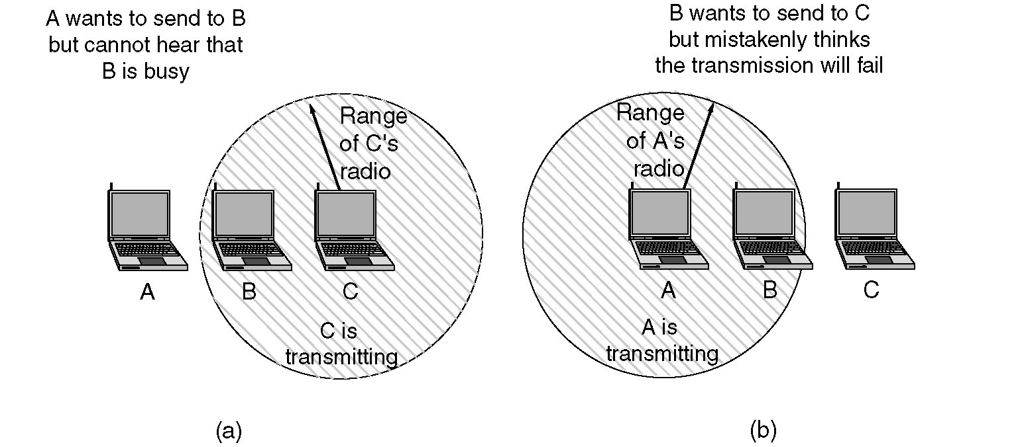
CSMA\CA

Slide 42
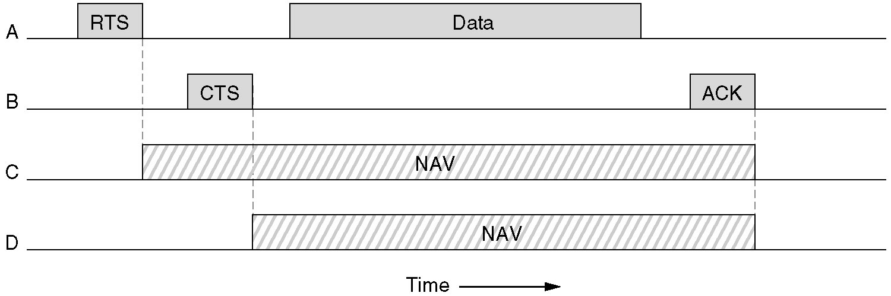
CSMA\CA

Slide 43
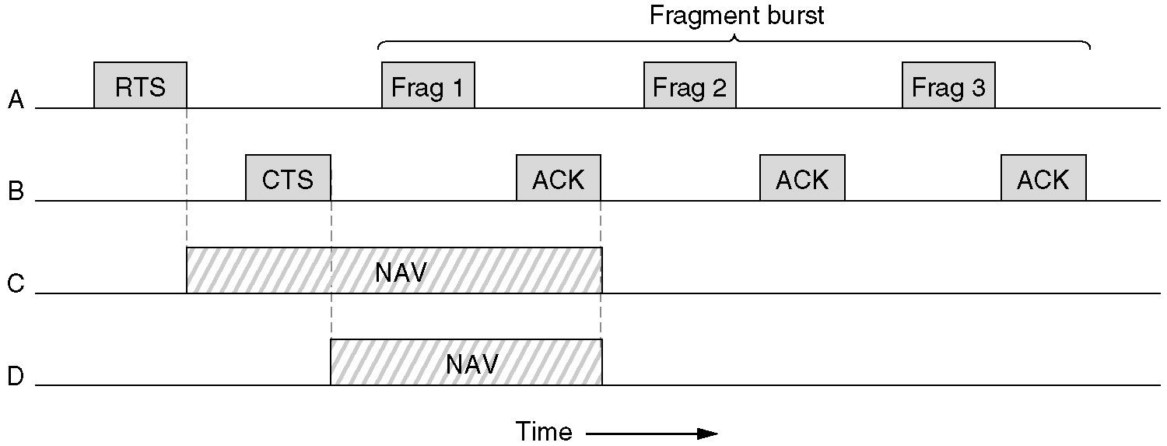
CSMA\CA- Fragment Burst

Slide 44
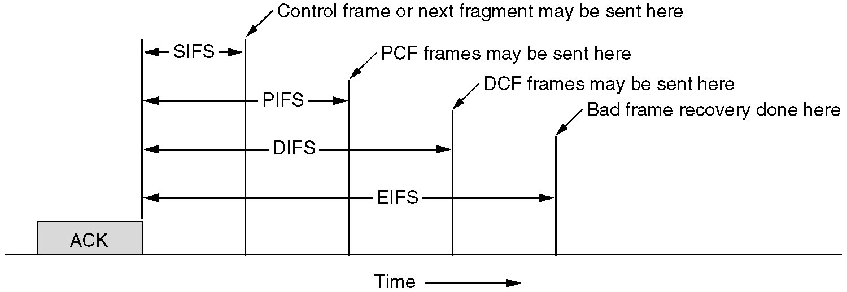
CSMA\CA-Inter frame Spaces

Slide 45
MAC Architecture

Slide 46
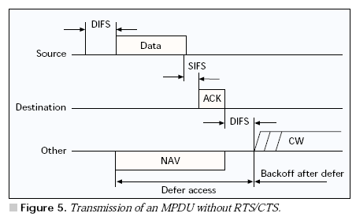
Transmission of MPDU without RTS\CTS

Slide 47
Fragmented MPDU

Slide 49
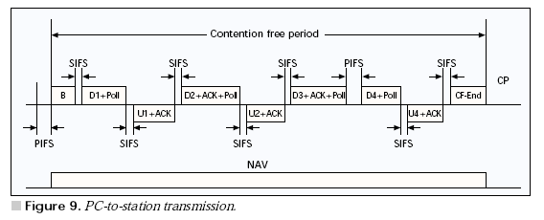

Slide 50
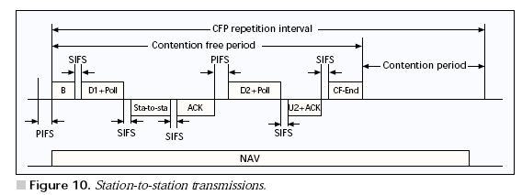

Slide 51
“Taking Turns” MAC protocols
channel partitioning MAC protocols:
share channel efficiently and fairly at high load
inefficient at low load: delay in channel access, 1/N bandwidth allocated even if only 1 active node!
Random access MAC protocols
efficient at low load: single node can fully utilize channel
high load: collision overhead
“taking turns” protocols
look for best of both worlds!

Slide 52
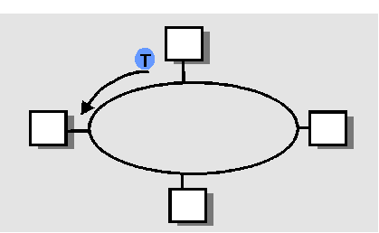
“Taking Turns” MAC protocols
Polling:
master node “invites” slave nodes to transmit in turn
concerns:
polling overhead
latency
single point of failure (master)
Token passing:
control token passed from one node to next sequentially.
token message
concerns:
token overhead
latency
single point of failure (token)

Slide 53
Summary of MAC protocols
What do you do with a shared media?
Channel Partitioning, by time, frequency or code
Time Division, Frequency Division
Random partitioning (dynamic),
ALOHA, S-ALOHA, CSMA, CSMA/CD
carrier sensing: easy in some technologies (wire), hard in others (wireless)
CSMA/CD used in Ethernet
CSMA/CA used in 802.11
Taking Turns
polling from a central site, token passing

Slide 54
Ethernet

Slide 55
Ethernet introduction
Ethernet is the most widely used local area network (LAN) technology.
Ethernet was designed to carry data at high speeds for very limited distances.
Ethernet is well suited to applications where a local communication medium must carry sporadic, occasionally heavy traffic at high peak data rates.

Slide 56
Ethernet history
1960s, the University of Hawaii.
1970s, Xerox developed the first system.
1980, IEEE released 802.3 specification.
1980s, Digital, Intel and Xerox jointly developed and released an Ethernet specification (v2.0), Compatible with 802.3
Today, the term Ethernet is often used to refer to Ethernet specifications, including IEEE 802.3.

Slide 57
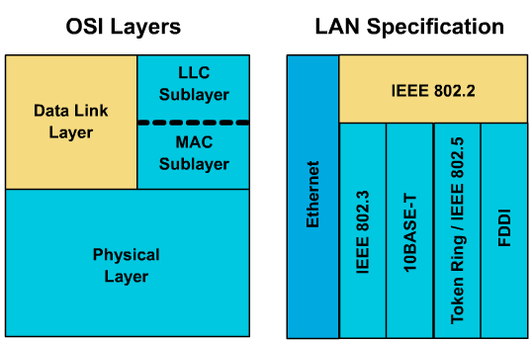
Datalink and Physical layers

Slide 58
Comparing Ethernet and IEEE 802.3
Specify similar technologies.
Broadcast network.
Using CSMA/CD algorithm.
Hardware implementation.
Differences:
Ethernet provides services corresponding to physical and datalink layer.
IEEE 802.3 specifies the physical layer and the channel-access portion of the data link layer but does not define a LLC protocol.

Slide 59
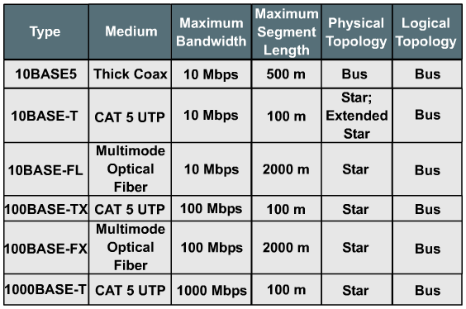
Ethernet family

Slide 60
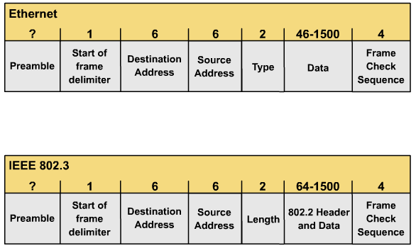
Ethernet frame format

Slide 61
Preamble
Note that a frame is Ethernet or IEEE 802.3.

Slide 62
Start of frame delimiter (SOF)
The IEEE 802.3: synchronize the frame-reception portions of all stations on the LAN.
Be explicitly specified in Ethernet.

Slide 63
Source and destination addresses
MAC addresses.
Unicast.
Multicast (D)
Broadcast (D)

Slide 64
Type (Ethernet)
Specifies the upper-layer protocol to receive the data after Ethernet processing is completed

Slide 65
Length (IEEE 802.3)
The length indicates the number of bytes of data that follows this field

Slide 66
Data (Ethernet)
the data contained in the frame is sent to an upper-layer protocol

Slide 67
Data (IEEE 802.3)
Data send to LLC layer, including LLC header and upper-layer data

Slide 68
Frame check sequence (FCS)
This sequence contains a 4 byte CRC value that is created by the sender and is recalculated by the receiver to check for damaged frames

Slide 69
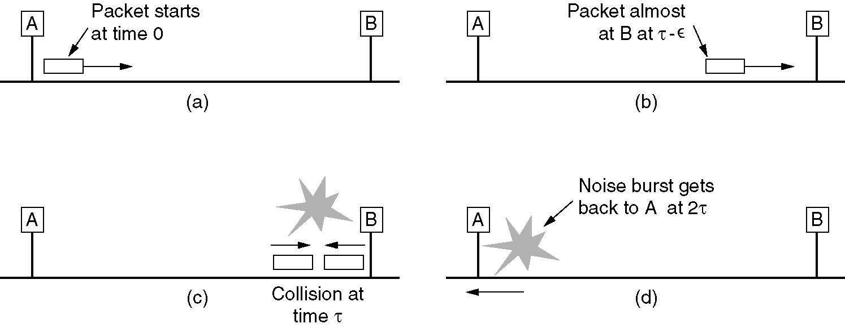
Ethernet MAC Sublayer Protocol (2)

Slide 70
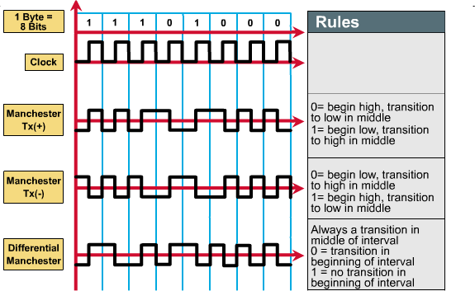
Encoding: Manchester T+/-

Slide 71
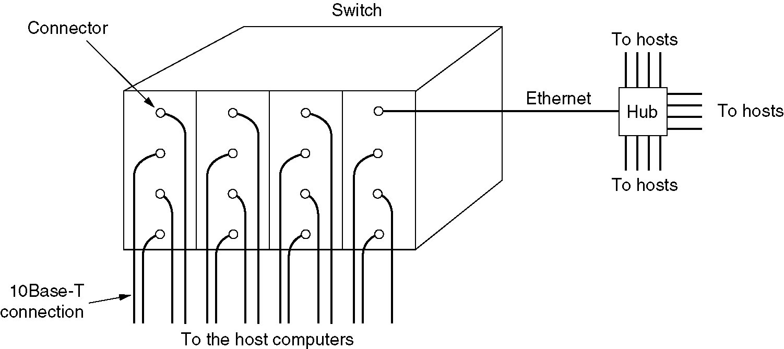
Switched Ethernet
A simple example of switched Ethernet.

Slide 72
Review
Ethernet differences from IEEE 802.3.
Ethernet and IEEE 802.3 frame structure.
Encoding and topology.

Slide 73
Reference
Lecture Slides of Jim F. Kurose (Chapter 5)
Lecture Slides of Behrouz A. Farouzan (Chapter 10)
Cisco Resources

Slide 74
Deterministic LAN Technologies: Token Ring & FDDI

Slide 75
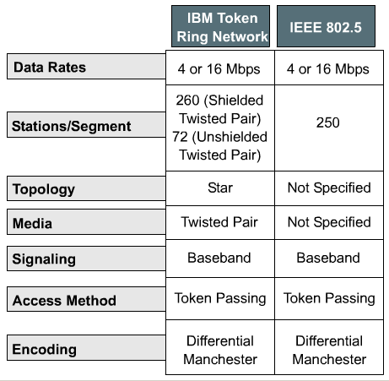
Token Ring and variants
IBM developed the first Token Ring network in the 1970s. It is still IBM's primary LAN technology, and is second only to Ethernet (IEEE 802.3) in terms of LAN implementation.

Slide 76
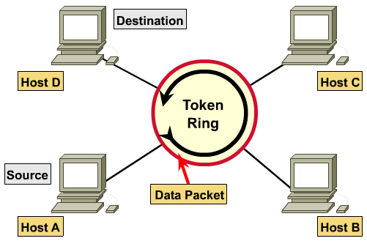
Ring topology

Slide 77
Data passing
When a station has information to transmit, it seizes the token and sends data frame to the next station.
When frame reaches the destination station, the data is copied for processing.
Frame continues to circle the ring until it returns to the sending station.
Sending station removes the frame from the ring, verifies receipt, and releases the token.

Slide 78
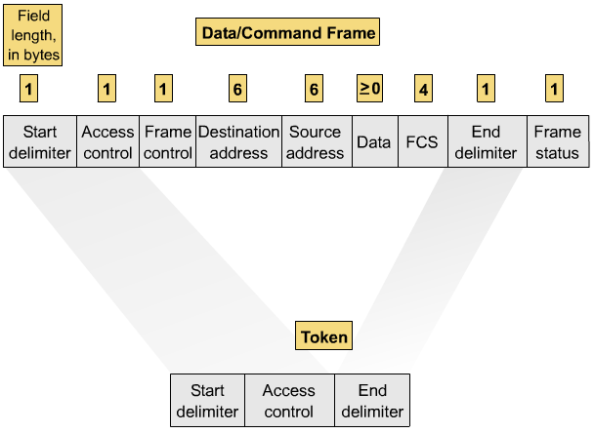
Token-Ring frame format

Slide 79
Start delimiter and End delimiter
Start delimiter.
Alert for the arrival of a token.
Includes an identification symbol.
End Delimiter
Completes the token or data/command frame.
Contains damage indicator.
Last of logical sequence.

Slide 80
Access control
P
P
P
T
M
R
R
R
P: Priority bits
T: Token bit
M: Monitor bit
R: Reservation bits

Slide 81
Priority and reservation bits
B'000' Normal User Priority
B'001' Normal User Priority
B'010' Normal User Priority
B'011' Normal User priority
B'100' Bridge/Router
B'101' Reserved IBM
B'110' Reserved IBM
B'111' Station Management

Slide 82
Priority management
Using the priority field and the reservation field.
Stations with a higher priority can reserve the token for the next network pass.
Stations that raise a token's priority level must reinstate the previous priority after their transmission has been completed.

Slide 83
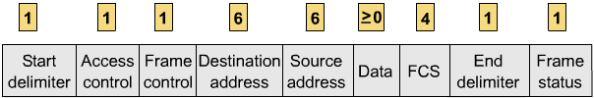
Frame control
Only present in data/command frames.
Indicates whether frame contains data or control information.
If control, this byte specifies type of control information.

Slide 84
Destination and Source addresses
Universal Address.
Local Administered Address.
Broadcast Address (D).

Slide 85
Data
Length limited by the maximum time a station may hold the token.

Slide 86
Frame checksum
Frame Check Sequence.
Source fills field with calculated value dependent on frame contents.
Destination recalculates to check data integrity.
Frame is discarded if damaged.

Slide 87
Frame status
Address recognized / frame copied indicator.

Slide 88
Management mechanisms
Active Monitor
One station acts as centralized source of timing information for other stations.
Removes continuously circulating frames by set monitor bit to 1.
Start a token, when token have been lost.
Beaconing
Detects and repairs network faults.
Initiates auto-reconfiguration.

Slide 89
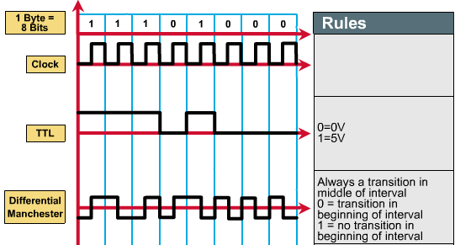
Encoding: Differential Manchester

Slide 90
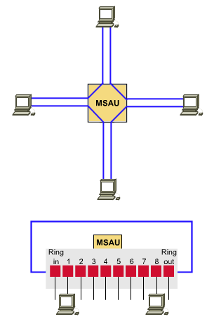
Physical topology
Physical topology : Star.
Logical topology : Ring.
IBM Token Ring network stations are connected to MSAU (Multi-Station Access Unit).
Many MSAU can be wired together to form one large ring.

Slide 91
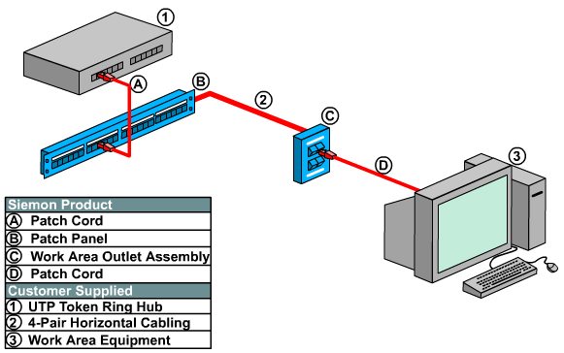
Physical connection

Slide 92
Review
Operation of Token-Ring.
Token-Ring frame structure.
Encoding and topology.

Slide 93
BASIC OF FDDI

Slide 94
Characteristics
Fiber Distributed Data Interface.
FDDI is popular as a campus backbone technology.
100 Mbps
Token passing
Dual-ring
Fiber Optic Cable
Total fiber length of 200Km
Station distances up to 2Km

Slide 95
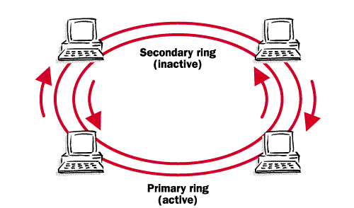
FDDI dual-ring (PR and SR)

Slide 96
FDDI Media
Fiber Optic
Single-mode, Laser (< 40Km)
Multi-mode, LED (< 2Km)
Multi-mode low cost, LED (< 500m)
Twisted Pair Copper
UTP, STP (< 100m)

Slide 97
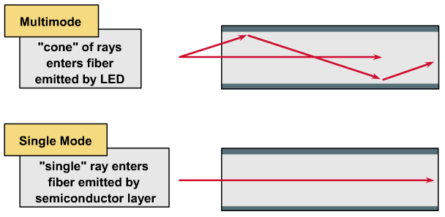
Fiber-optic modes

Slide 98
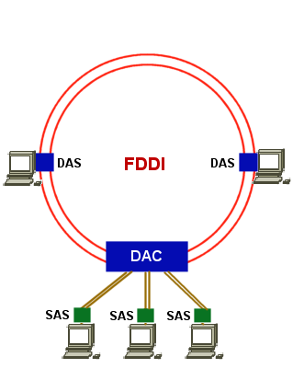
FDDI Connections
Class A: connect directly with PR – SR.
DAC: Dual Attachment Concentrator
DAS: Dual Attachment Station
Class B: connect via FDDI concentrator.
SAS: Single Attachment Station

Slide 99
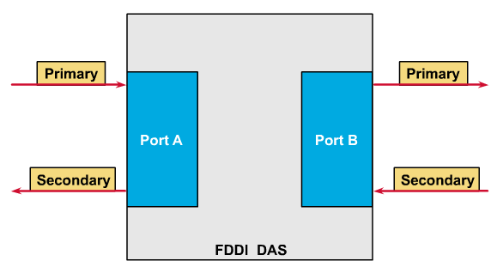
Attachments

Slide 100
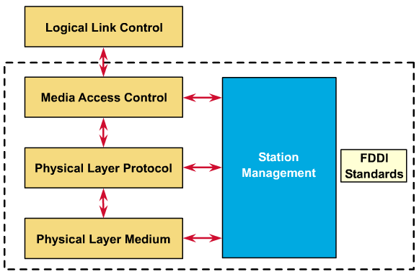
FDDI standard: ANSI X3T9.5

Slide 101
Physical Layer Medium (PMD)
Physical Medium Dependent:
How a station physically connect to a FDDI ring?
Defines the characteristics of the transmission medium:
Fiber optic link
Power levels
Bit error rates
Optical components
Connectors

Slide 102
Physical Layer Protocol (PHY)
PHysical laYer protocol:
How the signals are transmitted around the FDDI ring?
Part of the physical layer that are media independent.
Defines data encoding/decoding procedures:
Framing
Clocking requirements
Other functions (Link state…)

Slide 103
Media Access Control (MAC)
Media Access Control:
How the physical medium is accessed on FDDI ring?
Construction, transmission, receiving, and removal of frames and tokens.
Defines how the medium is accessed:
Frame format
Token handling
Addressing
Error recovery mechanisms

Slide 104
Station Management (SMT)
Defines the FDDI station configuration, enables stations to work together within the ring :
Ring configuration
Initialization
Station insertion and removal
Fault isolation and recovery
Scheduling
Collection of statistics

Slide 105
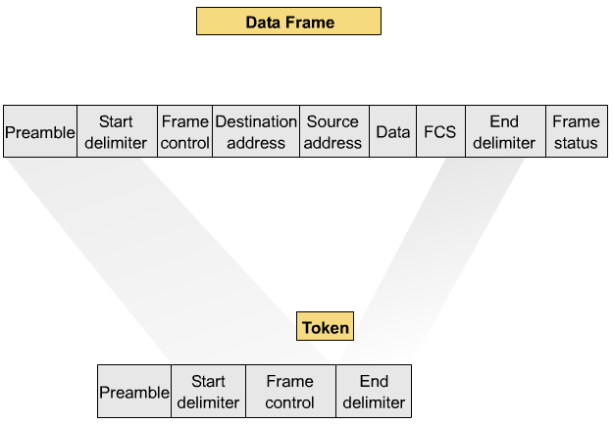
FDDI frame format

Slide 106
Preamble, Start and End delimiter
Preamble.
Prepares for the upcoming frame
Start delimiter.
Alert for the arrival of a token.
Differentiate from other frame fields.
End Delimiter
Completes the frame.
Contains damage indicator.

Slide 107
Frame control
The size of the address fields
Other control information
Asynchronous or Synchronous data

Slide 108
Source and destination addresses
Addresses are 6 bytes
Unicast
Multicast (D)
Broadcast (D)

Slide 109
Data
Control information, or information destined for an upper-layer protocol

Slide 110
FCS
Cyclic redundancy check (CRC).
For error control

Slide 111
Frame status
Allows the source station to determine if an error occurred and if the frame was recognized and copied by a receiving station

Slide 112
Operation mechanisms
Connection Establishment
Station connect to neighbors to form the ring.
Negotiate the length of the link.
Ring Initialization
Station claim the right to generate a token.
Steady-state Operation
Token passing
Ring Maintenance
Detects and repairs token or network faults.

Slide 113
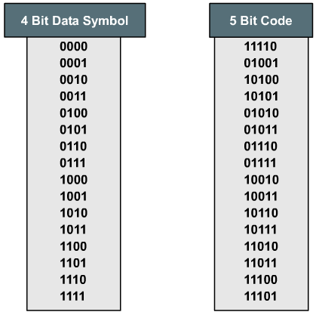
Encoding: 4B/5B

Slide 114
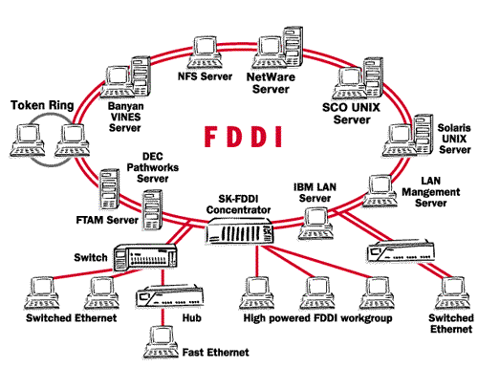
FDDI topology

Slide 115
Review
Operation of FDDI.
FDDI frame structure.
Encoding and topology.

Slide 116
LAN Addresses and ARP
32-bit IP address:
network-layer address
used to get datagram to destination IP network (recall IP network definition)
LAN (or MAC or physical or Ethernet) address:
used to get datagram from one interface to another physically-connected interface (same network)
48 bit MAC address (for most LANs) burned in the adapter ROM

Slide 117
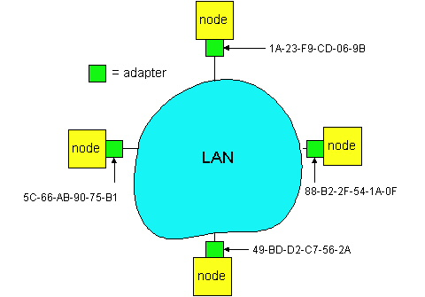
LAN Addresses and ARP
Each adapter on LAN has unique LAN address

Slide 118
LAN Address (more)
MAC address allocation administered by IEEE
manufacturer buys portion of MAC address space (to assure uniqueness)
Analogy:
(a) MAC address: like Social Security Number
(b) IP address: like postal address
MAC flat address => portability
can move LAN card from one LAN to another
IP hierarchical address NOT portable
depends on IP network to which node is attached

Slide 119
Recall Encapsulation
Starting at A, given IP datagram addressed to B:
look up net. address of B, find B on same net. as A
link layer send datagram to B inside link-layer frame
A
223.1.1.1
223.1.2.1
223.1.1.2
223.1.1.4
223.1.2.9
B
223.1.2.2
E
223.1.1.3
223.1.3.27
223.1.3.1
223.1.3.2
frame source,
dest address
datagram source,
dest address
B’s MAC
addr
A’s MAC
addr
A’s IP
addr
B’s IP
addr
IP payload
datagram
frame

Slide 120
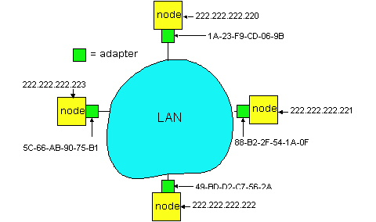
ARP: Address Resolution Protocol
Question: how to determine
MAC address of B
knowing B’s IP address?
Each IP node (Host, Router) on LAN has ARP table
ARP Table: IP/MAC address mappings for some LAN nodes
< IP address; MAC address; TTL>
TTL (Time To Live): time after which address mapping will be forgotten (typically 20 min)

Slide 121
ARP protocol
A wants to send datagram to B, and A knows B’s IP address.
Suppose B’s MAC address is not in A’s ARP table.
A broadcasts ARP query packet, containing B's IP address
all machines on LAN receive ARP query
B receives ARP packet, replies to A with its (B's) MAC address
frame sent to A’s MAC address (unicast)
A caches (saves) IP-to-MAC address pair in its ARP table until information becomes old (times out)
soft state: information that times out (goes away) unless refreshed
ARP is “plug-and-play”:
nodes create their ARP tables without intervention from net administrator

Slide 122
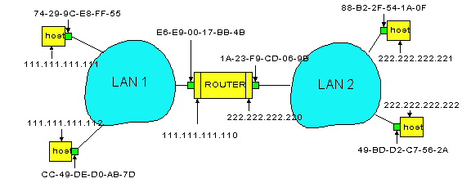
Routing to another LAN
walkthrough: send datagram from A to B via R
assume A knows B IP address
Two ARP tables in router R, one for each IP network (LAN)
In routing table at source Host, find router 111.111.111.110
In ARP table at source, find MAC address E6-E9-00-17-BB-4B, etc
A
R
B

Slide 123
A creates datagram with source A, destination B
A uses ARP to get R’s MAC address for 111.111.111.110
A creates link-layer frame with R's MAC address as dest, frame contains A-to-B IP datagram
A’s data link layer sends frame
R’s data link layer receives frame
R removes IP datagram from Ethernet frame, sees its destined to B
R uses ARP to get B’s physical layer address
R creates frame containing A-to-B IP datagram sends to B
A
R
B

Slide 124

ARP operation

Slide 125

ARP packet

Slide 126

Encapsulation of ARP packet

Slide 127

Example 1

Slide 128
Layer 2 Devices

Slide 129
Layer 2 Devices
NIC (Network Interface Card)
Connect your computer with network.
Provide MAC addresses to each connection.
Implement CSMA/CD algorithm.
Bridge
Forward or filter frame by MAC address.
Switch
Multi-port bridge.

Slide 130

NIC

Slide 131
NIC (cont.)
Provides ports for network connection.
When selecting a network card, consider:
Type of network:
Ethernet
Token Ring
FDDI
Type of media
Twisted-pair
Coaxial
Fiber-optic
Type of system bus
PCI (Peripheral Component Interface)
ISA

Slide 132
NIC: Layer 2 functions
Logical link control (LLC): communicates with upper layers in the computer
Naming: provides a unique MAC address identifier
Framing: part of the encapsulation process, packaging the bits for transport
Media Access Control (MAC): provides structured access to shared access media
Signaling: creates signals and interface with the media

Slide 133
Bridge
Connects network segments.
Make intelligent decisions about whether to pass signals on to the next segment.
Improve network performance by eliminating unnecessary traffic and minimizing the chances of collisions.
Divides traffic into segments and filters traffic based on MAC address.
Often pass frames b/w networks operating under different Layer 2 protocols.

Slide 134

Bridge (cont.)

Slide 135

Bridge (cont.): Filter

Slide 136

Bridge (cont.): Forward

Slide 137
Switch: Forwarding
switch
1
2
3
hub
hub
hub
How do determine onto which LAN segment to forward frame?
Looks like a routing problem...

Slide 138
Self learning
A switch has a switch table
entry in switch table:
(MAC Address, Interface, Time Stamp)
stale entries in table dropped (TTL can be 60 min)
switch learns which hosts can be reached through which interfaces
when frame received, switch “learns” location of sender: incoming LAN segment
records sender/location pair in switch table

Slide 139
Filtering/Forwarding
When switch receives a frame:
index switch table using MAC dest address
if entry found for destination then{
if dest on segment from which frame arrived then drop the frame
else forward the frame on interface indicated
}
else flood
forward on all but the interface
on which the frame arrived

Slide 140
Switch: traffic isolation
switch installation breaks subnet into LAN segments
switch filters packets:
same-LAN-segment frames not usually forwarded onto other LAN segments
segments become separate collision domains
switch
collision domain
hub
hub
hub
collision domain
collision domain

Slide 141
Switches: dedicated access
Switch with many interfaces
Hosts have direct connection to switch
No collisions; full duplex
Switching: A-to-A’ and B-to-B’ simultaneously, no collisions
A
C’
B
switch
C
B’
A’

Slide 142
Switching types
cut-through switching: frame forwarded from input to output port without first collecting entire frame
slight reduction in latency
Disadvantage?
Store-and-forward
combinations of shared/dedicated, 10/100/1000 Mbps interfaces

Slide 143

LAN Switch: Micro-segmentation

Slide 144
Institutional network
mail server
to external
network
router
web server
switch
IP subnet
hub
hub
hub

Slide 145
Wireless Local Area Network (WLAN)

Slide 146
IEEE 802.11 Wireless LAN
802.11b
2.4-5 GHz unlicensed radio spectrum
up to 11 Mbps
direct sequence spread spectrum (DSSS) in physical layer
all hosts use same chipping code
widely deployed, using base stations
802.11a
5-6 GHz range
up to 54 Mbps
802.11g
2.4-5 GHz range
up to 54 Mbps
All use CSMA/CA for multiple access
All have base-station and ad-hoc network versions

Slide 147

Base station approach
Wireless host communicates with a base station
base station = access point (AP)
Basic Service Set (BSS) (a.k.a. “cell”) contains:
wireless hosts
access point (AP): base station
BSSs combined to form distribution system (DS)

Slide 148

The 802.11 Protocol Stack
Part of the 802.11 protocol stack.

Slide 149
IEEE 802.11 Standard

Slide 150
Frequency Hopping Spread Spectrum (FHSS)
Band
2.4 GHz ISM
Modulation & Data Rate
FSK at 1 Mbaud/s
1 or 2 bits/baud which results in a data rate of 1 or 2 Mbps.

Slide 151
Direct Sequence Spread Spectrum (DSSS)
Band
2.4 GHz ISM
Modulation & Data Rate
PSK at 1 Mbaud/s
1 or 2 bits/baud (BPSK or QPSK)

Slide 152
Orthogonal Frequency Division Multiplexing (OFDM)—802.11a
Band
5 GHz ISM
52 subbands
Modulation & Data Rate
PSK and QAM
18 Mbps (PSK) and 54 Mbps (QAM)

Slide 153
High-rate DSSS- 802.11b
Band
2.4 GHz ISM
Similar to DSSS except for the coding method
Complementary Code Keying (CCK)
Modulation & Data Rate
1, 2, 5.5 & 11 Mbps
5.5 Mbps version uses BPSK and transmit 1.375 Mbaud/s with 4-bit CCK
11 Mbps version uses QPSK and transmit at 1.375 with 8-bit CCK encoding.

Slide 154
OFDM----802.11g
2.4 GHz

Slide 155

Frame format

Slide 156
Subfields in FC field
Field | Explanation
Version | The current version is 0.
Type | Type of information: management (00), control (01), or data (10).
Subtype | Defines the subtype of each type (see ).
To DS | Defined later.
From DS | Defined later.
More flag | When set to 1, means more fragments.
Retry | When set to 1, means retransmitted frame.
Pwr mgt | When set to 1, means station is in power management mode.
More data | When set to 1, means station has more data to send.
WEP | Wired equivalent privacy. When set to 1, means encryption implemented.
Rsvd | Reserved.

Slide 157

Control frames

Slide 158
Values of subfields in control frames
Subtype | Meaning
1011 | Request to send (RTS)
1100 | Clear to send (CTS)
1101 | Acknowledgment (ACK)

Slide 159
Subfields in FC field
To DS | From DS | Address 1 | Address 2 | Address 3 | Address 4
0 | 0 | Destination station | Source station | BSS ID | N/A
0 | 1 | Destination station | Sending AP | Source station | N/A
1 | 0 | Receiving AP | Source station | Destination station | N/A
1 | 1 | Receiving AP | Sending AP | Destination station | Source station

Slide 160

Addressing mechanism: case 1

Slide 161

Addressing mechanism: case 2

Slide 162

Addressing mechanism: case 3

Slide 163

Addressing mechanism: case 4

Slide 164
Bluetooth
Architecture
Radio Layer
Baseband Layer
L2CAP Layer
Other Upper Layers

Slide 165

Piconet

Slide 166

Scatternet

Slide 167

Bluetooth layers

Slide 168

Single-slave communication

Slide 169

Multiple-slave communication

Slide 170

Frame format types

Slide 171

L2CAP data packet format

