Slide 1
Introduction
CSC-114 Data Structures and Algorithms

Slide 2
Outline
Information about course & class
Introduction
Data Type
Abstract Data Type (ADT)
Data Structures
Algorithm
Approaches to Allocate Memory

Slide 3
Course Website & Information
Course Website
Section wise
https://piazza.com/ciitlahore.edu.pk/spring2017/csd202c/home
https://piazza.com/ciitlahore.edu.pk/spring2017/csd202d/home
Text and Reference Books
No Strict requirement, notes will be provided if needed
Just follows class notes and any additional material, if provided
Language/IDE
Java
Eclipse
Resource Person
Saba Anwar
Email: sabaanwar@ciitlahore.edu.pk
Office: C11-1

Slide 4
Introduction
In this course, we will look at:
Data Structures
Different ways for organizing data, so that it can be accessed efficiently?
Access for?
Operations that can be performed on it
Insert, delete, search/find
Algorithms
Logic to perform those operations
Dependent on data structures
Data structures have trade-offs
There is no ultimate data structure and resources are limited
The choice depends on our requirements
Time vs. Space

Slide 5
Data and Data Type
Data
Facts, figures, numbers
Data Type
Specifies properties of a certain category of data values
Domain: What kind of values it can hold
Operations: What kind of operations it support
Data Type can be:
Scalar/Atomic: also called primitive data types, no further sub-parts
int, float, double
Composite/Structured: have further sub-parts
struct, arrays, classes, interfaces, enums

Slide 6
Data Structure
Collection of data elements with a set of rules which defines the logical relationship of these elements.
Data elements
Can be atomic as well as composite, even another data structure too
Structure
Set of rules to hold data together
How you will organize your music collection?
How books are arranged in library?
A specific structure can be helpful for certain operations.
Finding a number in an unordered list vs finding it in an ordered list

Slide 7
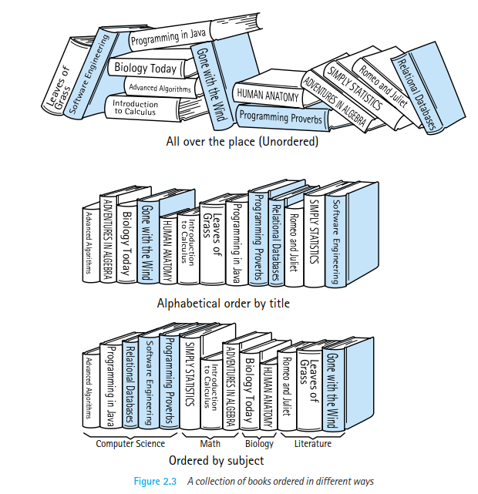
Data Structure
How easy would be the following operations in all three scenarios mentioned in figure?
Finding a book whose name starts with a specific word?
Finding all books of a particular subject?
Adding a new book to existing stock?
How to choose structure?
Which operations are more important?
Does the structure would help to perform those operations more efficiently than some other structure?

Slide 8
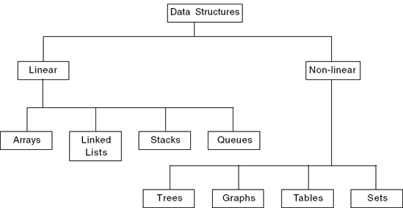
Different Types and Applications
Stack - undo\redo operation in word processors, Expression evaluation and syntax parsing, JVM is stack oriented.
Queues - Transport and operations research where various entities are stored and held to be processed later, buffer.
Priority queues - process scheduling in the kernel
Hash Table - used for fast data lookup - symbol table for compilers, database indexing, cache, dictionary
Trees - Parsers, File system, dictionary, such as one found on a mobile for auto-completion and spell-checking
Heap - Dynamic memory allocation
Graphs - Connections/relations in social networking sites, Routing ,networks of communication, data organization

Slide 9
Trade-offs
Common operations for a data collection
Add, Delete, Search, Update
How to decide that which data structure we need?
Structure of data affects efficiency of data operations
Time vs Space
Generality vs. simplicity vs. performance
One operation is more efficient if another less efficient
So there are trade-offs with each data structure
There is no one ultimate data structure, you have to choose according to your priorities
Does this support the operations I need? efficiently?
Will it be easy to use (and reuse), implement, and debug?
What assumptions am I making about how my software will be used? (E.g., more searching or more inserts?)
Does ordering is more important than anything

Slide 10



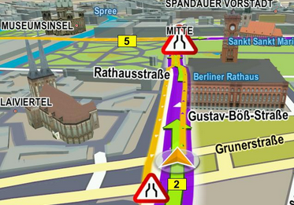

Abstraction
Logical view of data vs physical implementation
Binary form
Movies
Images
Abstraction has hidden the actual or physical representation of data
Maps
Music

Slide 11
Abstraction
The idea behind abstraction is to focus on what something can do(operations) rather than how it does (implementation).
Float and integer both takes 4 bytes but their physical implementation is different
Abstraction makes the logical view of a data type important than it’s physical implementation complexities.
int, float, Account, Point, Rectangle, 2D array
The advantages of using the ADT approach:
Implementation of ADT can be changed without affecting those method that use the ADT
Integer
Values: -2147483648 to +2147483647 Operations: +, -, /, *, +, relational operators + and – can be use as prefix, but all other operators would be use as infix
Abstraction: Physical implementation of values and operations is hidden from user. User does not need to know how integer has been implemented in particular language? He just needs to know what it does? Logical meaning of integer is same for different programming languages, but implementation may vary.

Slide 12
Abstract Data Type (ADT)
Abstraction has made the use of data structures more easy with concept of Abstract Data Type (ADT).
ADT is a data type whose internal implementation is hidden from user. In other words an ADT specifies set of data values and associated operations independent of any particular implementation.
Now when a programming language implements an ADT, it adopts a certain implementation logic which can vary from other languages, but their implementation does not change the definition of ADT
Stack ADT
Values: would follow last in first out order Operations: Push(E): will add element E on top of existing elements Pop(): will remove top element Peek(): will return top element, without removing
Abstraction: This ADT does not explain how it would be implemented? as a class, struct, simple structured programming, using array or linked list, would it work for integers? Or strings? There is no assumption about types and there is no logic given for operations. User just needs to know what a stack does? what push and pop will do?

Slide 13
Data Structure and ADT
ADT is the logical view
Stack ADT does not specify anything about implementation. It just describes the expected behaviors.
Data structure is the physical implementation
To implement Stack ADT you have to choose your container, and describe your algorithms for operations which greatly depends upon your choice.
In OO world interface and classes serve as an encapsulating units which can hide the implementation from user. User is only concerned about what methods are available and what they do?

Slide 14
What is algorithm?
To perform supported operations on data structure, we write algorithms.
An Algorithm is a finite set of ordered instructions which solves a particular problem.
Transforms input of a problem to output
Algorithm = Input + Process + Output
A good algorithm must be:
Correct
Finite
Unambiguous
Efficient
Data Structures
Algorithms
Program

Slide 15
Algorithm development: Basics
Clearly identify:
Purpose
What it will do?
What is the input?
What is needed?
What output is required?
What has to be produced?
What is Precondition?
Conditions must be true before algorithm runs
What is Postcondition?
Conditions must be true after it has been run
What steps are required to transform input into output
Needs problem solving skills
A problem can be solved in many different ways
Algorithm Analysis
Which solution, amongst the different possible solutions is optimal?

Slide 16
Memory Allocation
Every data structure needs memory to store data according to its structure.
Memory is allocated to each data element, and structure tells us how each element is connected to other
Data structures can be classified into two categories depending upon memory allocation
Contiguous
Single block of memory
Linked
Multiple blocks linked through pointers

Slide 17

Contiguous Allocation
Single block of memory, divided into uniform sized cells to store n number of data elements, also known as array
Each cell is accessed using its index
We need to know address to first cell and total number of cells to use the block
Application:
Hashtables, Adjacency Matrices, Stacks, Queues

Slide 18
Contiguous Allocation
Easy to use
Using index
Memory Wastage
If actual number of data elements is less than actual capacity
Not Dynamic
if more memory is required on run time, a request for new memory usually requires copying all information into the new memory
Allocation in not guaranteed
If big enough block is not available but only small blocks

Slide 19

Linked Allocation
Linked storage associates two pieces of data using pointers, each data element is wrapped in an object normally called node, node contains two parts:
Data itself
Pointer
Reference to the next node/object in memory
Reference to first node is required, so all that nodes can be traversed
Known as Linked List
Applications:
Lists, Trees, Adjacency Lists

Slide 20
Linked Allocation
Node Representation
The operations for a node must include:
Constructing a new node
Accessing the data values
Accessing the next pointer
C/C++
struct Node{
data declarations ;
Node* next;
}
Java
class Node{
data declarations;
Node next;
}

Slide 21
Linked Allocation
Not Simple
Involves pointers
No Memory Wastage
Create node when required
Dynamic
if more memory is required on run time, just create node
If not, then delete node
Allocation is guaranteed
As far as there are free blocks, they can be claimed using nodes

Slide 22
Summary
In this lecture, we have discussed:
What are data structures
What are algorithms
Why we need data structures & algorithms
How memory is allocated to data structures

