Slide 1
Tree
CSC-114 Data Structure and Algorithms

Slide 2
Outline
Binary Tree Variations
Binary Heap Tree
Max Heap
Min Heap
Insertion
Deletion

Slide 3
Binary Heap
A binary tree which holds two properties:
Heap Order Property:
Min-Heap Property: Every node is smaller than or equal to each of its children
Max-Heap Property: Every node is larger than or equal to each of its children
Shape Property:
Tree is complete.
A tree that is full at all levels except last level, and nodes are filled from left to right
Which tree is binary heap?
20
20
20
25
30
25
30
15
25
35
36
41
35
36
41
35
27

Slide 4
Finding Min
Finding minimum or maximum?
It will always be root node with max or min value depending upon it is min heap or max heap.
So constant time required
What about removal?
41
20
25
30
25
30
15
19
20
35
36
41

Slide 5
Deletion
Deleting minimum?
Root node will be removed
Which node will be next root node?
It must be next minimum that is 25
Then which node will come at place of 25?
Again, the minimum in sub tree of 25
Is this heap tree any more?
20
25
30
35
36
41
25
35
30
36
41

Slide 6
Deletion
Deleting minimum?
What if we replace root node with last inserted node?
Now the completeness property is reserved
But another problem is created, what is that?
20
41
41
25
30
25
30
25
30
35
36
41
35
36
41
35
36

Slide 7
Deletion
We need to perform another process to maintain heap order
After replacing root node, check if it is greater than its children, swap with appropriate child.
Repeat this process till leaf or parent node becomes smaller than its children
This process is called Heapify-Down or Down Heap
41
25
25
25
30
41
30
35
30
35
36
35
36
41
36

Slide 8
Heapify-Down
Example-2
Deletion involves following steps:
Replace root node with last inserted node, to maintain shape
Heapify-Down process, to maintain heap order
20
41
25
30
25
30
25
30
41
35
36
41
35
36
35
36

Slide 9
Insertion
Insertion of a new node
Always insert from left to right to maintain shape property of left completeness
Let say starting from root node how to decide that we should go left or right?
Always remember where you inserted last node
But heap property is not maintained
Solution?
Repeatedly check if parent is larger than node, then swap the node with parent
Process is called Heapify-Up or Up Heap
25
35
35
35
25
30
25
30
25
20

Slide 10
Insertion
Insertion of a new node
Always insert from left to right to maintain shape property of left completeness
How?
Always remember where you inserted last node
But heap property is not maintained
Solution?
Repeatedly check if parent is larger than node, then swap the node with parent
Process is called Heapify-Up or Up Heap
25
35
35
35
25
30
25
30
25
20

Slide 11
Heapify-Up
Insert 35
Insert 25
Swap with parent if parent is larger
Insert 30
Parent is already smaller
Insert 20
Swap with 35
Swap with 25
35
25
25
35
30
20
30
35
25
20
35
25
35
20
25
25
30
25
30
35

Slide 12
Insertion
Insert 36
Insert 41
Insertion involves two steps:
Inserting node at correct position using last node, to maintain left completeness
Heapify-Up process, to maintain heap order
20
25
30
35
36
41

Slide 13
Implementation
Using Linked Memory Allocation
Maintain two nodes:
Root
Last node
Using Array
Children of node at location k
Left -> 2K+1
Right -> 2K+2
Parent of a node located at k
(k-1)/2 (consider integer division)
20
25
30
35
36
41
0 | 1 | 2 | 3 | 4 | 5 | 6
20 | 25 | 30 | 35 | 36 | 41 | null

Slide 14
Using Array
Root is always 1st index
Last node’s index is = size-1
No need of functions for left, right, parent
Just do calculation
Deletion is always replacing root with last
Then Heapify-Down
Insertion is always at end of current nodes
And then Heapify-Up
20
25
30
35
36
41
0 | 1 | 2 | 3 | 4 | 5 | 6
20 | 25 | 30 | 35 | 36 | 41 | null

Slide 15
Using Linked Memory Allocation
Need to maintain last node?
In Deletion
Root is replaced with Last node
Last node is updated
And then Heapify-Down
In Insertion
Last node used to find correct location for new node
Node is inserted
Last node is updated
And then Heapify-Up
20
25
30
35
36
41
0 | 1 | 2 | 3 | 4 | 5 | 6
20 | 25 | 30 | 35 | 36 | 41 | null

Slide 16
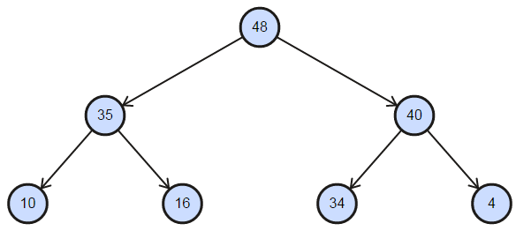
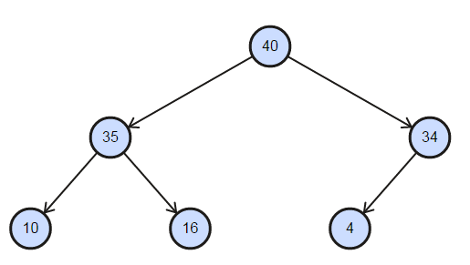
Example
See the figure, it’s a max heap
Here last node is 4
If we delete 48
Which node will become last node now?
In array?
In Linked allocation?
0 | 1 | 2 | 3 | 4 | 5 | 6
48 | 35 | 40 | 10 | 16 | 34 | 4
After deletion
0 | 1 | 2 | 3 | 4 | 5 | 6
40 | 35 | 34 | 10 | 16 | 4 | null

Slide 17
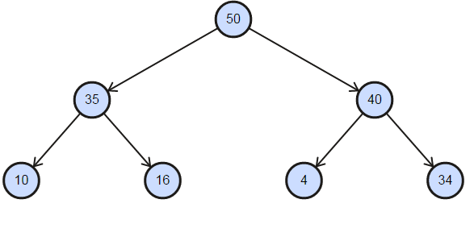
Example
Last node is 4
Insert 50
Which node will become last node now?
In array?
In Linked allocation?
Perform few more insertions and deletions
It will give you good understanding of last node
0 | 1 | 2 | 3 | 4 | 5 | 6
40 | 35 | 34 | 10 | 16 | 4 | null
After insertion
0 | 1 | 2 | 3 | 4 | 5 | 6
50 | 35 | 40 | 10 | 16 | 4 | 34

Slide 18
Applications
Priority Queue
Heap data structure is mainly as priority queue, often they are used as synonyms
Highest priority is always on top.
Time complexity of binary tree depends upon height of tree which is equivalent to logN. Where N is total number of nodes.
What can be heap tree’s worst case?
Data Structure | FindMin | Add | Remove
Unsorted Array | O(n) | O(1) | O(n)
Sorted Array | O(1) | O(n) | O(1)
Unsorted List | O(n) | O(1) | O(n)
Sorted List | O(1) | O(n) | O(1)
Heap | O(1) | O(log n) | O(log n)

Slide 19
Applications
Heapsort
Heap tree can also be used to sort a list of numbers
How?
Build the heap tree from given list
Reconstruct list by repeatedly doing the following:
Remove min and put in list until tree becomes empty
Time Complexity? O(nlogn)
Remove min→ logn
Total number of nodes→n

Slide 20
Applications
Selection Algorithms
Finding kth minimum or maximum number from list? Depends upon structure?
Insertion?
Data Structure | Find | Insert
Unsorted List | O(n) | O(1)
Sorted List | O(1) | O(n)
Heap | O(1) | O(log n)

Slide 21
HomeWork-3
Book Problems:
9.24
9.25
9.26

