Slide 1
Graphs
CSC-114 Data Structure and Algorithms

Slide 2
Outline
Non-Linear Data Structures
Graphs
Intro
Application
Terminologies
Representation
Adjacency List
Adjacency Matrix

Slide 3
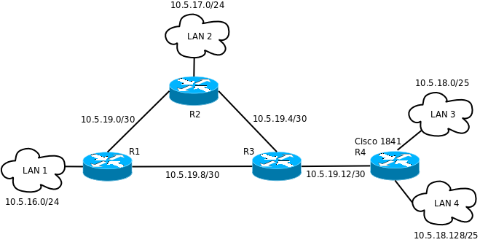
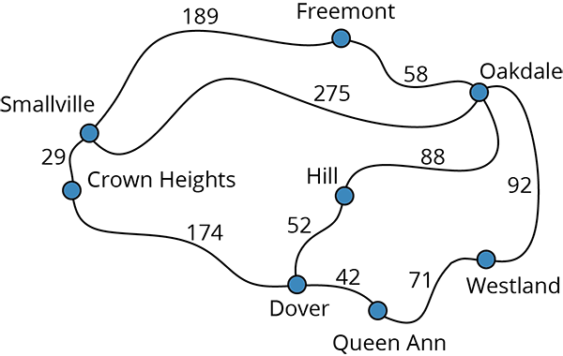
Graph
A graph is a way of representing relationships between pairs of objects.
It is a set of objects, called vertices, together with a collection of pairwise connections between them, called edges

Slide 4
Graph
Graph is a mathematical structure that is defined as G= (v, e), where v is a set of vertices{v₁, v₂, …v_{n}} and e is a set of edges {e₁,e₂,e₃,…e_{m}}
Where edge e is an ordered pair of two vertices, represents a connection between two vertices
Graph can be directed, or undirected
Example:
V = {A, B, C, D, E, F, G}
E = { {A, B}, {A, D}, {A, E}, {B, C}, {B, D}, {B, E}, {C, E}, {C, F}, {D, E} }
Then the graph G=(V,E) is:
|V|= 7
|E|=9
B
B
A
A
C
C
D
E
F
G
D
E
F
G

Slide 5
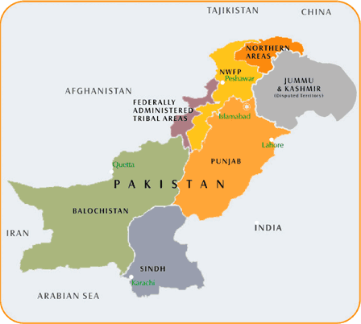
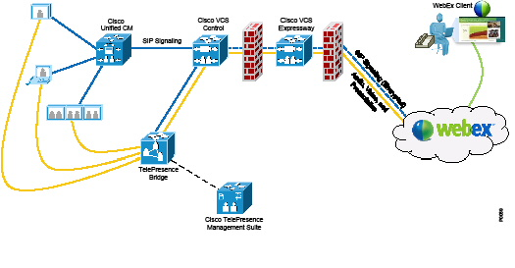

Applications
Maps
Communication Networks Social networks

Slide 6
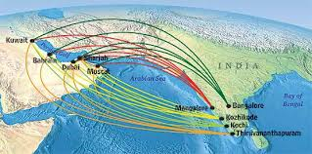
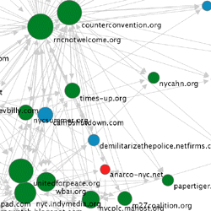

Applications
Flight routes
Web graphs Maze (games)

Slide 7
Terminologies
Directed Graph
Also called digraph
Every edge has a direction, an incoming edge is not equal to outgoing edge
Vertex order is important
Un-Directed Graph
Edge has no direction and considered as two-ways
Vertex order is not important
V
U
X
Z
W
Y

Slide 8
Terminologies
End Points
Vertices at both ends of an edge
Incident Edge
If vertex is an end point of edge, edge is incident on that vertex
a is incident on u and v
Adjacent/Neighbor Vertices
Vertices that are end points of same edge
u, v and w are adjacent
Self Loop
Node connected to itself
Z is in self loop and j is self edge
Degree of Node
Number of incident edges
U has degree 2, X has degree 5
Self edge is considered twice, so z has degree 4
Parallel Edges
Edges with same end points
h and i are parallel edges
V
a
b
h
d
U
X
Z
j
c
e
i
S
W
g
f
Y

Slide 9
Terminologies
In a directed graph we can distinguish between
Incoming Edges
Directed edges for which the given vertex is destination
c is incoming edge of U
Outgoing Edges
Directed edges for which the given vertex is origin
a is outgoing edge of U
In-Degree of Vertex
Number of incoming edges
Out-Degree of Vertex
Number of outgoing edges
Source Vertices
Vertices with an in-degree of zero
w is source vertex
Sink Vertices
Vertices with an out-degree of zero
v is sink vertex
V
a
b
h
d
U
X
Z
c
e
i
W
g
f
Y

Slide 10
Terminologies
Path
A path between two vertices is sequence of alternating vertices and edges, where each successive vertex is connected.
V
V
U
X
Z
U
X
Z
W
W
Y
Y

Slide 11
Terminologies
Simple Path
A path with distinct nodes
One of the possible paths from u to v is u-w-v
Cycle
A path that starts and finish at same vertex
V
V
U
X
Z
U
X
Z
W
W
Y
Y

Slide 12
Terminologies
Reachability of Vertex
A vertex is v reachable from other vertex if there exists a path from other vertex to vertex v
In undirected graph, edge is considered as 2-ways, so every vertex is reachable in following example.
U , V and X are not reachable from Z all vertices are reachable from each other
V
V
U
X
Z
U
X
Z

Slide 13
Terminologies
Connected Graph
Each vertex is reachable from every other vertex, in other words there exists a path from each vertex to every other vertex
Disconnected Graph
A graph that is not connected
V
V
U
X
Z
U
X
Z

Slide 14
Terminologies
Strongly Connected Graph
If there exists a directed path between each pair of vertices
Weakly Connected Graph
If there exists a path between each pair of vertices which ignores direction
V
V
U
X
Z
U
X
Z

Slide 15
Terminologies
Completely Connected Graph
If there exists an edge between each pair of vertices
Directed
Maximum Edges?
|E|=|V|*|V-1| =O(|V|²)
Undirected
Maximum Edges
|E|=|V|*|V-1|/2= O(|V|²)
V
V
U
X
U
X
X

Slide 16
Terminologies
Sub Graph
A graph that is consists of subset of vertices and edges of G
Two possible sub-graphs
Following is not valid sub-graph of G, why?
Look at definition of sub-graph
V
U
X
Z
V
U
X
Z
U
X
U
X
Z

Slide 17
Terminologies
Simple Graph
A graph with no parallel and self edges
V
U
X
Z

Slide 18
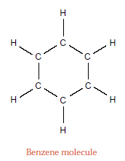
Terminologies
Weighted Graph
Weights on edge means cost or distance between end points of edge
Non-Weighted Graph

Slide 19
Terminologies
Path Length
Sum of weights of edges on path from one vertex to other.
Length of path between u and w is 2
Length of path between u and y is 3
There are two paths from u to x
Path u-w-x has length 6 and path u-w-y-x has length 5
Shortest Path
Path with minimum length
From u to x is 5
From u to v is 4
V
1
2
2
2
U
X
Z
2
4
1
W
2
1
Y

Slide 20
Terminologies
Tree
An undirected graph G is tree if it fulfills any of the following condition:
G has V-1 edges and no cycles
G has V-1 edges and is connected
G is connected, but removing any edge disconnects it
G is acyclic, but adding any edges creates a cycle
Exactly one simple path between each pair of vertices in G
V
V
U
X
Z
U
X
Z

Slide 21
Terminologies
Directed Acyclic Graph (DAG)
Directed graph without cycles
Following graph is not DAG, as it contains a cycle
V
U
X
Z
V
U
X
Z

Slide 22
Terminologies
Directed Acyclic Graph (DAG)
A directed graph without cycles
Applications:
The parse tree constructed by a compiler to execute sequential statements
Dependency graphs for task scheduling
Dependency graphs between classes formed by inheritance relationships in object-oriented programming languages
Information categorization systems, such as folders in a computer
Course pre-requisites
B
D
A
C
E
CS16
CS141
CS242
CS15
CS17
CS18
CS32
CS123
CS224

Slide 23
Graph ADT
Common methods for Graph ADT can be:
numVertices()
vertices()
numEdges()
edges()
outgoingEdges(v)
incomingEdges(v)
getEdge(v1, v2)
endVertices(e)
opposite(v, e)
insertVertex(value)
insertEdge(v1, v2, value)
removeVertex(v)
removeEdge(e)
Run time depends upon underlying implementation

Slide 24
Memory Representation
There are multiple ways to represent a graph in memory:
Adjacency Matrix
Adjacency List
Edge List
Adjacency Map
Assume following example for all representations
V1
V3
V5
V2
V4

Slide 25
Adjacency Matrix
The adjacency matrix of a graph G = (V, E) is a |V | × |V | matrix E, where each entry E_{ij} is equal to 1 if there exists an edge e = (vi, vj ) ∈ E and 0 otherwise.
1 and 0 can also be replaced with true/false.
Vertex list itself is stored in 1D array
0 | 1 | 2 | 3 | 4
“V1” | “V2” | “V3” | “V4” | “V5”
 | V1 | V2 | V3 | V4 | V5
V1 | 0 | 1 | 1 | 0 | 0
V2 | 1 | 0 | 1 | 1 | 0
V3 | 1 | 1 | 0 | 1 | 1
V4 | 0 | 1 | 1 | 0 | 1
V5 | 0 | 0 | 1 | 1 | 0
V1
V3
V5
V2
V4

Slide 26
Adjacency Matrix
If graph is directed?
Then entry E_{ij} is equal to 1 if there exists an edge e = from vi to vj and 0 otherwise.
Weighted Graph:
1 and 0 are replaced with respective weights
0 or -1 presents no edge
 | V1 | V2 | V3 | V4 | V5
V1 | 0 | 1 | 1 | 0 | 0
V2 | 0 | 0 | 1 | 0 | 0
V3 | 0 | 0 | 0 | 1 | 1
V4 | 0 | 1 | 0 | 0 | 0
V5 | 0 | 0 | 0 | 1 | 0
V1
V3
V5
V2
V4

Slide 27
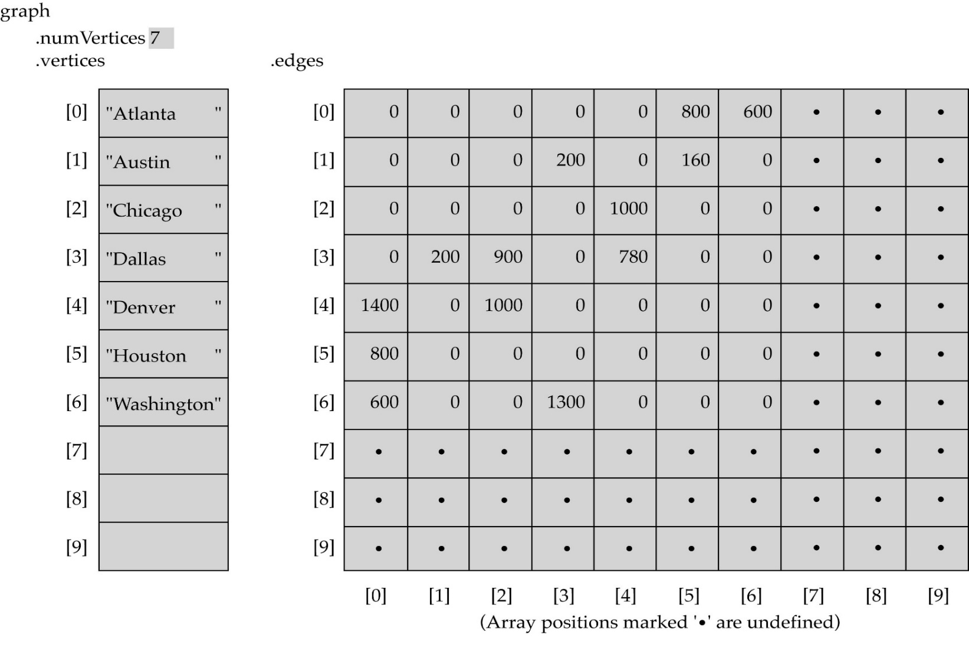
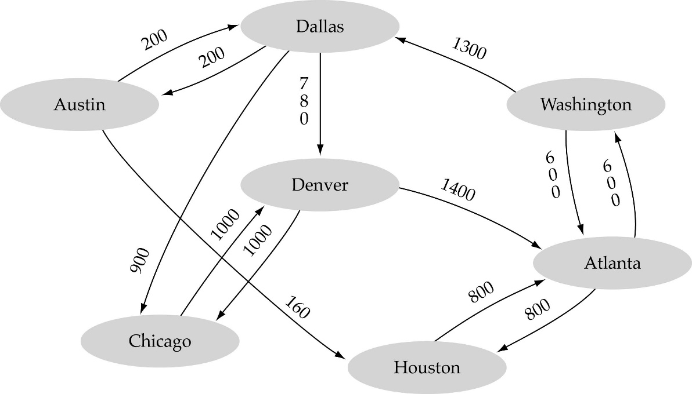
Example

Slide 28
Example
If vertices labels can be used as index, then separate 1D array is not needed to store them, edge matrix would be enough.
 | 0 | 1 | 2 | 3 | 4
0 | 0 | 1 | 1 | 0 | 0
1 | 0 | 0 | 1 | 0 | 0
2 | 0 | 0 | 0 | 1 | 1
3 | 0 | 1 | 0 | 0 | 0
4 | 0 | 0 | 0 | 1 | 0
0
2
4
1
3

Slide 29
Adjacency Matrix
Vertex list and Edge list are given
Running Time?
Get a vertex’s out-edges
Get a vertex’s in-edges
Decide if some edge exists
Insert an edge
Delete an edge
Inset a vertex
Remove a vertex
Memory
O(|V|²)
Good for?
Dense graphs
Edges are close to |V|²
0 | 1 | 2 | 3 | 4
“V1” | “V2” | “V3” | “V4” | “V5”
 | V1 | V2 | V3 | V4 | V5
V1 | 0 | 1 | 1 | 0 | 0
V2 | 0 | 0 | 1 | 0 | 0
V3 | 0 | 0 | 0 | 1 | 1
V4 | 0 | 1 | 0 | 0 | 0
V5 | 0 | 0 | 0 | 1 | 0

Slide 30
Adjacency List
Each vertex is associated with its list of connected vertices.
There can be different ways to implement it. Simplest one is using vertex numbers as array index, where each index would hold a pointer to linked list of connected vertices.
0
1
2
0
2
1
0
2
3
4
2
0
2
3
4
1
3
3
1
2
4
4
2
3

Slide 31
Adjacency List
Another idea can be to store edges list inside of vertex and storing vertices in array.
Edge list then can be a list of vertices itself or list of indices of connected vertices
It also can be label of vertices
Here edge list is storing indicies
1
“V1”
2
3
2
“V2”
1
3
4
V1
V3
3
“V3”
1
2
4
5
V5
4
“V4”
2
3
5
V2
V4
5
“V5”
3
4

Slide 32
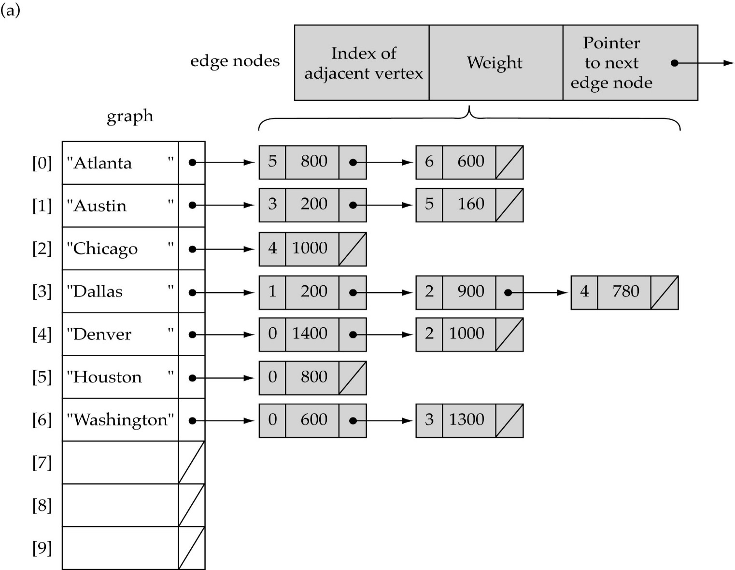

Slide 33
Adjacency List
Running Time?
Get a vertex’s out-edges
Get a vertex’s in-edges
Decide if some edge exists
Insert an edge
Delete an edge
Inset a vertex
Remove a vertex
Memory
O(|V|+|E|)
Good for?
Sparse
Edges are significantly less than |V|²
1
“V1”
2
3
2
“V2”
1
3
4
3
“V3”
1
2
4
5
4
“V4”
2
3
5
5
“V5”
3
4

