Slide 1
Digital Image Processing CCS331
Image Interpolation

Slide 2
Summery of previous lecture
Why and when, do we need image interpolation and image resampling.
Interpolation operation
Algorithms for different image transformations and the needed interpolation operations.

Slide 3
Todays lecture
Image Interpolation explanation
Interpolation operation
Unitary matrix and its equation

Slide 4
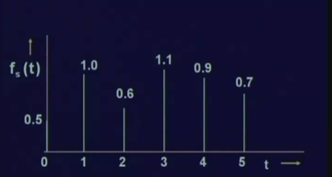
sample values of 1 dimensional
We need have to approximate the value of the function f (t) at any arbitrary point in the time axis. Which is the interpolation operation

Slide 5
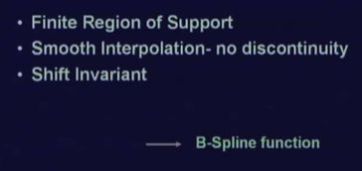
Properties of the interpolation
B spline function satisfies all these 3 properties we need

Slide 6



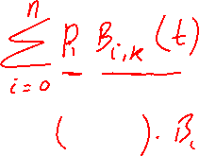









Slide 7










Slide 8
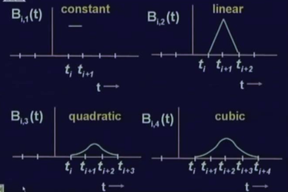
Nature of B spline functions
The region of support for this cubic function is 5 points
The region of support for quadratic function is 4 points
The region of support for the linear B spline is 3 points
The region of support for 1 is 2 points.
In all cases, the region of support is finite.

Slide 9
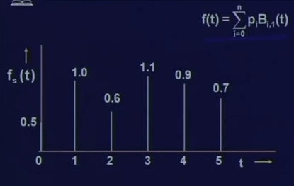




interpolation

Slide 10
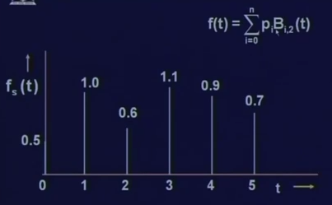



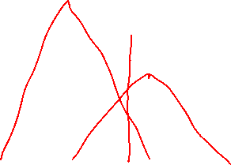




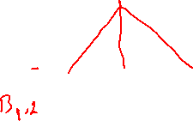



Interpolation

Slide 11
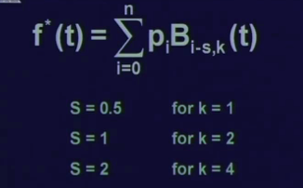
Changes in interpolation formula

Slide 12
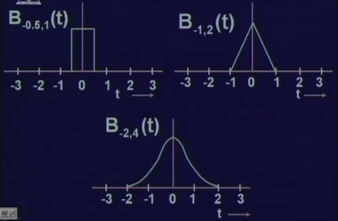

Slide 13
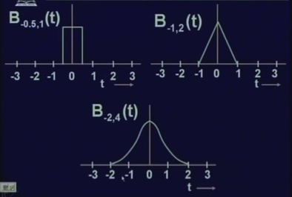
Change in shift

Slide 14
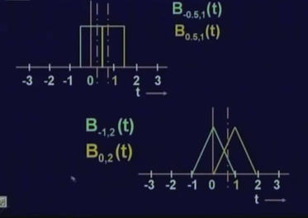
interpolating the function

Slide 15
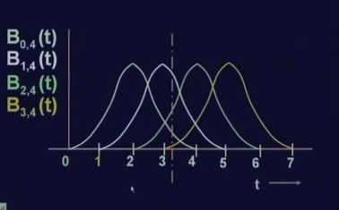
interpolating the function

Slide 16
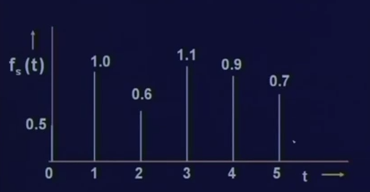









Slide 17

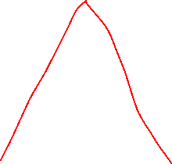


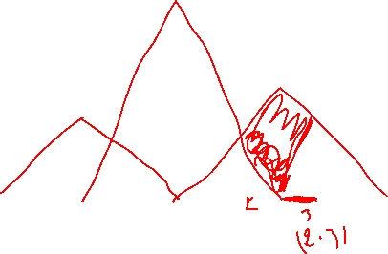


Slide 18



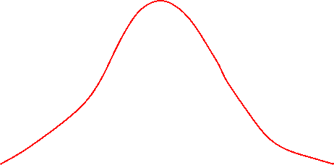

Slide 19









Slide 20


















Slide 21
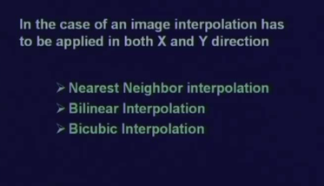
Image interpolation

Slide 22
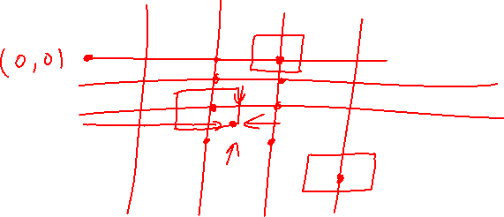


Slide 23

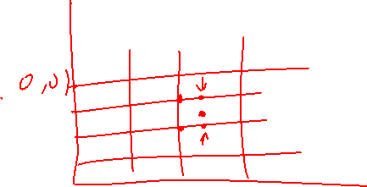

Slide 24
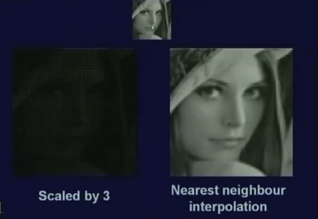
Results, constant interpolation

Slide 25
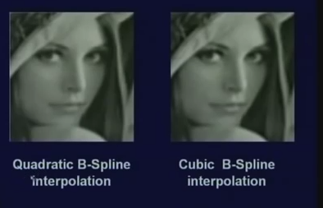
Results, constant interpolation

Slide 26
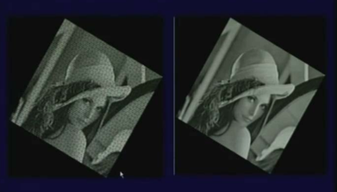
Results, cubic

Slide 27
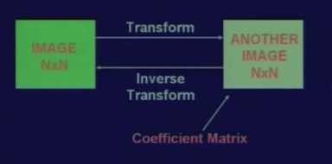
Image transformation

Slide 28
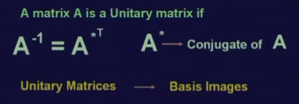
Unitary matrix
By image transformation, a given image is represented as a series summation of a set of unitary matrices.
matrix A is a unitary matrix if A inverse is equal to A star transpose where A star is the complex conjugate of A.
And these unitary matrices, we will call as the basis images.

Slide 29







Slide 30










Slide 31











Slide 32








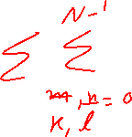





Slide 33
Summery of the lecture
Image Interpolation explanation
Interpolation operation
Unitary matrix and its equation

Slide 34
References
Prof .P. K. Biswas Department of Electronics and Electrical Communication Engineering Indian Institute of Technology, Kharagpur
Gonzalez R. C. & Woods R.E. (2008). Digital Image Processing. Prentice Hall.
Forsyth, D. A. & Ponce, J. (2011).Computer Vision: A Modern Approach. Pearson Education.

