Slide 1
Digital Image Processing CSC331
Image transformation

Slide 2
Summery of previous lecture
Image Interpolation explanation
Interpolation operation
Unitary matrix and its equation
Unitary matrix with 1D signal
Unitary matrix with 2D signal

Slide 3
Todays lecture
Analyze the computational complexity of image transform operations
The separable transformation
computational complexity reduction of the separable transformation

Slide 4












Slide 5
Spline function??
In image processing, a spline function is a mathematical function used for interpolating or smoothing a set of data points. Spline functions are widely used in image processing and computer graphics because they provide a flexible way to approximate complex shapes or curves.
A spline function is defined by a set of control points, which are used to determine the shape of the curve. The spline function passes through the control points, and the shape of the curve between the control points is determined by a set of interpolation or approximation rules.
There are several types of spline functions used in image processing, including cubic splines, B-splines, and Bezier curves. Cubic splines are the most commonly used spline functions in image processing, as they are simple to compute and provide a good balance between smoothness and accuracy.
Cubic spline functions are defined by a set of control points, which are used to construct a piecewise cubic function that interpolates the control points. The cubic function is constructed so that it is smooth at each control point, with continuous first and second derivatives. This ensures that the resulting curve is smooth and has no sharp corners or discontinuities.
Spline functions are used in a wide range of image processing applications, such as image registration, image segmentation, and image smoothing. They can be used to interpolate missing or noisy data, to create smooth contours or boundaries around objects in an image, or to generate smooth curves for use in computer graphics or animation.

Slide 6





Slide 7













Slide 8









Slide 9










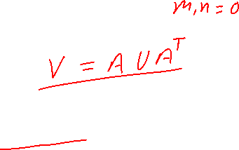

Slide 10



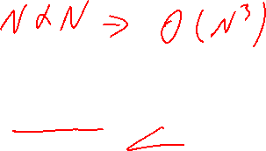







Slide 11
















Basis image

Slide 12










Slide 13






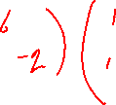








Slide 14


















Slide 15










Slide 16
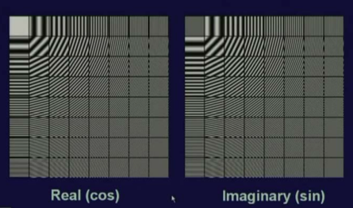
Discrete cosine trasformatine Basis Image
Basis images of dimension 8 by 8 in total 64 basis images.
One is the real component, other one is the imaginary component.

Slide 17
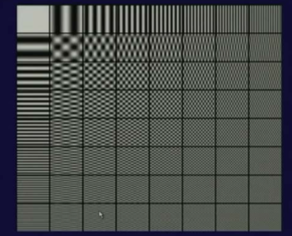
Discrete cosine trasformatine Basis Image
The row of this represents the index k
The column indicates the index l.
We have 64 images, each of these 64 images is of size 8 by 8 pixels.

Slide 18
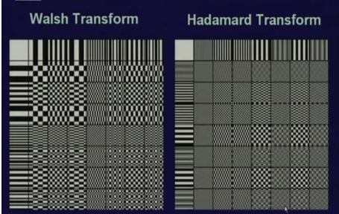
Basis images for other transformations
The purpose of showing these basis images is to represent an input image as linear combination of the set of basis images
Each of basis images will be weighted by the corresponding coefficient in the transformation coefficient v (k, l)
v (k, l) is the inner product of k, l’th basis image.

Slide 19
Summery of the lecture
Analyze the computational complexity of image transform operations
The separable transformation
computational complexity reduction of the separable transformation

Slide 20
References
Prof .P. K. Biswas Department of Electronics and Electrical Communication Engineering Indian Institute of Technology, Kharagpur
Gonzalez R. C. & Woods R.E. (2008). Digital Image Processing. Prentice Hall.
Forsyth, D. A. & Ponce, J. (2011).Computer Vision: A Modern Approach. Pearson Education.

