Slide 1
Digital Image Processing CSC331
Image Enchantement

Slide 2
Summery of previous lecture
Analyze the computational complexity of image transform operations
The separable transformation
computational complexity reduction of the separable transformation

Slide 3
Today's lecture
Necessity of image enhancement.
Image enhancement techniques broad categories.
One of the category is spatial domain operations In spatial domain operations,
point processing,
histogram based processing techniques
mask processing techniques
Frequency domain operations

Slide 4
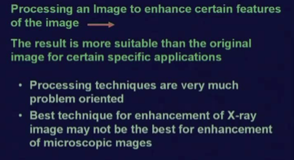
What is image enhancement?

Slide 5
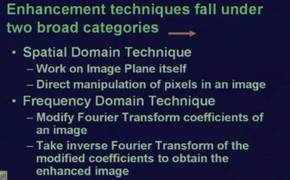
Types of image enchantement techniques

Slide 6

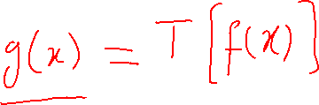




Slide 7
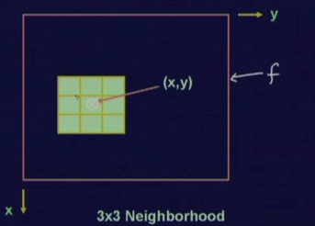
Neighborhood of the point (x, y)
point processing the transformation operator T operates at point (x, y) considering a certain neighborhood of the point (x, y)
neighborhood size of 3 by 3 around point (x, y).
Different applications, the neighborhood size may be different .
neighborhood size of 5 by 5, 7 by 7

Slide 8


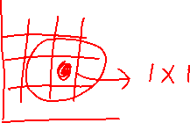

single pixel location

Slide 9
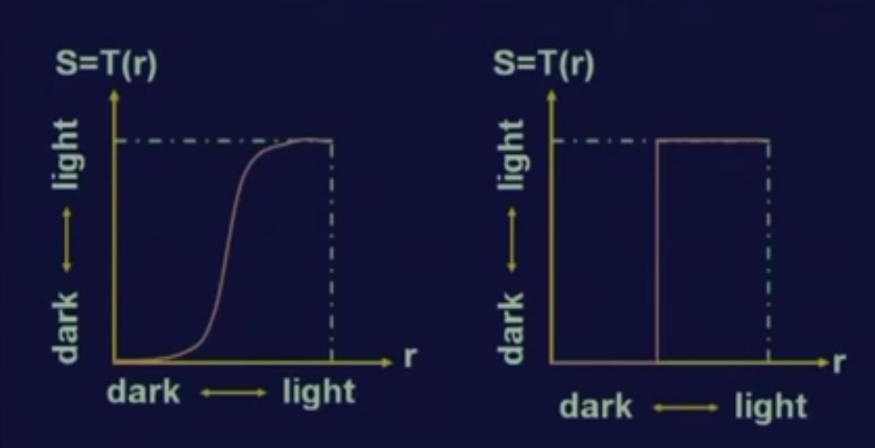
Point processing plotting
1x1 is also Threshold operation

Slide 10
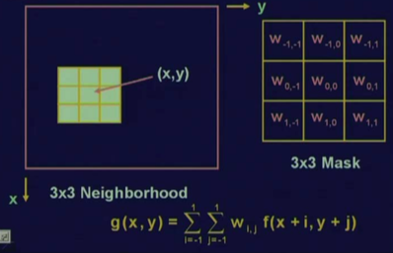
Mask operation
W _{I,j} are also called coefficients

Slide 11
coefficient values
Different point processing techniques are used according to its need
The coefficient values different (W values) in the mask determine the kind of image enhancement operations
image sharpening operation
image averaging operation
s enhancement operations
All of them depend upon the mask values that is the w ij present in this particular mask.

Slide 12
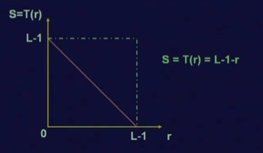



Negative image

Slide 13
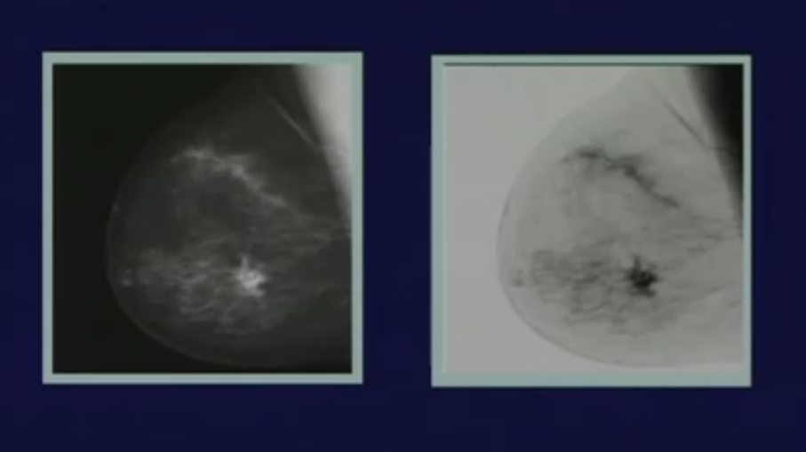


Result of Negative image

Slide 14
Contrast enhancement
Dark images
Various reasons
The object or scene illumination is poor
Dynamic range can not be capture by the sensor
The aperture of the lens of the camera not properly set

Slide 15
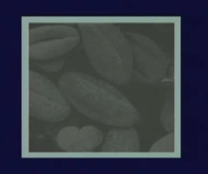
Low Contrast image

Slide 16
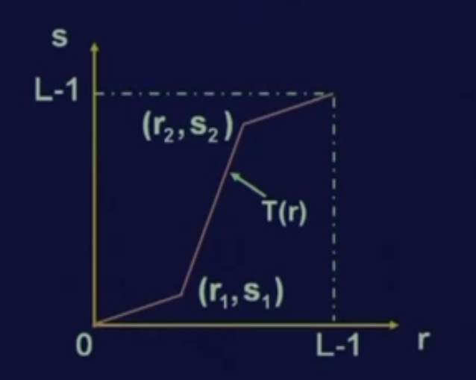

Transformation for contrast operation

Slide 17
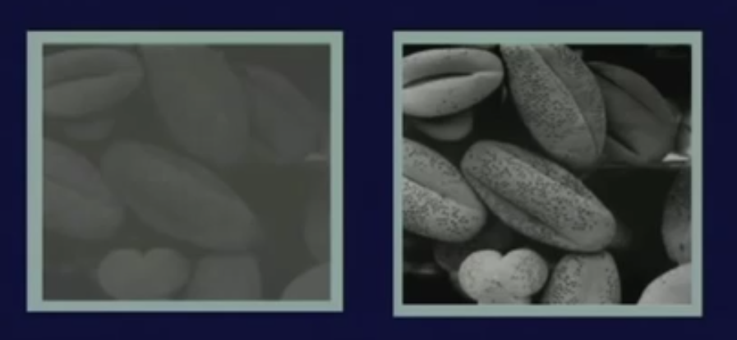
Result of contrast enhancement

Slide 18
Dynamic range enhancement
We need to reduce the dynamic range
An image with high dynamic range cannot be properly reproduced by some display device.
If a gray level display device uses bits to display intensity levels from 0 to 255 that is total 256 different intensity levels.
If the original image a minimum intensity value of id 0 and the maximum intensity value is 1048,
then the dynamic range of the original image is very high but my display device cannot take care of such a high dynamic range; so the display device will mostly display the highest intensity values and the lower intensity values will be in most of the cases suppressed.

Slide 19

Results reducing dynamic range

Slide 20
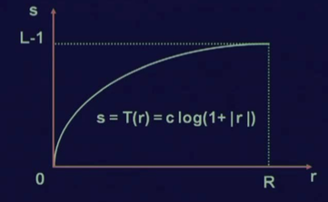
Compress the dynamic range by logarithmic transformation

Slide 21


Power law transformation
The power law transformation is normally used for different imaging devices.
It is used for image capturing devices, image printers and so on.
The transformation function between the original image, intensity and the processed image intensity is given by
s is equal to T (r) which is nothing but c into r to the power gamma.

Slide 22
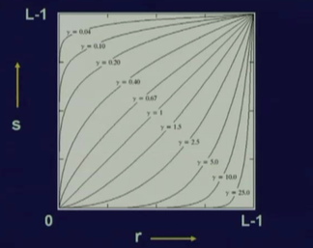
Different values of gamma where c is equal to 1

Slide 23
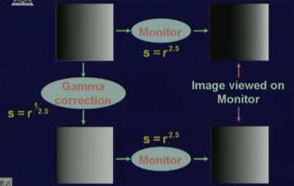
Gamma correction

Slide 24
Power law transformations as a images enhancing
The transformation curve gets various shapes depending upon different values of gamma
if the value of gamma is less than 1, then on the darker side, the lower range of intensity values will be mapped into a larger range of intensity values in the processed image whereas on the brighter side, a larger range of intensity values will be mapped into lower range of intensity values in the processed image and the reverse is true when gamma is greater than 1.

Slide 25
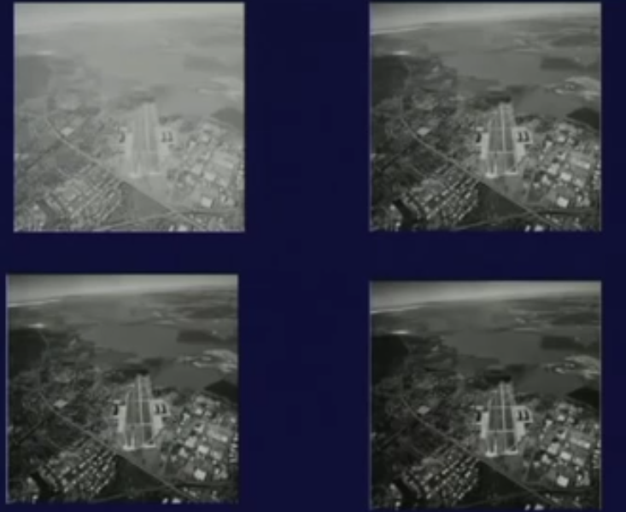
Power law transformations as a controlled enhancement

Slide 26
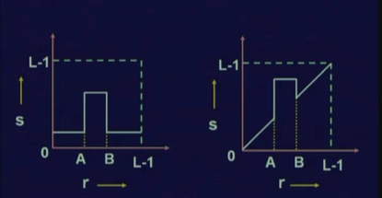
Gray level slicing

Slide 27
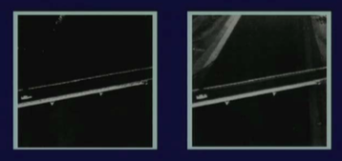
Results of gray level slicing

Slide 28
Summery of the lecture
Necessity of image enhancement.
Image enhancement techniques broad categories.
1: spatial domain operations
2: Frequency domain operations
point processing
Threshold operation
Mask operation
Negative image
Low Contrast image
reducing dynamic range
Power law transformation
Gray level slicing

Slide 29
References
Prof .P. K. Biswas Department of Electronics and Electrical Communication Engineering Indian Institute of Technology, Kharagpur
Gonzalez R. C. & Woods R.E. (2008). Digital Image Processing. Prentice Hall.
Forsyth, D. A. & Ponce, J. (2011).Computer Vision: A Modern Approach. Pearson Education.

