Slide 1
Digital Image Processing CSC331
Image Enhancement

Slide 2
Summery of previous lecture
Necessity of image enhancement.
Image enhancement techniques broad categories.
1: spatial domain operations
2: Frequency domain operations
point processing
Threshold operation
Mask operation
Negative image
Low Contrast image
reducing dynamic range
Power law transformation
Gray level slicing

Slide 3
Todays lecture
The global information of the image with the help of histogram
Histogram based techniques,
Histogram equalization
Histogram specification or also known as histogram matching or histogram modification

Slide 4












Slide 5
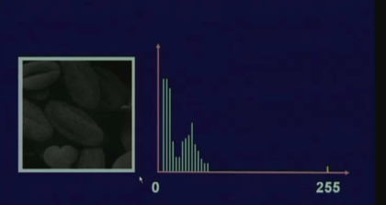
Dark image

Slide 6
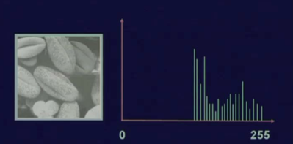
Bright Image

Slide 7
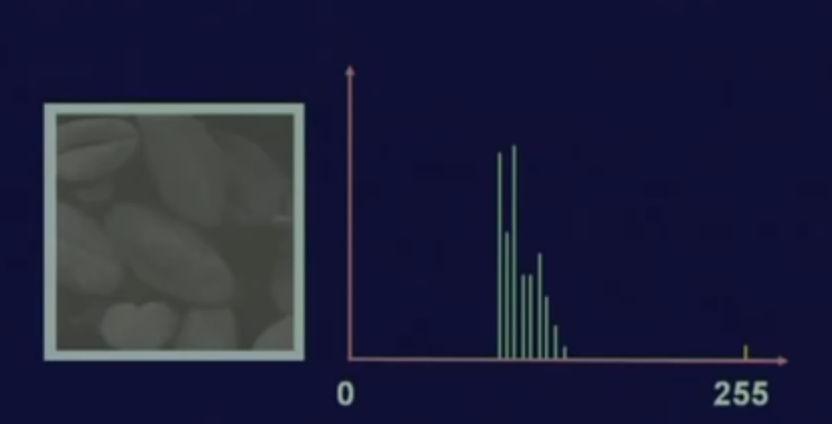
Low contrast image

Slide 8
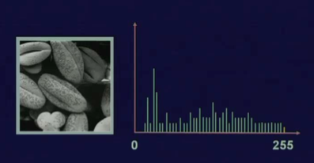
Equalized image

Slide 9
Histogram give us a global appearance of that particular image
histogram based techniques to modify the image
Histogram equalization operation
Histogram modification operation
How these histograms can be processed to enhance the images?

Slide 10

















Slide 11



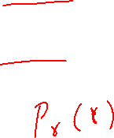













Slide 12













Slide 13





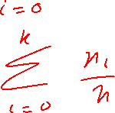






Slide 14
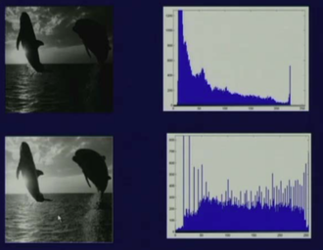
Histogram equalization

Slide 15
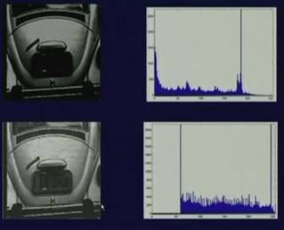
Histogram equalization

Slide 16
Limitation of Histogram equalization
whatever image the equalized image you get that is fixed. No interactive manipulation of the image.
For some certain region of the histogram, enhancement the we need histogram matching or histogram specification techniques.

Slide 17
















Slide 18





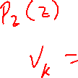






Slide 19
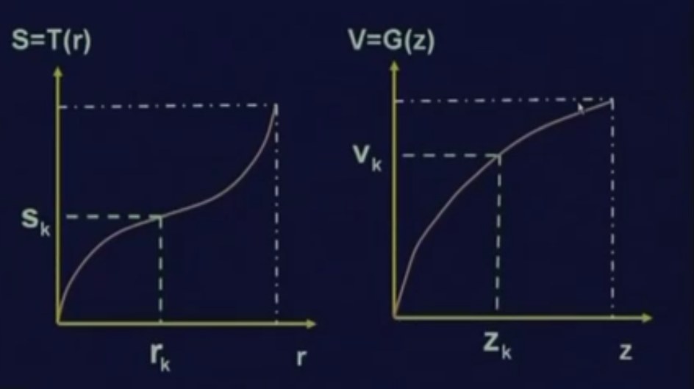
Histogram specification

Slide 20
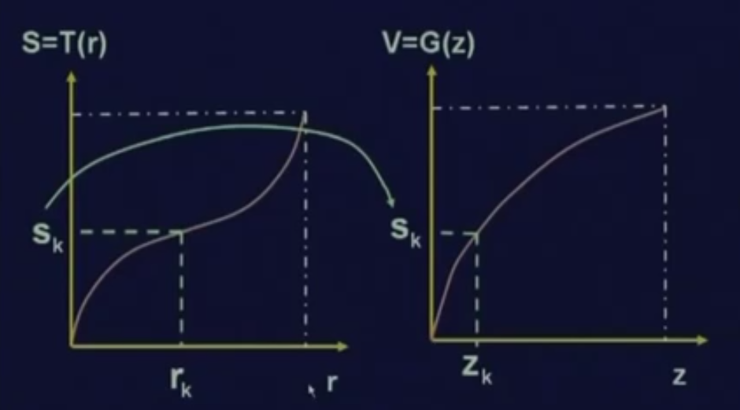
Histogram specification

Slide 21
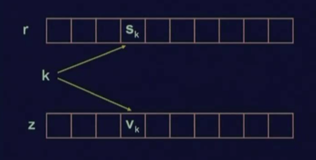
look of tables implementation

Slide 22








Slide 23
Summery of the lecture
The global information of the image with the help of histogram
Histogram based techniques,
Histogram equalization
Histogram specification or also known as histogram matching or histogram modification

Slide 24
References
Prof .P. K. Biswas Department of Electronics and Electrical Communication Engineering Indian Institute of Technology, Kharagpur
Gonzalez R. C. & Woods R.E. (2008). Digital Image Processing. Prentice Hall.
Forsyth, D. A. & Ponce, J. (2011).Computer Vision: A Modern Approach. Pearson Education.

