Slide 1
Digital Image Processing CSC331
Image Enhancement

Slide 2
Summery of previous lecture
The global information of the image with the help of histogram
Histogram based techniques,
Histogram equalization
Histogram specification or also known as histogram matching or histogram modification

Slide 3
Todays lecture
Image differencing
Averaging of the images
Mask processing
Linear smoothing operation

Slide 4




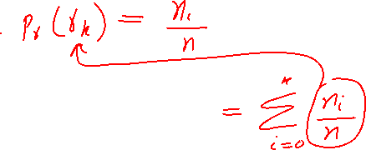



Slide 5











Slide 6
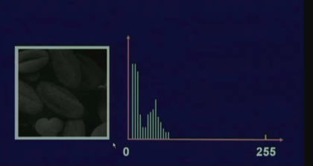
Dark image

Slide 7
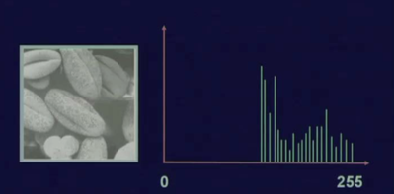

Bright Image

Slide 8
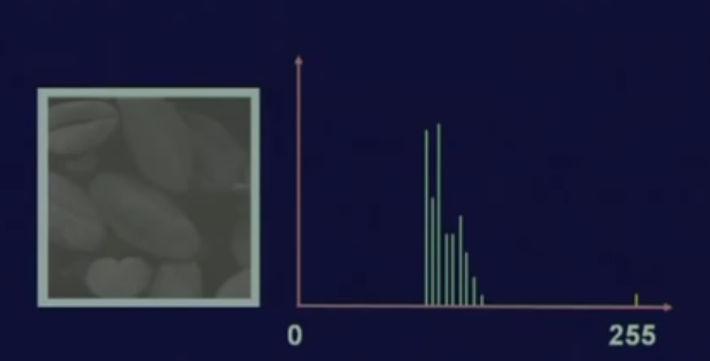
Low contrast image

Slide 9
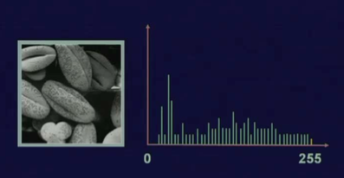
Equalized

Slide 10
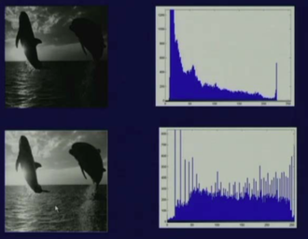
Histogram equalization

Slide 11
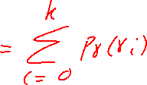





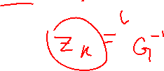



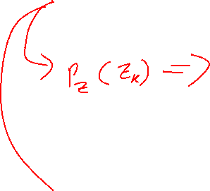


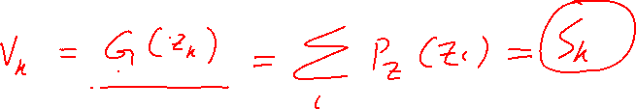








Slide 12
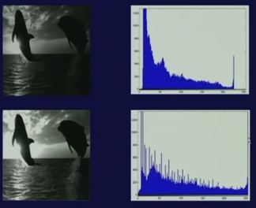
Histogram Specification

Slide 13
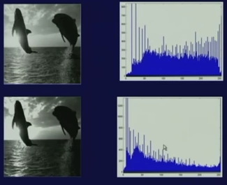
Histogram equalization and Histogram specification

Slide 14
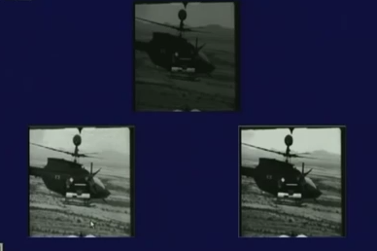

Histogram equalization and Histogram specification

Slide 15




Image differencing operation
Image differencing taking the difference of pixel values between 2 images

Slide 16
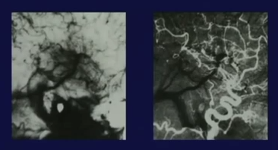
Image differencing

Slide 17










Averaging of the images
Possibility to reduce the noise of the image if the images are of the same scene also known as smoothing/blurring

Slide 18
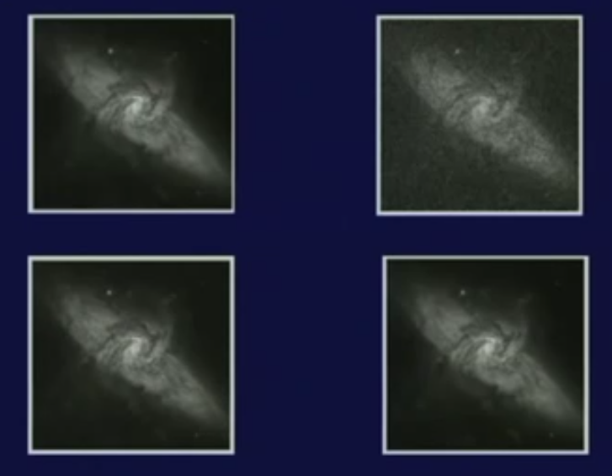
Image Averaging

Slide 19
Mask processing
A neighborhood of size more than 1, then the kind of operation that we are going to have that is known as mask processing operation.
Linear smoothing operation
Nonlinear operation (which is based on the statistical features of the image known as the median filtering operation)
The sharpening filter

Slide 20
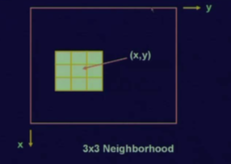
3 by 3 neighborhood around a pixel location (x, y)

Slide 21
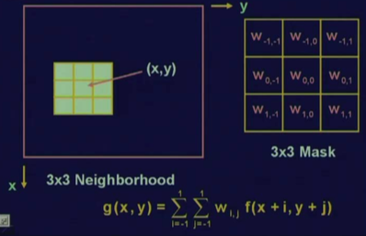
Mask operation
W _{I,j} are also called coefficients

Slide 22
Smoothing operation
image smoothing is also called the image averaging operation.
Is a special filtering operation where the value at a particular location (x, y) in the processed image is the average of all the pixel values in the neighborhood of x and y.
So, because it is the average, this is also known as averaging filter and later on we will see that this averaging filter is nothing but a low pass filter.

Slide 23
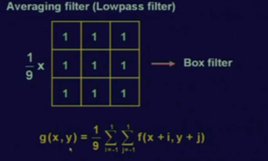
Image smoothing

Slide 24
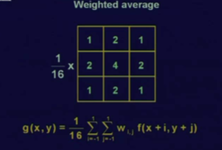

Smoothing spatial filter

Slide 25
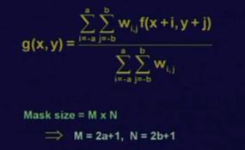
Smoothing spatial filter Expression

Slide 26
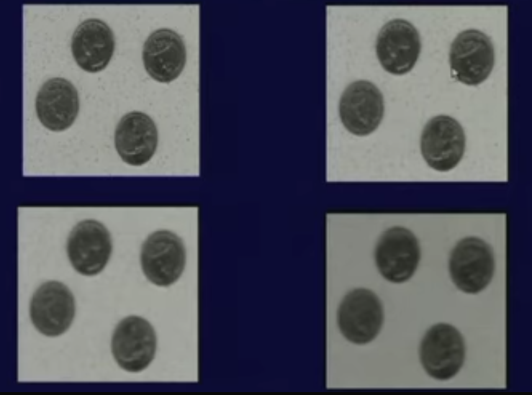
Spatial Low-pass Filter

Slide 27
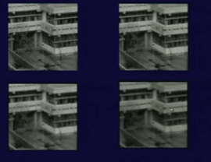
Spatial Low-pass Filter

Slide 28
Summery of the lecture
Image differencing
Averaging of the images
Mask processing
Linear smoothing operation

Slide 29
References
Prof .P. K. Biswas Department of Electronics and Electrical Communication Engineering Indian Institute of Technology, Kharagpur
Gonzalez R. C. & Woods R.E. (2008). Digital Image Processing. Prentice Hall.
Forsyth, D. A. & Ponce, J. (2011).Computer Vision: A Modern Approach. Pearson Education.

