Slide 1
Digital Image Processing CSC331
Image Enhancement

Slide 2
Summery of previous lecture
Image differencing
Averaging of the images
Mask processing
Linear smoothing operation

Slide 3
Todays lecture
Mask processing
Linear smoothing operation
Median filter
Sharpening spatial filter

Slide 4
Mask processing
A neighborhood of size more than 1, then the kind of operation that we are going to have that is known as mask processing operation.
Linear smoothing operation
Nonlinear operation (which is based on the statistical features of the image known as the median filtering operation)
The sharpening filter

Slide 5
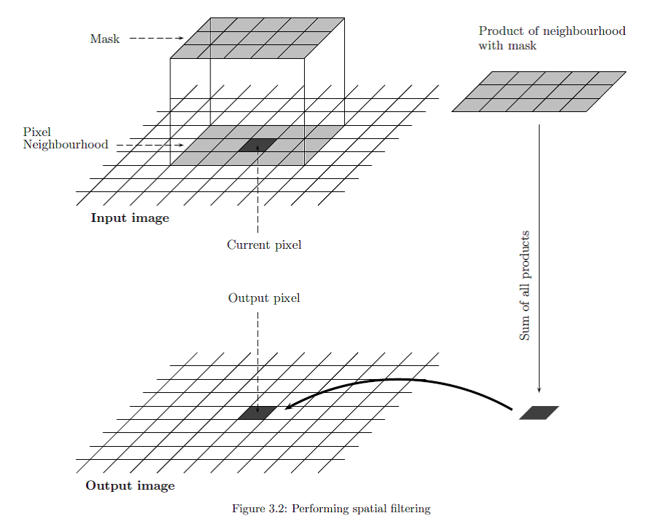
Mask use

Slide 6
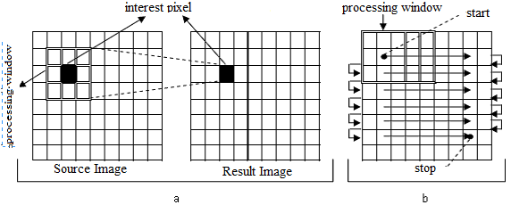

Mask process

Slide 7
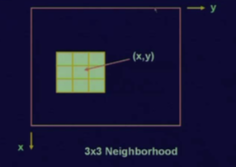
3 by 3 neighborhood around a pixel location (x, y)

Slide 8
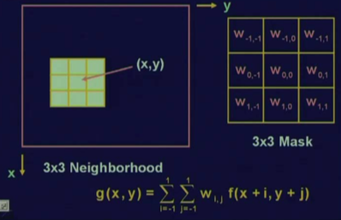

Mask operation
W _{I,j} are also called coefficients

Slide 9
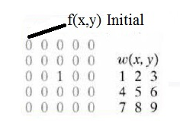
Example

Slide 10
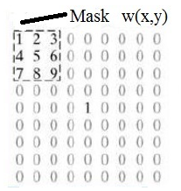


Slide 11
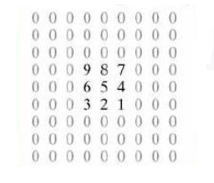


Slide 12
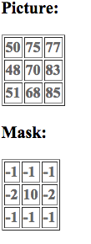
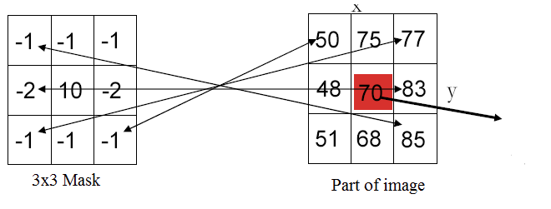
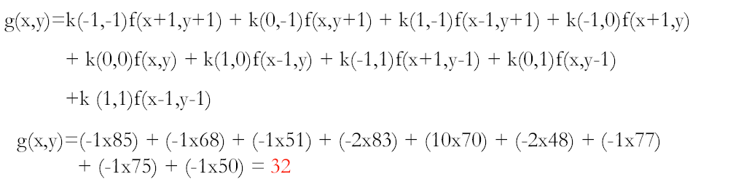

Slide 13
Smoothing operation
Image smoothing is also called the image averaging operation.
Is a special filtering operation where the value at a particular location (x, y) in the processed image is the average of all the pixel values in the neighborhood of x and y.
So, because it is the average, this is also known as averaging filter and later on we will see that this averaging filter is nothing but a low pass filter.

Slide 14
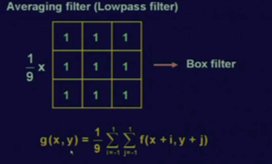
Image smoothing

Slide 15
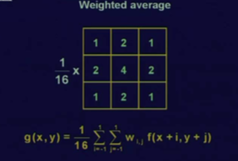
Filter to avoid the blur effect

Slide 16
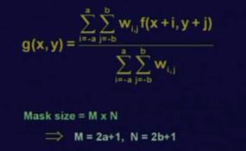
Smoothing spatial filter Expression

Slide 17
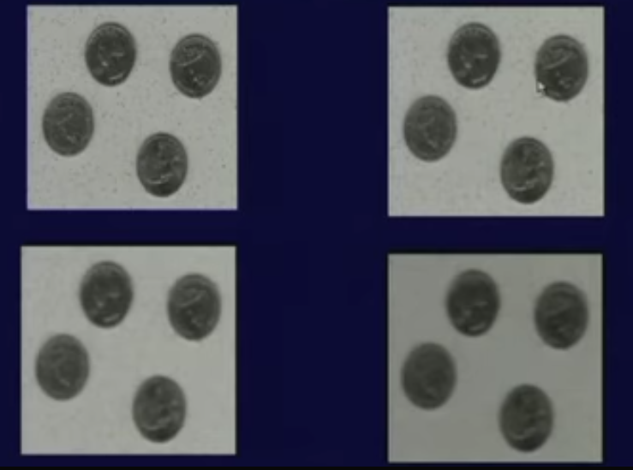

Spatial Low-pass Filter

Slide 18
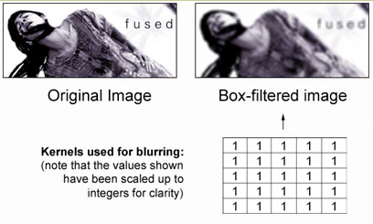
Spatial Low-pass Filter

Slide 19
Median filter
Non-Linear Filtering of Images
The median filter is conceptually similar to an averaging kernel.
An averaging kernel produces an output pixel g(i,j) that is the mean intensity of a neighborhood around f(i,j).
The output is simply the middle value of the sorted list.

Slide 20
The median filter is ideal for removing impulsive noise, sometimes referred to as "salt and pepper" or "shot" noise
This type of noise manifests itself as outlier pixel intensities, completely independent of signal content. Because of the need to sort the values within the sliding window,
The median filter can be quite costly to implement – however they are preferred to a smoothing filter in these cases because they are far better at preserving the edges in an image

Slide 21




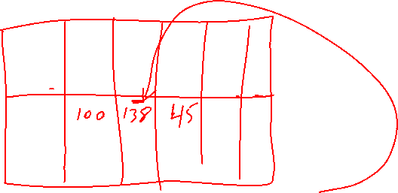

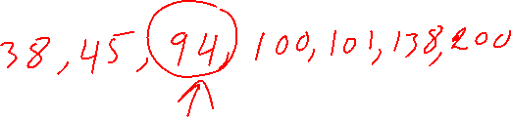


Slide 22
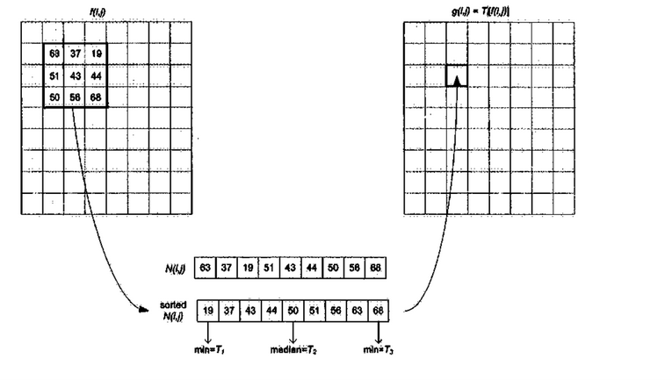
median filter process

Slide 23
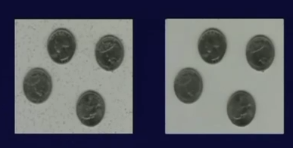

Slide 24
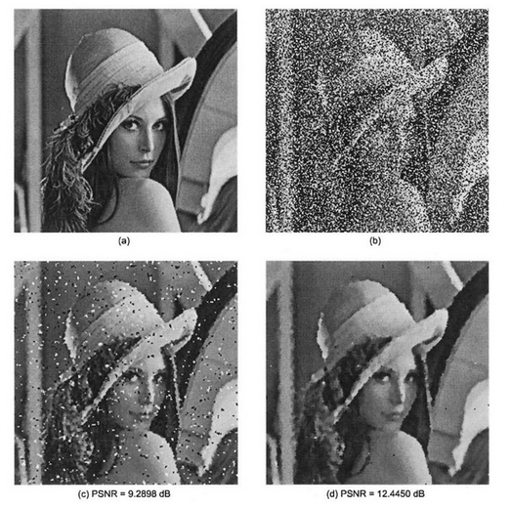
(a) Original image, (b) Lenna with 40% additive impulse noise, (c) Processed image using 3×3 median filter, (d) Processed image using 5×5 median filter.

Slide 25
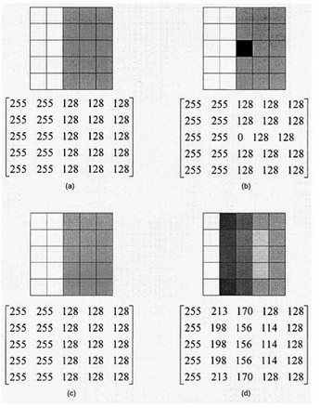

Comparison of a median filter vs an averaging filter

Slide 26
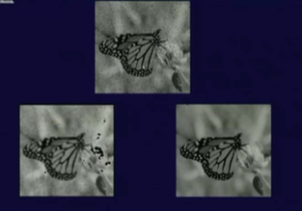

Comparison of a median filter vs an averaging filter

Slide 27
Sharpening spatial filter
By averaging over an image, then the image becomes blurred or the details in the image are removed. Now, this averaging operation is equivalent to integration operation.
So, integrate the image, we get blurring effect
The opposite differentiation operation or derivative operations , the sharpness of the image is likely to be increased.

Slide 28
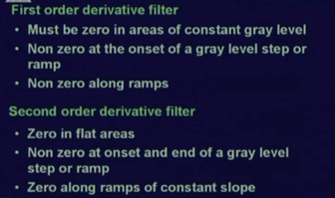

Types of derivatives

Slide 29
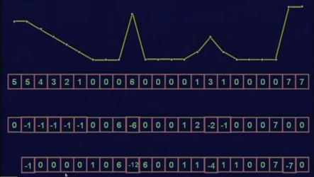




1st and 2nd order derivative response

Slide 30
Summery of the lecture
Mask processing
Linear smoothing operation
Median filter
Sharpening spatial filter

Slide 31
References
Prof .P. K. Biswas Department of Electronics and Electrical Communication Engineering Indian Institute of Technology, Kharagpur
Gonzalez R. C. & Woods R.E. (2008). Digital Image Processing. Prentice Hall.
Forsyth, D. A. & Ponce, J. (2011).Computer Vision: A Modern Approach. Pearson Education.

