Slide 1
Digital Image Processing CSC331
Image Enhancement

Slide 2
Summery of previous lecture
Mask processing
Linear smoothing operation
Median filter
Sharpening spatial filter

Slide 3
Box filter:
A box filter, also known as a box blur or a mean filter, is a type of image filter that is used for smoothing and noise reduction. It is a simple filter that replaces each pixel in an image with the average value of its neighboring pixels within a fixed window or kernel.
The box filter is called a "box" filter because the kernel used for filtering is typically a square or rectangular box-shaped matrix of equal weights. The size of the box determines the size of the kernel, and therefore the size of the window over which the averaging is performed.
The box filter works by averaging the pixel values within the kernel. This has the effect of smoothing out the image and reducing the amount of high-frequency noise or detail. The filter is often used as a pre-processing step for other image processing tasks, such as edge detection or segmentation, as it can help to remove noise and artifacts that might interfere with these tasks.

Slide 4
Cont.
The box filter is also computationally efficient, as it only requires simple arithmetic operations to compute the average value for each pixel. However, it does have some limitations. For example, it can blur edges and other important features in the image, and it may not be effective for removing all types of noise.
Overall, the box filter is a useful tool for basic image smoothing and noise reduction and is often used as a starting point for more advanced image processing tasks.

Slide 5
What is kernel?
A kernel (also known as a filter or mask) is a matrix of numbers that is used to apply a specific image processing operation to an image. The kernel is usually a small matrix of odd dimensions, such as 3x3, 5x5, or 7x7, and contains numerical values that determine the behavior of the filter.
When the kernel is applied to an image, each pixel in the image is replaced with a new value that is calculated based on the values of the surrounding pixels, as specified by the kernel. The size and shape of the kernel, as well as the values in the kernel matrix, determine the specific operation that is performed.
For example, in the case of a box filter (also known as a mean filter), the kernel contains a matrix of equal weights, and the operation involves replacing each pixel with the average value of its neighboring pixels within the kernel. In contrast, in the case of an edge detection filter such as the Sobel filter, the kernel contains a matrix of values that are designed to highlight edges in the image.
Kernels are an important tool in image processing because they allow a wide range of image processing operations to be performed, including smoothing, sharpening, edge detection, and noise reduction. By adjusting the size and values of the kernel, it is possible to achieve a wide range of image processing effects.

Slide 6
Todays lecture
1st and 2nd order derivatives
Laplacian filter
Unsharp masking and high-boost filtering

Slide 7
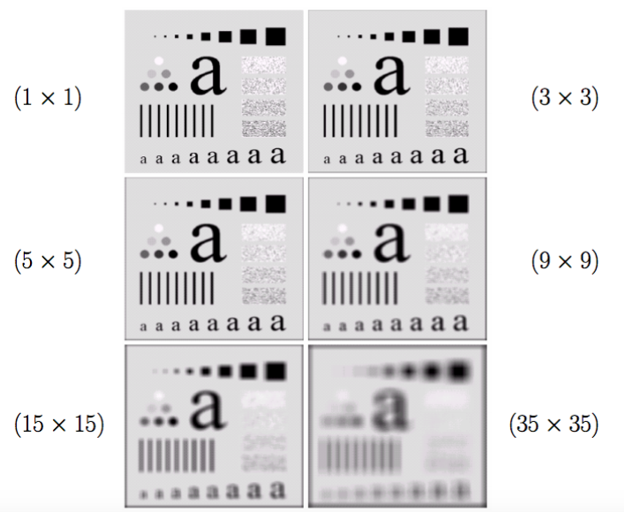
Smoothing linear filters with different mask size

Slide 8
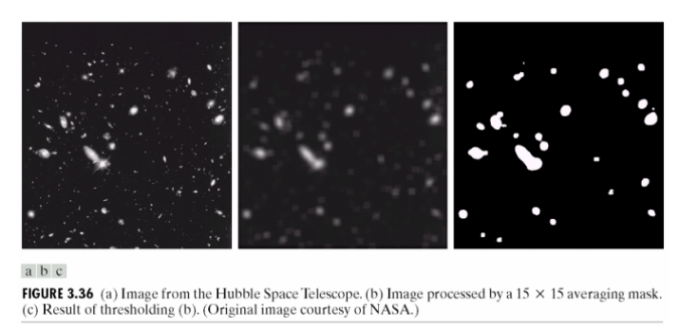

Slide 9
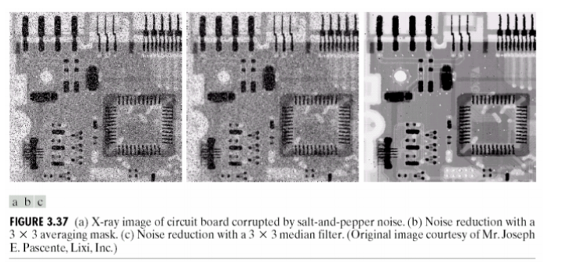
Salt-and-pepper noise

Slide 10
Sharpening
The term sharpening is referred to the techniques suited for enhancing the intensity transitions.
In images, the borders between objects are perceived because of the intensity change: more crisp the intensity transitions, more sharp the image.
The intensity transitions between adjacent pixels are related to the derivatives of the image.
Hence, operators (possibly expressed as linear filters) able to compute the derivatives of a digital image are very interesting

Slide 11
Sharpening spatial filter
By averaging over an image, then the image becomes blurred or the details in the image are removed. Now, this averaging operation is equivalent to integration operation.
The opposite differentiation operation or derivative operations will make the image sharp.
We need derivative operations

Slide 12
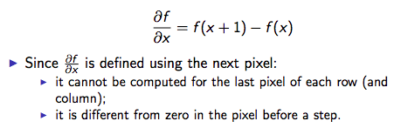
First derivative of an image
Since the image is a discrete function, the traditional definition of derivative cannot be applied.
Hence, a suitable operator have to be defined such that it satisfies the main properties of the first derivative:
1. it is equal to zero in the regions where the intensity is constant;
2. it is different from zero for an intensity transition;
3. it is constant on ramps where the intensity transition is constant.
The natural derivative operator is the difference between the intensity of neighboring pixels (spatial differentiation).

Slide 13
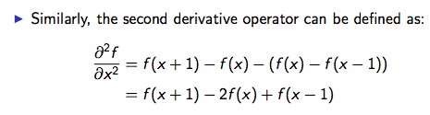
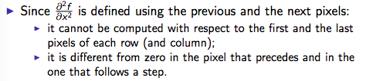
Second derivative of an image
This operator satisfies the following properties:
1. it is equal to zero where the intensity is constant;
2. it is different from zero at the begin of a step (or a ramp) of the intensity;
3. it is equal to zero on the constant slope ramps.

Slide 14
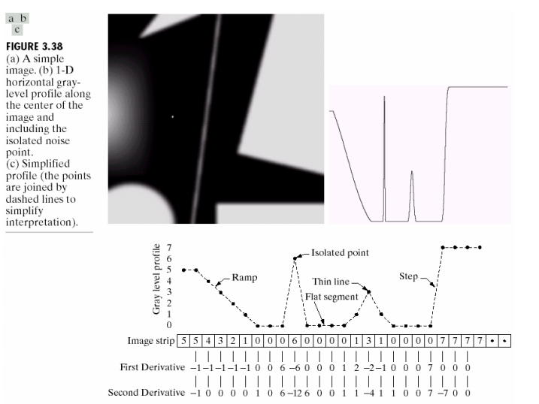

Slide 15
Observations
1st order derivatives produce thicker edges
2nd order derivatives have stronger response to finer details
1st order derivatives have stronger response to gray level step
2nd order derivatives produce double response to step changes
Both 1st and 2nd order derivatives produce negative pixel values
Shift output image for display
Some applications use only the absolute value
overall 2nd order is better for most of the cases

Slide 16
Laplacian operator
Usually, the sharpening filters make use of the second order operators.
A second order operator is more sensitive to intensity variations than a first order operator.
Besides, partial derivatives has to be considered for images
The derivative in a point depends on the direction along which it is computed.
Isotropic means no change in all directions. Anisotropic means change in values by rotation.
Operators that are invariant to rotation are called isotropic.
Rotate and differentiate (or filtering) has the same effects of differentiate and rotate.
The Laplacian is the simpler isotropic derivative operator (wrt. the principal directions):

Slide 17
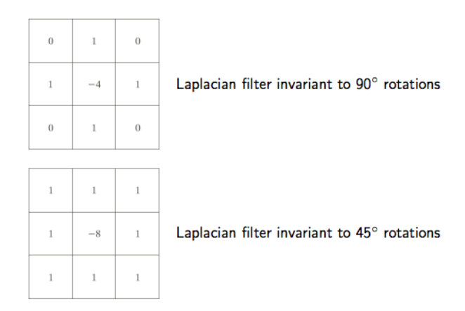
Laplacian filter

Slide 18
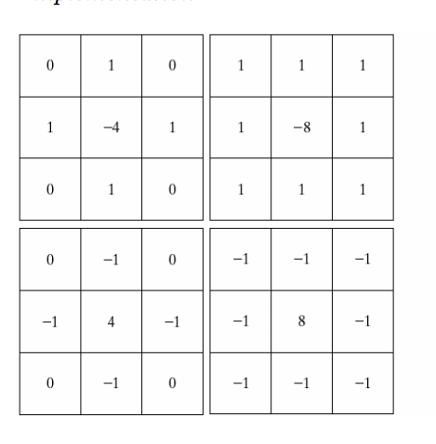

(a) and (c): Isotropic results for increments of 90º
(b) and (d): Isotropic results for increments of 45º

Slide 19

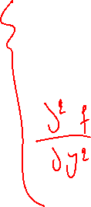
















Slide 20














Slide 21
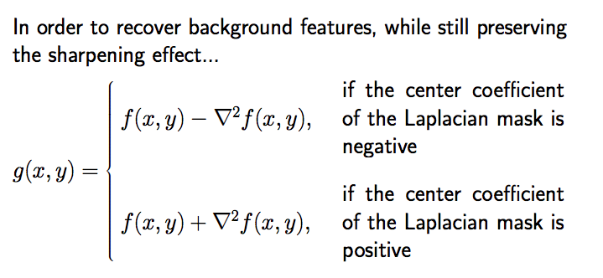

Slide 22
Background recovery:
Background recovery refers to the process of enhancing the low-frequency components of an image while suppressing the high-frequency components. This is useful for removing noise or artifacts in the image while preserving important features.
The Laplacian filter is a commonly used filter for background recovery in image processing. It is based on the Laplace operator, which is a second-order derivative operator that highlights areas of rapid change in pixel intensity.
The Laplacian filter can produce both positive and negative values, depending on the local contrast of the image. Positive values indicate areas where the pixel intensity is increasing rapidly, while negative values indicate areas where the pixel intensity is decreasing rapidly.
To understand how positive and negative values in the Laplacian filter can be used for background recovery, consider the following:
In areas of the image where the pixel intensity is changing slowly (i.e., low-frequency components), the Laplacian filter will produce values close to zero.

Slide 23
Why take negative or positive values?
In areas of the image where the pixel intensity is changing rapidly (i.e., high-frequency components), the Laplacian filter will produce positive or negative values, depending on the direction of the change.
By thresholding the Laplacian filter output to keep only the positive values, we can enhance the high-frequency components of the image while suppressing the low-frequency components. This is because the positive values correspond to areas of rapid change in pixel intensity, which are likely to be edges or other important features.
Similarly, by thresholding the Laplacian filter output to keep only the negative values, we can enhance the low-frequency components of the image while suppressing the high-frequency components. This is because the negative values correspond to areas of rapid decrease in pixel intensity, which are likely to be smooth areas or homogeneous regions.

Slide 24
Final comments on background recovery:
In summary, the positive and negative values produced by the Laplacian filter can be used for background recovery by thresholding the filter output to enhance or suppress different components of the image. The logical reason behind this is that the Laplacian filter highlights areas of rapid change in pixel intensity, which are often associated with important features in the image. By selectively enhancing or suppressing these areas, we can improve the overall quality of the image while preserving important information.

Slide 25
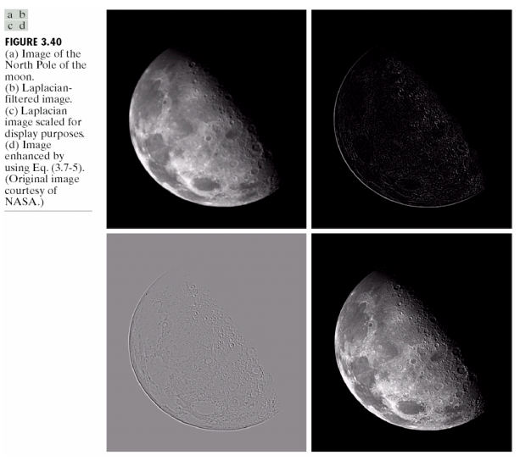

Slide 26
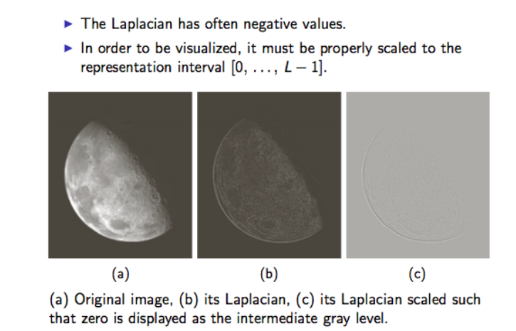

Slide 27
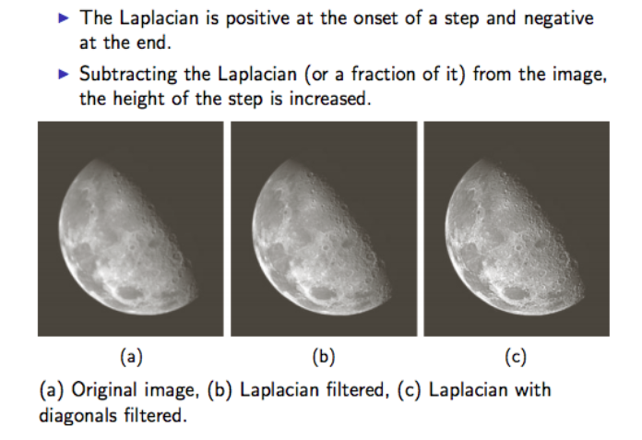

Slide 28
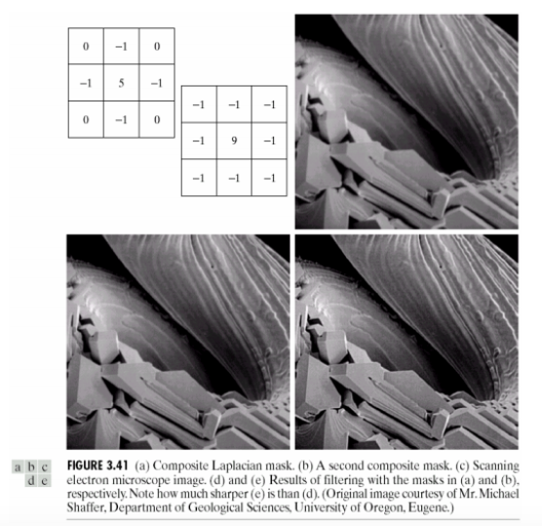

Slide 29
Unsharp masking and high-boost filtering
The technique known as unsharp masking is a method of common use in graphics for making the images sharper.
It consists of:
1. defocusing the original image;
2. obtaining the mask as the difference between the original image and its defocused copy;
3. adding the mask to the original image.

Slide 30














Slide 31











Slide 32
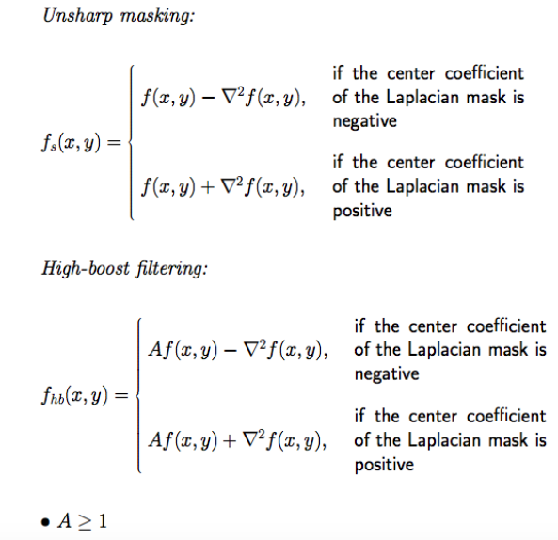


Slide 33
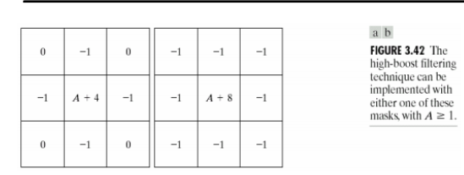
Mask of High Boost

Slide 34
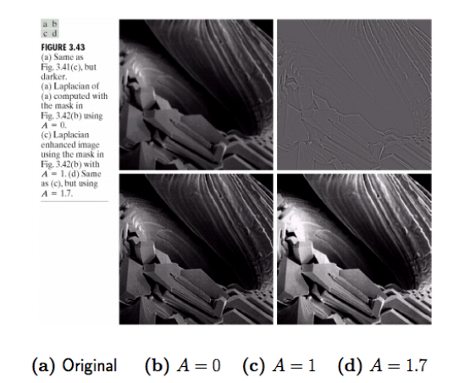


Slide 35
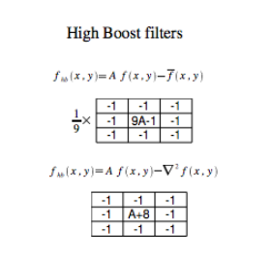

Slide 36
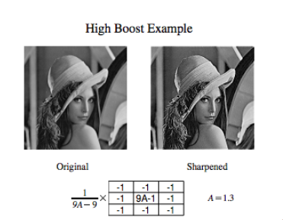

Slide 37
High & low boosting:
Low and high boost are two techniques used to enhance the details and edges in an image using the Laplacian filter.
The Laplacian filter is a second-order derivative filter that highlights areas of rapid change in pixel intensity, such as edges and corners. It is commonly used for edge detection and image sharpening.
Low boost is a technique that enhances the low-frequency components of an image, such as the smooth areas and large features, while preserving the high-frequency components, such as the details and edges. Low boost is achieved by adding a scaled version of the Laplacian filter output to the original image. The scaling factor determines the strength of the boost effect.
In low boosting, center element is negative, and neighbors are positive while high boosting is opposite. In the previous slide, matrix was high boost because center was positive!!

Slide 38
Cont.
High boost, on the other hand, is a technique that enhances the high-frequency components of an image, such as the edges and details, while suppressing the low-frequency components, such as the smooth areas and large features. High boost is achieved by subtracting a blurred version of the original image from the original image, and then adding a scaled version of the Laplacian filter output to the result. The size of the blur kernel and the scaling factor determine the strength of the boost effect.
In summary, low boost enhances the overall clarity and detail of an image, while high boost enhances the sharpness and edge definition. Both techniques can be useful for enhancing the visual impact of an image, depending on the specific application and desired effect.

Slide 39
Scaling:
scaling refers to the process of resizing an image by either enlarging or reducing its dimensions. Scaling can be performed for a variety of reasons, such as to fit an image into a specific space or to increase or decrease its resolution.
Scaling an image involves changing the number of pixels that make up the image. When an image is enlarged, new pixels are added to the image, which can result in a loss of image quality or pixelation if the scaling is not done properly. When an image is reduced, some pixels are removed or combined, which can result in loss of detail if the scaling is too severe.

Slide 40
Cont.
Scaling an image can be done using various techniques, such as nearest-neighbor interpolation, bilinear interpolation, and bicubic interpolation. These techniques use different algorithms to interpolate the pixel values of the scaled image based on the values of the original image.
Scaling is a common operation in image processing, and is used for a variety of applications, such as resizing images for display on a screen or for printing, or for preparing images for analysis or processing. The choice of scaling technique and parameters depends on the specific application and the desired outcome, as well as the characteristics of the original image.

Slide 41
Summery of the lecture
1st and 2nd order derivatives
Laplacian filter
Un-sharp masking and high-boost filtering

Slide 42
References
Prof .P. K. Biswas Department of Electronics and Electrical Communication Engineering Indian Institute of Technology, Kharagpur
Gonzalez R. C. & Woods R.E. (2008). Digital Image Processing. Prentice Hall.
Forsyth, D. A. & Ponce, J. (2011).Computer Vision: A Modern Approach. Pearson Education.

