Slide 1
Digital Image Processing CSC331
Image Enhancement

Slide 2
Summery of previous lecture
Sharpening
1st and 2nd order derivatives
Laplacian filter
Unsharp masking and high-boost filtering

Slide 3
Todays lecture
First order derivatives using the gradient operator
Shobel operator using first order derivatives
What are Edges in image?
Modeling intensity changes
steps of edge detection

Slide 4
Sharpening
The term sharpening is referred to the techniques suited for enhancing the intensity transitions.
In images, the borders between objects are perceived because of the intensity change: more crisp the intensity transitions, more sharp the image.
The intensity transitions between adjacent pixels are related to the derivatives of the image.
Hence, operators (possibly expressed as linear filters) able to compute the derivatives of a digital image are very interesting

Slide 5
Sharpening spatial filter
By averaging over an image, then the image becomes blurred or the details in the image are removed. Now, this averaging operation is equivalent to integration operation.
The opposite differentiation operation or derivative operations will make the image sharp.
We need derivative operations
First derivative
Second derivative

Slide 6
Laplacian operator
Usually the sharpening filters make use of the second order operators.

Slide 7
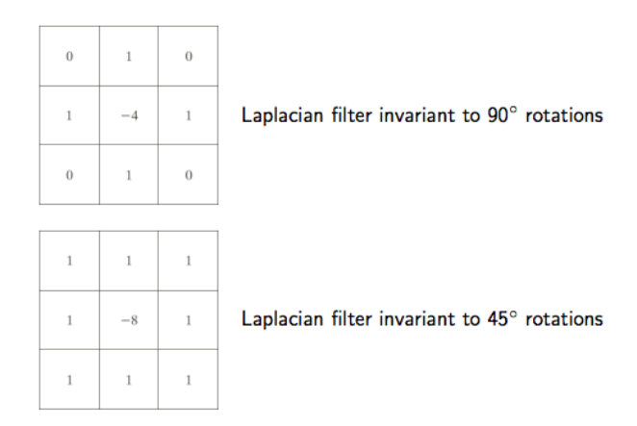
Laplacian filter

Slide 8
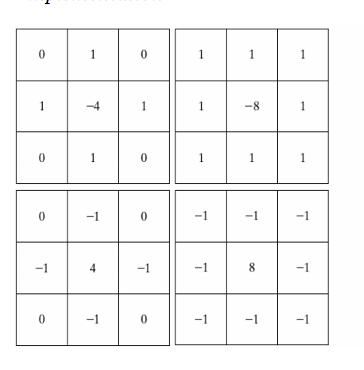
(a) and (c): Isotropic results for increments of 90º
(b) and (d): Isotropic results for increments of 45º

Slide 9
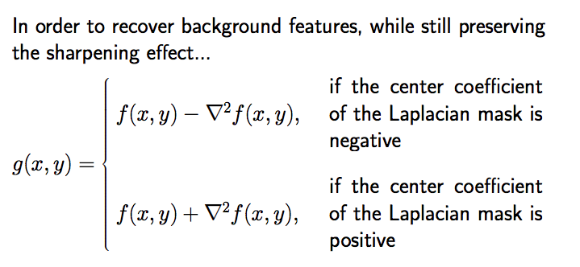

Slide 10
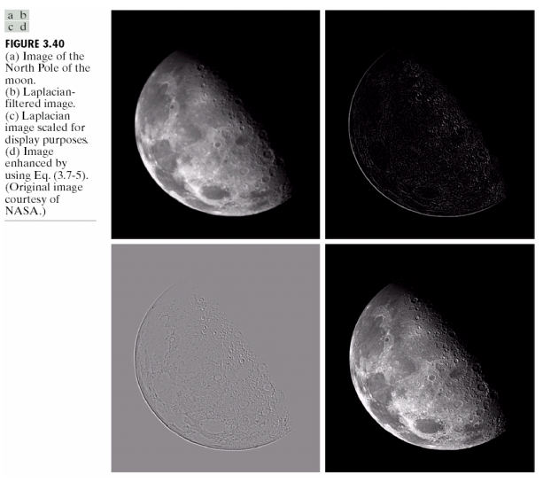

Slide 11
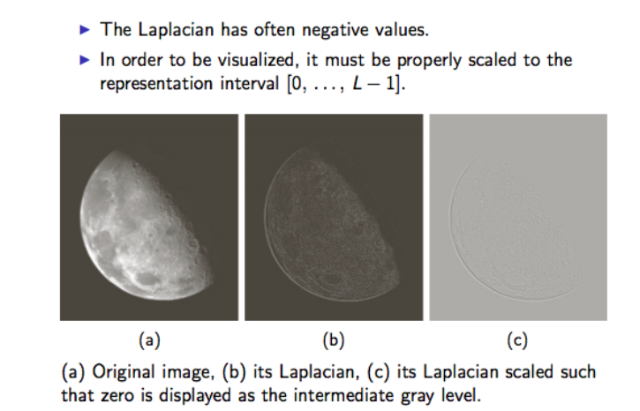

Slide 12
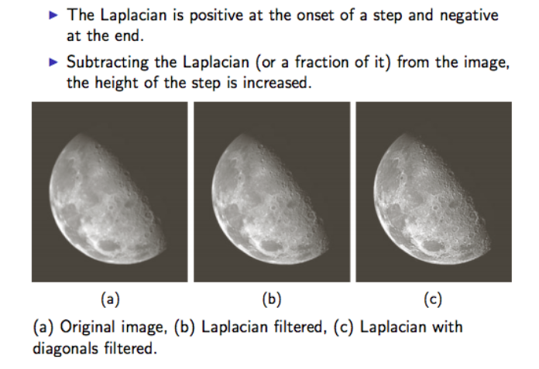

Slide 13
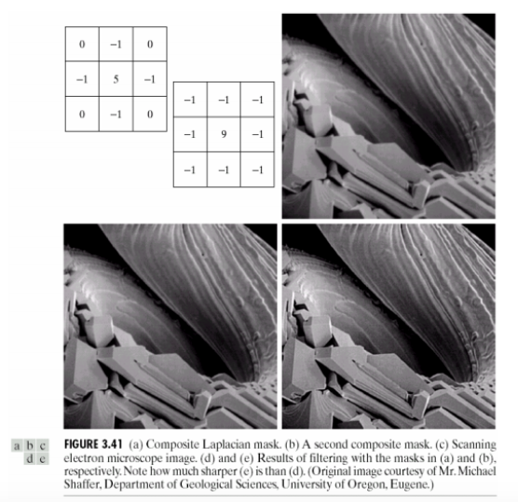

Slide 14
Un-sharp masking and high-boost filtering
The technique known as un-sharp masking is a method of common use in graphics for making the images sharper.
It consists of:
1. defocusing the original image;
2. obtaining the mask as the difference between the original image and its defocused copy;
3. adding the mask to the original image.

Slide 15
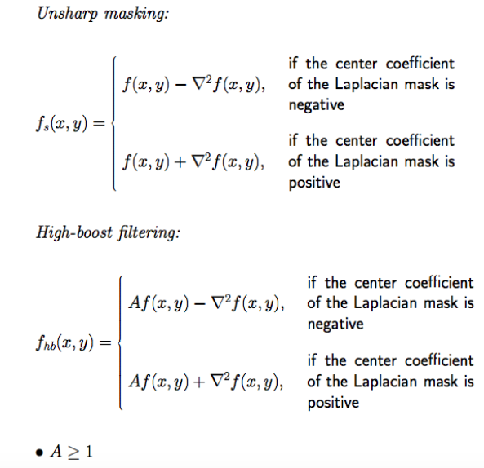

Slide 16
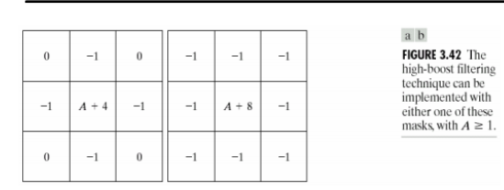
Mask of High Boost

Slide 17
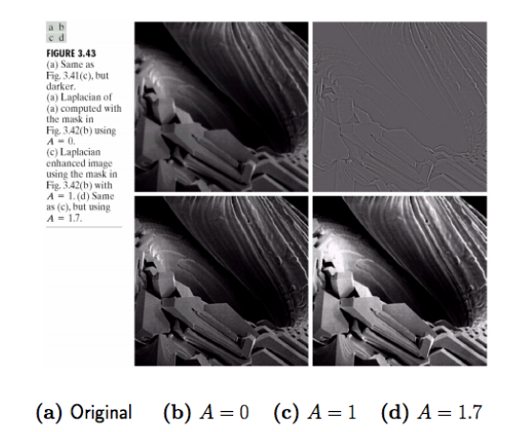

Slide 18
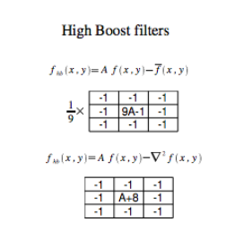

Slide 19
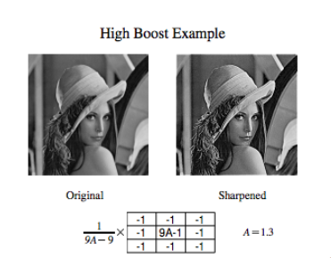

Slide 20
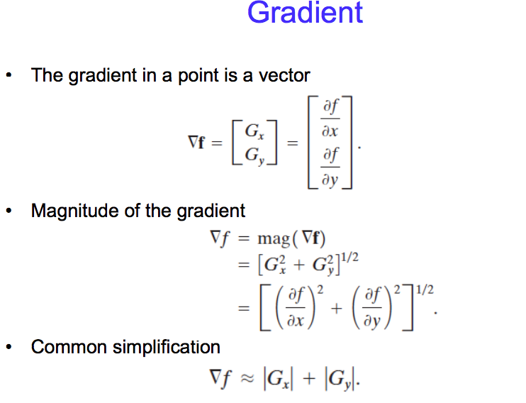

Slide 21
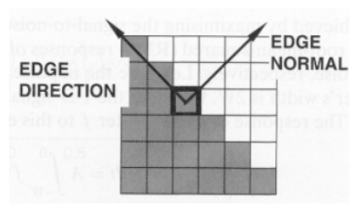
Properties of the gradient
The magnitude of gradient provides information about the strength of the edge.
The direction of gradient is always perpendicular to the direction of the edge (the edge direction is rotated with respect to the gradient direction by -90 degrees).

Slide 22
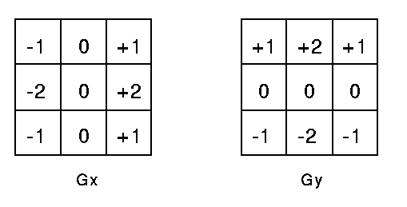
Shobel operator using first order derivatives

Slide 23
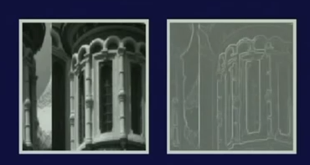
Sobel operator using first order derivatives

Slide 24
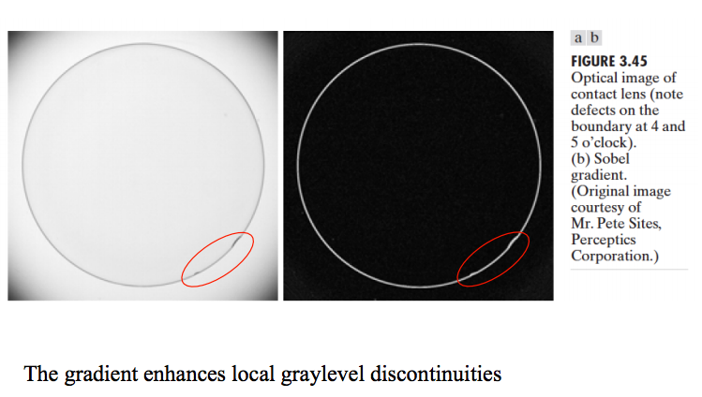

Slide 25
The combination of different spatial enhancement methods leads to “better quality” images
For instance
utilize the Laplacian to highlight fine detail, and the gradient to enhance prominent edges
a smoothed version of the gradient image can be used to mask the Laplacian image
increase the dynamic range of the gray levels by using a gray-level transformation

Slide 26
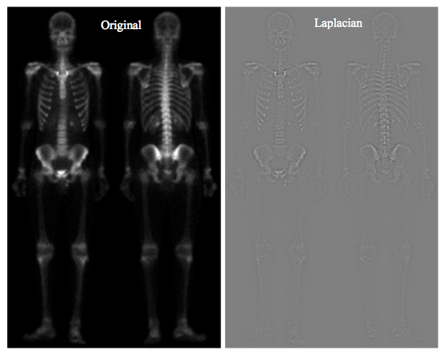

Slide 27
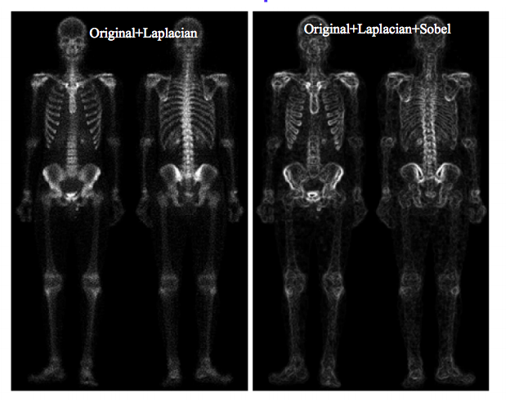
Combination of different operations:

Slide 28
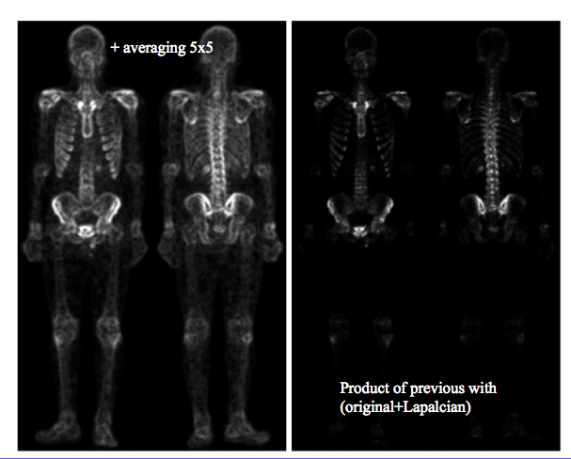

Slide 29
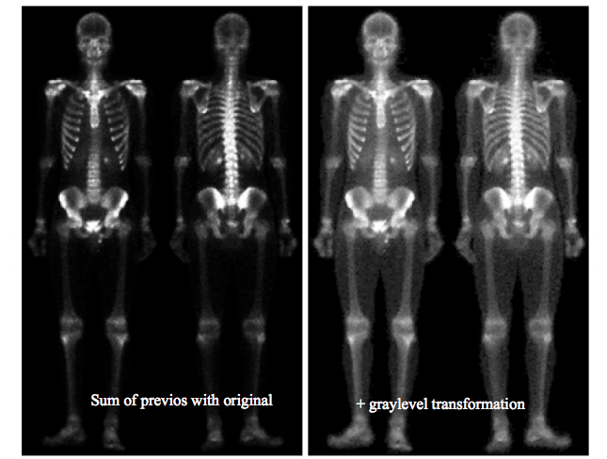

Slide 30
What are Edges in image?
Edges are significant local changes of intensity in an image.
Edges typically occur on the boundary between two different regions in an image
Intuitively, edge corresponds to singularities in the image
(i.e. where pixel value experiences abrupt change)
Detects large intensity transitions between pixels
0 0 0 33
0 0 45 78
0 45 23 33
0 0 42 76
0 0 0 38

Slide 31
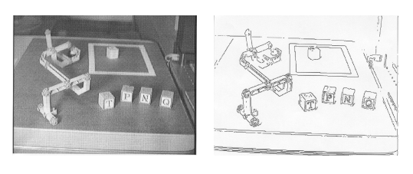
Goal of edge detection
Produce a line drawing of a scene from an image of that scene.
Important features can be extracted from the edges of an image (e.g., corners, lines, curves).
These features are used by higher-level computer vision algorithms (e.g., recognition).

Slide 32

Where is the edge?
Edge easy to find

Slide 33

Where is the edge?
Where is edge? Single pixel wide or multiple pixels?

Slide 34
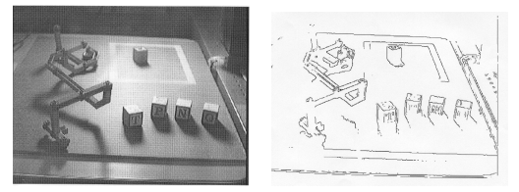
What causes intensity changes?
Various physical events cause intensity changes.
Geometric events
object boundary (discontinuity in depth and/or surface color and texture)
surface boundary (discontinuity in surface orientation and/or surface color and texture)
Non-geometric events
secularity (direct reflection of light, such as a mirror)
shadows (from other objects or from the same object)
inter-reflections

Slide 35
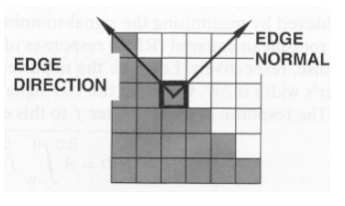
Edge descriptors
Edge normal: unit vector in the direction of maximum intensity change.
Edge direction: unit vector to perpendicular to the edge normal.
Edge position or center: the image position at which the edge is located.
Edge strength: related to the local image contrast along the normal.

Slide 36
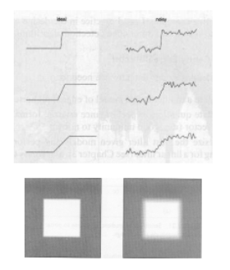
Modeling intensity changes
Edges can be modeled according to their intensity profiles.
Step edge: the image intensity abruptly changes from one value to one side of the discontinuity to a different value on the opposite side.
Ramp edge: a step edge where the intensity change is not instantaneous but occur over a finite distance.

Slide 37
Ramp vs step edge:
A ramp edge is a gradual transition between two regions of different pixel intensity values. The pixel values gradually increase or decrease along the edge, forming a ramp-like pattern. A ramp edge is typically caused by a smooth change in the underlying physical property that the image represents, such as a gradual change in lighting or reflectance. The slope of the ramp edge can be quantified by the gradient or slope of the pixel intensity values along the edge.

Slide 38
Cont.
A step edge, on the other hand, is a sudden transition between two regions of different pixel intensity values. The pixel values change abruptly along the edge, forming a step-like pattern. A step edge is typically caused by a sharp change in the underlying physical property that the image represents, such as a sharp change in lighting or reflectance. The height of the step edge can be quantified by the difference or jump in the pixel intensity values across the edge.

Slide 39
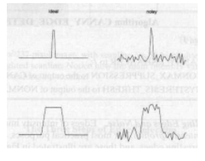
Modeling intensity changes
Ridge edge: the image intensity abruptly changes value but then returns to the starting value within some short distance (generated usually by lines).

Slide 40
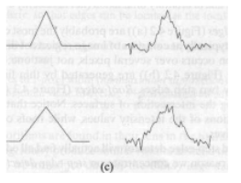
Modeling intensity changes
Roof edge: a ridge edge where the intensity change is not instantaneous but occur over a finite distance (generated usually by the intersection of surfaces).

Slide 41
The four steps of edge detection
Smoothing: suppress as much noise as possible, without destroying the true edges.
Enhancement: apply a filter to enhance the quality of the edges in the image (sharpening).
Detection: determine which edge pixels should be discarded as noise and which should be retained (usually, thresholding provides the criterion used for detection).
Localization: determine the exact location of an edge (sub-pixel resolution might be required for some applications, that is, estimate the location of an edge to better than the spacing between pixels). Edge thinning and linking are usually required in this step.

Slide 42
Edge detection using derivatives
Calculus describes changes of continuous functions using derivatives.
An image is a 2D function, so operators describing edges are expressed using partial derivatives.
Points which lie on an edge can be detected by:
(1) detecting local maxima or minima of the first derivative
(2) detecting the zero-crossing of the second derivative

Slide 43
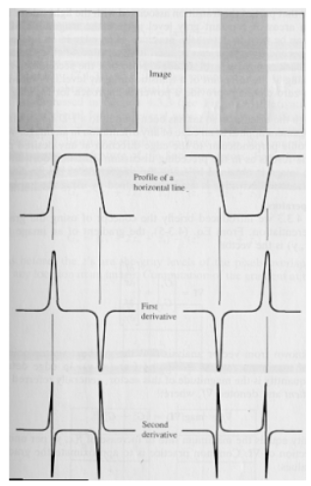

Slide 44
Gradient Operators
• Motivation: detect changes
change in the pixel value
large gradient
image
Gradient
operator
edge
map
Thresholding
x(m,n)
g(m,n)
I(m,n)

Slide 45
Common Operators
• Gradient operator
Examples: 1. Roberts operator
g₁
g₂

Slide 46
Common Operators (cont’d)
2. Prewitt operator
3. Sobel operator
vertical
horizontal

Slide 47
Applications:
Roberts, Sobel, and Prewitt operators are commonly used edge detection operators in image processing and computer vision. These operators are used to highlight edges and boundaries in images, which can be useful for tasks such as image segmentation, object recognition, and feature extraction.
The Sobel operator is a more sophisticated edge detection operator that uses a 3x3 kernel to calculate the gradient of the image.

Slide 48
Cont.
Edge detection: The primary application of these gradients is in edge detection, where they are used to highlight edges and boundaries in images. This can be useful for tasks such as image segmentation, object recognition, and feature extraction.
Object tracking: Gradients can be used to track objects in video sequences. By computing the gradients at each frame, the direction and speed of movement of an object can be estimated.
Optical flow: Gradients can also be used to estimate the optical flow of an image sequence. Optical flow refers to the apparent motion of objects in an image sequence and can be used for tasks such as object tracking and motion analysis.
Texture analysis: Gradients can be used to analyze the texture of an image. By computing the gradients at different scales and orientations, texture features can be extracted and used for tasks such as texture classification and segmentation.
Image enhancement: Gradients can be used to enhance the sharpness and clarity of an image. By sharpening the edges in an image, details can be made more visible and the overall quality of the image can be improved.

Slide 49
Disadvantages:
Sensitivity to noise: These operators are sensitive to noise in the image, which can lead to false edge detections. Noise can cause the gradient to fluctuate, resulting in spurious edges being detected.
Limited edge orientation detection: The Roberts operator is limited to detecting edges with a diagonal orientation, while the Sobel and Prewitt operators can detect edges with both horizontal and vertical orientations. However, these operators are not as effective at detecting edges with other orientations, such as diagonal or curved edges.
Computationally intensive: These operators require convolution of the input image with a kernel, which can be computationally intensive, especially for larger kernels. This can lead to slower processing times, which can be problematic for real-time applications.
Edge thickness: These operators only detect the presence of an edge but do not provide information about the thickness or width of the edge. This can be problematic for applications where the thickness of the edges is important.
Edge localization: These operators do not provide precise localization of the edges, which can make it difficult to accurately segment objects or extract features from images.

Slide 50
Summery of the lecture
First order derivatives using the gradient operator
Sobel operator using first order derivatives
What are Edges in image?
Modeling intensity changes
steps of edge detection

Slide 51
References
Prof .P. K. Biswas Department of Electronics and Electrical Communication Engineering Indian Institute of Technology, Kharagpur
Gonzalez R. C. & Woods R.E. (2008). Digital Image Processing. Prentice Hall.
Forsyth, D. A. & Ponce, J. (2011).Computer Vision: A Modern Approach. Pearson Education.

