Slide 1
Digital Image Processing CSC331
Image Enhancement

Slide 2
Summery of previous lecture
First order derivatives using the gradient operator
Shobel operator using first order derivatives
What are Edges in image?
Modeling intensity changes
Steps of edge detection

Slide 3
Todays lecture
Frequency domain Filters
Ideal Lowpass Filters
Butterworth Highpass Filters
Gaussian Highpass Filters
The Laplacian in the Frequency Domain
High boost filtering
Homomorphic Filtering

Slide 4
Background
Any function that periodically repeats itself can be expressed as the sum of sines and/or cosines of different frequencies, each multiplied by a different coefficient (Fourier series).
Even functions that are not periodic (but whose area under the curve is finite) can be expressed as the integral of sines and/or cosines multiplied by a weighting function (Fourier transform).

Slide 5
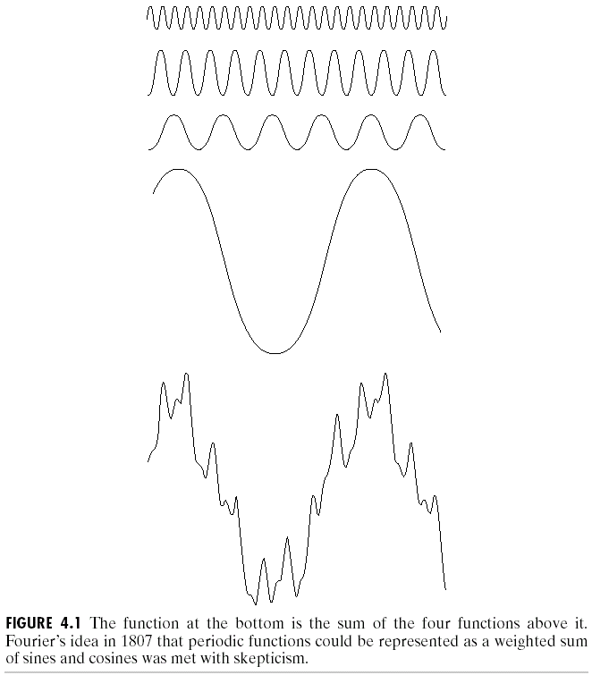
Background
The frequency domain refers to the plane of the two dimensional discrete Fourier transform of an image.
The purpose of the Fourier transform is to represent a signal as a linear combination of sinusoidal signals of various frequencies.

Slide 6
Introduction to the Fourier Transform
and the Frequency Domain
The one-dimensional Fourier transform and its inverse
Fourier transform (continuous case)
Inverse Fourier transform:
The two-dimensional Fourier transform and its inverse
Fourier transform (continuous case)
Inverse Fourier transform:

Slide 7
Introduction to the Fourier Transform
and the Frequency Domain
The one-dimensional Fourier transform and its inverse
Fourier transform (discrete case) DTC
Inverse Fourier transform:

Slide 8
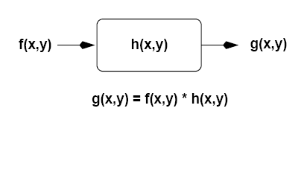
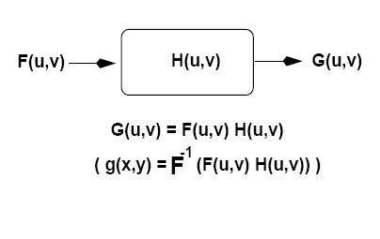
Frequency Domain Methods
Spatial Domain
Frequency Domain

Slide 9
Major filter categories
Typically, filters are classified by examining their properties in the frequency domain:
(1) Low-pass
(2) High-pass
(3) Band-pass
(4) Band-stop

Slide 10
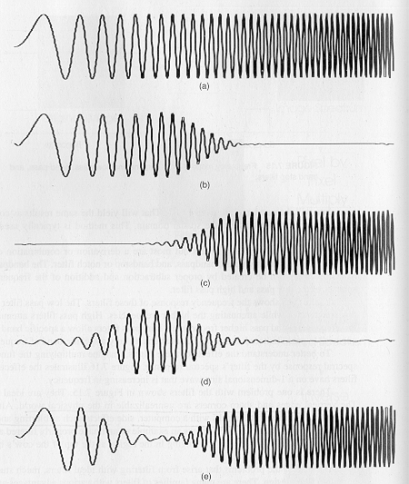
Example
Original signal
Low-pass filtered
High-pass filtered
Band-pass filtered
Band-stop filtered

Slide 11
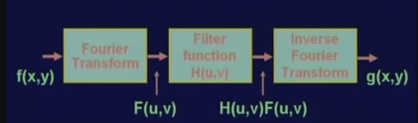
Frequency Domain Methods

Slide 12
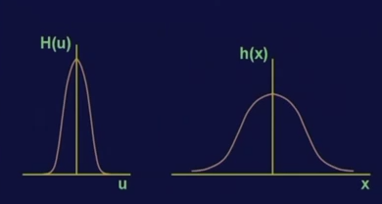
Low pass filter functions
left hand side: frequency domain filter H (u) as a function of u
right hand side: spatial domain filter h (x) which is a function of x.
filter H (u) as a function of u in the frequency domain, the corresponding filter h (x) in the spatial domain, will have all positive values.
A low-pass filter leaves the low frequencies alone.
We expect a low-pass filter to smooth the image. This is good for removing noise, but blurs the image.

Slide 13
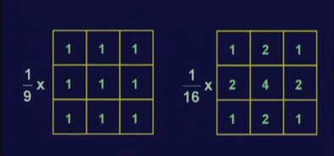
Low pass filter Mask

Slide 14
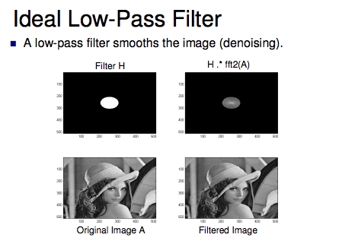

Slide 15
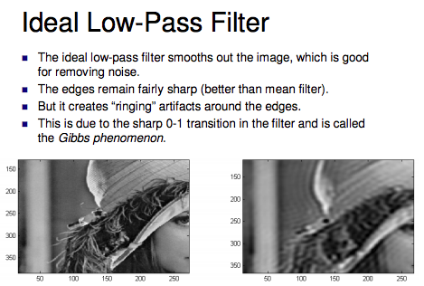

Slide 16
high pass filters in the Gaussian domain
A high-pass filter leaves the high frequencies alone.
We expect a high-pass filter to sharpen the edges.
This is good for edge detection.

Slide 17
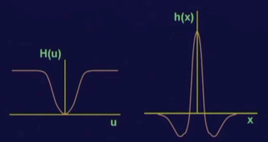
Plot high pass filter
The plot in the frequency domain, shows the high pass filter in the frequency domain.
It attenuate the low frequency components whereas it will pass the high frequency components and the corresponding filter in the spatial domain is in form of h (x) as the function of x.
The function h (x) can be positive as well as negative;
In the spatial domain, the Laplacian operator is of similar nature.

Slide 18
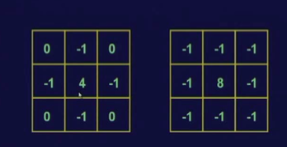
Laplacian mask as a high pass filtering

Slide 19
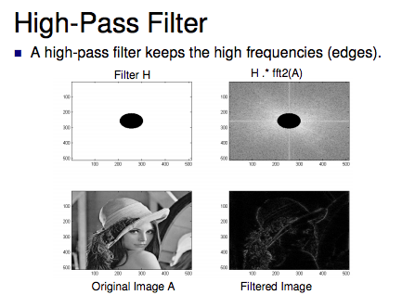

Slide 20
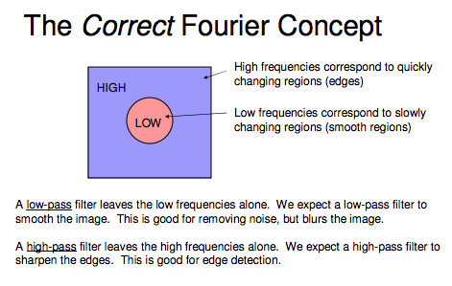

Slide 21
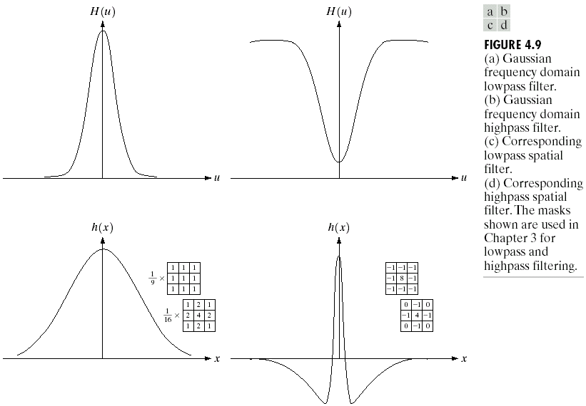
Correspondence between Filtering in
the Spatial and Frequency Domain

Slide 22
Correspondence between Filtering in
the Spatial and Frequency Domain
One very useful property of the Gaussian function is that both it and its Fourier transform are real valued; there are no complex values associated with them.
In addition, the values are always positive. So, if we convolve an image with a Gaussian function, there will never be any negative output values to deal with.
There is also an important relationship between the widths of a Gaussian function and its Fourier transform. If we make the width of the function smaller, the width of the Fourier transform gets larger. This is controlled by the variance parameter σ² in the equations.
These properties make the Gaussian filter very useful for lowpass filtering an image. The amount of blur is controlled by σ². It can be implemented in either the spatial or frequency domain.
Other filters besides lowpass can also be implemented by using two different sized Gaussian functions.

Slide 23
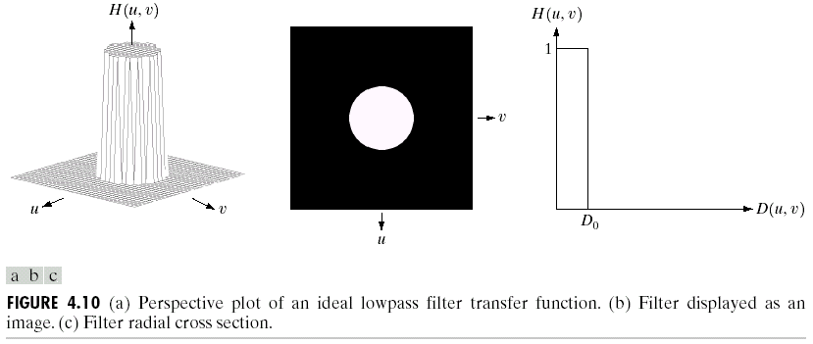
Ideal Lowpass Filters (ILPFs)

Slide 24
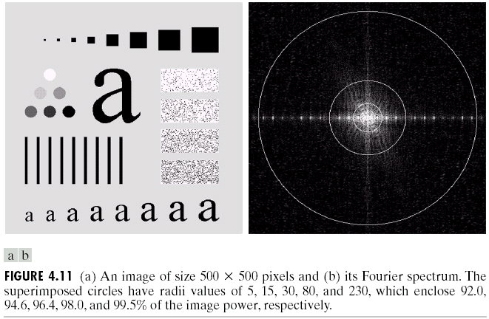
Ideal Lowpass Filters (ILPFs)

Slide 25
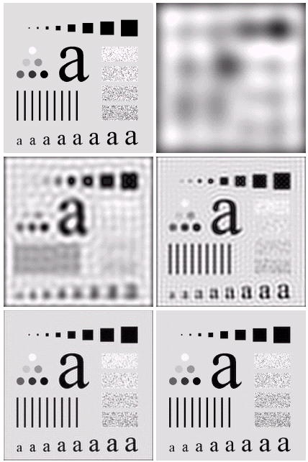

Ideal Lowpass Filters

Slide 26
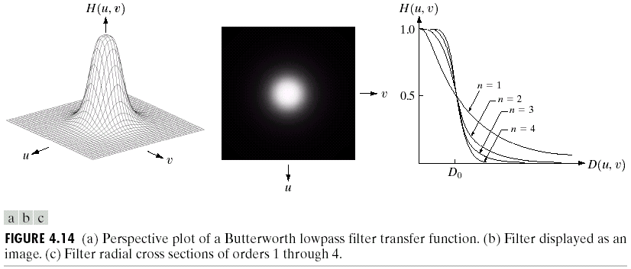
Butterworth Lowpass Filters (BLPFs)
With order n

Slide 27
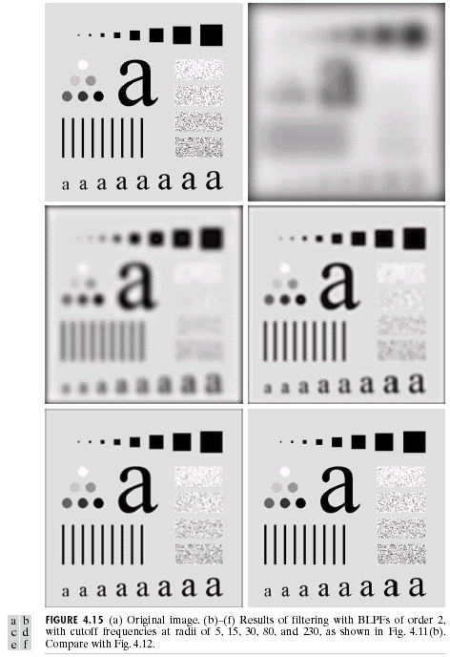
Butterworth Lowpass
Filters (BLPFs)
n=2
D₀=5,15,30,80,and 230

Slide 28
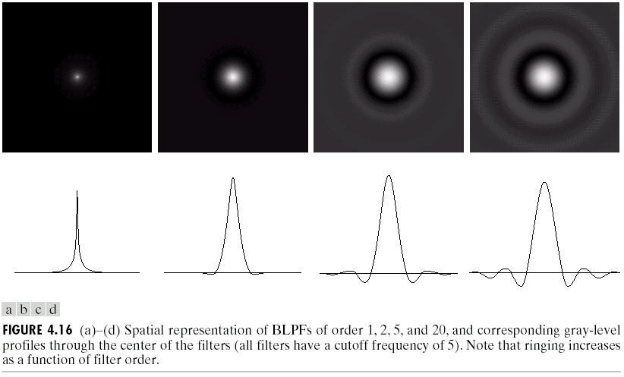
Butterworth Lowpass Filters (BLPFs)
Spatial Representation
n=1
n=2
n=5
n=20

Slide 29
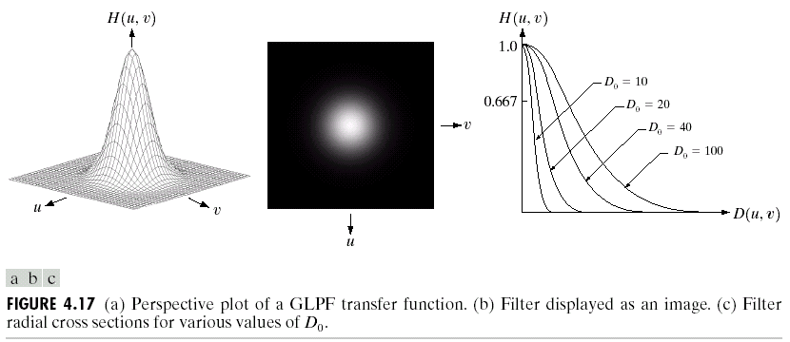
Gaussian Lowpass Filters (FLPFs)

Slide 30
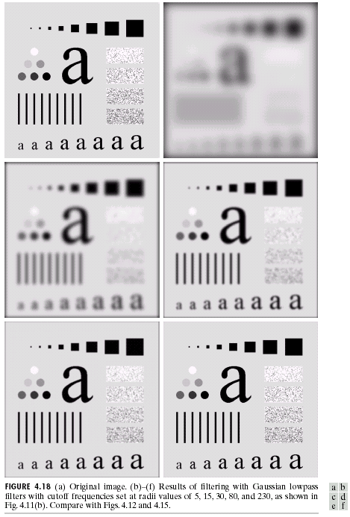
Gaussian Lowpass
Filters (FLPFs)
D₀=5,15,30,80,and 230

Slide 31
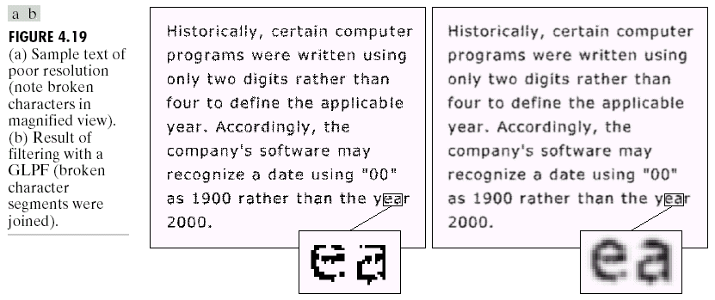
Additional Examples of Lowpass Filtering

Slide 32
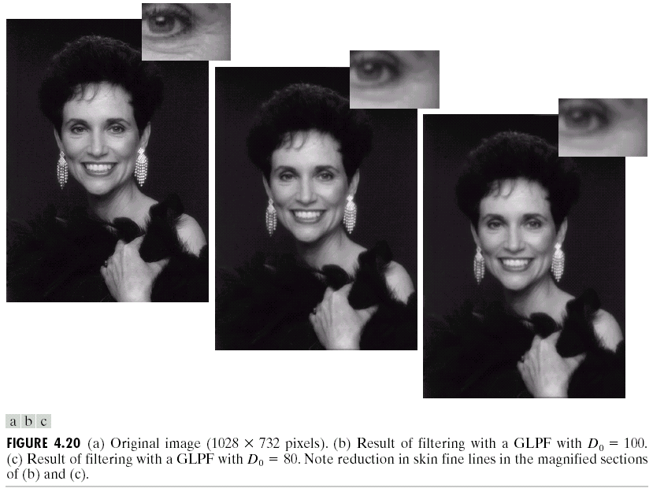
Additional Examples of Lowpass Filtering

Slide 33
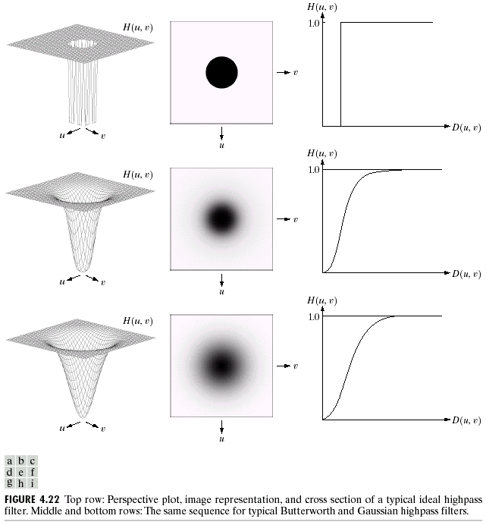
Sharpening Frequency Domain Filter
Ideal high pass filter
Ideal highpass filter
Butterworth highpass filter
Gaussian highpass filter

Slide 34
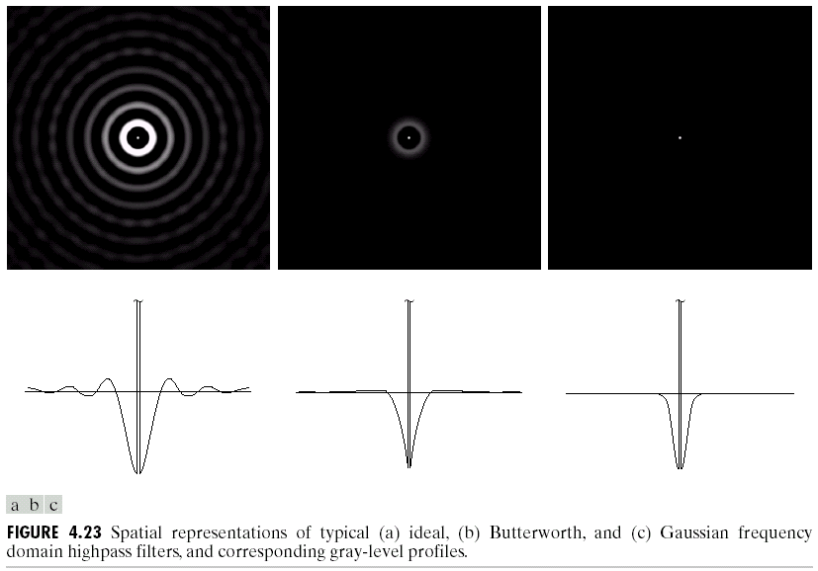
Highpass Filters
Spatial Representations

Slide 35
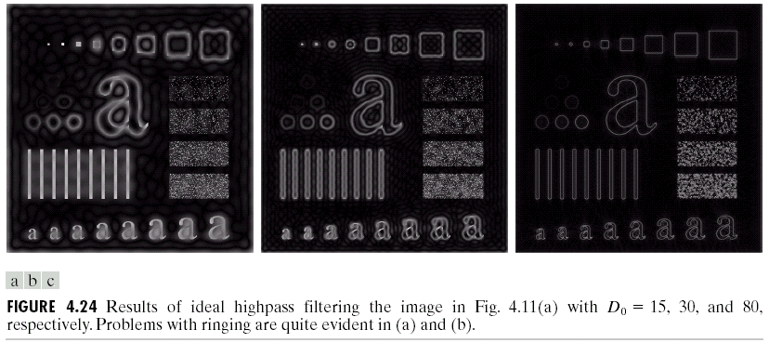
Ideal Highpass Filters

Slide 36
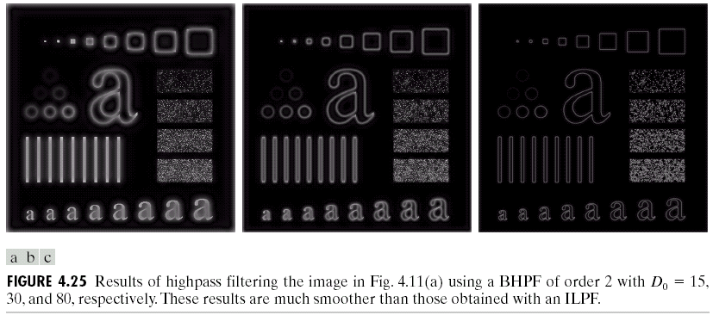
Butterworth Highpass Filters

Slide 37
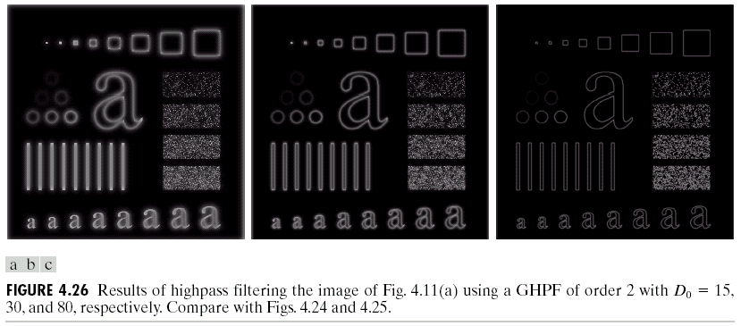
Gaussian Highpass Filters

Slide 38
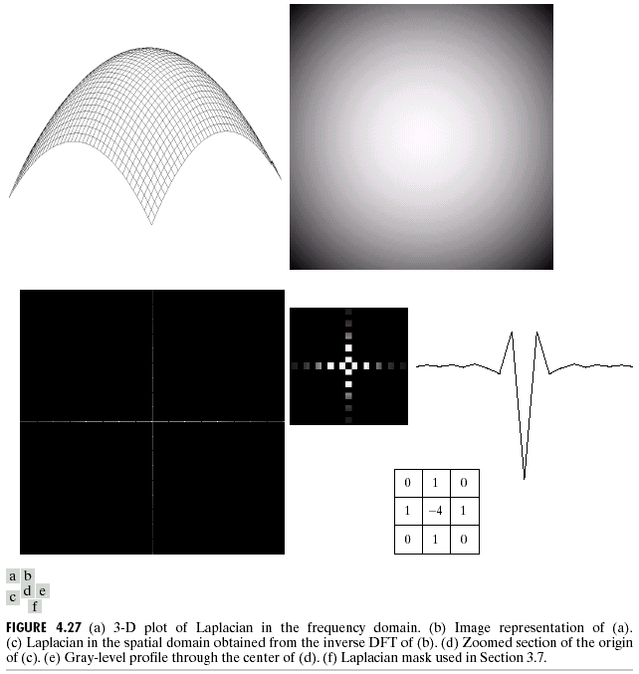
The Laplacian in the Frequency Domain
The Laplacian filter
Shift the center:
Frequency
domain
Spatial domain

Slide 39
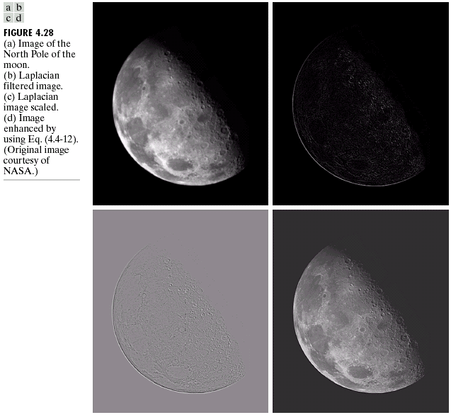
For display purposes only

Slide 40
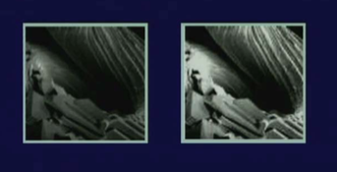
High boost filtering results

Slide 41
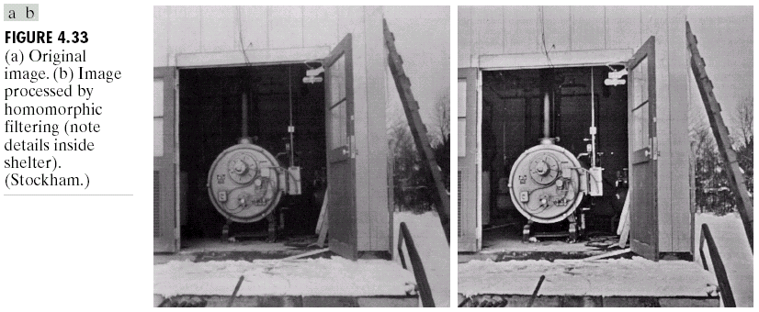
Homomorphic filtering
Many times, we want to remove shading effects from an image (i.e., due to uneven illumination)
Enhance high frequencies
Attenuate low frequencies but preserve fine detail.

Slide 42
Homomorphic Filtering (cont’d)
Consider the following model of image formation:
In general, the illumination component i(x,y) varies slowly and affects low frequencies mostly.
In general, the reflection component r(x,y) varies faster and affects high frequencies mostly.
i(x,y): illumination
r(x,y): reflection
IDEA: separate low frequencies due to i(x,y)
from high frequencies due to r(x,y)

Slide 43
How are frequencies mixed together?
Low and high frequencies from i(x,y) and r(x,y)
are mixed together.
When applying filtering, it is difficult to handle
low/high frequencies separately.

Slide 44
Can we separate them?
Idea:
Take the ln( ) of

Slide 45
Steps of Homomorphic Filtering
(1) Take
(2) Apply FT:
or
(3) Apply H(u,v)

Slide 46

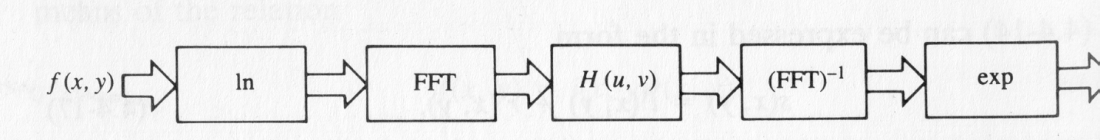
Steps of Homomorphic Filtering (cont’d)
(4) Take Inverse FT:
or
(5) Take exp( ) or

Slide 47
Example using high-frequency emphasis
Attenuate the contribution made by illumination and amplify the contribution made by reflectance
Attenuate the contribution made by illumination and amplify the contribution made by reflectance

Slide 48
Homomorphic Filtering: Example

Slide 49
Homomorphic Filtering: Example

Slide 50
Summery of the lecture
Frequency domain Filters
Ideal Lowpass Filters
Butterworth Highpass Filters
Gaussian Highpass Filters
The Laplacian in the Frequency Domain
High boost filtering
Homomorphic Filtering

Slide 51
References
Prof .P. K. Biswas Department of Electronics and Electrical Communication Engineering Indian Institute of Technology, Kharagpur
Gonzalez R. C. & Woods R.E. (2008). Digital Image Processing. Prentice Hall.
Forsyth, D. A. & Ponce, J. (2011).Computer Vision: A Modern Approach. Pearson Education.

