Slide 1
Digital Image Processing CSC331
Image restoration

Slide 2
Summery of previous lecture
Image Enhancement techniques
Spatial domain techniques
Pont processing techniques
Mask Processing techniques
Frequency domain techniques
Ideal and Butterworth lowpass filter
Ideal and Butterworth highpass filer
Gaussian filter
Homemorphic filter

Slide 3
Todays lecture
Image restoration techniques
Difference between image enchantment and image restoration
Image formation process and the degradation model
Degradation model in continues function and its discrete formulation
Discrete formulation for 1D and 2D

Slide 4
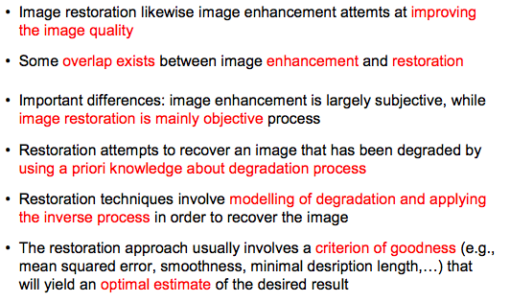
Objectives of Image Restoration

Slide 5
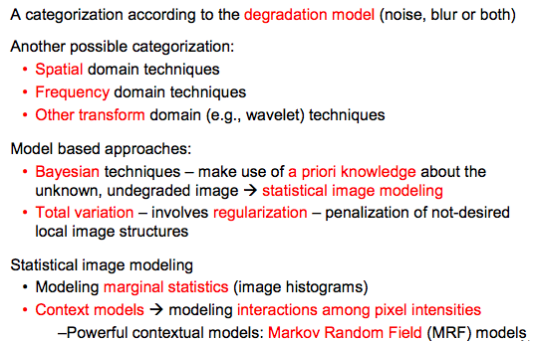
Overview of restoration techniques

Slide 6
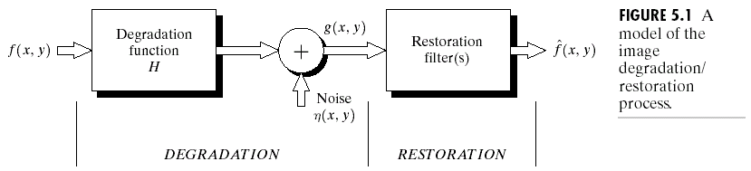
Degradation model

Slide 7
Definitions

Slide 8
Defining linearity (Super position theorem)

Slide 9
Homogeneity property

Slide 10
Degradation model in case of continuous functions

Slide 12
Impulse response (point spread function)

Slide 13
H as position invariant

Slide 14
Discrete formulation degradation model
First in case of 1 dimension and later it will be extend to 2 dimensional cases for digital image processing operations.
For simplicity, initially, we will neglect the contribution of the noise term that is eta (x, y).

Slide 18
2D Discrete formulation degradation model

Slide 21
Summery of the lecture
Image restoration techniques
Difference between image enchantment and image restoration
Image formation process and the degradation model
Degradation model in continues function and its discrete formulation
Discrete formulation for 1D and 2D

Slide 22
References
Prof .P. K. Biswas Department of Electronics and Electrical Communication Engineering Indian Institute of Technology, Kharagpur
Gonzalez R. C. & Woods R.E. (2008). Digital Image Processing. Prentice Hall.
Forsyth, D. A. & Ponce, J. (2011).Computer Vision: A Modern Approach. Pearson Education.

