Slide 1
Digital Image Processing CSC331
Image restoration

Slide 2
Summery of previous lecture
Image restoration techniques
Difference between image enchantment and image restoration
Image formation process and the degradation model
Degradation model in continues function and its discrete formulation
Discrete formulation for 1D and 2D

Slide 3
Todays lecture
Estimation of Degradation Model
By observation
By experimentation
Mathematical model
Restoration techniques
Inverse filtering

Slide 4
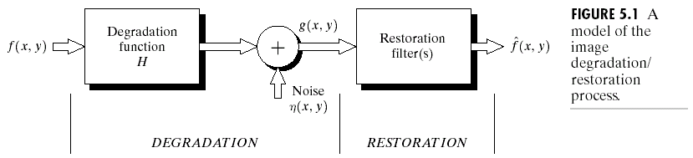
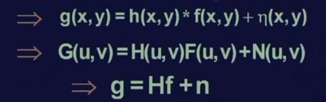
Degradation model

Slide 5
Estimation of Degradation Model
Blind convolution operation
By observation
By experimentation
Mathematical model

Slide 6
Degradation Model by observation

Slide 7
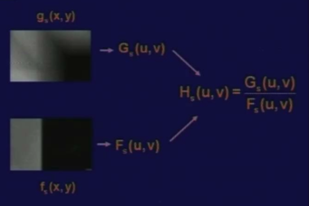
Example degraded image which has been cut out from a bigger degraded image.

Slide 8
Degradation Model by experimentation
we try to get an imaging setup which is similar to the imaging setup before the degraded image.
our purpose will be to find the impulse response of imaging setup.
So, once the impulse response is known, the response of that system to any arbitrary input can be computed.
So this means we need impulse simulation.

Slide 9
Impulse simulation
How do you simulate an impulse?
An impulse can be simulated by a very bright spot of light and because our imaging setup is a camera, so we will have a bright spot as small as possible of light falling on the camera,
whatever image we get that is the response to that bright spot of light which in our case is an impulse.

Slide 10
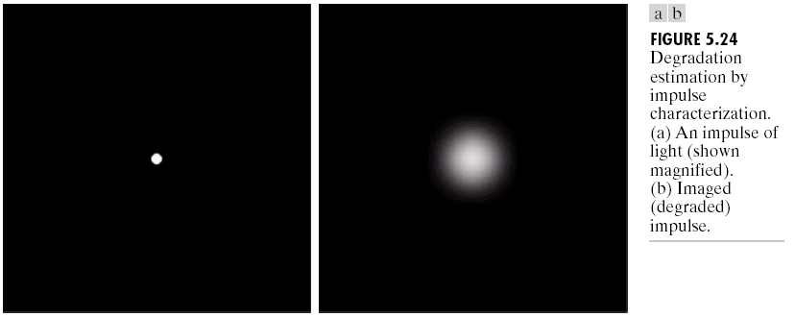
Simulated impulse
^{simulated impulse}
Impulse response which is captured by the
camera when this impulse falls on camera lens.
Now, we know from our earlier discussion that for a narrow impulse, the Fourier transformation of an impulse is a constant.

Slide 12
Experimental setup
We have got the degradation function through an experimental setup Is
we have an imaging setup with a light source which can simulate an impulse. Using that impulse, we got an image which is the impulse response of this imaging system.
We assume that the Fourier transform of the impulse is true as a constant A
We obtain the Fourier transform of the response which is G (u, v) and now this G (u, v) divided by A shall be equal to the degradation function H (u, v) which is the degradation function of this particular imaging setup.
one point should be kept in mind that the intensity of the light which is the simulated impulse should be very high so that the effect of noise is reduced otherwise the estimation will not be a correct

Slide 13
Degradation by Mathematical Model
Mathematical modeling approach for estimation of the degradation function has been used for many years.
Reasons for using this mathematical approach
The first one is it provides an insight into the degradation process.
The second reason is that it can model even the atmospheric disturbance which leads to degradation of the image.

Slide 14
Degradation by Mathematical Model

Slide 15
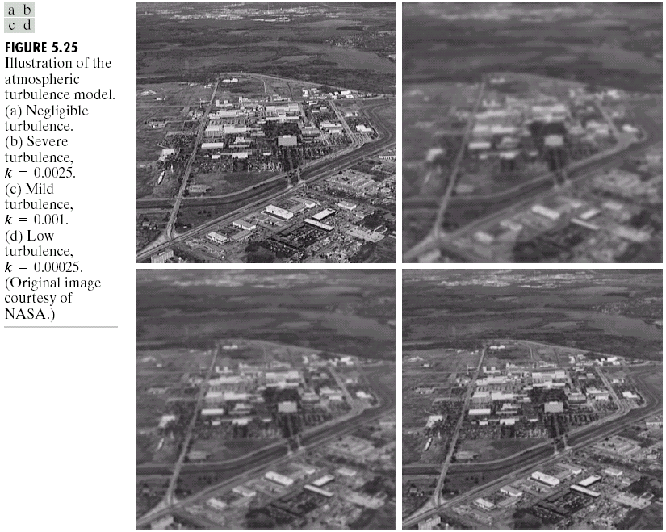
Degradation by Mathematical Model

Slide 16
Degradation model estimation basic principles
1st we will try to find the degradation function where the image is degraded by linear motion
Taking the image a fast moving object;
There is some sort of blurring which is known as motion blurring and this motion blurring occurs
Whenever we take the snap of the scene, the shutter of the camera is open for certain duration of time and during this period, during which the shutter is open, the object is not stationary, the object is moving.
The light from the scene does not reflect from a single point. But the light you get at a particular point on the imaging sensor is the aggregation of the reflected light from various points in the scene.

Slide 17
Motion blurring

Slide 18
Motion blurring function

Slide 22
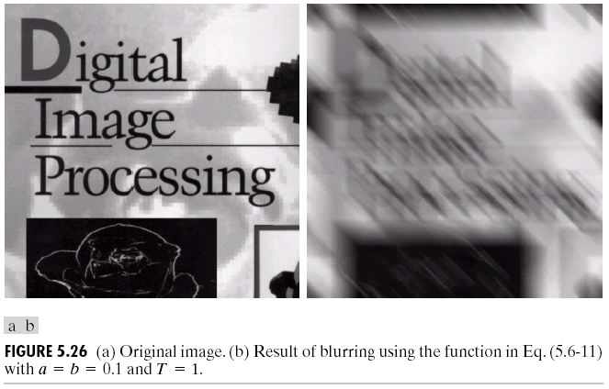

Slide 23
Filtering techniques
Now we obtained a an estimated degradation function, for a blurred image; how to restore the original image or how to recover the original image?
So, as we have mentioned that there are different types of filtering techniques for obtaining or for restoring the original image from a degraded image.
The simplest kind of filtering technique is what is known as inverse filtering.

Slide 24
Inverse filtering

Slide 25
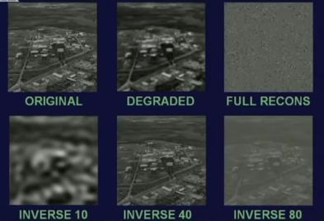
Results

Slide 26
Summery of the lecture
Estimation of Degradation Model
By observation
By experimentation
Mathematical model
Restoration techniques
Inverse filtering

Slide 27
References
Prof .P. K. Biswas Department of Electronics and Electrical Communication Engineering Indian Institute of Technology, Kharagpur
Gonzalez R. C. & Woods R.E. (2008). Digital Image Processing. Prentice Hall.
Forsyth, D. A. & Ponce, J. (2011).Computer Vision: A Modern Approach. Pearson Education.

