Slide 1
Digital Image Processing CSC331
Image restoration

Slide 2
Summery of previous lecture
Estimation of Degradation Model
By observation
By experimentation
Mathematical model
Restoration techniques
Inverse filtering

Slide 3
Todays lecture
Restoration techniques
Inverse filtering
Minimum Mean Square error (Wiener)
Constrained Least square Filter
Restoration in presence of periodic noise

Slide 4
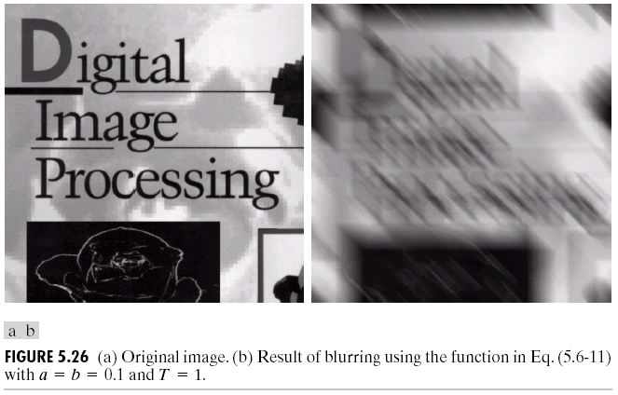
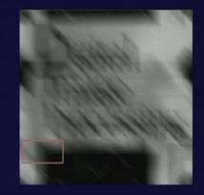
Degradation Model by observation

Slide 5
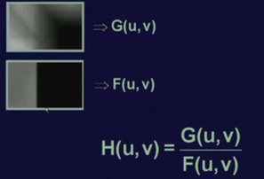
Example degraded image which has been cut out from a bigger degraded image.

Slide 6
Degradation Model by experimentation
So, our requirement is that whichever imaging device or imaging setup that has been used for getting a degraded image which has been used to record a degraded image for experimentation purpose; then we try to find out that what is the impulse response of that imaging setup. As we have already discussed that it is the impulse response which completely characterizes any system.
If we know what is the impulse response of the system; we can always calculate the response of the system to any type of input signal.
We simulate an impulse by using a narrow strong beam of light.

Slide 7
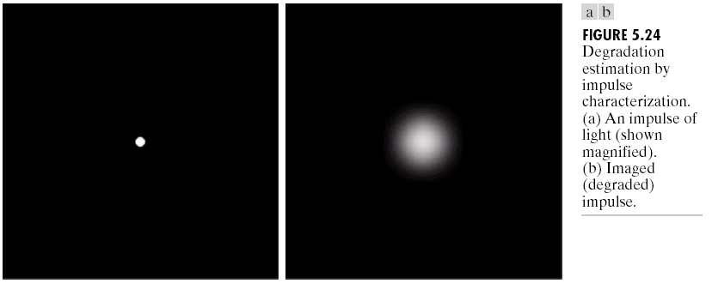
Simulated impulse
^{simulated impulse}
Impulse response which is captured by the
camera when this impulse falls on camera lens.
Now, we know from our earlier discussion that for a narrow impulse, the Fourier transformation of an impulse is a constant.

Slide 8
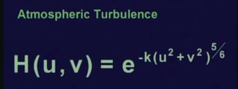
Degradation by Mathematical Model

Slide 9
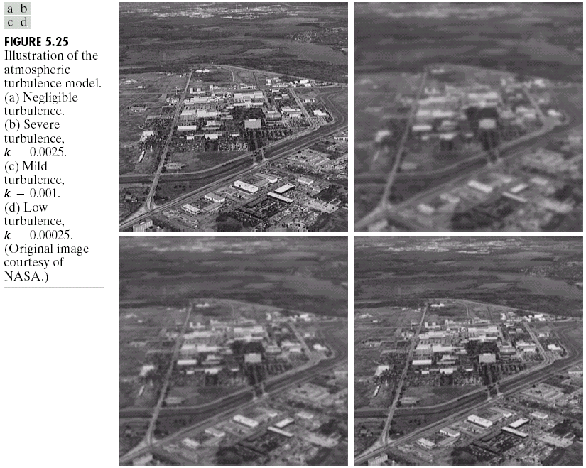
Degradation by Mathematical Model

Slide 10
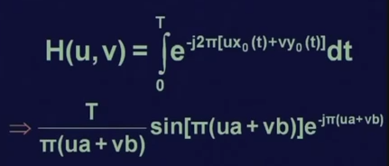
Motion blurring mathematical modeling

Slide 12
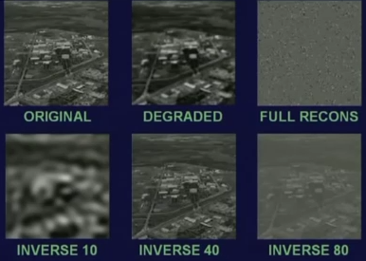
Inverse filtering Results

Slide 13
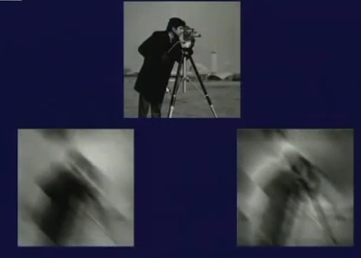
Inverse filtering results for motion blur

Slide 14
Motion blurring mathematical modeling

Slide 15

point spread function

Slide 16
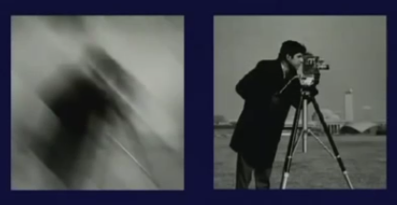
direct inverse filtering Fourier transformation of the point spread function
degradation model was recomputed from Fourier transformation of the point spread function.

Slide 17
minimum mean square error approach or Wiener filtering
the Wiener filtering tries to reconstruct the degraded image by minimizing an error function.

Slide 20
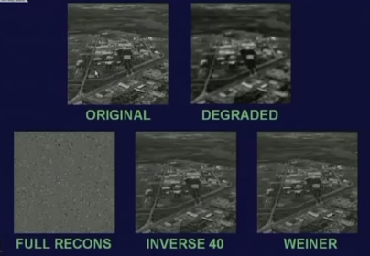
Results with Wiener filter

Slide 21
Constant least square filtering

Slide 24
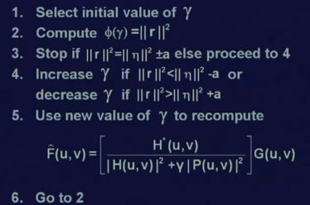
iterative algorithm for estimation of the value of gamma

Slide 25
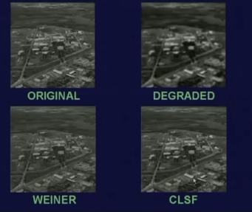
Results of Constant least square filtering

Slide 26
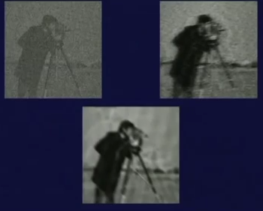
Motion degraded image with some additive noise results by direct inverse filtering, Wiener and constant least square filtering.

Slide 27

Noise estimation

Slide 29
Noise estimation

Slide 30
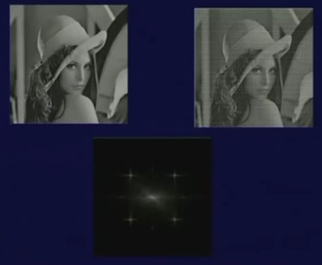
Periodic noise present in the image

Slide 31
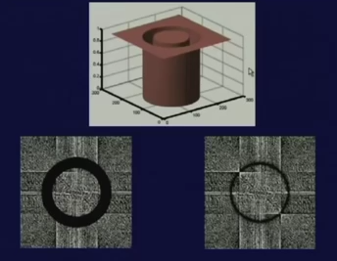
band reject filter

Slide 32
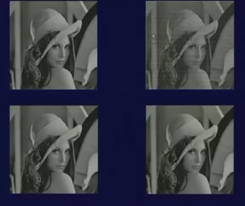
Results

Slide 33
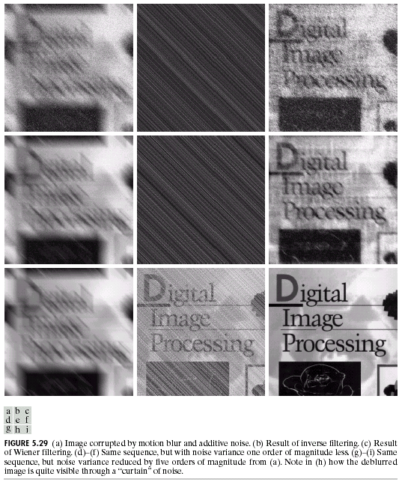

Slide 34
Summery of the lecture
Restoration techniques
Inverse filtering
Minimum Mean Square error (Wiener)
Constrained Least square Filter
Restoration in presence of periodic noise

Slide 35
References
Prof .P. K. Biswas Department of Electronics and Electrical Communication Engineering Indian Institute of Technology, Kharagpur
Gonzalez R. C. & Woods R.E. (2008). Digital Image Processing. Prentice Hall.
Forsyth, D. A. & Ponce, J. (2011).Computer Vision: A Modern Approach. Pearson Education.

