Slide 1
Digital Image Processing CSC331
Image registration

Slide 2
Summery of previous lecture
Estimation of Degradation Model
By observation
By experimentation
Mathematical model
Restoration techniques
Inverse filtering
Minimum Mean Square error (Wiener)
Constrained Least square Filter
Restoration in presence of periodic noise

Slide 3
Todays lecture
Image registration
Different mismatch or measures
Cross correlation between tow images
Applications of image registration

Slide 4
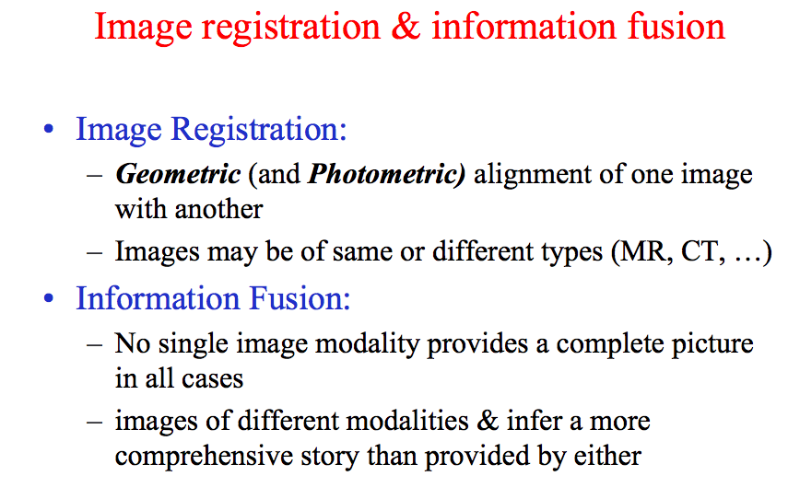

Slide 5
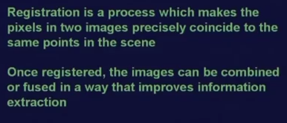
Image registration

Slide 6
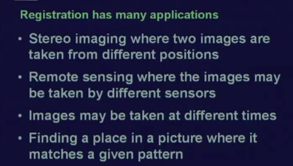
image registration

Slide 7
Registration techniques Template matching

Slide 8
Different match or similarity measures

Slide 10
Cauchy Schwarz inequality

Slide 12
Normalized cross correlation

Slide 14
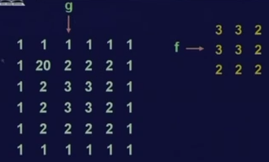
Working example

Slide 15
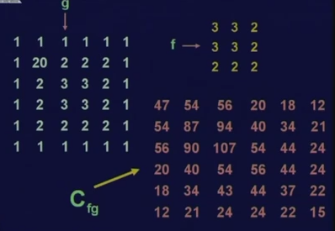
Cross correlation The similarity measure

Slide 16
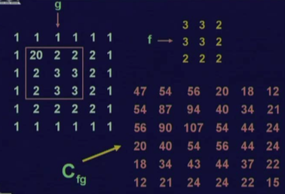
cross correlation measure directly cannot be used as a similarity measure as a false match

Slide 17
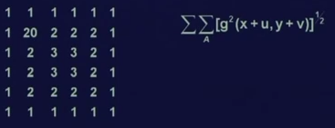
normalized cross correlation value

Slide 18
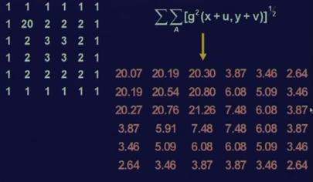
All normalized cross correlation value

Slide 19
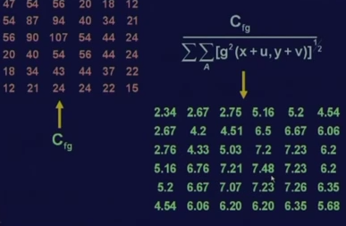

Slide 20
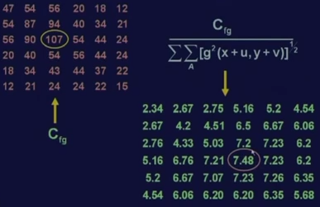

Slide 21
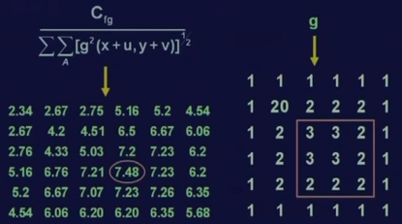

Slide 22
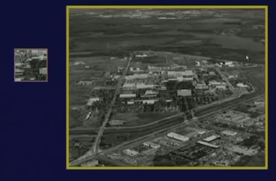
Application

Slide 23
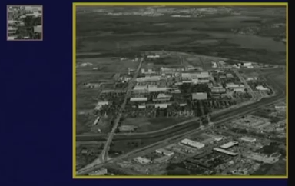
Placing the template

Slide 24
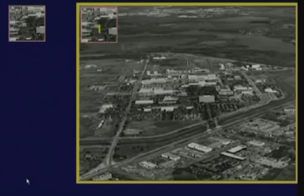

Slide 25
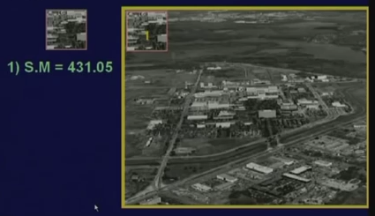

Slide 26
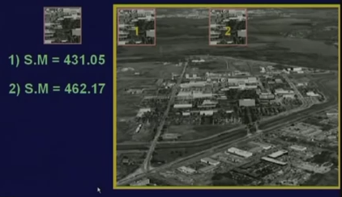

Slide 27
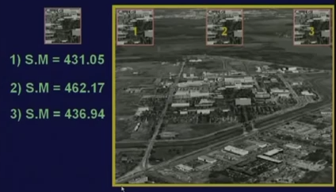

Slide 28
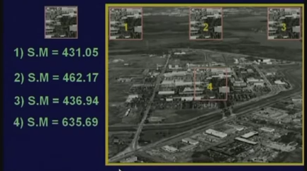

Slide 29
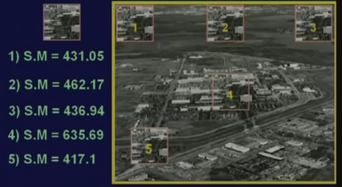

Slide 30
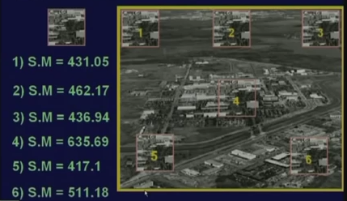

Slide 31
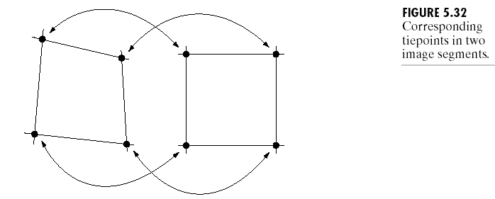
Registration as a image restoration

Slide 33
Registration as a image restoration

Slide 34
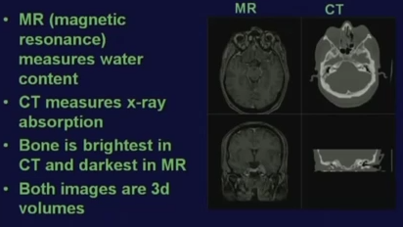
Applications

Slide 35
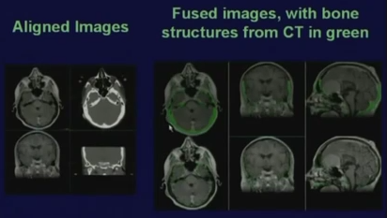

Slide 36
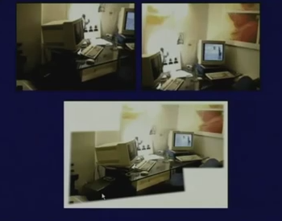
Image mosaicing

Slide 37
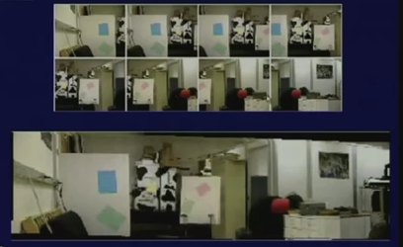
Image mosaicing

Slide 38
Summery of the lecture
Image registration
Different mismatch or measures
Cross correlation between tow images
Applications of image registration

Slide 39
References
Prof .P. K. Biswas Department of Electronics and Electrical Communication Engineering Indian Institute of Technology, Kharagpur
Gonzalez R. C. & Woods R.E. (2008). Digital Image Processing. Prentice Hall.
Forsyth, D. A. & Ponce, J. (2011).Computer Vision: A Modern Approach. Pearson Education.

