Slide 1
Digital Image Processing CSC331
Image Segmentation

Slide 2
Summery of previous lecture
Color image processing
Primary and secondary colors
Color characteristics
Color models
RGB color model
CMY model
HSI color model
Pseudocolors image processing
Full color image processing

Slide 3
Todays lecture
Image analysis
Image segmentation
Segmentation Algorithms
Discontinuities intensity:
points, lines and edges
Gradient Operators
Linking the edge points

Slide 4
Image analysis
Is the extraction of meaningful information from images;
Image analysis tasks can be as simple as reading bar coded tags or as sophisticated as identifying a person from their face.
Computers are indispensable for the analysis of large amounts of data, for tasks that require complex computation, or for the extraction of quantitative information.
On the other hand, the human visual cortex is an excellent image analysis apparatus, especially for extracting higher-level information, and for many applications — including medicine, security, and remote sensing — human analysts still cannot be replaced by computers.
For this reason, many important image analysis tools such as edge detectors and neural networks are inspired by human visual perception models.

Slide 5
Techniques
There are many different techniques used in automatically analyzing images. Each technique may be useful for a small range of tasks, however there still aren't any known methods of image analysis that are generic enough for wide ranges of tasks, compared to the abilities of a human's image analyzing capabilities.
Examples of image analysis techniques in different fields include:
image segmentation,
2D and 3D object recognition
motion detection e.g. Single particle tracking,
video tracking,
optical flow,
medical scan analysis,
3D Pose Estimation,
automatic number plate recognition.

Slide 6
Image Segmentation
Segmentation divides an image into its constituent regions or objects.
Segmentation of images is a difficult task in image processing. Still under research.
Segmentation allows to extract objects in images.
Segmentation is unsupervised learning.
Model based object extraction, e.g., template matching, is supervised learning.

Slide 7
Image segmentation is the division of an image into regions or categories, which correspond to different objects or parts of objects.
Every pixel in an image is allocated to one of a number of these categories. A good segmentation is typically one in which:
• pixels in the same category have similar greyscale of multivariate values and form a connected region,
• neighbouring pixels which are in different categories have dissimilar values

Slide 8
What it is useful for
After a successful segmenting the image, the contours of objects can be extracted using edge detection and/or border following techniques.
Shape of objects can be described.
Based on shape, texture, and color objects can be identified.
Image segmentation techniques are extensively used in similarity searches,

Slide 9
Segmentation Algorithms
Segmentation algorithms are based on one of two basic properties of color, gray values, or texture:
discontinuity
similarity.
First category is to partition an image based on abrupt changes in intensity, Isolated points, lines and edges.
Differences are sudden changes (discontinuities) in any of these, but especially sudden changes in intensity along a boundary line, which is called an edge.
Second category are based on partitioning an image into regions that are similar according to a predefined criteria. Thresholding, Region growing and region splitting and merging.
Similarity may be due to pixel intensity, color or texture.

Slide 10

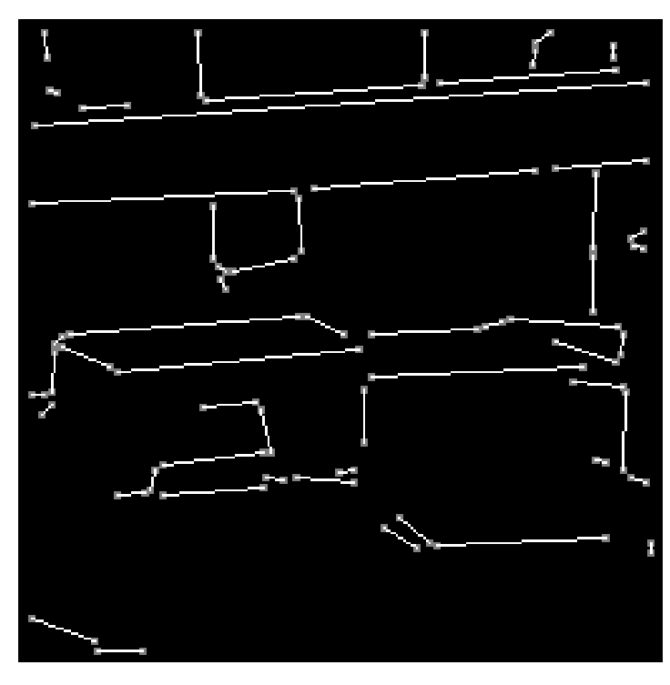
Example : Straight Lines

Slide 11

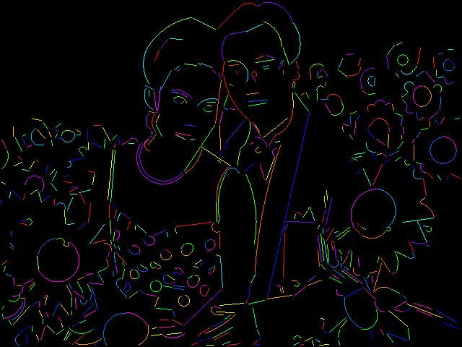
Example : Lines and Circular Arcs

Slide 12
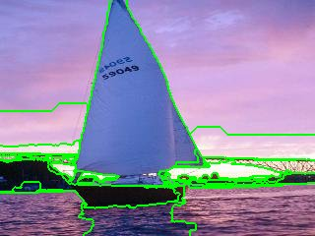
Example : Regions

Slide 13
Image segmentation by Discontinuity
Points
Edges
Lines
We can segment all these by using a Mask processing

Slide 14
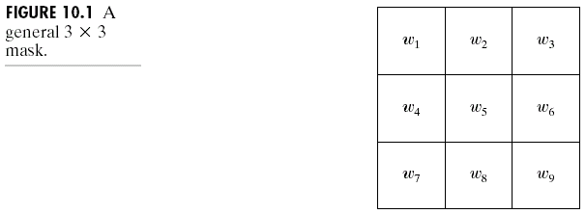
Detection of Discontinuities
There are three kinds of discontinuities of intensity: points, lines and edges.
The most common way to look for discontinuities is to scan a small mask over the image. The mask determines which kind of discontinuity to look for.

Slide 15
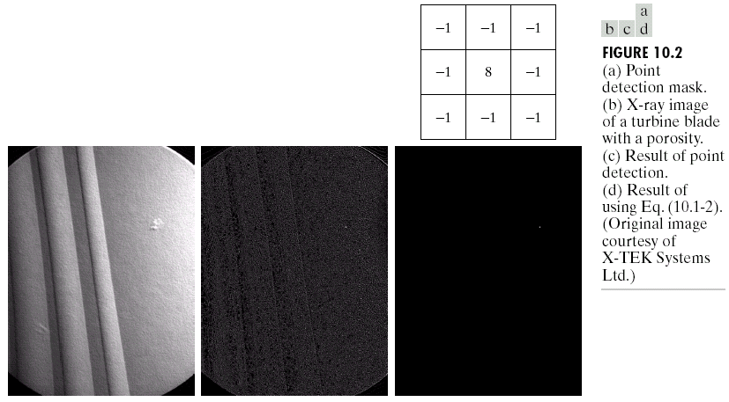
Detection of Discontinuities
Point Detection

Slide 16
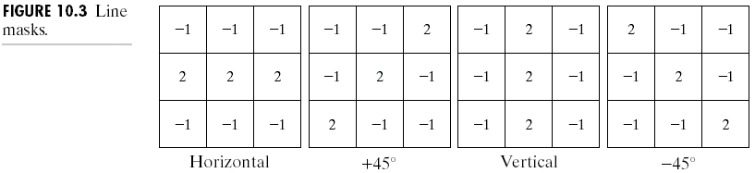
Detection of Discontinuities
Line Detection
Only slightly more common than point detection is to find a one pixel wide line in an image.
For digital images the only three point straight lines are only horizontal, vertical, or diagonal (+ or –45°).

Slide 17
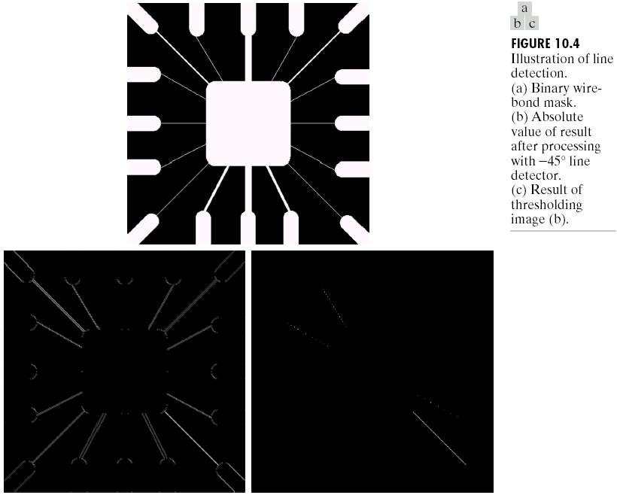
Detection of Discontinuities
Line Detection

Slide 18
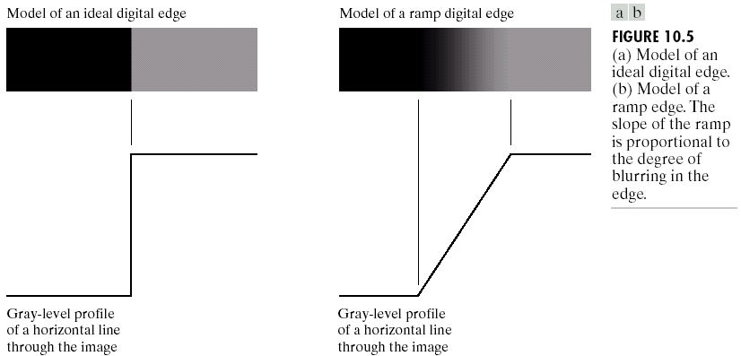
Detection of Discontinuities
Edge Detection

Slide 19
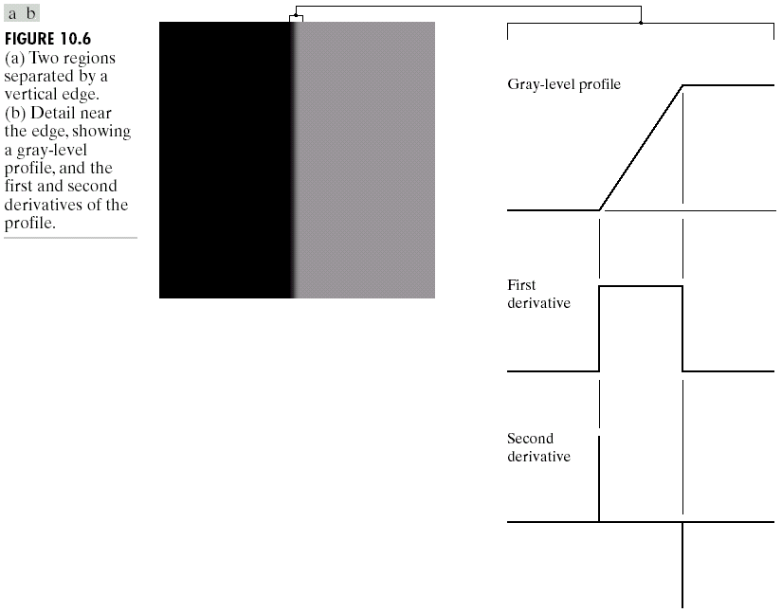
Detection of Discontinuities
Edge Detection

Slide 20
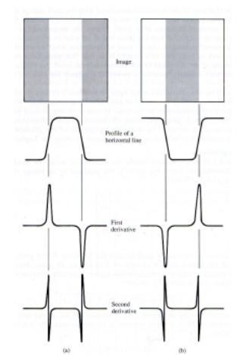

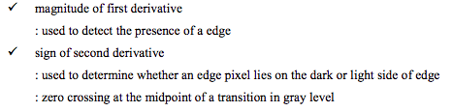

Slide 21

Detection of Discontinuities
Edge Detection

Slide 22
Detection of Discontinuities
Edge Detection

Slide 23
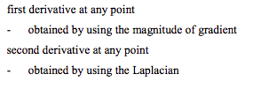
How to apply it?

Slide 24
Detection of Discontinuities by
Gradient Operators
First-order derivatives:
The gradient of an image f(x,y) at location (x,y) is defined as the vector:

Slide 25
For the edge detection operation, we are interested in the magnitude of the gradient
The magnitude of this vector:

Slide 26
Detection of Discontinuities
Gradient Operators
Roberts cross-gradient operators
Prewitt operators Horizontal, vertical
Sobel operators Horizontal, vertical

Slide 27
Detection of Discontinuities
Gradient Operators
Prewitt masks for
detecting diagonal edges
Sobel masks for
detecting diagonal edges

Slide 28
Difference
sobel edge operator gives an averaging effect, so due to the presence of spurious noise in the image to some extend the sobel can take care of it
prewitt operator can not handle the noise

Slide 29
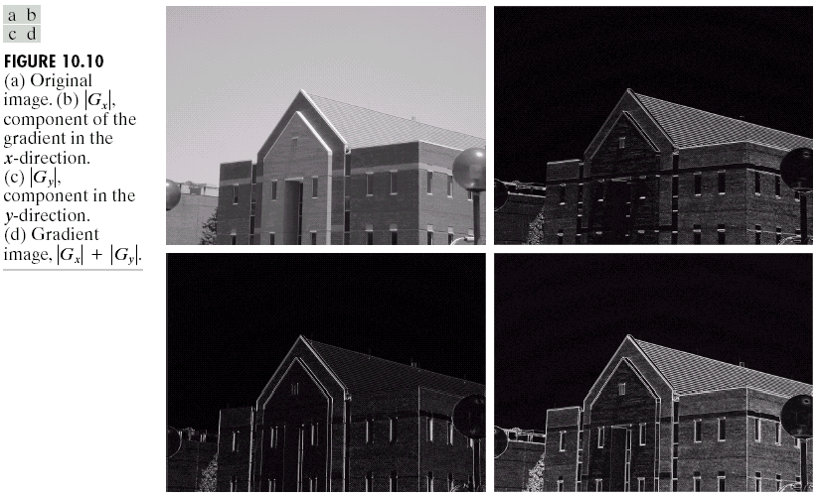
Detection of Discontinuities
Gradient Operators: Example

Slide 30
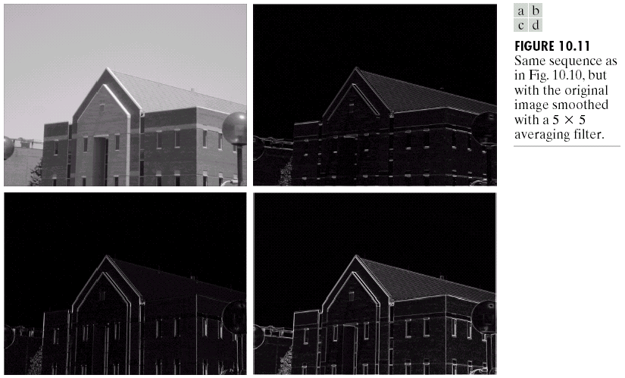
Detection of Discontinuities
Gradient Operators: Example

Slide 31
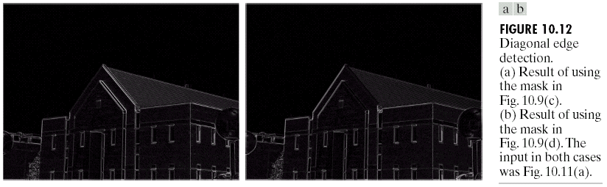
Detection of Discontinuities
Gradient Operators: Example

Slide 32
second derivative operator
the disadvantage of the second derivative operator
sensitive to noise
gives double edges
But the second derivative operators can be used to extract the secondary information.
whether a point lies on the darker side of the edge or the or the brighter side of the edge
The operator always gives a zero crossing between the positive side and the negative side and the zero crossing points accurately determine the location of an edge whenever an edge is a smooth edge.

Slide 33
second derivative operators are not normally used for this detection operation but they can be used for such a secondary information extraction.
one such second derivative operator is the Laplacian operator.

Slide 34
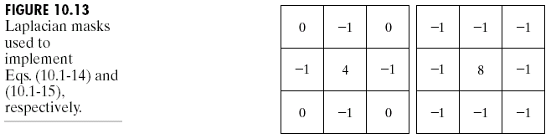
Detection of Discontinuities
Gradient Operators
Second-order derivatives: (The Laplacian)
The Laplacian of an 2D function f(x,y) is defined as
Two forms in practice:
horizontal and vertical directions diagonal directions

Slide 35
Laplacian operator is very sensitive to noise
To reduce the effect of noise we first smooth the image using a Gaussian operator
smooth image can then be operated Laplacian operator
Called as a Laplacian of Gaussian or LOG operator.

Slide 36
Detection of Discontinuities
Gradient Operators
Consider the function:
The Laplacian of h is
The Laplacian of a Gaussian sometimes is called the Mexican hat function. It also can be computed by smoothing the image with the Gaussian smoothing mask, followed by application of the Laplacian mask.
A Gaussian function
The Laplacian of a Gaussian (LoG)

Slide 37
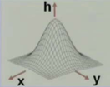
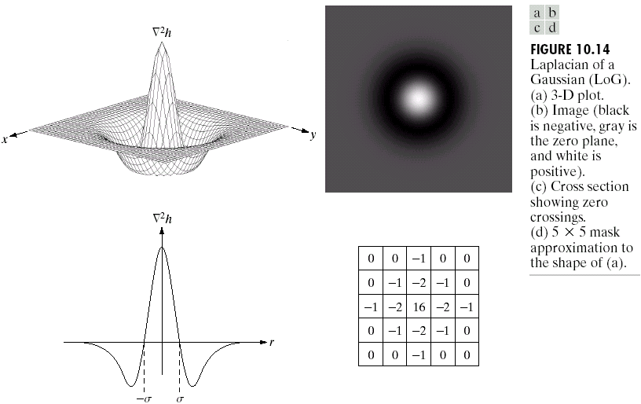
Detection of Discontinuities
Gradient Operators
^{Gaussian mask}

Slide 38
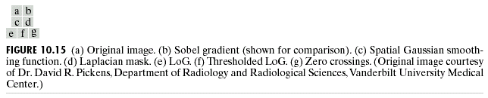
Detection of Discontinuities
Gradient Operators: Example
Sobel gradient
Laplacian mask

Slide 39
Link the edge points
When you apply the sobel operator to an image, the edges are not always connected
Can be because of the noise
Or non uniform illumination of the scene
We need to link the edge points to get some meaningful edges to extract some meaningful edge information.
There are 2 approaches by which linking can be done
Local processing
Global processing

Slide 40
Edge Linking and Boundary Detection
Local Processing
We need to take similarity measure of 2 points to link it
Two properties of edge points are useful for edge linking:
the strength (or magnitude) of the detected edge points
their directions (determined from gradient directions)
This is usually done in local neighborhoods.
Adjacent edge points with similar magnitude and direction are linked.

Slide 41
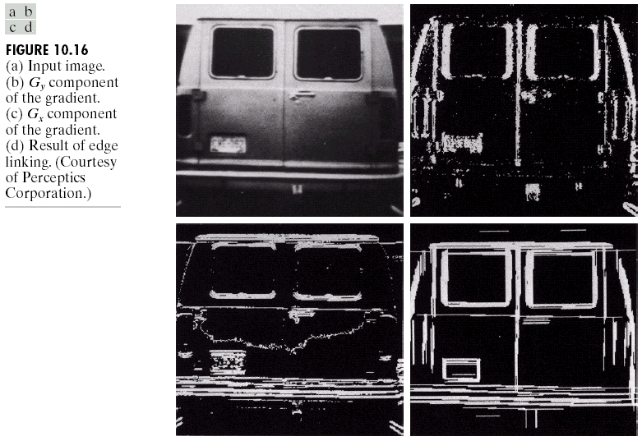
Edge Linking and Boundary Detection
Local Processing: Example
In this example,
we can find the
license plate
candidate after
edge linking
process.

Slide 42
Summery of the lecture
Image analysis
Image segmentation
Segmentation Algorithms
Discontinuities intensity:
points, lines and edges
Gradient Operators
Linking the edge points

Slide 43
References
Prof .P. K. Biswas Department of Electronics and Electrical Communication Engineering Indian Institute of Technology, Kharagpur
Gonzalez R. C. & Woods R.E. (2008). Digital Image Processing. Prentice Hall.
Forsyth, D. A. & Ponce, J. (2011).Computer Vision: A Modern Approach. Pearson Education.

