Slide 1
Digital Image Processing CSC331
Image Segmentation

Slide 2
Summery of previous lecture
Image analysis
Image segmentation
Segmentation Algorithms
Discontinuities intensity:
points, lines and edges
Gradient Operators
Linking the edge points

Slide 3
Todays lecture
Link the edge points
Local processing
Global processing
Hough transformation

Slide 4
Link the edge points
When you apply the sobel operator to an image, the edges are not always connected
Can be because of the noise
Or non uniform illumination of the scene
We need to link the edge points to get some meaningful edges to extract some meaningful edge information.
There are 2 approaches by which linking can be done
Local processing
Global processing

Slide 5
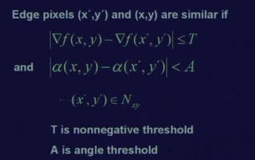
Edge Linking and Boundary Detection
Local Processing
We need to take similarity measure of 2 points to link it
Two properties of edge points are useful for edge linking:
the strength (or magnitude) of the detected edge points
their directions (determined from gradient directions)
This is usually done in local neighborhoods.
Adjacent edge points with similar magnitude and direction are linked.

Slide 6
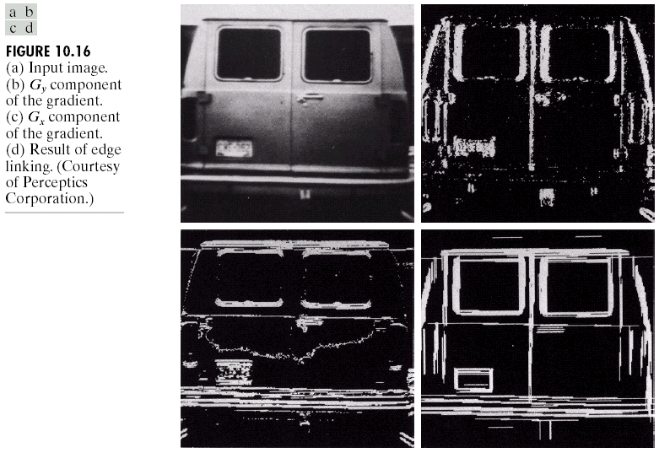
Edge Linking and Boundary Detection
Local Processing: Example
In this example,
we can find the
license plate
candidate after
edge linking
process.

Slide 7
Sometime we need the linking of the edge points that are discontinues and normally the neighborhood size that is taken is a small neighborhood.
The local processing technique does not help to link the edge points. We need the global processing technique.
Hough transformation

Slide 8
Hough transformation

Slide 11
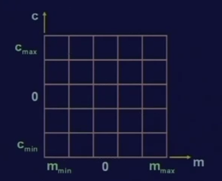

Slide 14
Now, the problem comes when this straight line tries to be vertical that is parallel to x axis.
slope of the straight line that is the value of m tends to be infinity and in this formulation,
The value of m which becomes very large or which tends to become infinite can not be handled
To solve this problem, instead of considering the slope intercept form, use the normal representation of a straight line.

Slide 15
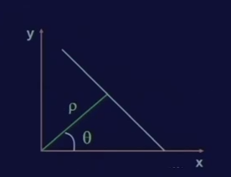

Slide 18
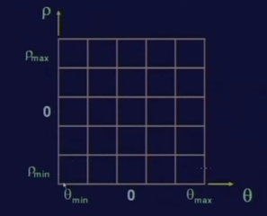

Slide 20
Edge Linking and Boundary Detection
Hough Transform Example
The intersection of the curves corresponding to points 1,3,5
2,3,4
1,4

Slide 21
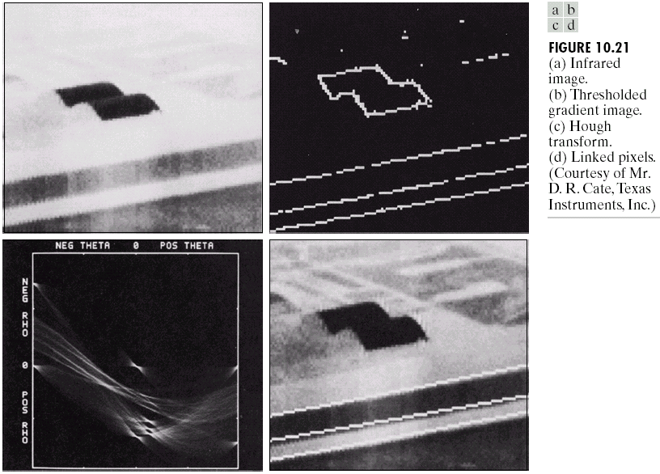
Edge Linking and Boundary Detection
Hough Transform Example

Slide 22
Summery of the lecture
Link the edge points
Local processing
Global processing
Hough transformation

Slide 23
References
Prof .P. K. Biswas Department of Electronics and Electrical Communication Engineering Indian Institute of Technology, Kharagpur
Gonzalez R. C. & Woods R.E. (2008). Digital Image Processing. Prentice Hall.
Forsyth, D. A. & Ponce, J. (2011).Computer Vision: A Modern Approach. Pearson Education.

