Slide 1
Digital Image Processing CSC331
Image Segmentation

Slide 2
Summery of previous lecture
Similarity base Image Segmentation
Image Segmentation by thresholding
Global threshold
Adaptive/Dynamic threshold
Local threshold

Slide 3
Todays lecture
There are two main approaches to region-based segmentation:
Region growing
Region splitting and merging
Texture based segmentation
Color based

Slide 4
Region-Based Segmentation
Edges and thresholds sometimes do not give good results for segmentation.
Region-based segmentation is based on the connectivity of similar pixels in a region.
Each region must be uniform.
Connectivity of the pixels within the region is very important.
There are two main approaches to region-based segmentation: region growing and region splitting.

Slide 5
Working of Region growing
Start from a set of seed points and from these points grow the regions by appending to each seed those neighbouring pixels that have similar properties
The selection of the seed points depends on the problem. When a priory information is not available, clustering techniques can be used: compute the above mentioned properties at every pixel and use the centroids of clusters
The selection of similarity criteria depends on the problem under consideration and the type of image data that is available
Descriptors must be used in conjunction with connectivity (adjacency) information
Formulation of a “stopping rule”. Growing a region should stop when no more pixels satisfy the criteria for inclusion in that region.
When a model of the expected results is partially available, the consideration of additional criteria like the size of the region, the likeliness between a candidate pixel and the pixels grown so far, and the shape of the region can improve the performance of the algorithm.

Slide 6
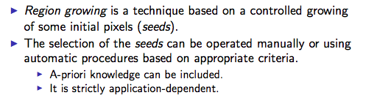
To conclude

Slide 7
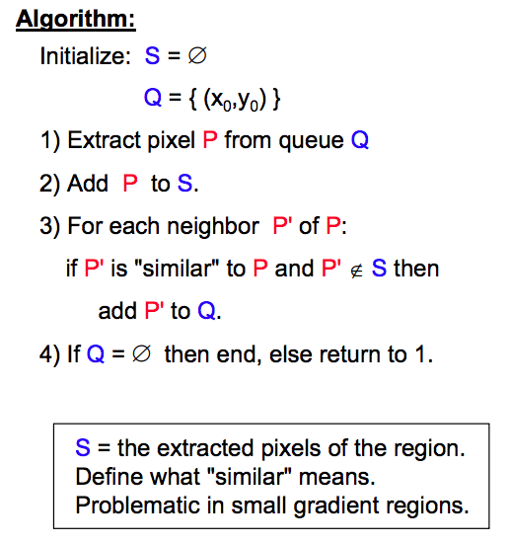

Slide 8
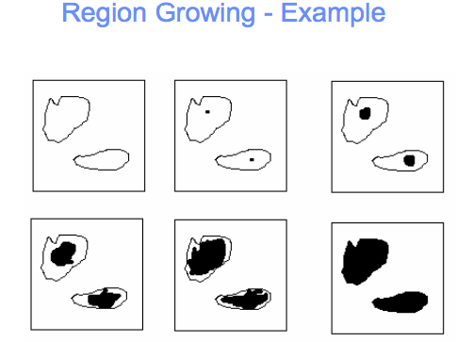

Slide 9
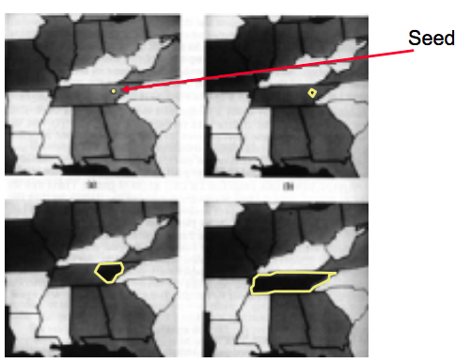

Slide 10
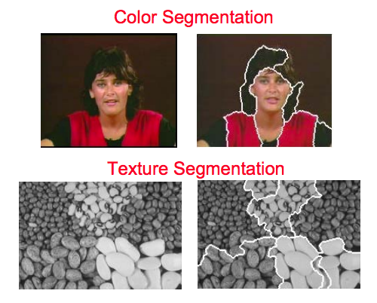

Slide 11
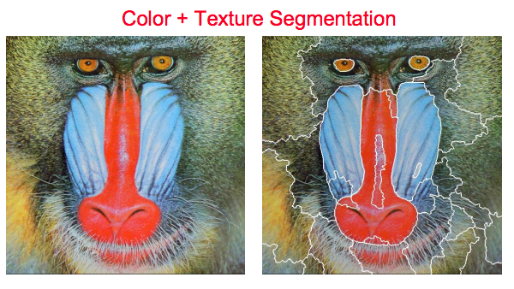

Slide 12
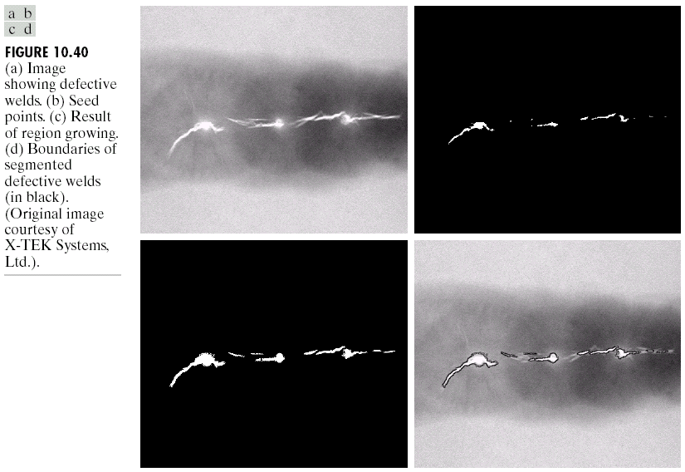
Region-Based Segmentation
Region Growing

Slide 13
Region-Based Segmentation
Region Growing
Fig. 10.41 shows the histogram of Fig. 10.40 (a). It is difficult to segment the defects by thresholding methods. (Applying region growing methods are better in this case.)
Figure 10.40(a)
Figure 10.41

Slide 14
Region splitting and merging
I Iterative subdivision of the image in homogeneous regions (splitting).
I Joining of the adjacent homogeneous regions (merging).

Slide 15
Region-Based Segmentation
Region Splitting and Merging
Region splitting is the opposite of region growing.
First there is a large region (possible the entire image).
Then a predicate (measurement) is used to determine if the region is uniform.
If not, then the method requires that the region be split into two regions.
Then each of these two regions is independently tested by the predicate (measurement).
This procedure continues until all resulting regions are uniform.

Slide 16
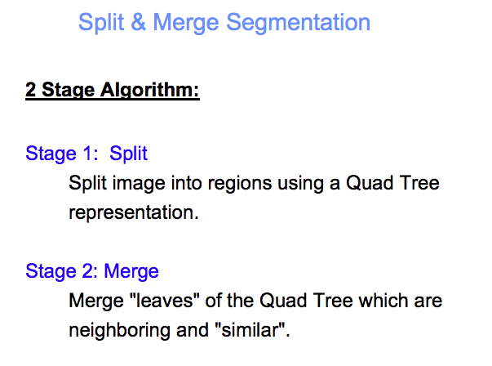

Slide 17
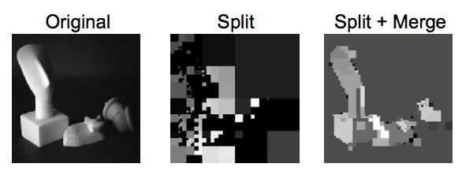

Slide 18
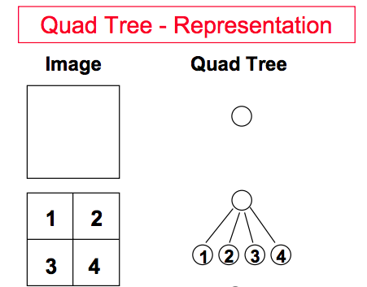

Slide 19
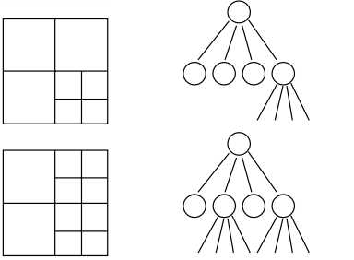
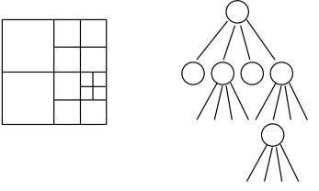

Slide 20
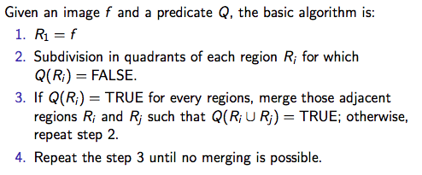
Working of S and M

Slide 21
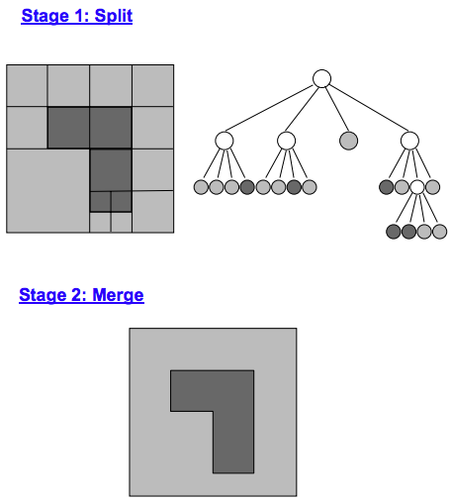

Slide 22
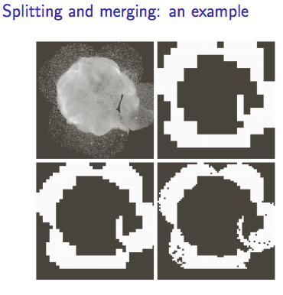
Original, 8x8,
16x16, 32x32

Slide 23
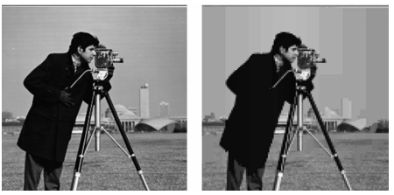
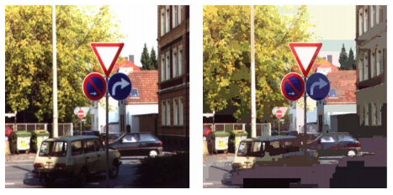

Slide 24
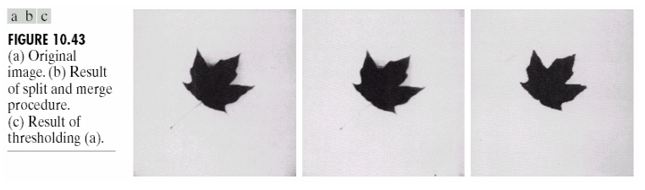
S and M compression with thresholding

Slide 25
Different other segmentation methods,
Graph-Cut Segmentation
Watershed
Watershed with marker
Texture based segmentation
Color based etc.

Slide 26
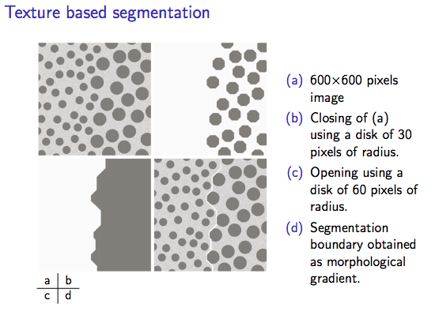

Slide 27
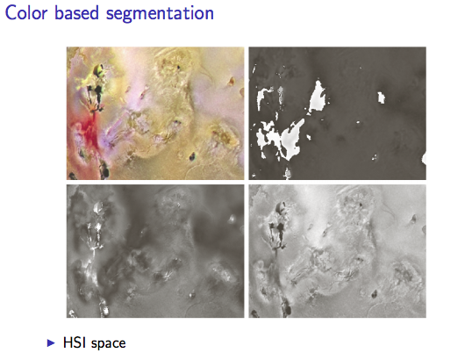

Slide 28
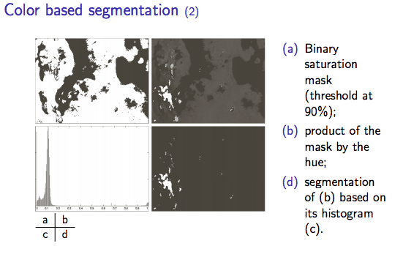

Slide 29
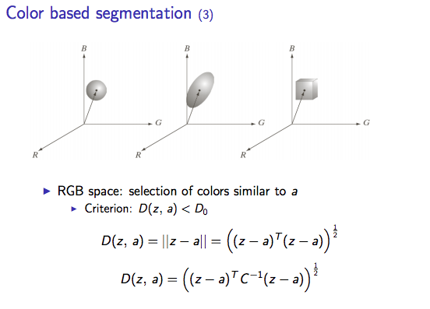

Slide 30
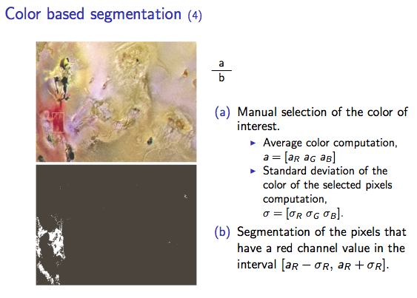

Slide 31
Summery of the lecture
There are two main approaches to region-based segmentation:
Region growing
Region splitting and merging
Texture based segmentation
Color based

Slide 32
References
Prof .P. K. Biswas Department of Electronics and Electrical Communication Engineering Indian Institute of Technology, Kharagpur
Gonzalez R. C. & Woods R.E. (2008). Digital Image Processing. Prentice Hall.
Forsyth, D. A. & Ponce, J. (2011).Computer Vision: A Modern Approach. Pearson Education.

