Slide 1
Digital Image Processing CSC331
Morphological image processing

Slide 2
Summery of previous lecture
Similarity base Image Segmentation
Region-based segmentation:
region growing and region splitting and merging
Color based segmentation

Slide 3
Todays lecture
Morphological image processing
Set points
Structuring Elements
Morphological operations
Dilation and Erosion

Slide 4
Introduction
Morphology: a branch of biology that deals with the form and structure of animals and plants
Morphological image processing is used to extract image components for representation and description of region shape, such as boundaries, skeletons, and the convex hull

Slide 5
Morphological Image Processing
The field of mathematical morphology contributes a wide range of operators to image processing, all based around a few simple mathematical concepts from set theory.
The operators are particularly useful for the analysis of binary images and common usages include edge detection, noise removal, image enhancement and image segmentation.

Slide 6
structuring element
Morphological techniques typically probe an image with a small shape or template known as a structuring element.
The structuring element is positioned at all possible locations in the image and it is compared with the corresponding neighborhood of pixels.
Morphological operations differ in how they carry out this comparison.

Slide 7
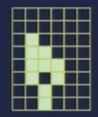
Set points

Slide 8
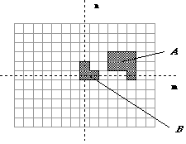
Fundamental Definitions
We defined an image as an (amplitude) function of two, real (coordinate) variables a(x,y) or two, discrete variables a[m,n]. An alternative definition of an image can be based on the notion that an image consists of a set (or collection) of either continuous or discrete coordinates. In a sense the set corresponds to the points or pixels that belong to the objects in the image.
This is illustrated in Figure which contains two objects or sets A and B. Note that the coordinate system is required. For the moment we will consider the pixel values to be binary.
Figure : A binary image containing two object sets A and B.

Slide 9
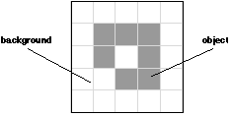
Fundamental Definitions
The object A consists of those pixels a that share some common property:
Object -
The background of A is given by A^{c} (the complement of A) which is defined as those elements that are not in A:
Background -

Slide 10
Fundamental Definitions
The fundamental operations associated with an object are the standard set operations union, intersection, and complement plus translation:

Slide 11
Some Basic Concepts from Set Theory
If a=(a1,a2) is an element of A, then we write: a∈ A
If a is not an element of A , we write: a∉ A
The set with no elements is called the null or empty set and is denoted by the symbol ∅.
If every element of a set A is also an element of another set B, then a is said to be a subset of B, denoted as A ⊆ B
The union of two sets A and B, denoted by C=A∪ B
Is the set of all elements belonging to either A,B or both
The intersection of two sets A and B, denoted by D=A ∩ B;
Is the set of all elements belonging to both A and B
Two sets A and B are said to be disjoint or mutually exclusive if they have no common elements. A ∩ B = ∅

Slide 12
Structuring Elements
The structuring element is sometimes called the kernel, but we reserve that term for the similar objects used in convolutions.
The structuring element consists of a pattern specified as the coordinates of a number of discrete points relative to some origin. Normally Cartesian coordinates are used and so a convenient way of representing the element is as a small image on a rectangular grid.
Figure 1 shows a number of different structuring elements of various sizes. In each case the origin is marked by a ring around that point. The origin does not have to be in the center of the structuring element, but often it is.
As suggested by the figure, structuring elements that fit into a 3×3 grid with its origin at the center are the most commonly seen type.

Slide 13
Structuring Elements
Figure 1 Some example structuring elements.

Slide 14
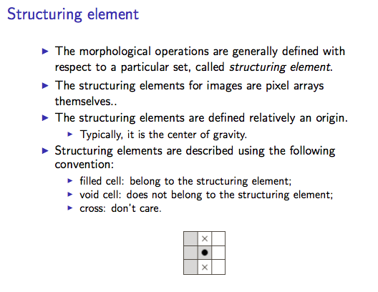

Slide 15
Examples: Structuring Elements

Slide 16
Sstructuring Element
Note that each point in the structuring element may have a value. In the simplest structuring elements used with binary images for operations such as erosion, the elements only have one value, conveniently represented as a one. More complicated elements, such as those used with thinning or grayscale morphological operations, may have other pixel values.
The structuring element is already just a set of point coordinates (although it is often represented as a binary image).
It differs from the input image coordinate set in that it is normally much smaller, and its coordinate origin is often not in a corner, so that some coordinate elements will have negative values.
Note that in many implementations of morphological operators, the structuring element is assumed to be a particular shape (e.g. a 3×3 square) and so is hardwired into the algorithm.

Slide 17
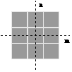
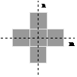
Sstructuring Element
The two most common structuring elements (given a Cartesian grid) are the 4-connected and 8-connected sets, N₄ and N₈. They are illustrated in Figure .
Figure: The standard structuring elements N₄ and N₈.

Slide 18
Fundamental Morphological Operations
Erosion and dilation work (at least conceptually) by translating the structuring element to various points in the input image, and examining the intersection between the translated kernel coordinates and the input image coordinates.
Virtually all other mathematical morphology operators can be defined in terms of combinations of erosion and dilation along with set operators such as intersection and union. Some of the more important are opening, closing and skeletonization.

Slide 19
Dilation
The basic effect of the operator on a binary image is to gradually enlarge the boundaries of regions of foreground pixels (i.e. white pixels, typically). Thus areas of foreground pixels grow in size while holes within those regions become smaller.

Slide 21
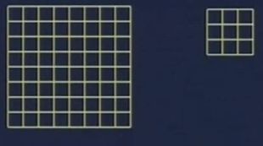
Working of dilation

Slide 22
Dilation - How It Works
The dilation operator takes two pieces of data as inputs. The first is the image which is to be dilated. The second is a (usually small) set of coordinate points known as a structuring element (also known as a kernel). It is this structuring element that determines the precise effect of the dilation on the input image.
The mathematical definition of dilation for binary images is as follows:
Suppose that X is the set of Euclidean coordinates corresponding to the input binary image, and that K is the set of coordinates for the structuring element.
Let Kx denote the translation of K so that its origin is at x.
Then the dilation of X by K is simply the set of all points x such that the intersection of Kx with X is non-empty.

Slide 23
Dilation - How It Works
To compute the dilation of a binary input image by this structuring element, we consider each of the background pixels in the input image in turn. For each background pixel (which we will call the input pixel) we superimpose the structuring element on top of the input image so that the origin of the structuring element coincides with the input pixel position.
If at least one pixel in the structuring element coincides with a foreground pixel in the image underneath, then the input pixel is set to the foreground value. If all the corresponding pixels in the image are background, however, the input pixel is left at the background value.
For our example 3×3 structuring element, the effect of this operation is to set to the foreground color any background pixels that have a neighboring foreground pixel (assuming 8-connectedness). Such pixels must lie at the edges of white regions, and so the practical upshot is that foreground regions grow (and holes inside a region shrink).

Slide 24
Guidelines for Use
Most implementations of this operator expect the input image to be binary, usually with foreground pixels at pixel value 255, and background pixels at pixel value 0. Such an image can often be produced from a grayscale image using thresholding. It is important to check that the polarity of the input image is set up correctly for the dilation implementation being used.
A larger structuring element produces a more extreme dilation effect, although usually very similar effects can be achieved by repeated dilations using a smaller but similarly shaped structuring element. With larger structuring elements, it is quite common to use an approximately disk shaped structuring element, as opposed to a square one.

Slide 25
Effect of dilation

Slide 26


Guidelines for Use
This image was produced by two dilation passes using a disk shaped structuring element of 11 pixels radius. Note that the corners have been rounded off. In general, when dilating by a disk shaped structuring element, convex boundaries will become rounded, and concave boundaries will be preserved as they are.

Slide 27


Guidelines for Use
There are many specialist uses for dilation. For instance it can be used to fill in small spurious holes (`pepper noise') in images
The image shows the result of dilating this image with a 3×3 square structuring element. Note that although the noise has been effectively removed, the image has been degraded significantly.

Slide 28

Guidelines for Use
Dilation can also be used for edge detection by taking the dilation of an image and then subtracting away the original image, thus highlighting just those new pixels at the edges of objects that were added by the dilation. For example, starting with

Slide 29
Erosion-How It Works
The erosion operator takes two pieces of data as inputs. The first is the image which is to be eroded.
The second is a (usually small) set of coordinate points known as a structuring element (also known as a kernel ).
It is this structuring element that determines the precise effect of the erosion on the input image.

Slide 30
The mathematical definition of erosion for binary images is as follows:

Slide 31
Erosion
The basic effect of the operator on a binary image is to erode away the boundaries of regions of foreground pixels (i.e. white pixels, typically). Thus areas of foreground pixels shrink in size, and holes within those areas become larger
Figure 2 Effect of erosion using a 3×3 square structuring element
Strip away a layer of pixels from an object, shrinking it in the process.

Slide 32
Erosion-How It Works
As an example of binary erosion, suppose that the structuring element is a 3×3 square, with the origin at its center as shown in Figure 2. Note that in this and subsequent diagrams, foreground pixels are represented by 1's and background pixels by 0's.
Figure 2
The erosion of a binary image A by a binary image B is 1 at a pixel p if and only if every 1 pixel in the translation of B to p is also 1 in A.

Slide 33
Erosion-How It Works
To compute the erosion of a binary input image by this structuring element, we consider each of the foreground pixels in the input image in turn. For each foreground pixel (which we will call the input pixel) we superimpose the structuring element on top of the input image so that the origin of the structuring element coincides with the input pixel coordinates.
If for every pixel in the structuring element, the corresponding pixel in the image underneath is a foreground pixel, then the input pixel is left as it is. If any of the corresponding pixels in the image are background, however, the input pixel is also set to background value.
For our example 3×3 structuring element, the effect of this operation is to remove any foreground pixel that is not completely surrounded by other white pixels (assuming 8-connectedness). Such pixels must lie at the edges of white regions, and so the practical upshot is that foreground regions shrink (and holes inside a region grow).

Slide 34
Erosion-Guidelines for Use
Most implementations of this operator will expect the input image to be binary, usually with foreground pixels at intensity value 255, and background pixels at intensity value 0. Such an image can often be produced from a grayscale image using thresholding. It is important to check that the polarity of the input image is set up correctly for the erosion implementation being used.
The structuring element may have to be supplied as a small binary image, or in a special matrix format, or it may simply be hardwired into the implementation, and not require specifying at all. In this latter case, a 3×3 square structuring element is normally assumed which gives the shrinking effect described above. The effect of an erosion using this structuring element on a binary image is shown in Figure 3

Slide 35
Erosion-Guidelines for Use
The 3×3 square is probably the most common structuring element used in erosion operations, but others can be used. A larger structuring element produces a more extreme erosion effect, although usually very similar effects can be achieved by repeated erosions using a smaller similarly shaped structuring element.
Erosions can be made directional by using less symmetrical structuring elements.
For example, a structuring element that is 10 pixels wide and 1 pixel high will erode in a horizontal direction only. Similarly, a 3×3 square structuring element with the origin in the middle of the top row rather than the center, will erode the bottom of a region more severely than the top.

Slide 36

Erosion-Guidelines for Use
This image is the result of eroding four times with a disk shaped structuring element 11 pixels in diameter. It shows that the hole in the middle of the image increases in size as the border shrinks. Note that the shape of the region has been quite well preserved due to the use of a disk shaped structuring element. In general, erosion using a disk shaped structuring element will tend to round concave boundaries, but will preserve the shape of convex boundaries.

Slide 37

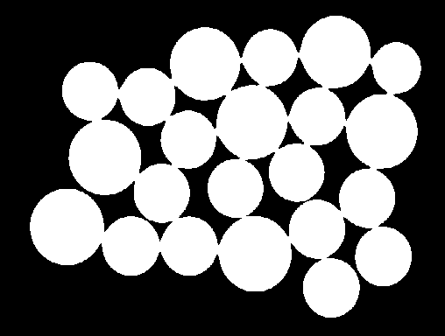
Erosion-Guidelines for Use
There are many specialist uses for erosion. One of the more common is to separate touching objects in a binary image so that they can be counted using a labeling algorithm. The image shows a number of dark disks (coins in fact) silhouetted against a light background
The result of thresholding the image at pixel value 90 yields :
It is required to count the coins. However, this is not going to be easy since the touching coins form a single fused region of white, and a counting algorithm would have to first segment this region into separate coins before counting, a non-trivial task

Slide 38

Erosion-Guidelines for Use
.The situation can be much simplified by eroding the image
The image shows the result of eroding twice using a disk shaped structuring element 11 pixels in diameter. All the coins have been separated neatly and the original shape of the coins has been largely preserved. At this stage a labeling algorithm can be used to count the coins. The relative sizes of the coins can be used to distinguish the various types by, for example, measuring the area of each distinct region.

Slide 39

Erosion-Guidelines for Use
The image is derived from the same input picture, but a 9×9 square structuring element is used instead of a disk (the two structuring elements have approximately the same area). The coins have been clearly separated as before, but the square structuring element has led to distortion of the shapes, which is some situations could cause problems in identifying the regions after erosion.

Slide 40
Erosion-Guidelines for Use
Erosion can also be used to remove small spurious bright spots (`salt noise‘ ) in images.
We can also use erosion for edge detection by taking the erosion of an image and then subtracting it away from the original image, thus highlighting just those pixels at the edges of objects that were removed by the erosion.
Finally, erosion is also used as the basis for many other mathematical morphology operators.

Slide 41
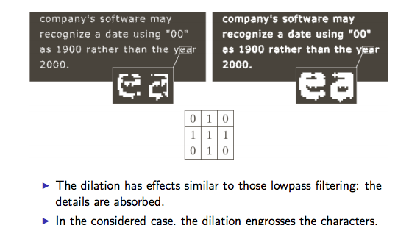
Dilation

Slide 42
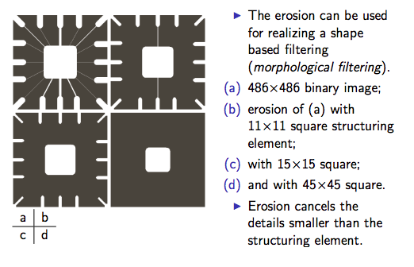
Erosion

Slide 43
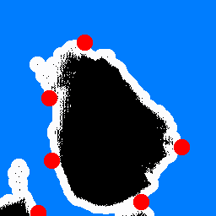

Effect of Dilation and Erosion
Original Binary Image: Black
Structure Element: Red
Resultant Image: White
a)Dilation
b)Erosion
B) We must imagine that we are sliding the structuring element around the boundary on the inside of the object

Slide 44
Summery of the lecture
Morphological image processing
Set points
Structuring Elements
Morphological operations
Dilation and Erosion

Slide 45
References
Prof .P. K. Biswas Department of Electronics and Electrical Communication Engineering Indian Institute of Technology, Kharagpur
Gonzalez R. C. & Woods R.E. (2008). Digital Image Processing. Prentice Hall.
Forsyth, D. A. & Ponce, J. (2011).Computer Vision: A Modern Approach. Pearson Education.

