Slide 1
Digital Image Processing CSC331
Morphological image processing

Slide 2
Summery of previous lecture
Morphological image processing
Set points
Structuring Elements
Morphological operations
Dilation and Erosion

Slide 3
Todays lecture
Morphological closing
Morphological opening
Hit and Miss transform
Boundary extraction
Region filling
Extraction of connected component
Thinning
Thickening
Skeletonization

Slide 5
Closing
Closing is similar in some ways to dilation in that it tends to enlarge the boundaries of foreground (bright) regions in an image (and shrink background color holes in such regions), but it is less destructive of the original boundary shape. As with other morphological operators, the exact operation is determined by a structuring element.
The effect of the operator is to preserve background regions that have a similar shape to this structuring element, or that can completely contain the structuring element, while eliminating all other regions of background pixels. a

Slide 6
Closing - Guidelines for Use
One of the uses of dilation is to fill in small background color holes in images, e.g. `pepper noise'.
One of the problems with doing this, however, is that the dilation will also distort all regions of pixels indiscriminately. By performing an erosion on the image after the dilation, i.e. a closing, we reduce some of this effect. The effect of closing can be quite easily visualized. Imagine taking the structuring element and sliding it around outside each foreground region, without changing its orientation.
For any background boundary point, if the structuring element can be made to touch that point, without any part of the element being inside a foreground region, then that point remains background. If this is not possible, then the pixel is set to foreground. After the closing has been carried out the background region will be such that the structuring element can be made to cover any point in the background without any part of it also covering a foreground point, and so further closings will have no effect. This property is known as idempotence

Slide 7
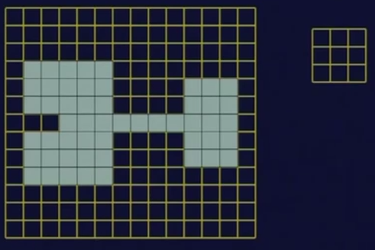
Closing

Slide 8
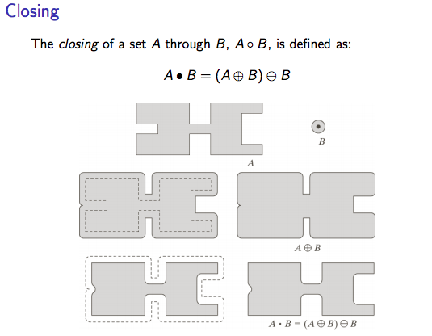

Slide 9
Closing - Guidelines for Use
Figure: Effect of closing using a 3×3 square structuring element

Slide 10


Closing - Guidelines for Use
An image containing large holes and small holes. If it is desired to remove the small holes while retaining the large holes, then we can simply perform a closing with a disk-shaped structuring element with a diameter larger than the smaller holes, but smaller than the large holes.
The image is the result of a closing with a 22 pixel diameter disk.

Slide 11
Opening
The basic effect of an opening is somewhat like erosion in that it tends to remove some of the foreground (bright) pixels from the edges of regions of foreground pixels. However it is less destructive than erosion in general. As with other morphological operators, the exact operation is determined by a structuring element.
The effect of the operator is to preserve foreground regions that have a similar shape to this structuring element, or that can completely contain the structuring element, while eliminating all other regions of foreground pixels.

Slide 12
Opening - Guidelines for Use
While erosion can be used to eliminate small clumps of undesirable foreground pixels, e.g. `salt noise', quite effectively, it has the big disadvantage that it will affect all regions of foreground pixels. Opening gets around this by performing both an erosion and a dilation on the image.
The effect of opening can be quite easily visualized. Imagine taking the structuring element and sliding it around inside each foreground region, without changing its orientation.
All pixels which can be covered by the structuring element with the structuring element being entirely within the foreground region will be preserved.
However, all foreground pixels which cannot be reached by the structuring element without parts of it moving out of the foreground region will be eroded away. After the opening has been carried out, the new boundaries of foreground regions will all be such that the structuring element fits inside them, and so further openings with the same element have no effect.

Slide 13
Opening

Slide 14
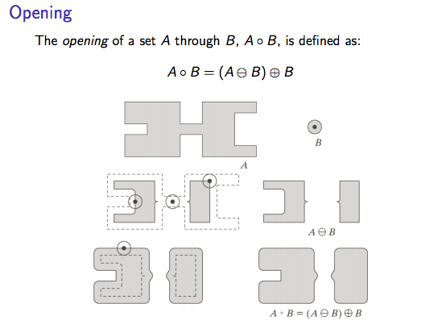

Slide 15


Opening - Guidelines for Use
A binary image containing a mixture of circles and lines. Suppose that we want to separate out the circles from the lines, so that they can be counted. Opening with a disk shaped structuring element 11 pixels in diameter gives
Some of the circles are slightly distorted, but in general, the lines have been almost completely removed while the circles remain almost completely unaffected.

Slide 16



Opening - Guidelines for Use
Suppose that this time we wish to separately extract the horizontal and vertical lines.
The result of an opening with a 3×9 vertically oriented structuring element is shown in
The image shows what happens if we use a 9×3 horizontally oriented structuring element instead. Note that there are a few glitches in this last image where the diagonal lines cross vertical lines.

Slide 17


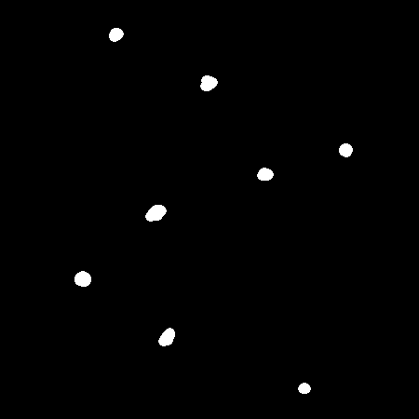
Opening - Guidelines for Use
The image contains two kinds of cell: small, black ones and larger, gray ones. Thresholding the image at a value of 210 yields
We want to retain only the large cells in the image, while removing the small ones. This can be done with straightforward opening. Using a 11 pixel circular structuring element yields

Slide 18
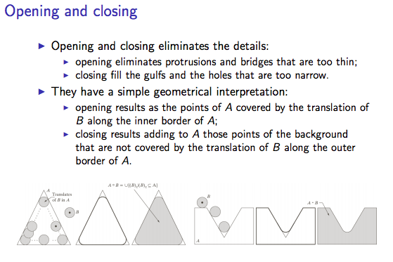

Slide 19
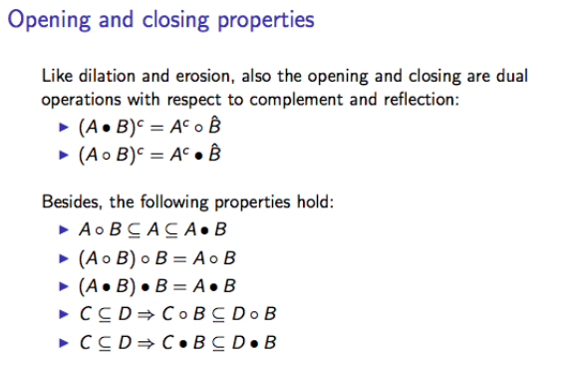

Slide 20
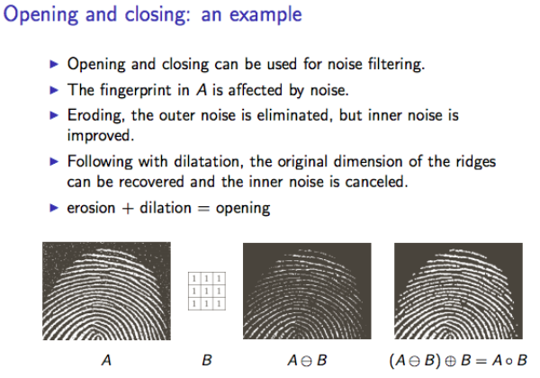

Slide 21
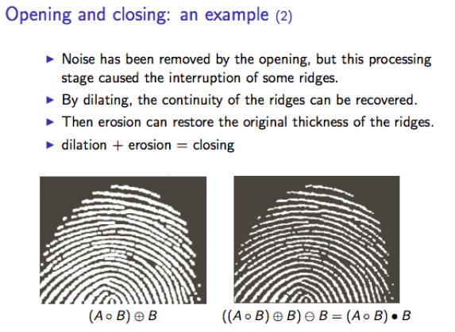

Slide 22
The hit-and-miss transform
The hit-and-miss transform is a general binary morphological operation that can be used to look for particular patterns of foreground and background pixels in an image.
The hit-and-miss operation is performed in much the same way as other morphological operators, by translating the origin of the structuring element to all points in the image, and then comparing the structuring element with the underlying image pixels.
If the foreground and background pixels in the structuring element exactly match foreground and background pixels in the image, then the pixel underneath the origin of the structuring element is set to the foreground color.
If it doesn't match, then that pixel is set to the background color.

Slide 23
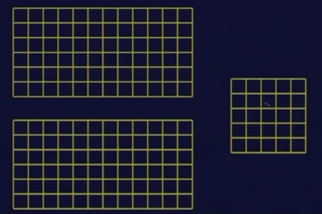

Slide 24
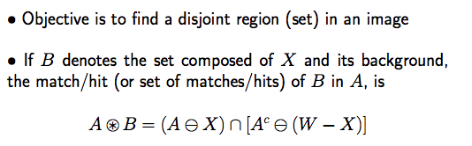
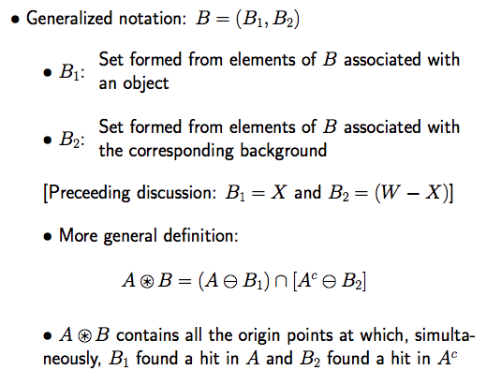

Slide 25
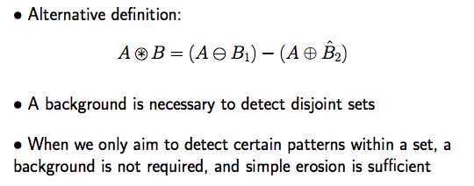

Slide 26
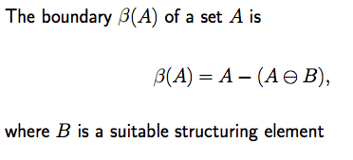
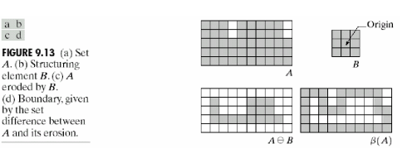
Boundary extraction

Slide 27
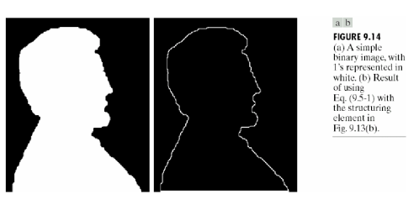

Slide 28
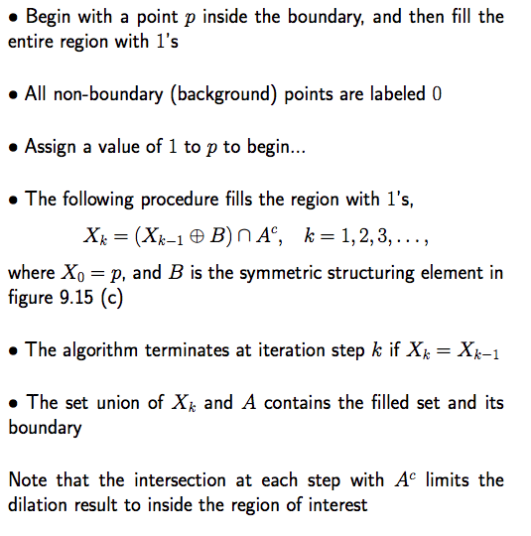
Region filling

Slide 29
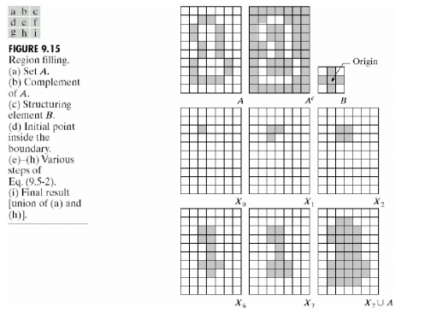

Slide 30
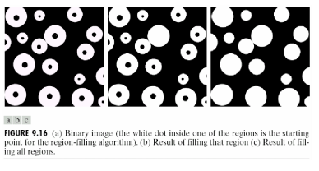

Slide 31
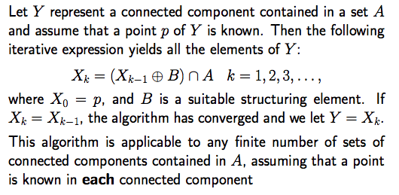
Extraction of connected component

Slide 32
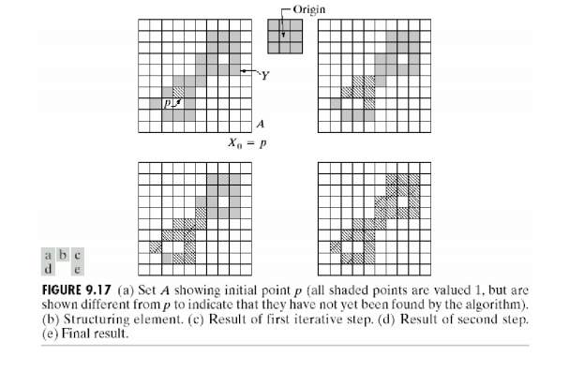

Slide 33
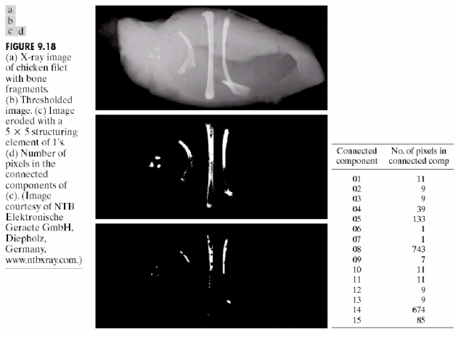

Slide 34
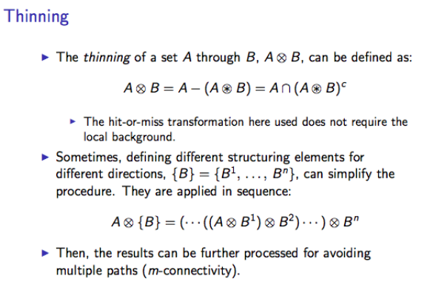

Slide 35
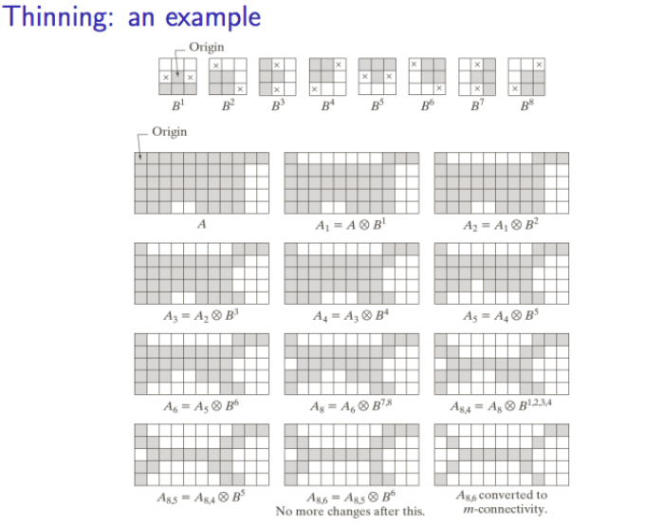

Slide 36
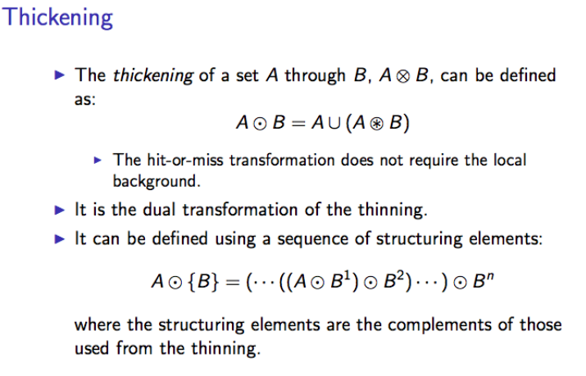

Slide 37
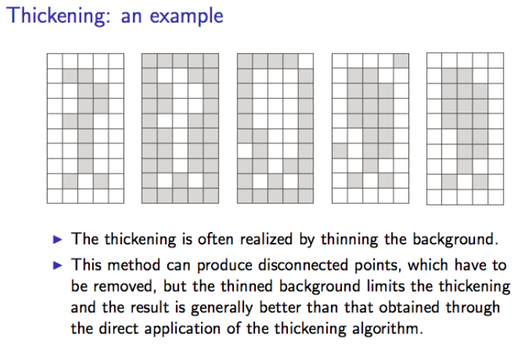

Slide 38
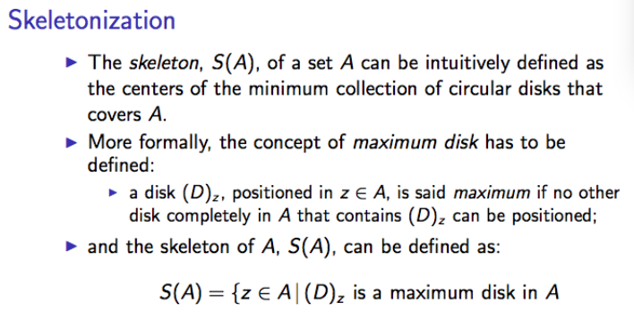

Slide 39
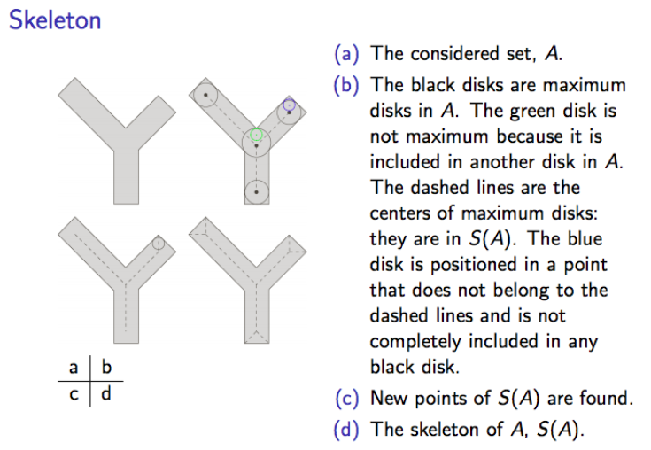

Slide 40
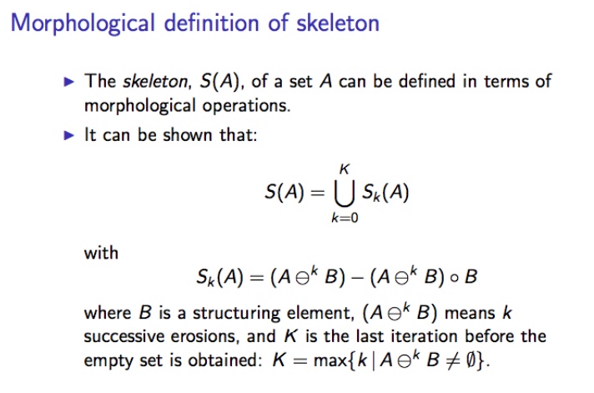

Slide 41
Summery of the lecture
Morphological closing
Morphological opening
Hit and Miss transform
Boundary extraction
Region filling
Extraction of connected component
Thinning
Thickening
Skeletonization

Slide 42
References
Prof .P. K. Biswas Department of Electronics and Electrical Communication Engineering Indian Institute of Technology, Kharagpur
Gonzalez R. C. & Woods R.E. (2008). Digital Image Processing. Prentice Hall.
Forsyth, D. A. & Ponce, J. (2011).Computer Vision: A Modern Approach. Pearson Education.

