Slide 1
Digital Image Processing CSC331
Object Representation

Slide 2
Summery of previous lecture
Morphological image processing
Morphological operations
Dilation and Erosion
Morphological closing
Morphological opening
Hit and Miss transform
Boundary extraction
Region filling
Extraction of connected component
Thinning
Thickening
Skeletonization

Slide 3
Todays lecture
image understanding
Define the Image objects representation mechanism
Use of the segmentation
representations
boundary based segmentation
region based segmentation
Description
boundary based segmentation
region based segmentation

Slide 4
Representation and Description
A segmented region can be represented by
boundary pixels
internal pixels
When shape is important, a boundary (external) representation is used
When colour or texture is important, an internal representation is used
The description of a region is based on its representation, for example a boundary can be described by its length
The features selected as descriptors are usually required to be as insensitive as possible to variations in
(1) scale,
(2) translation and
(3) rotation

Slide 5
Representation
Image data, for example a boundary, is usually represented in a more compact way so that it can be described more easily
Skeletonization, that is the process that reduces the boundary of a region to a graph (which is a single pixel thick), often pre- cedes other representation schemes and is therefore discussed first..

Slide 6
Chain Codes
Assumption: thinning algorithm already applied to edge pixels
Generation of chain code: follow the boundary in an anti-clockwise direction and assign a direction to the segment between successive
Difficulties:
Noise changes the code
pixels Code generally very long
Solution:
Resample the boundary using a larger grid spacing New boundary represented by 4- or 8-directional chain code

Slide 7
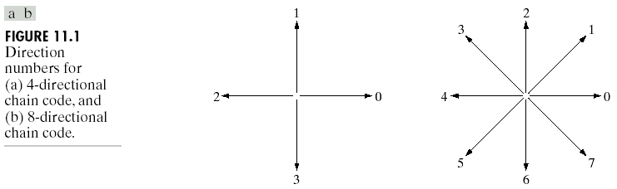
Chain codes: represent a boundary of a connected region and its moves are define

Slide 8
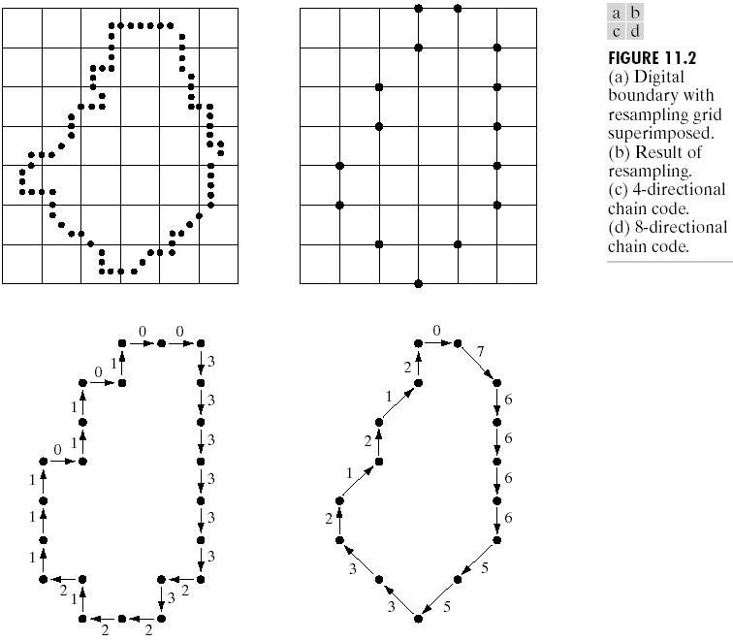
Representation
Chain Codes

Slide 9
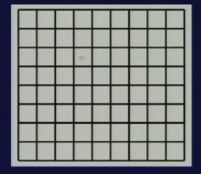
Chain code depends on starting point
Chain code is not Rotation invariance

Slide 10
Chain code is not Rotation invariance
Deferential chain code
Go counter-clockwise
Count the difference
Consider it as a cycle instead of chain
by this we can achieve rotation, translation and Scale invariance: change in grid size

Slide 11
Boundary Descriptors
There are several simple geometric measures that can be useful for describing a boundary.
The length of a boundary: the number of pixels along a boundary gives a rough approximation of its length.
Curvature: the rate of change of slope
To measure a curvature accurately at a point in a digital boundary is difficult
The difference between the slops of adjacent boundary segments is used as a descriptor of curvature at the point of intersection of segments

Slide 12
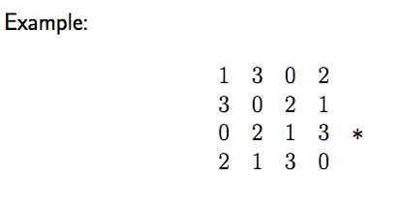
Shape numbers as a Description
To understand the objects we can use this code to identify the object (not from color or texture) only from the boundary
How do we do it?
Consider the code to be circular and choose the starting point in such a way that the sequence represents the smallest integer

Slide 13
Boundary Descriptors
Shape Numbers
First difference
The shape number of a boundary is defined as the first difference of smallest magnitude.
The order n of a shape number is defined as the number of digits in its representation.

Slide 14
Boundary Descriptors
Shape Numbers

Slide 15
Representation
Polygonal Approximations
Polygonal approximations: to represent a boundary by straight line segments, and a closed path becomes a polygon.
The number of straight line segments used determines the accuracy of the approximation.
Only the minimum required number of sides necessary to preserve the needed shape information should be used (Minimum perimeter polygons).
A larger number of sides will only add noise to the model.

Slide 16
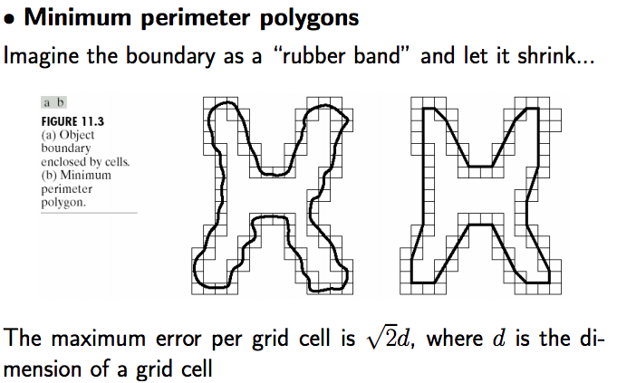

Slide 17
Representation
Polygonal Approximations
Minimum perimeter polygons: (Merging and splitting)
Merging and splitting are often used together to ensure that vertices appear where they would naturally in the boundary.
A least squares criterion to a straight line is used to stop the processing.

Slide 18
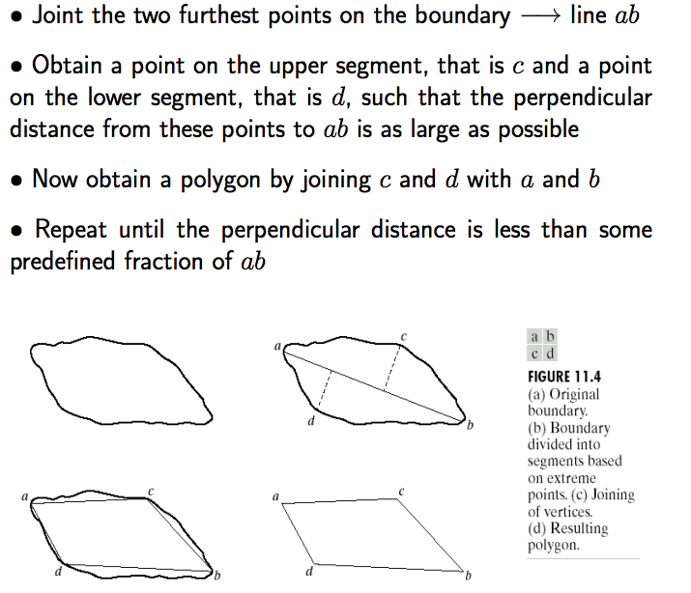

Slide 19
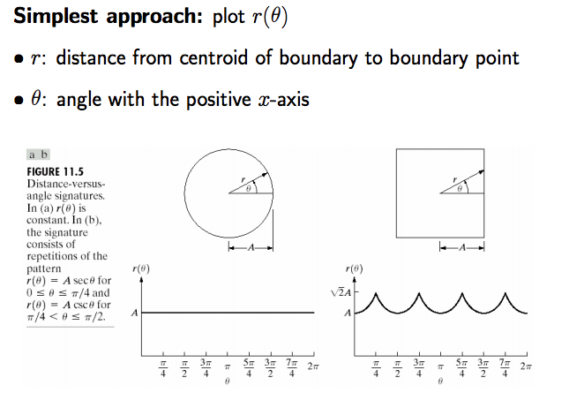
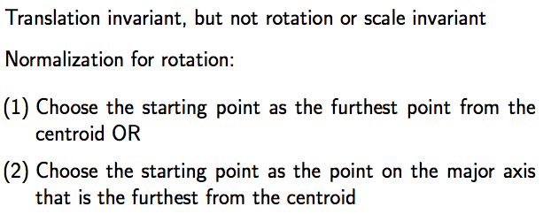
Representation
Signature
The idea behind a signature is to convert a two dimensional boundary into a representative one dimensional function.

Slide 20
Representation
Signature
Signatures are invariant to location, but will depend on rotation and scaling.
Starting at the point farthest from the reference point or using the major axis of the region can be used to decrease dependence on rotation.
Scale invariance can be achieved by either scaling the signature function to fixed amplitude or by dividing the function values by the standard deviation of the function.

Slide 21
Boundary Descriptors
Fourier Descriptors
This is a way of using the Fourier transform to analyze the shape of a boundary.
The x-y coordinates of the boundary are treated as the real and imaginary parts of a complex number.
Then the list of coordinates is Fourier transformed using the DFT (chapter 4).
The Fourier coefficients are called the Fourier descriptors.
The basic shape of the region is determined by the first several coefficients, which represent lower frequencies.
Higher frequency terms provide information on the fine detail of the boundary.

Slide 22
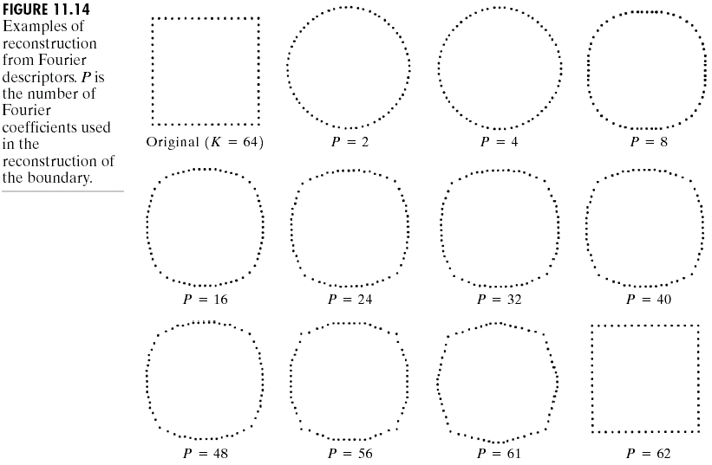
Boundary Descriptors
Fourier Descriptors

Slide 23
Boundary Descriptors
Statistical Moments
Moments are statistical measures of data.
They come in integer orders.
Order 0 is just the number of points in the data.
Order 1 is the sum and is used to find the average.
Order 2 is related to the variance, and order 3 to the skew of the data.
Higher orders can also be used, but don’t have simple meanings.

Slide 24
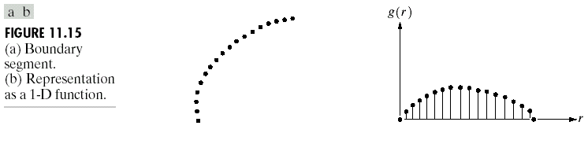
Boundary Descriptors
Statistical Moments
Let r be a random variable, and g(r_{i}) be normalized (as the probability of value r_{i} occurring), then the moments are

Slide 25
Regional Descriptors
Some simple descriptors
The area of a region: the number of pixels in the region
The perimeter of a region: the length of its boundary
The compactness of a region: (perimeter)²/area
The mean and median of the gray levels
The minimum and maximum gray-level values
The number of pixels with values above and below the mean

Slide 26
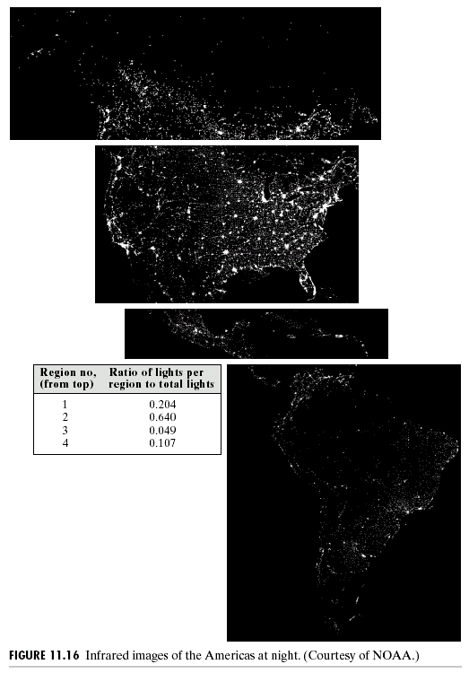
Regional Descriptors
Example

Slide 27
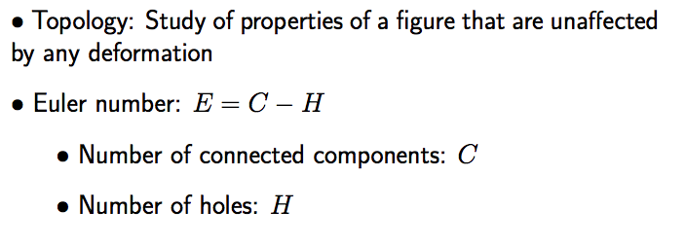

Slide 28
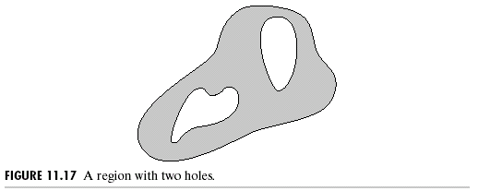
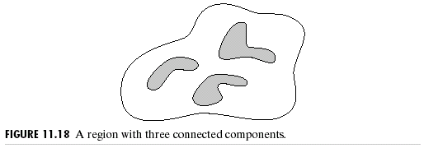
Regional Descriptors
Topological Descriptors
Topological property 1:
the number of holes (H)
Topological property 2:
the number of connected
components (C)

Slide 29
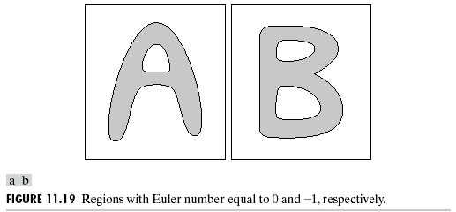
Regional Descriptors
Topological Descriptors
Topological property 3:
Euler number: the number of connected components subtract the number of holes
E = C - H
E=0
E= -1

Slide 30
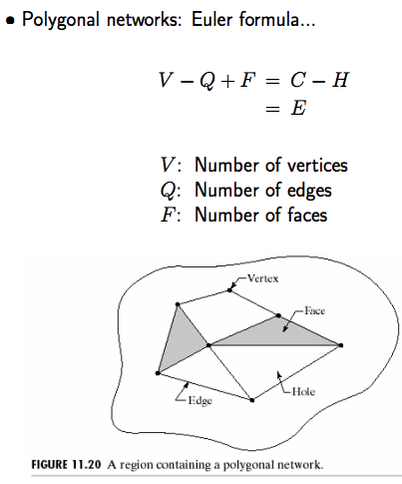


Slide 31
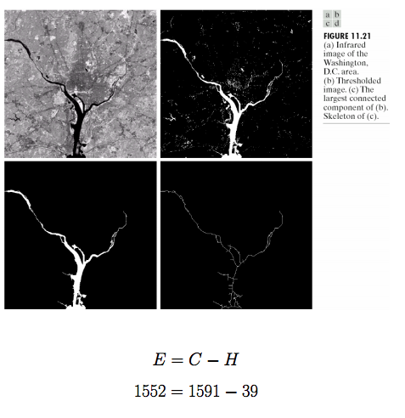
Topological
property 4:
the largest
connected
component.

Slide 32
Regional Descriptors
Texture
Texture is usually defined as the smoothness or roughness of a surface.
In computer vision, it is the visual appearance of the uniformity or lack of uniformity of brightness and color.
There are two types of texture: random and regular.
Random texture cannot be exactly described by words or equations; it must be described statistically. The surface of a pile of dirt or rocks of many sizes would be random.
Regular texture can be described by words or equations or repeating pattern primitives. Clothes are frequently made with regularly repeating patterns.
Random texture is analyzed by statistical methods.
Regular texture is analyzed by structural or spectral (Fourier) methods.

Slide 33
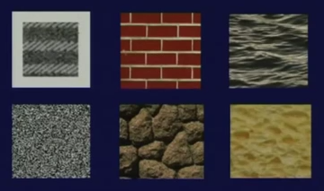
Regional Descriptors
Texture
Texture
(1) Statistical approaches
(2) Structural approaches
(3) Spectral approaches

Slide 34
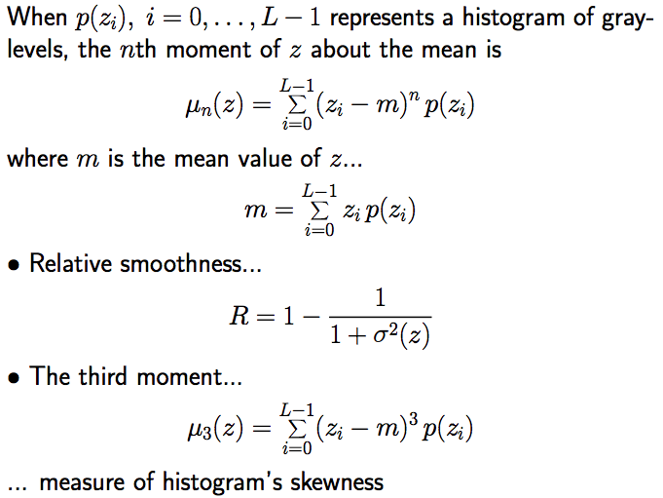
Statistical approaches

Slide 35
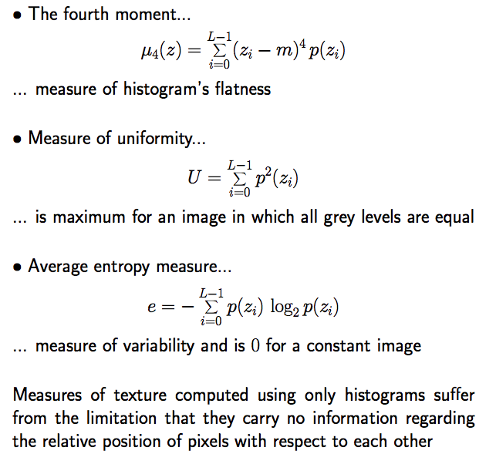
Statistical approaches

Slide 36
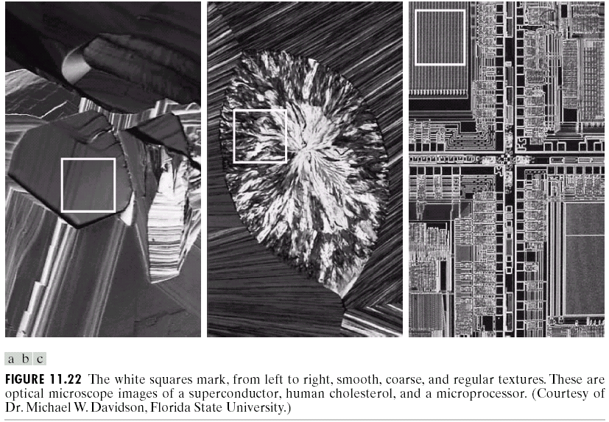
Regional Descriptors
Texture

Slide 37
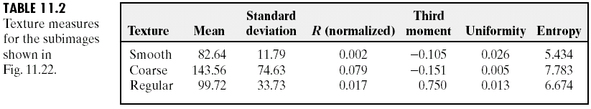
Regional Descriptors
Statistical Approaches
Smooth
Coarse
Regular

Slide 38
Structural approaches
A simple “texture primitive” can be used to form more complex texture patterns by means of some rules that limit the number of possible arrangements of the primitive(s)

Slide 39
Regional Descriptors
Structural Approaches
Structural concepts:
Suppose that we have a rule of the form S→aS, which indicates that the symbol S may be rewritten as aS.
If a represents a circle [Fig. 11.23(a)] and the meaning of “circle to the right” is assigned to a string of the form aaaa… [Fig. 11.23(b)] .

Slide 40
Spectral approaches
Three features of Fourier spectrum that is useful for texture
description...
(1) Prominent peaks → principal direction of texture patterns
(2) Location of peaks → fundamental spatial period
(3) Elimination of periodic components
non-periodic image elements
statistical descriptors

Slide 41
Regional Descriptors
Spectral Approaches
For non-random primitive spatial patterns, the 2-dimensional Fourier transform allows the patterns to be analyzed in terms of spatial frequency components and direction.
It may be more useful to express the spectrum in terms of polar coordinates, which directly give direction as well as frequency.
Let is the spectrum function, and r and are the variables in this coordinate system.
For each direction , may be considered a 1-D function .
For each frequency r, is a 1-D function.
A global description:

Slide 42

Regional Descriptors
Spectral Approaches

Slide 43
Summery of the lecture
image understanding
Define the Image objects representation mechanism
Use of the segmentation
representations
boundary based segmentation
region based segmentation
Description
boundary based segmentation
region based segmentation

Slide 44
References
Prof .P. K. Biswas Department of Electronics and Electrical Communication Engineering Indian Institute of Technology, Kharagpur
Gonzalez R. C. & Woods R.E. (2008). Digital Image Processing. Prentice Hall.
Forsyth, D. A. & Ponce, J. (2011).Computer Vision: A Modern Approach. Pearson Education.

