Slide 1
Digital Image Processing CSC331
Object Recognition

Slide 2
Summery of previous lecture
image understanding
Define the Image objects representation mechanism
Use of the segmentation
representations
boundary based segmentation
region based segmentation
Description
boundary based segmentation
region based segmentation

Slide 3
Todays lecture
What is object recognition?
Pattern classes
Pattern recognition
Object classifier
Structural methods
Decision theoretic methods

Slide 4
Patterns and Pattern Classes
Patterns and features
Pattern classes: a pattern class is a family of patterns that share some common properties
Pattern recognition: to assign patterns to their respective classes
Three common pattern arrangements used in practices are
Vectors
Strings
Trees

Slide 5
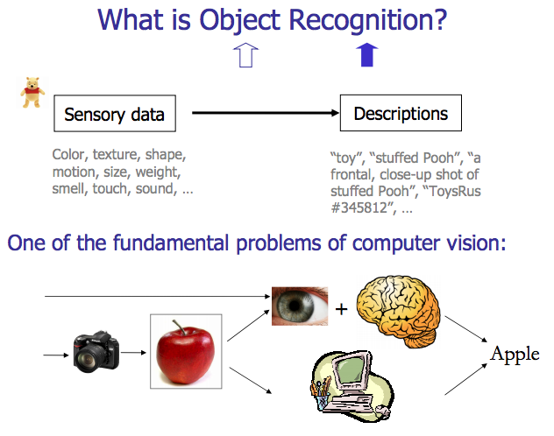

Slide 6
Basic object recognition flowchart
Sensor
Feature
generation
Feature
selection
Classifier design
System evaluation

Slide 7
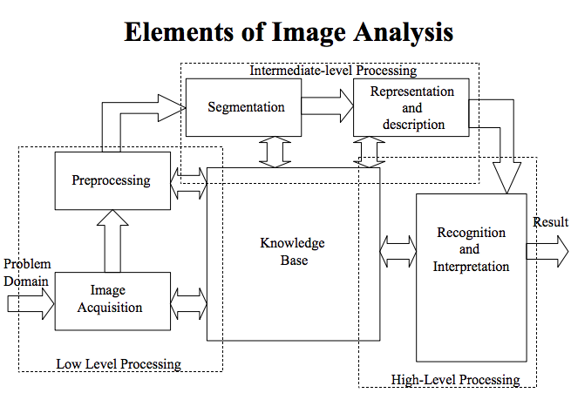

Slide 8
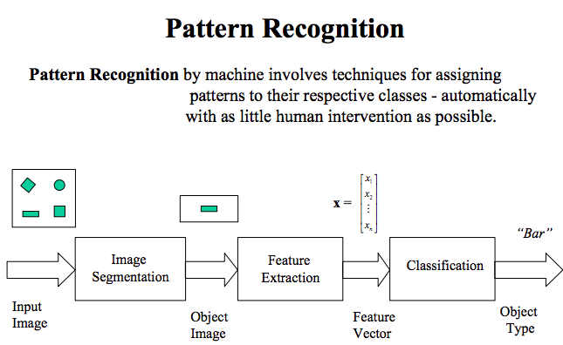

Slide 9
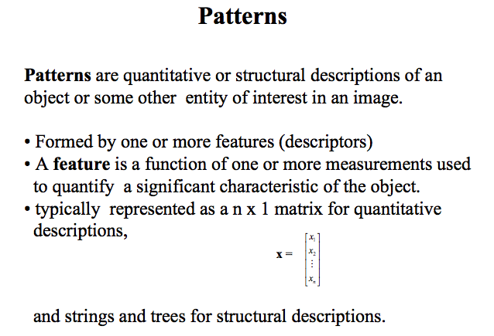

Slide 10
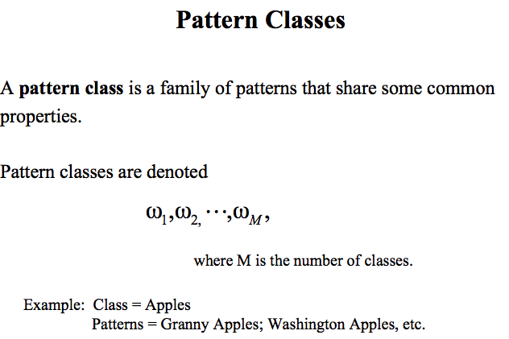

Slide 11
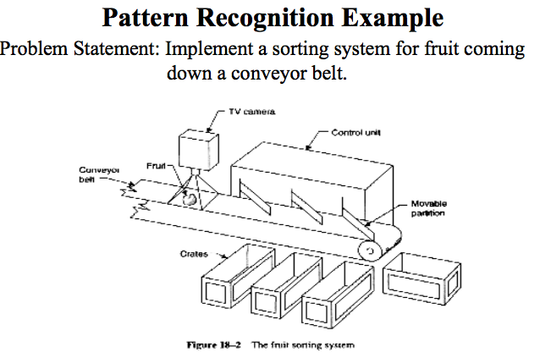

Slide 12
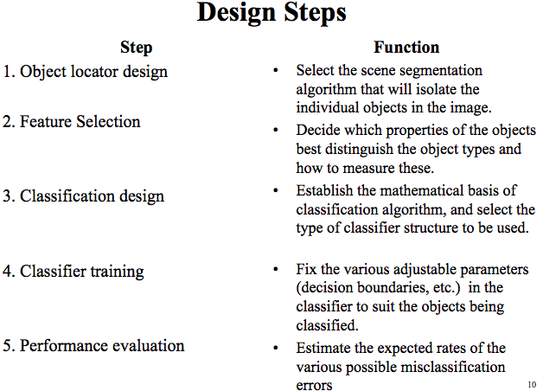

Slide 13
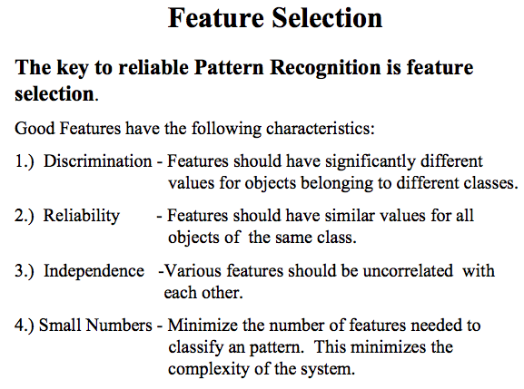

Slide 14
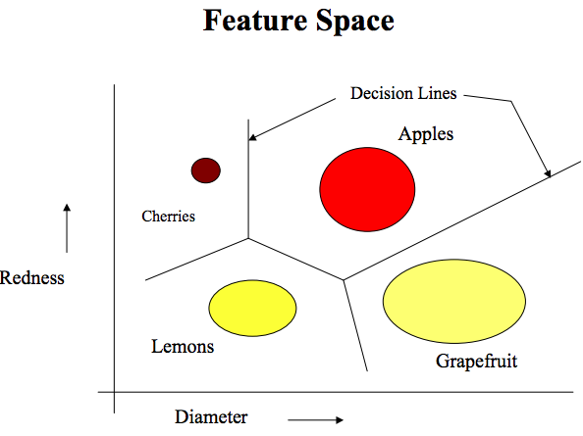

Slide 15
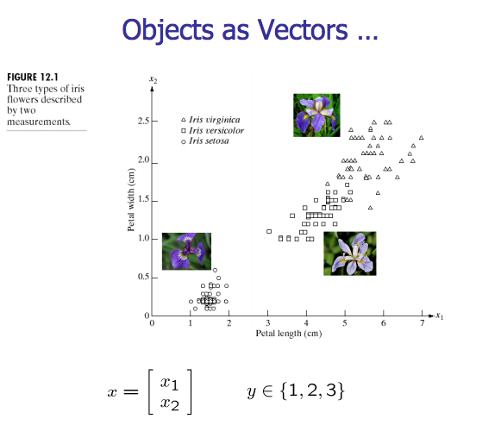

Slide 16
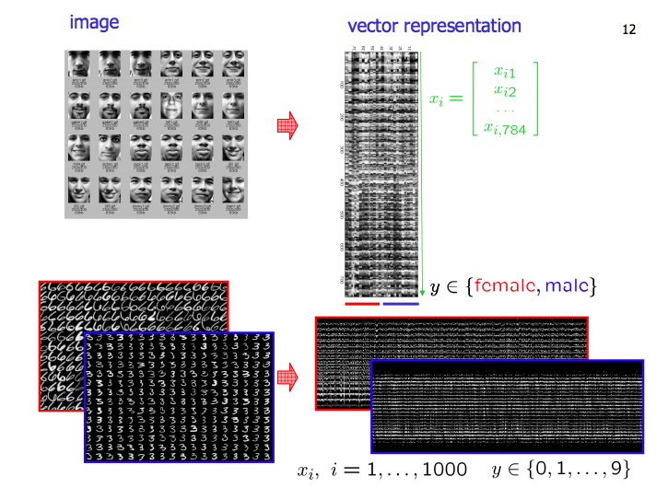

Slide 17
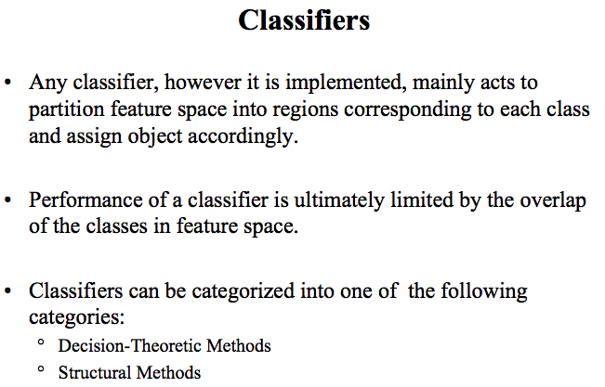

Slide 18
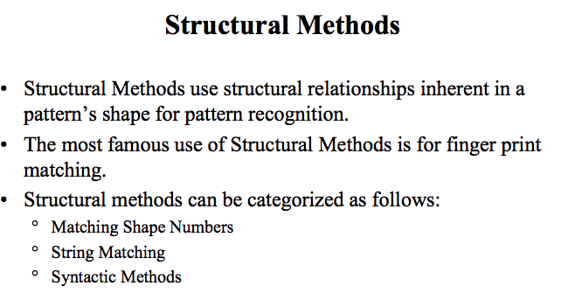

Slide 19
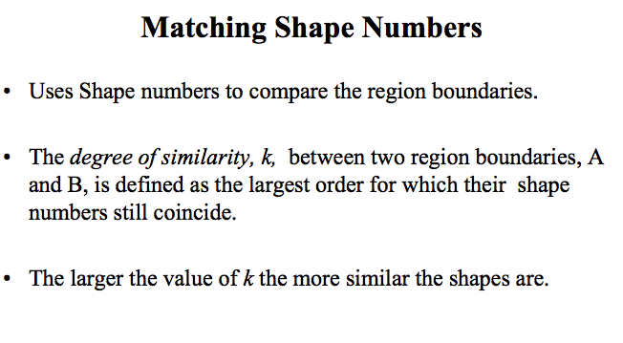

Slide 20
Matching Shape Numbers
Direction numbers for 4-directional chain code, and 8-directional chain code
1
2
3
1
2
0
4
0
5
7
3
6

Slide 21
Matching Shape Numbers
Digital boundary with resampling grid superimposed

Slide 22
Matching Shape Numbers
All shapes of order 4, 6,and 8
Order6
Order4
Chain code: 0321
Difference : 3333
Shape no. : 3333
Chain code: 003221
Difference : 303303
Shape no. : 033033
Order8
Chain code: 00332211
Difference : 30303030
Shape no. : 03030303
Chain code:03032211
Difference :33133030
Shape no. :03033133
Chain code: 00032221
Difference : 30033003
Shape no. : 00330033

Slide 23
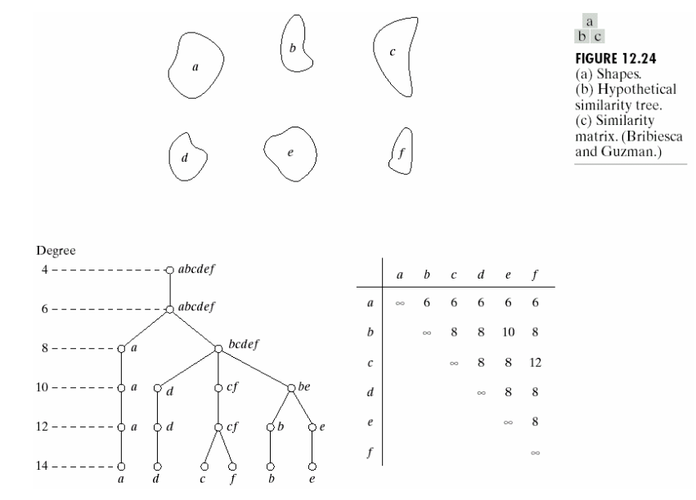

Slide 24
Matching Shape Numbers
Advantages:
1. Matching Shape Numbers suits the processing
structure simple graph, specially becomes by the
line combination
2. Can solve rotation the question
3. Matching Shape Numbers mostly to the
graph outline, Shape similarity also may completely
overcome
4. The Displacement question definitely may
overcome

Slide 25
Matching Shape Numbers
Disadvantages :
1. It can not uses for a hollow structure
2. Scaling is a shortcoming which
needs to change, perhaps coordinates
the alternative means
3. Intensity
4. Mirror problem
5. The color is unable to recognize

Slide 26
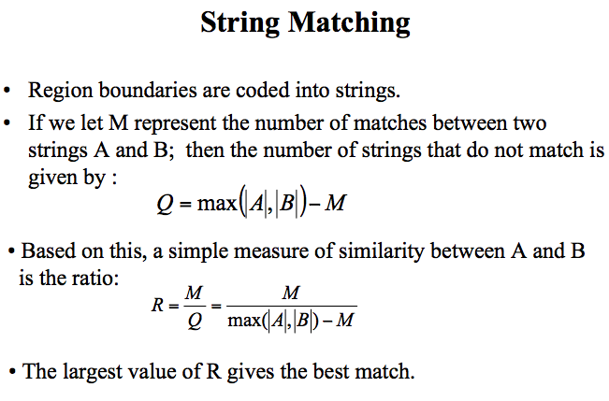

Slide 27
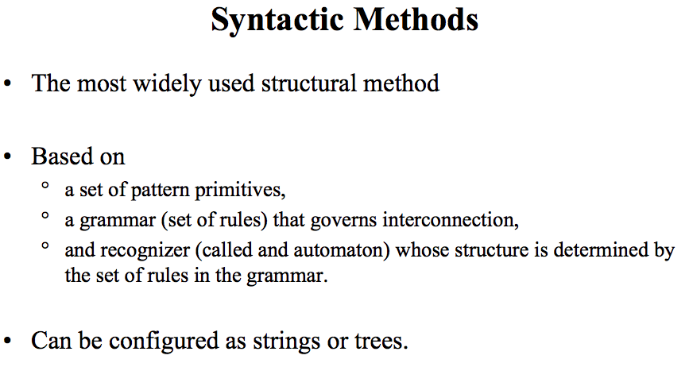

Slide 28
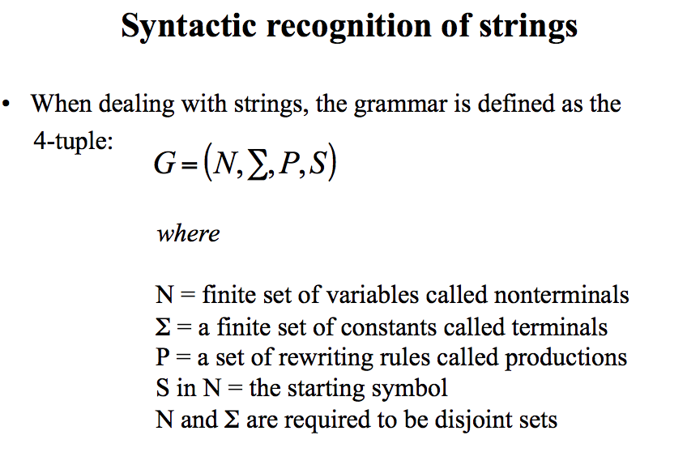

Slide 29
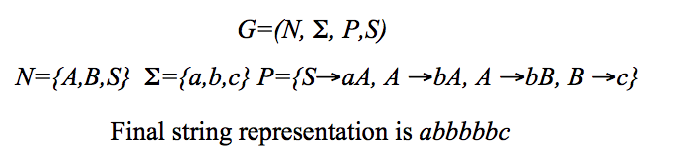
Structural Methods
Syntactic Recognition of Strings

Slide 30
Structural Methods
Syntactic Recognition of Strings
String grammars
Step 3: automata as string recognizers
String: abbbbbc

Slide 31
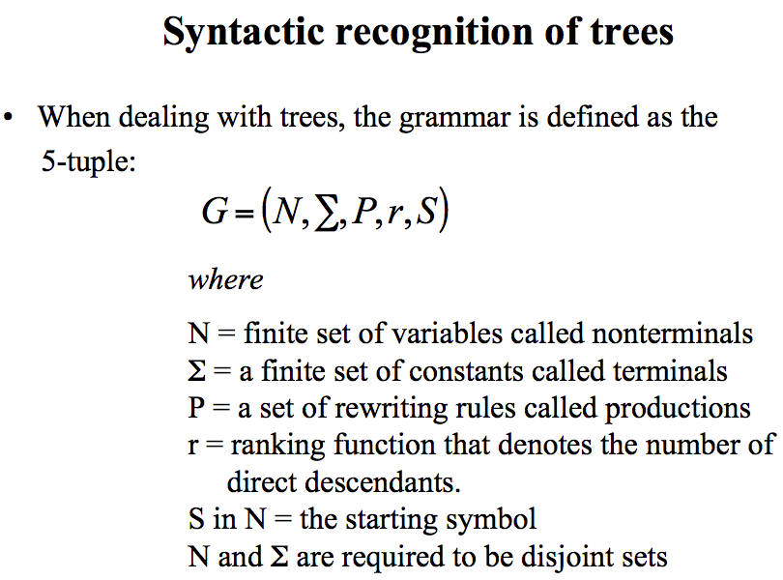

Slide 32
Structural Methods
Syntactic Recognition of Trees
Tree grammars
Production rules
Example
S → a
|
X₁
X₁ → c
/ \
X₂ X₃
Tree automata

Slide 33
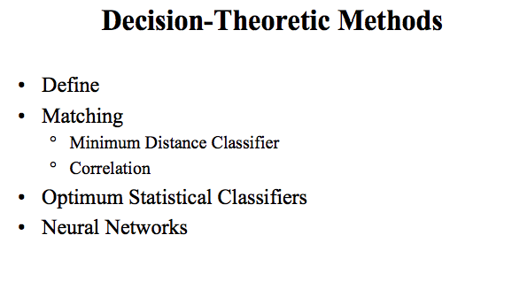

Slide 34
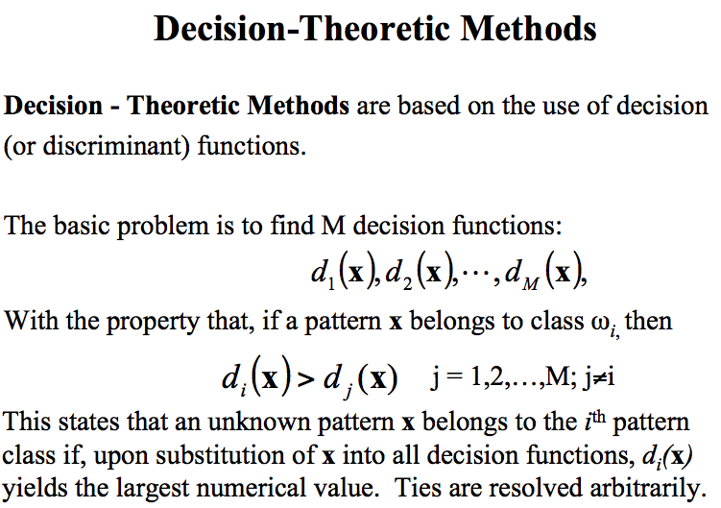

Slide 35
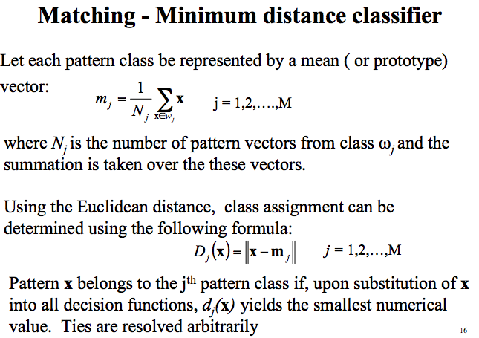

Slide 36
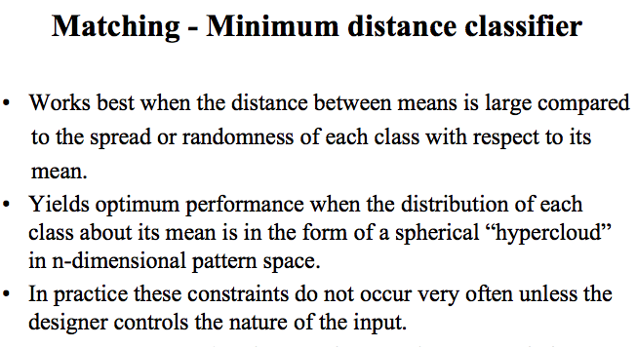

Slide 37
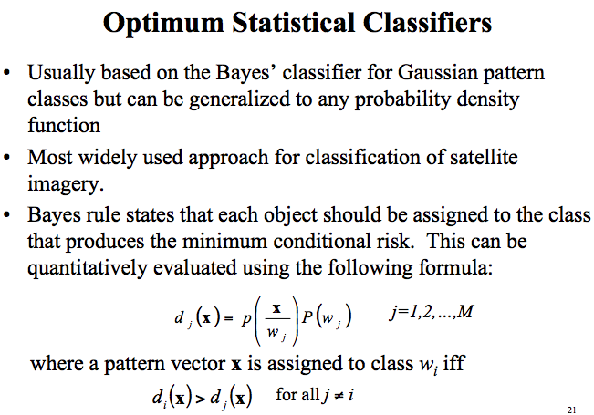

Slide 38
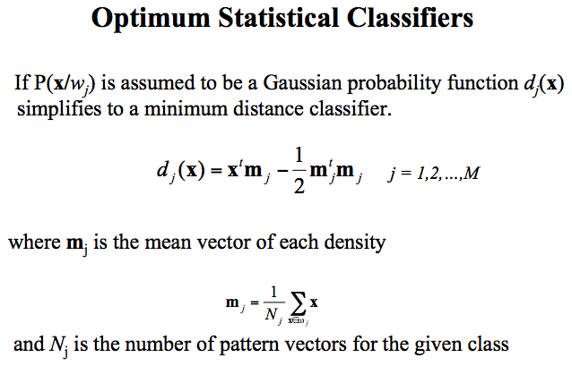

Slide 39
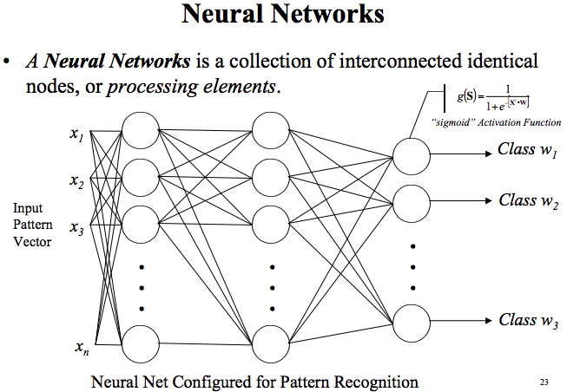

Slide 40
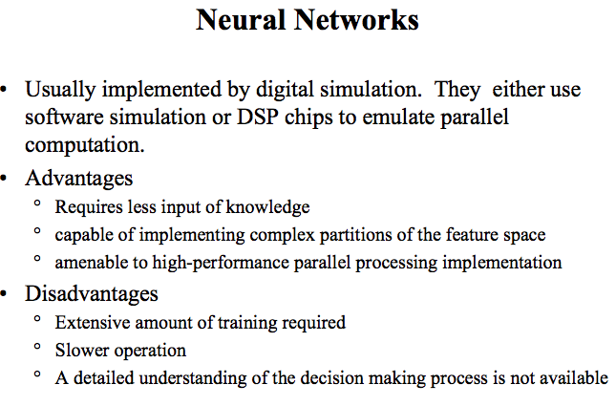

Slide 41
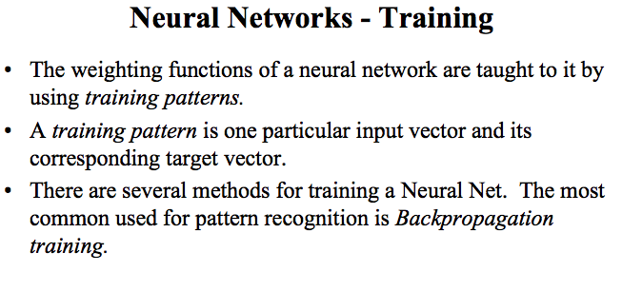

Slide 42
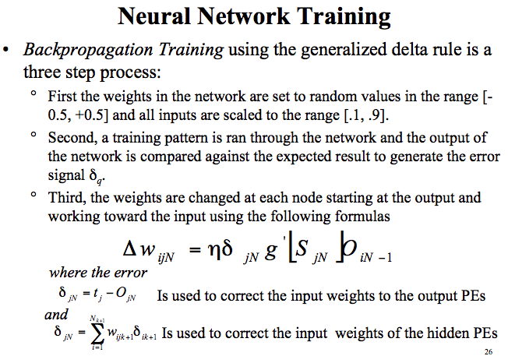

Slide 43
Other methods of Object recognition
Instance-based Methods
k-Nearest Neighbour (kNN)
Learning Vector Quantization (LVQ)
Self-Organizing Map (SOM)
Decision Tree Learning
Classification and Regression Tree (CART)
Decision Stump
Random Forest
Bayesian
Naive Bayes
Averaged One-Dependence Estimators (AODE)
Bayesian Belief Network (BBN)
Kernel Methods
Support Vector Machines (SVM)
Radial Basis Function (RBF)
Linear Discriminant Analysis (LDA)
Clustering Methods
k-Means
Expectation Maximisation (EM)
Artificial Neural Networks
Perceptron
Back-Propagation
Hopfield Network
Self-Organizing Map (SOM)
Learning Vector Quantization (LVQ)
Deep Learning
Restricted Boltzmann Machine (RBM)
Deep Belief Networks (DBN)
Convolutional Network
Stacked Auto-encoder

Slide 44
Summery of the lecture
Pattern classes
Pattern recognition
Object classifier
Structural methods
Decision theoretic methods

Slide 45
References
Prof .P. K. Biswas Department of Electronics and Electrical Communication Engineering Indian Institute of Technology, Kharagpur
Gonzalez R. C. & Woods R.E. (2008). Digital Image Processing. Prentice Hall.
Forsyth, D. A. & Ponce, J. (2011).Computer Vision: A Modern Approach. Pearson Education.

