Slide 1
Digital Image Processing CCS331
Relationships of Pixel

Slide 2
Summery of previous lecture
Sampling: instead of taking the possible intensity values at every possible location in the image; we take the pixels values or intensity values at some discrete locations in the 2 dimensional space
Quantization: The sample values are quantized to one of the discrete levels and depending upon the number of levels that we choose, the number of bits needed to represent each and every sample value.

Slide 3
Summery of previous lecture
Normally 8 bits for quantization of every sample value is used.
if it is a black and white image; then the set of values for black and white will be 16
if it is a color image, then there are 3 different planes - the red plane, green plane and blue plane. For each of these different planes, every point is represented by 8 bits.
for a color image, normally we have 24 bits for every sample which we call it pixel;
an image is represented in the form of a matrix or a 2 dimensional matrix which is a digital image and each of the matrix elements are is now called a pixel.

Slide 4
Todays lecture
By representing the image in matrix with different points called “pixels”,
There are some important relationships exist among those pixels.
Neighborhood of the pixel and there types.
Connectivity in an image.
Connected component labeling algorithm
Adjacency and different types of adjacency relationships.
Distance measures method
Different image operations

Slide 5
Pixel neighborhood
An image is represented as a function f(x , y)
Each element f(x , y) at location of x and y in 2D matrix is called pixel.
So the location is sampling and the values are quantization
as it’s a matrix so there will be some pixels around one x, y location

Slide 6
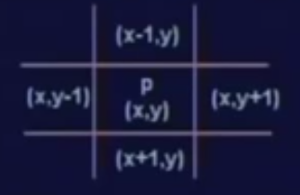


Pixel neighborhood
Consider a pixel at location a pixel p at location x y
matrix will have a number of rows and columns
row which is just before x that is row x minus 1, and the row just after the row x is, row x plus 1.
Similarly, there will be a column just before the column y that is column y minus 1 and there will be a column just after column y which is column y plus 1.
2 pixels are vertical neighbors of point p by x axes.
2 pixels are the horizontal neighbors of the point p by y axes.
4 pixels are called 4 neighbors of the point p and is represented by p N₄ ^{(p).}

Slide 7
boundary pixel, neighbors
Particular pixel p, does not have any pixel in the row above this pixel;
And it does not have any pixel in the column before this particular column.

Slide 8
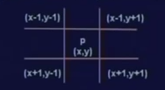


Diagonal neighborhood of pixel
There are 4 diagonal points. One at location x minus 1 y minus 1, the other one at location x plus 1 y plus 1, one at location x minus 1 y plus 1 and the other one is at location x plus 1 and y minus 1.
4 pixels are known as the diagonal neighbors of point p and represented by N_{D} (p)

Slide 9


8 neighbors of Pixel
N₄ (p) and N_{D} (p), they together are called 8 neighbors of point p and represented by N8 (p) and is the union of N₄ (p) and N_{D}(p)
the points belongs to N8 (p) or the number of 8 neighbors of the point p will be 8 if p is inside an image,
if its its a boundary point N8 (p) will be less then 8

Slide 10
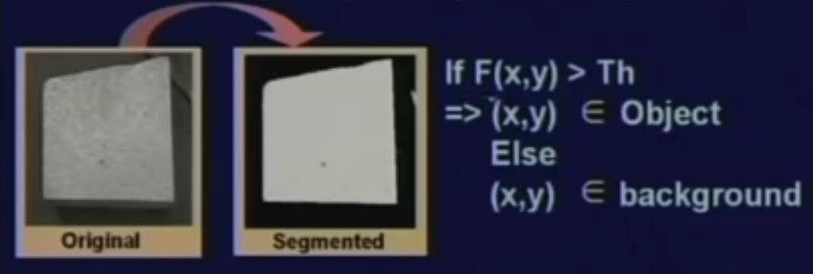
Connectivity
How are the pixels connected with each other?
Segmentations
It is used for finding the objects boundaries
Defining image components, regions
if the intensity value or if x y at a particular point x y is greater than certain threshold Th; then point x y belongs to the object.
Whereas, if the point or the intensity level at the point x y is less than the threshold; then the point x y belongs to the background.
we represent every object point as a white pixel or assign a value 1 to it and every background pixel as a black pixel or assign a value 0

Slide 11

Connectivity
Do the Pixels belong to 1 object?
What are the properties of the object?
I need grouping of pixels

Slide 12

Connectivity
Pixels are connected if they are adjacent in some sense
Adjacent means that they have to be neighbors
If 2 pixels p and q are connected; then by adjacency, we mean that p must be a neighbor of q or q must be a neighbor of p.
That means q has to belong to N₄(p) or N_{D} (p) or N8 (p)
The intensity values of the 2 points p and q must be similar.

Slide 13
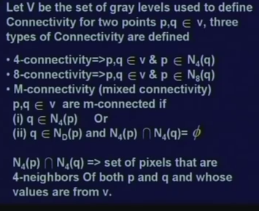
Connectivity
In case of gray level image where for example we take 8 levels of black and 8 levels of white
^{N}₄ ^{(p) intersection with N}₄ ^{(q) must be equal to phi}
means if the point q belongs to the diagonal neighbor of p and there is a common set of points which have 4 neighbors to both the points p and q; then M connectivity is not valid.

Slide 14
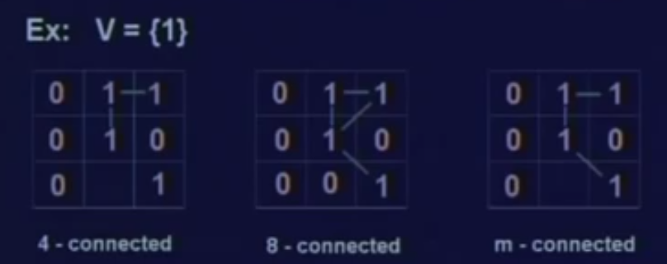


M connectivite
M connectivity or mixed connectivity this to avoid multiple connection path
mixed connectivity is 2 points are M connected if one is the 4 neighbor of other or one is 4 neighbor of other and at the same time, they do not have any common 4 neighbor.

Slide 15
Relationship of adjacency
pixels p and q are adjacent if they are connected.
3 different types of connectivity
4 connectivity
8 connectivity
M connectivity
3 different types of adjacency
4 adjacency,
th8 adjacency
m adjacency

Slide 16

Adjacency
Adjacency of 2 different points can be extended to image regions.
that 2 image regions may be adjacent, or they may not be adjacent.
What is the condition for adjacency of 2 image regions?
^{2 image regions are adjacent} ^{S}_{i} ^{and S}_{j}, if there exists a point p in image region S_{i} and a point q in image region S_{j} such that p and q are adjacent.

Slide 17
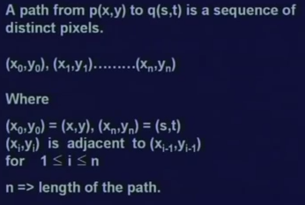
Path between 2 points
Sequence of points between p and q such that all the points which are traversed in between p and q,
And all those subsequent points; they are adjacent,
Then a path exists between from point p to point q.
And we can also define the length of the path to be n.

Slide 18
Connected region
We define that 2 pixels are connected, if they are adjacent in some sense that is
they are neighbors and their intensity values are also similar.
We have also defined 2 regions to be adjacent if there is a point in one region which is adjacent to some other point in another region
We have defined a path between a point p and q if there are a set of points in between which are adjacent to each other.
Now, this concept can be called as connected component.

Slide 19
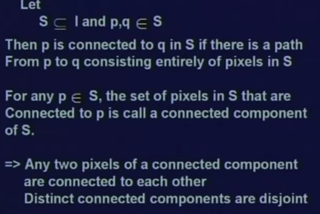
Connected component
We take a subset S of an image I
we take 2-point p and q which belong to this subset S of image I.
Then p is connected to q in S. which means if there exists a path from p to q consisting entirely of pixels in S.
For any such p belonging to S, the set of pixels in S that are connected to p is called a connected component of S.

Slide 20

Connected component labeling
To extracting the region property, we need to distinguish the components
For the identification or group identification, we need identify a set of pixels which are connected; belonging to a particular group, assign a particular identification number.

Slide 21
Component labeling
Once we identify group of pixels which belong particular region;
then we can go for finding out some region properties
Region properties may be
shape up that particular region,
area of that particular region,
the boundary,
the length of the boundary
and many other features can be extracted

Slide 22
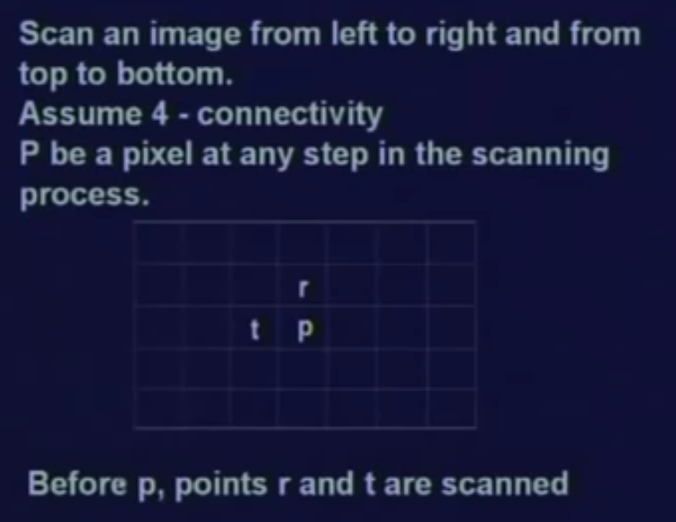
Algorithm for labeling
^{The} algorithm is called component leveling algorithm to assign an identification number to each of the connected pixels which will identify a particular region.

Slide 23
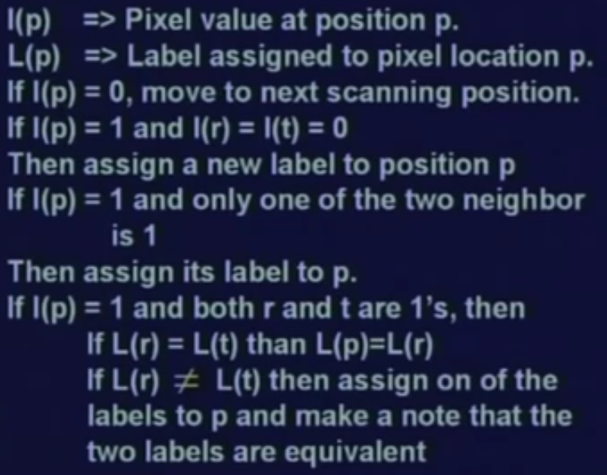
Ccomponent leveling algorithm

Slide 24
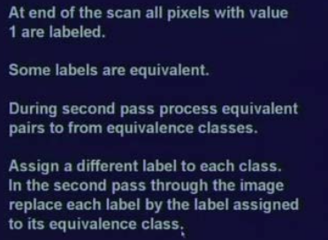
2nd level

Slide 25
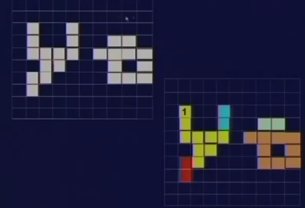

Slide 26
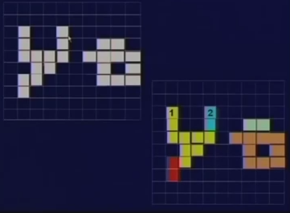

Slide 27
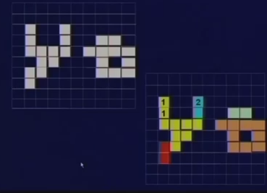

Slide 28


Slide 29
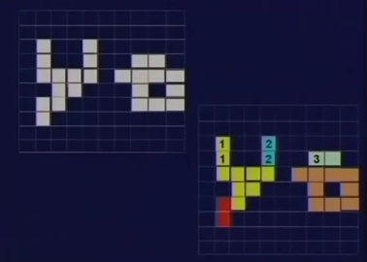

Slide 30
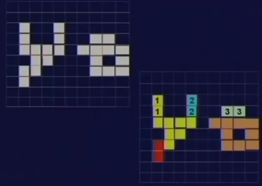

Slide 31
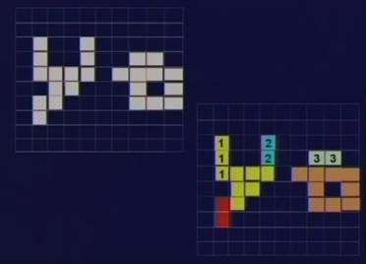

Slide 32
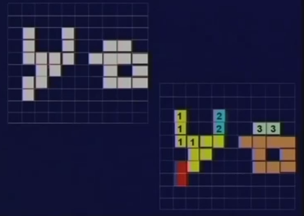

Slide 33
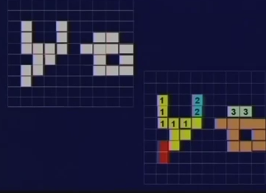

Slide 34
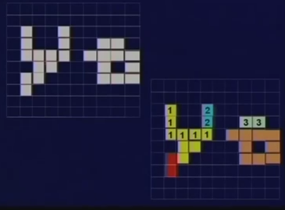

Slide 35
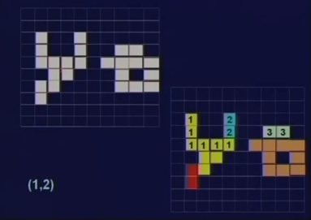

Slide 36
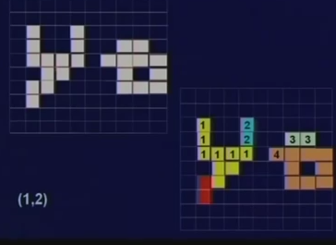

Slide 37
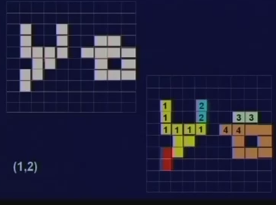

Slide 38
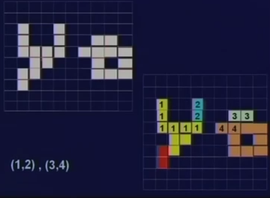

Slide 39
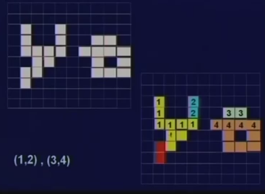

Slide 40
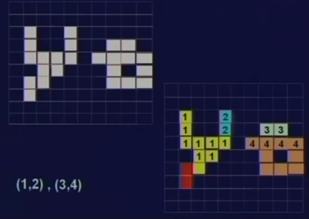

Slide 41
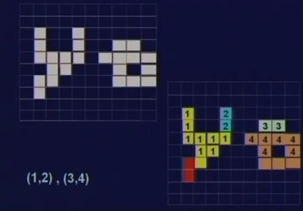

Slide 42
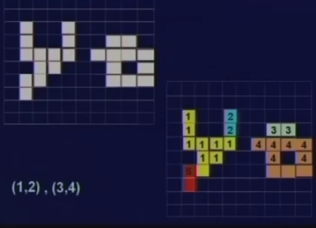

Slide 43
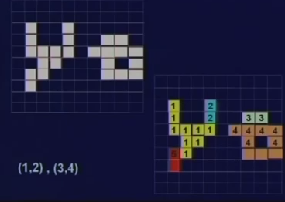

Slide 44
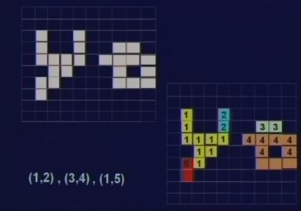

Slide 45
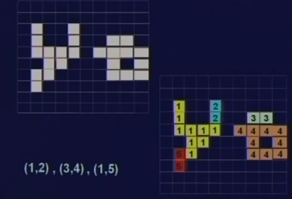

Slide 46
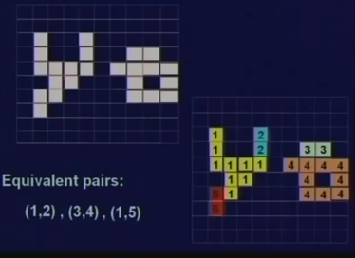

Slide 47
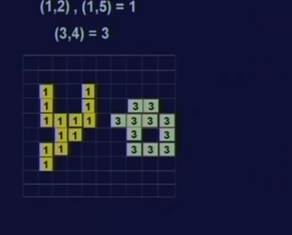
2nd pass

Slide 48
Summery
Pixel connectivity,
What is adjacency
Different types of adjacency
We have also seen a connected component labeling problem.

Slide 49
References
Prof .P. K. Biswas Department of Electronics and Electrical Communication Engineering Indian Institute of Technology, Kharagpur
Gonzalez R. C. & Woods R.E. (2008). Digital Image Processing. Prentice Hall.
Forsyth, D. A. & Ponce, J. (2011).Computer Vision: A Modern Approach. Pearson Education.

