Slide 1
Digital Image Processing CCS331
Relationships of Pixel

Slide 2
Summery of previous lecture
Pixel connectivity
What is adjacency
Different types of adjacency
Connected component labeling problem
Component leveling algorithm

Slide 3
Todays lecture
Different distance measures
Application of distance measures
Arithmetic and logical operations on images
Neighborhood operation on images

Slide 4
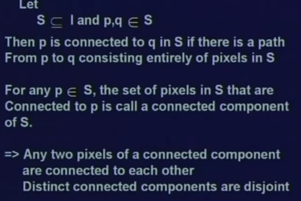
Connected component
We take a subset S of an image I
we take 2-point p and q which belong to this subset S of image I.
Then p is connected to q in S. which means if there exists a path from p to q consisting entirely of pixels in S.
For any such p belonging to S, the set of pixels in S that are connected to p is called a connected component of S.

Slide 5
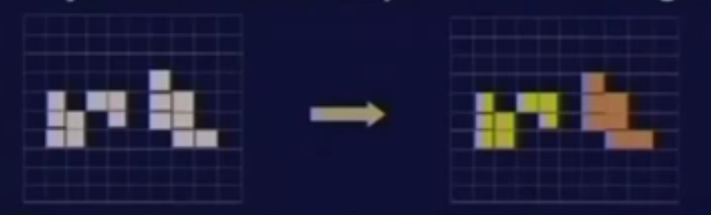
Connected component labeling
To extracting the region property we need to distinguish the components
For the identification or group identification, we need identify a set of pixels which are connected; belonging to a particular group, assign a particular identification number.

Slide 6
Component labeling
Once we identify group of pixels which belong particular region;
then we can go for finding out some region properties
Region properties may be
shape up that particular region,
area of that particular region,
the boundary,
the length of the boundary
and many other features can be extracted

Slide 7
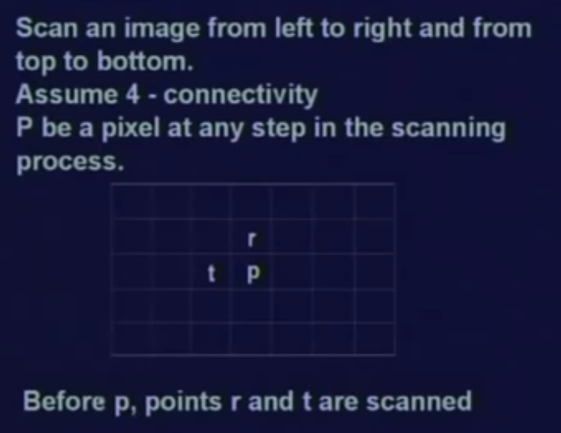
Algorithm for labeling
^{The} algorithm is called component leveling algorithm to assign an identification number to each of the connected pixels which will identify a particular region.

Slide 8
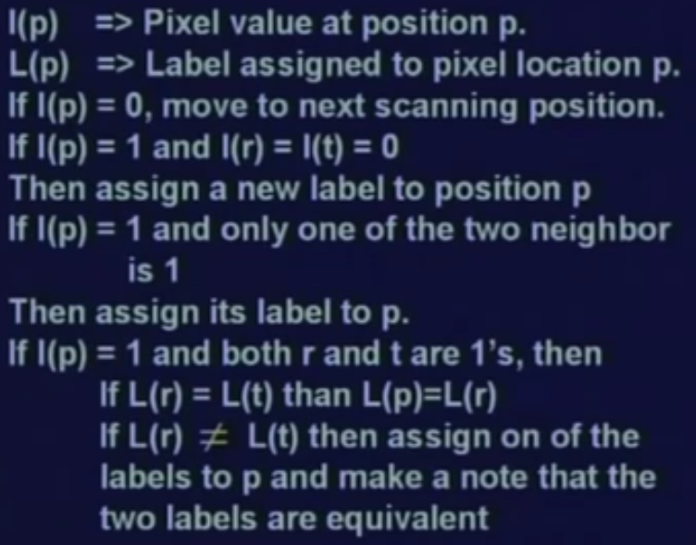
Component leveling algorithm

Slide 9
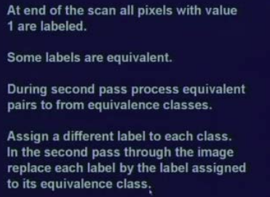
2nd level

Slide 10
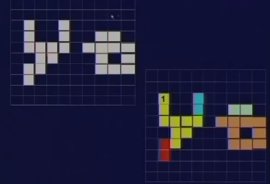

Slide 11
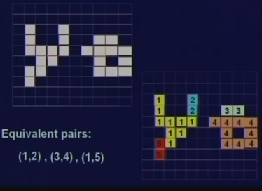

Slide 12
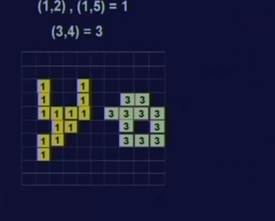
2nd pass

Slide 13




Distance measures
To find the distance between 2 points, we need the coordinate or the location of 2 different points
There are various other distance measures which can be used in digital domain.
city block distance
chess board distance and so on.
So, to see that if D is a distance function or a distance metric, then what is the property that should be followed by this distance function D?

Slide 14
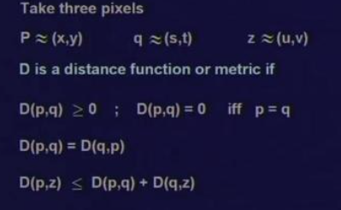


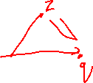



Distance measures
Three pixels p,q,z
D is a distance measure or valid distance metric. If D (p, q) is greater than or equal to 0 for any p and q, any 2 points p and q; D (p, q) must be greater than or equal to 0 and D (p, q) will be 0 only if p is equal to q.
If distance from p to q is same as the distance from q to p.
If we take a third point z, then the distance between p and z that is D (p, z) must be less than or equal to the distance between the p and q plus the distance between q and z

Slide 15
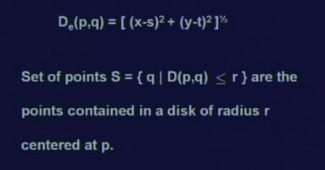
Euclidean distance
So, in case of Euclidean distance,
A set of points q where D (p, q) the distance between p and q, is less than or equal to some value r.
So, set of all this points are the points contained within a radius r where starts from location p.

Slide 16
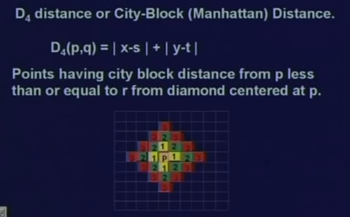
City block distance
The second distance measure which is also known as D4 distance or city block distance or Manhattan distance
Its defined as D4 (p, q) is equal to x minus s absolute value plus y minus t absolute value.

Slide 17
Diamond shape
All the points having a city block distance from point p less than or equal to some value r, will from a diamond center centered at point p.
So p is the point at the center, then all the points having city block distance, they are the 4 neighbors of the point p.
Similarly, all the points having the city block distance is equal to 2, they are simply the points which are at distance 2.
That is the distance taken in the horizontal direction plus the distance taken in the vertical direction that becomes equal to 2and set of all this points with city block distance is equal to 2 that simply forms a diamond of radius 2
and similarly other points at distances 3 4 and so on.

Slide 18
Chess board distance
In case of city block distance, the distance between 2 points was defined as the sum of the distances that you cover along x direction plus the distance along the y direction.
In case of chess board distance, it is the maximum distances that you can cover along x direction and y direction.

Slide 19
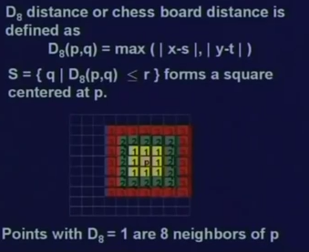
Chess board distance
D8 (p, q) which is equal to max of x minus s and y minus t where we take the absolute value of both x minus s and y minus t
Where the set of points with a chess board distance is less than or equal to r,
It forms a square centered at point p.
So all the points with a chess board distance of equal to 1 from point p, they are nothing but the 8 neighbors of point p.

Slide 20
What are the distance measure ?
We need to go for an example to understand.

Slide 21

Shape Matching
If we want to find the difference in shapes .
These 2 shapes are almost similar except that you have a hole in the second shape.

Slide 22
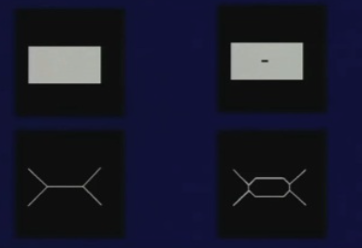
Shape Matching
To find the feature of shapes
We need to take the skeleton of the shapes which are shown in the figures below the shapes

Slide 23
The skeleton information
By comparing the 2 skeletons,
the skeleton of the first shape, there are only 5 line segments, whereas for the skeleton of the second shape there are 10 line segments.
Similarly, the number of points where more than 2 line segments meet; in the first skeleton there are only 2 such points, whereas in the second skeleton there are 4 such points.
By compare the skeleton rather than comparing using the original shape, there is lot of difference that can be found out both in terms of the number of line segments, and also in terms of the number of points where more than 1 line segments meet.

Slide 24
What is skeleton?
When we remove some of the foreground points in such a way that the shape information as well as the dimension is more or less retained in the skeleton
Now, the question is how do we get this skeleton?

Slide 25
How to get the Skeleton
assume that the foreground region in the input binary image is made of some uniform slow burning material
What if we light fire at all the points across the boundary of this region that is the foreground region.
Then as the fire lines go in, there will be some points in the foreground region where the fire coming from 2 different boundaries will meet and at that point, the fire will extinguish itself.
The set of all those points is what is called the quench line and the skeleton of the region is nothing but the quench line that we obtained by using this fire propagation concept.
The set of all those points are called the quench line
The skeleton of the region is “the quench line obtained by using fire propagation concept”
This is also called “Medial Axis Transformation”

Slide 26
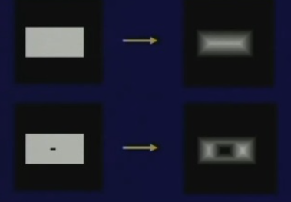

Slide 27
Simple description of movement of the fire line does not give you an idea of how to compute the skeleton of a particular shape.
So, for that we use distance measure.
When we a lighting the fire across all the boundary points simultaneously and the fire is moving inside the foreground region slowly,
We can note at every point the time the fire takes to reach the particular point so it is a distance transformation of the image.

Slide 28
Distance transform is normally used for binary images and we calculate the time value for every point the the fire takes to reach that particular point;
so by applying distance transformation, we get an image or the shape of the image is in a grey level image
Where the grey level intensity of the points in the inside the foreground region had changed to show the distance of that point from the closest boundary point.

Slide 29
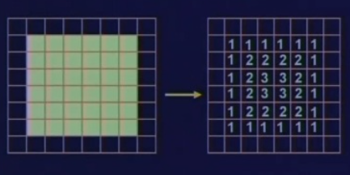

Distance transform
Here, we have a binary image where the foreground region is a rectangular region and if I take the distance transform,
Image in the right all the boundary points, they are getting a distance value equal to 1.
Then the points inside the boundary points, they get a distance value equal to 2
and the points further inside, they gets a distance value equal to 3.
The intensity value that we are assigning to different points within the foreground region, the intensity value increases slowly from the boundary to the interior points.
A grey level image which you get after performing the distance transformation.

Slide 30
By analyzing this distance transformed image, you find that there are few points at which there is some discontinuity of the curvature.
So, by identify the points of discontinuity or curvature discontinuity, those are actually the point which lies on the skeleton of this particular shape.

Slide 31
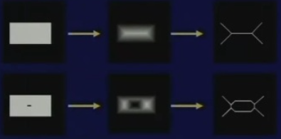
original image;
the middle column is the distance transformed image
and the right most columns is the skeleton
By correlating the right most column with the middle column, is the skeleton in the right most columns can now be easily obtained from the middle column

Slide 32
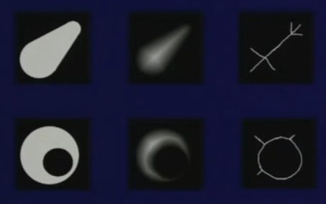
Skeletons shapes
We can use this method when there is the need for shape matching or discrimination problem;
So instead of processing on the original shapes, we compare the shapes using skeleton,

Slide 33
Distance measures
There are different types of distance measures or distance metrics like Euclidian distance metric, city block distance metric or chess board distance metric; there will be different transformations
There are also multiple skeletons algorithms, all the skeletons we get using different distance metrics, they will be a different. But the effect will be more or less similar
The skeleton is very useful because it provides a simple and compact representational shape that preserves many of the topological and size characteristics of the original shape.

Slide 34
Use of skeleton
We can have the length of a shape because by getting the different end points of the skeleton and the distances between every pair of end points in the skeleton, then the maximum of all those pair wise distances will give the length of the shape
The skeleton gives us the ability of qualitatively/quantitatively difference between different shapes because

Slide 35
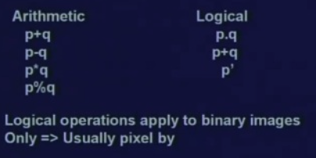
Arithmetic and logical operations
In case of numerical system, if its decimal number system or binary number system; We can have arithmetic as well as logical operations.
Similarly, for images also we can have arithmetic and logical operations.
We can add 2 image pixel by pixel. That is a pixel from an image can be added to the corresponding pixel of a second image.

Slide 36
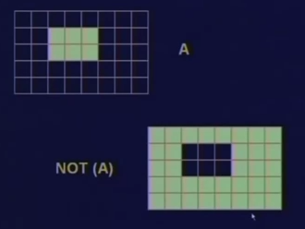
NOT operation or invert operation
Invert the particular binary image that is I can make a NOT operation or invert operation,
A is binary image where by NOT operation, all the pixels in the original image which was black now becomes white or 1 and pixels which are white or 1 in the original pixel, those pixels became become equal to 0.

Slide 37
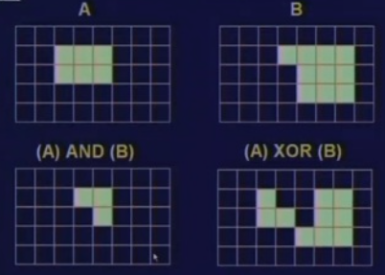
AND, XOR
Similarly, 2 images - A and B,
A and B, the logical AND operation which is shown in the left image lower.
Similarly, the XOR operation the image in the right image lower.

Slide 38
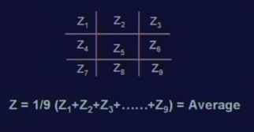
Pixel Neighborhood operations
3 by 3 matrix, this represents the part of an image which has nine pixel elements Z1 to Z9
I want to replace every pixel value by the average of its neighborhood considering the pixel itself.
The simple average operation at individual at every pixel level
We are replacing the intensity by a function of the intensities of its neighborhood pixels.
We will see later that this is the simplest form of low pass filtering to remove noise from the image.

Slide 39
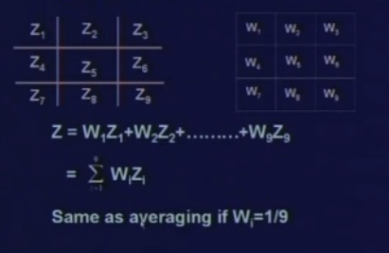
Using templates
We define a 3 by 3 template which is shown on this right-hand figure where the template contains nine elements W1 to W9
To perform the neighborhood operation; we put the template, on the original image in such a way that the pixel at which place we want to replace the value, the center of the template just relates with that pixel.
We replace the value with the weighted sum of the values taken from the image and the corresponding point from the template.
the value which will be replaced is given by Z equal to W_{i} ^{Z}_{i} summation of i varying from 1 to 9.

Slide 40
Neighborhood operation
The template operation can also be used for edge detection operation in different images.
So, with this, we complete our lecture today.

Slide 41
Summery of the lecture
Different distance measures
Application of distance measures
Arithmetic and logical operations on images
Neighborhood operation on images

Slide 42
References
Prof .P. K. Biswas Department of Electronics and Electrical Communication Engineering Indian Institute of Technology, Kharagpur
Gonzalez R. C. & Woods R.E. (2008). Digital Image Processing. Prentice Hall.
Forsyth, D. A. & Ponce, J. (2011).Computer Vision: A Modern Approach. Pearson Education.

