Slide 1
Digital Image Processing CCS331
Basic Transformations

Slide 2
Summery of previous lecture
Different distance measures
Application of distance measures
used to find the distance transformation of a binary image and using the distance transformation, we can find out the skeleton of the image which gives a compact representation or compact description of the shape.
Arithmetic and logical operations on images
Neighborhood operation on images

Slide 4
Todays lecture
some basic mathematical transformations
translation, rotation and scaling in 2D and 3D
The inverse transformations of these different mathematical transformations.

Slide 5
What is the translation operation?

Slide 6
translation the equation in the form of a matrix,

Slide 7
combine all the operation in a single matrix form

Slide 9
Rotate point P

Slide 10
Expanding the equation

Slide 11
Matrix equation

Slide 13
Translation and rotation

Slide 14
3D coordinate system
Transformations we consider
translation,
rotation
and scaling
3D in dimensional coordinate system.

Slide 15
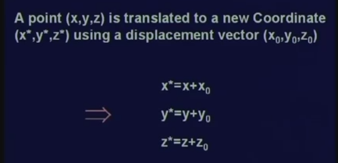
Translation
We have 3 coordinates x, y and z and all these 3D coordinates,
The 3 coordinate are to be translated by the translation vector x0 y0 z0 and then new translation at the new point we get as x star, y star and z star.

Slide 16
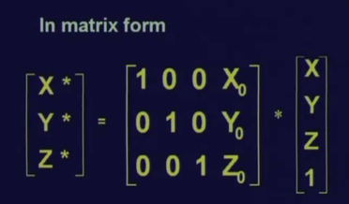
Matrix for 3D Translaation
we have added the additional component which is equal to 1
But this is not uniform matrix

Slide 17
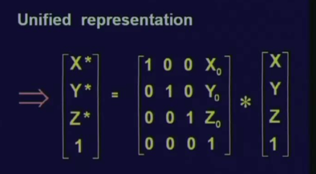
unified representations
we will represent the matrix by uppercase letter T.

Slide 18
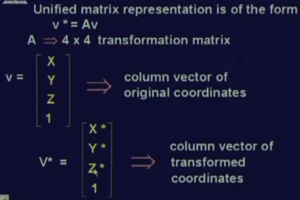
Unified matrix representation
if you have a vector V, a position vector V which is translated by the transformation matrix A, the transformation matrix A is a 4 by 4 transformation matrix;
V the original position vector was X, Y, Z, we have added and additional component 1 to it in our unified matrix representation.
So, V now a 4 dimensional vector having components X, Y, Z and 1.
Similarly, the transformed position vector V star is also a 4 dimensional vector

Slide 19
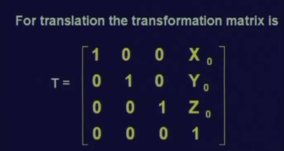
Transformation matrix
We can have the transformation matrix which is represented, for translating a point in point 3D by vector.

Slide 20
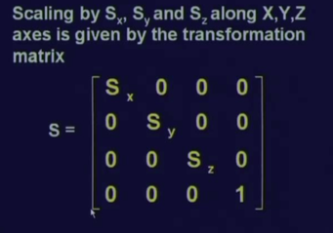
Scaling of 3D
position vector X Y Z in unified form it will be (X Y Z 1)
if that position vector is translated by scaling matrix, then what we get is the new position vector corresponding to point (X Y Z 1) in the scale form and
there if we remove the last component that is equal to 1, what we get is the scaled 3D coordinate of the point which has been scaled up or scaled down.

Slide 21
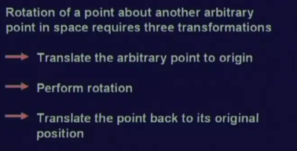
Rotation in 3D
3 different rotation matrixes for representing rotation around a particular axis and specifically,
If the rotation is to be done about an arbitrary point;
then what we have translate the arbitrary point to the origins by using the translation transformation.
Then we have to perform rotation around
then we have to translate back the point to its original position.

Slide 22
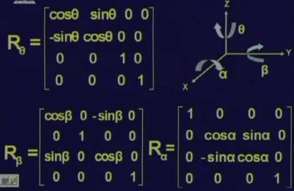
Rotation matrix
If we rotate the point along z axis, then obviously the z coordinate of the point will remain unchanged even in the rotated position. But the x coordinate and y coordinate of the point in its new rotated position will change.
And because the z coordinates is remaining unchanged, so we can think that this is a rotation on a plane which is parallel to the xy pair.
The same transformation which we have done for rotating a point in 2 dimensions in the (x, y) coordinate, the same transformation matrix holds true for rotating this point in 3 dimension along the axis z.
But know because the number of components in our position vector is more, we have to take care of the other components as well.

Slide 23
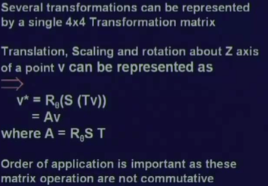
Concatenate
To concatenate different transformation that is translation, scaling and rotation
If we want to rotate a point about Z axis; then the translations, scaling and rotation, this can be concatenated as
First translate the point V by the translation operation T of the translation matrix T,
Then perform scaling,
Then perform rotation and this rotation is R theta and
all these 3 different transformation matrix that is R theta, S and T all of them being 4 dimension matrix can be combined into a single matrix say the single transformation matrix, A which is nothing but the product of R theta, S and T and this A again will be a matrix of dimension 4 by 4.

Slide 24
The note
The case of concatenation of transformations, the order in which these transformations are to be applied, is very important because these matrix operations are in general not commutative.

Slide 25
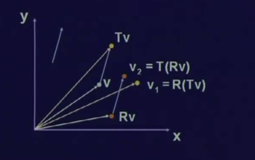
Not commutative
There are 2 ways in which these 2 operations can be done.
V1 = yellow
V2 = orange
Not the same result

Slide 26
Transform a set of points

Slide 27
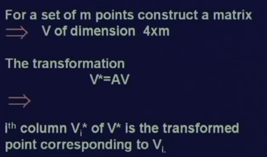
Transformation all the points
apply transformation to all the points simultaneously, rather than applying transformation to individual points 1 by 1.
So, for a set of m points, we have to construct a matrix V of a dimension 4 by m.
That every individual point will now be considered, now be consider as a column vector of this matrix which is of dimension of 4 by m.
And then, we apply the transformation A to this enter matrix
and the transformation after this transformation, we get the new matrix V star which is given by the transformation A multiplied by the V.
So at any particular columns, i’th columns in the matrix in the Vi V star which is a Vi star is the transformed point corresponding to the i’th column of matrix B which is represented Vi.

Slide 29
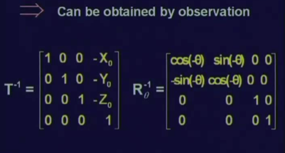
Inverse transformation
If we translate a point by a displacement vector V, then inverse transformation should bring back the point to its original position.
So, if a vector V, the inverse translation should be by a vector minus V.

Slide 30
Inverse matrix for scaling
Similarly, the inverse matrix for scaling will be the Sx will be replaced by 1 upon Sx.

Slide 31
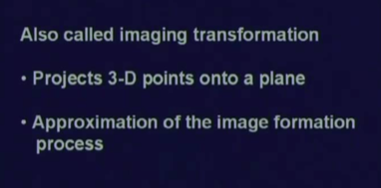
Perspective transformation
is also known as an imaging transformation
The purpose of this imaging transformation is to project a 3D point, (a 3D world point) into the image plane
This gives an approximation to the image formation process which is actually followed by a camera.

Slide 32
Summery of the lecture
some basic mathematical transformations
translation, rotation and scaling in 2D and 3D
The inverse transformations of these different mathematical transformations.

Slide 33
References
Prof .P. K. Biswas Department of Electronics and Electrical Communication Engineering Indian Institute of Technology, Kharagpur
Gonzalez R. C. & Woods R.E. (2008). Digital Image Processing. Prentice Hall.
Forsyth, D. A. & Ponce, J. (2011).Computer Vision: A Modern Approach. Pearson Education.

