Slide 1
Digital Image Processing CCS331
Camera Model and Imaging Geometry

Slide 2
Summery of previous lecture
Some basic mathematical transformations
translation, rotation and scaling in 2D and 3D
The inverse transformations of these different mathematical transformations.
We learn the relationship between Cartesian coordinate system and homogeneous coordinate system and the importance of homogeneous coordinate system in formations of camera.

Slide 3
Today's lecture
Inverse perspective transformation
imaging geometry where the world coordinate system and the camera coordinate system
what are the transformations steps involved in a generalized imaging setup
illustrate the concept with the help of an example

Slide 4
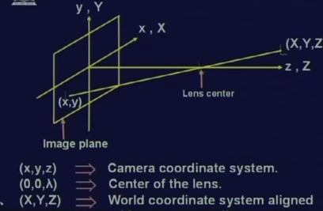
Image formation
Assumed that the camera coordinate system and the 3D world coordinate system are perfectly aligned.
Assume point XYZ in 3 dimension, the center of the lens is at location 0 0 lambda; so obviously, the lambda which is the Z coordinate of the lens center, this also the focal length of the camera
X, Y, Z 3D point, is mapped to the camera coordinate given by lowercase x and lowercase y.

Slide 5
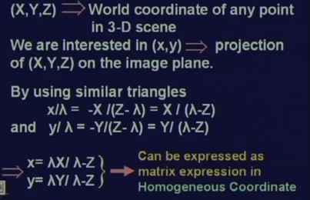
The image coordinates of the 3D world coordinate capital X capital Y, capital Z is given by x coordinate x inverse coordinate x is given by lambda x by lambda minus capital Z.
Similarly, the inverse coordinate y is given by lambda capital Y divided by lambda minus capital Z. Now, these expressions also can be represented in the form of the matrix and so for homogeneous coordinate system, then this matrix expression is even simpler.

Slide 6
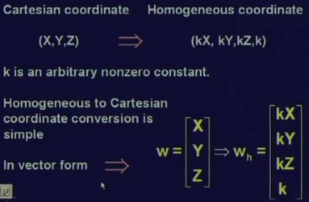
Homogeens coordinated system
The Cartesian coordinate capital X, capital Y capital Z; then in unified coordinate system, we just append a value 1 as an additional component.
In Homogeneous coordinate system, instead of simply adding 1, we add an arbitrary non 0 constant k and multiply all the coordinated X, Y and Z by the same value k.

Slide 7
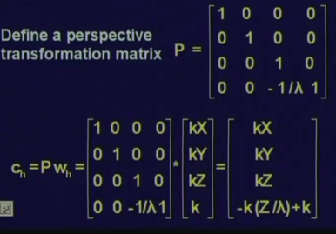
Perspective transformation
The perspective transformation takes an image of a point or a set of points in the 3-dimensional world and these points are mapped to the imaging plane which is a 2-dimensional plane.
Perspective transformation matrix P
The homogenous coordinate Wh
homogenous coordinate of the camera Ch

Slide 8
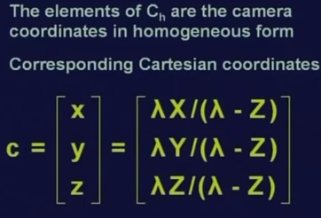
Homogenous image point into the corresponding Cartesian coordinate,

Slide 9
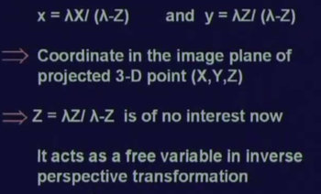
Compare the expression with the camera coordinate
The third component Z which is not importance in our case because in the camera coordinate, the value of Z is always equal to 0 because we are assuming that the imaging plane is the X Y plane of the world coordinate system as well as the camera coordinate system.

Slide 10
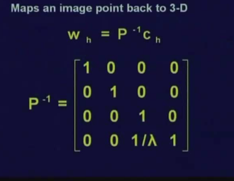
Inverse perspective transformation
The inverse perspective transformation is just the reverse, the inverse perspective transformation or P inverse tries to find out the corresponding 3D point in the 3D world from a 2D image.
In the homogenous coordinate system, the camera coordinate C of the image coordinate point will be replaced to the corresponding homogenous form which is given by Ch
The world coordinate point W will be obtained in the form of Wh.

Slide 11
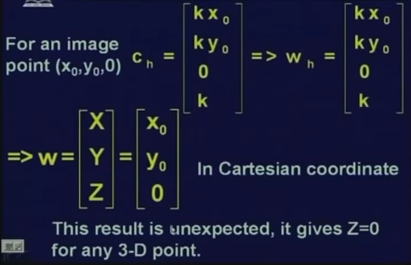
Inverse perspective transformation
Assume an image point x0, y0 and we want to find the corresponding 3D world point W to which this x0, y0 image point corresponds.
The first is to convert the image point x0, y0 to the corresponding homogenous coordinate which will be obtained as kx0, ky0 and 0 and then the forth component comes as k.
Now, here the third component or z coordinate is 0 because in the 2D we have assumed the z coordinate to be 0.
If we multiply or (transform) the homogenous coordinate kx, kx0, ky0, 0, k with the inverse perspective transformation P inverse, then we get is the homogenous coordinate corresponding to the 3D world point which is obtained has Wh as given in this equation; Wh is equal to kx0, ky0, 0, k.
homogenous coordinate system we convert to the Cartesian coordinate form and obtained as W equal to capital X capital Y capital Z which is nothing but x₀^{, y}₀^{, 0.}

Slide 12
3D world coordinate is as x0, y0, 0 which is the same point from where the image point started
Moreover, for all the 3D coordinate points, the z component always comes as 0.
Obviously, this solution is not acceptable because for every coordinate or for every point in the 3 dimensional world, the z coordinate cannot be 0.

Slide 13
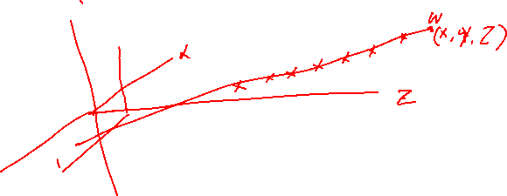






Slide 14
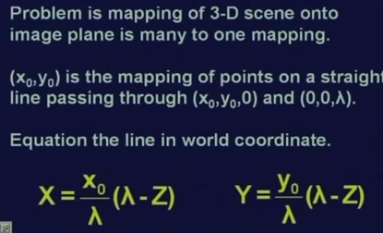
Straight line for inverse perspective transformation
This is the equation of the straight line is mapped to the same point x0, y0 in the image plane.
So, the inverse perspective transformation cannot gives us a unique point in the 3D world because the mapping the perspective transformation is not a 1 to 1 mapping.
So if we cannot get exactly the 3D point but at least the inverse transformation matrix should be able to give the points belonging to which particular line maps
So, let us see whether we can have this information at least.

Slide 15
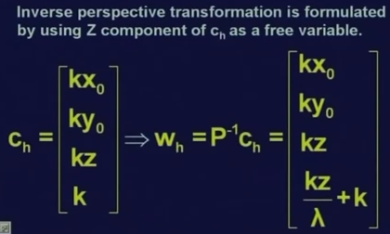
Instead of assuming the z coordinate to be 0, we assume that z coordinate to be a free variable.
So now homogenous coordinate, will be convert to the Cartesian coordinate system for which we divide all the components with the last component, so kx0, ky0 and kz, z all of them will be divided by kz by lambda plus k.

Slide 16
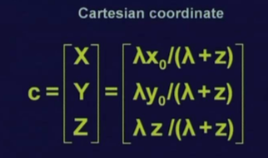
Cartesian coordinate system
Cartesian coordinate system is W is equal to lambda x0 divided by lambda plus Z, lambda y0 divided by lambda plus Z and lambda Z divided by lambda plus Z.
So, on the right-hand side all the z’s in lower case letters are the free variable that we had assumed, the column matrix on the left-hand side, all X Y Z are in upper case are the 3D coordinate.

Slide 17
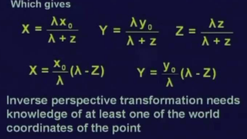
Solve the values of capital X and capital Y
What we get is the equation of the straight line was exactly like the one obtained now
So, by using this inverse perspective transformation, we have not been able to identify the 3D world point which is of course not possible, but we have been able to identify the equation of the straight line so that the points on this straight-line maps to the image point x0, y0 in the image plane.
If we want to exactly find out a particular 3D point to which this image point x0, y0 corresponds; then we need some more information.

Slide 18
More information can be at least need to know what is the Z coordinate value of the particular 3D point W and once we know this, then using the perspective transformation along with this information of the Z coordinate value, we can exactly identify the point W which maps to point x0, y0 in the image plane.
Till now, all these discussions we have assumed that the image coordinate system and the camera coordinate system they are perfectly aligned.
Now, let us discuss about a general situation where the image coordinate system and the camera coordinate system, they are not perfectly aligned. So, here we assume that the camera is mounted on a Gimbal.

Slide 19
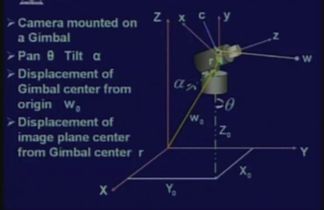
Not perfectly aligned camera
The camera can be a pan of angle theta, it can also be given a tilt by an angle alpha.

Slide 20
For a given world point W, what will be the corresponding image point C?
we will need to find a set of transformations to bring the camera coordinate system and the world coordinate system in perfectly aligned.
Then apply the perspective transformation to the transformed 3D world points to the corresponding image coordinates

Slide 21
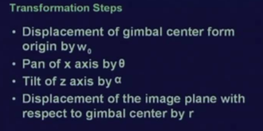
Transformation steps
we have 4 different transformation steps which are to be applied one after another and these transformation steps will give you the transformed coordinate of the 3D world point W.

Slide 22
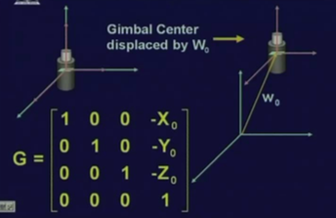
Displacement
If the camera center is displaced by vector W0; so all the world coordinate points, will be displaced by the vector which is negative of W0

Slide 23
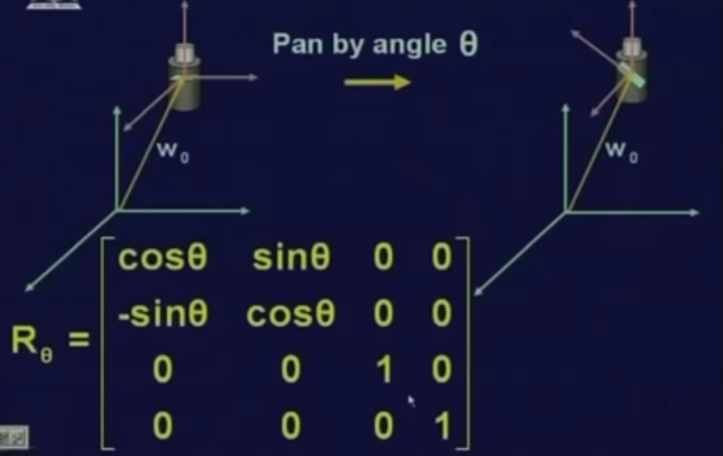

panning the camera
Pan the camera by angle theta and this panning is done along the Z axis.

Slide 24
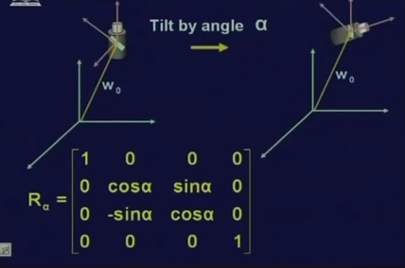

Tilt the camera
we must find out what is the corresponding transformation matrix for this tilt operation which has to applied to all the 3D points.

Slide 25
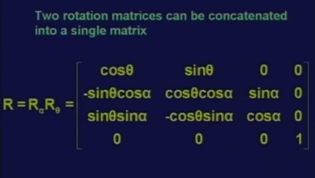
combined into a single rotation matrix

Slide 26
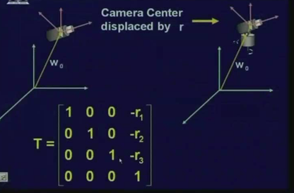
camera center transformation
Then final transformation is the camera center from the Gimbal center by a vector R

Slide 27
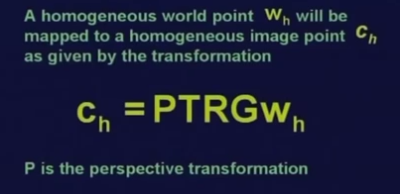
All transformation one after another

Slide 28
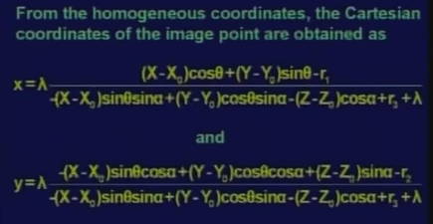

Slide 29
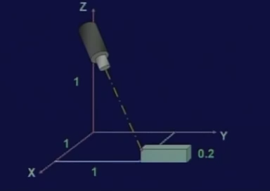
Example
What are the world coordinate points seen by the camera.
The pan is 135 degree; the tilt is 135 degree.

Slide 30

image coordinate system and the camera coordinate system are perfectly aligned

Slide 31



pan of camera by 135 degree

Slide 32
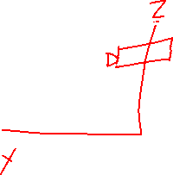


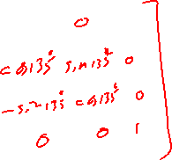

Tilt Opration

Slide 33


corresponding image point

Slide 34



overall transformation matrix

Slide 35




perspective transformation to the points

Slide 36
Summery of the lecture
Inverse perspective transformation
imaging geometry where the world coordinate system and the camera coordinate system
what are the transformations steps involved in a generalized imaging setup
illustrate the concept with the help of an example

Slide 37
References
Prof .P. K. Biswas Department of Electronics and Electrical Communication Engineering Indian Institute of Technology, Kharagpur
Gonzalez R. C. & Woods R.E. (2008). Digital Image Processing. Prentice Hall.
Forsyth, D. A. & Ponce, J. (2011).Computer Vision: A Modern Approach. Pearson Education.

