Slide 1
Digital Image Processing CCS331
Camera Calibration and Stereo Imaging

Slide 2
Summery of previous lecture
Inverse perspective transformation
imaging geometry where the world coordinate system and the camera coordinate system are perfectly aligned
what are the transformations steps involved in a generalized imaging setup where the world coordinate system and the camera coordinate system not aligned
Illustrate the concept with the help of an example

Slide 3
Today's lecture
Calibration of the camera
Extracting the 3D point from 2 images which is also known as stereo images
Stereo correspondence problem complexity

Slide 4
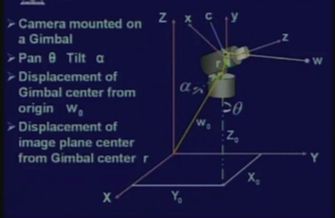
Not perfectly aligned camera
The camera can be a pan of angle theta, it can also be given a tilt by an angle alpha.

Slide 5
For a given world point W, what will be the corresponding image point C?
we will need to find a set of transformations to bring the camera coordinate system and the world coordinate system in perfectly aligned.
Then apply the perspective transformation to the transformed 3D world points to the corresponding image co-ordinates

Slide 6
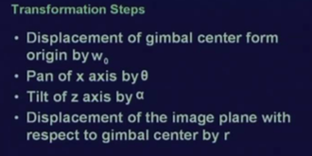
Transformation steps
we have 4 different transformation steps which are to be applied one after another and these transformation steps will give you the transformed coordinate of the 3D world point W.

Slide 7
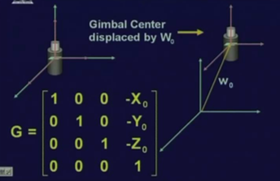
Displacement
If the camera center is displaced by vector W0; so, all the world coordinate points, will be displaced by the vector which is negative of W0

Slide 8
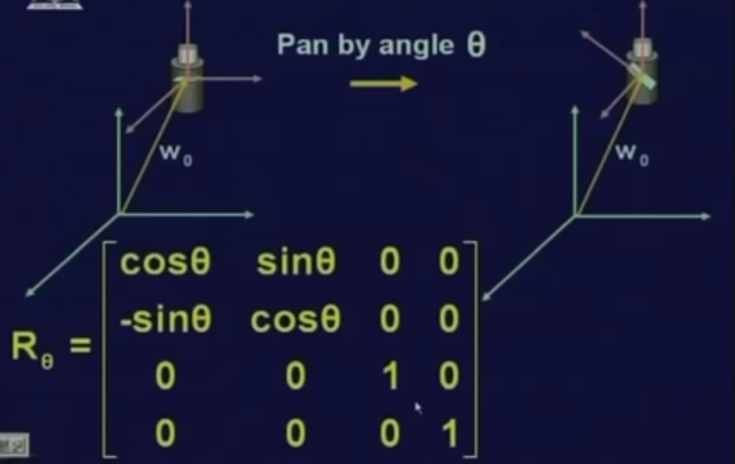
Panning the camera
Pan the camera by angle theta and this panning is done along the Z axis.

Slide 9
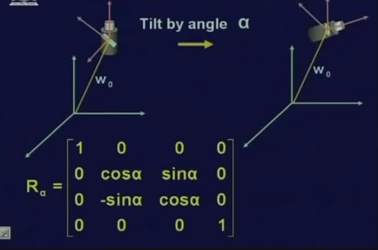
Tilt the camera
we have to find out what is the corresponding transformation matrix for this tilt operation which has to applied to all the 3D points.
Rotating towards Z-axis

Slide 10
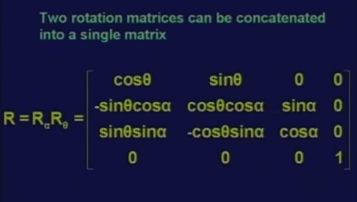
combined into a single rotation matrix

Slide 11
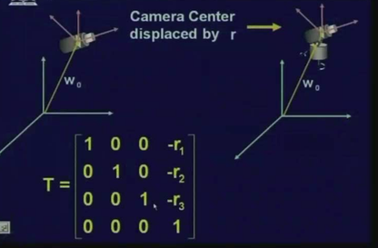
camera center transformation
Then final transformation is the camera center from the Gimbal center by a vector R

Slide 12
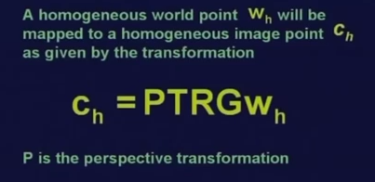
All transformation one after another

Slide 13
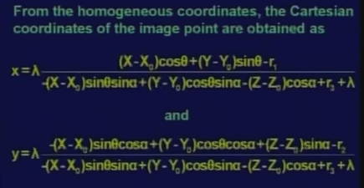
Co-ordinate measurements

Slide 14
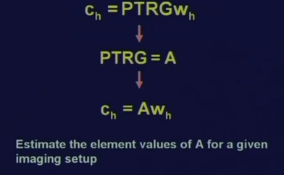
Calibrate camera
The transformation which is involved
Transformation matrices are of dimension 4 by 4;
This matrix A will also be a 4 by 4 matrix
the transformations T, R and G, they depend up on the imaging setup. So, G corresponds to translation of the Gimbal center from the origin of the 3D world coordinate system, R corresponds to pan angle and the tilt angle and T corresponds to translation of the image plane center from the Gimbal center.
P is perspective transformation matrix, property of the camera, P has a term lambda which is the focal length of the camera.

Slide 15










Slide 16






Slide 17










Slide 18
The problem still exists that given an imaging point, we cannot uniquely identify what is the location of the 3D world point. Because of z value
To identify the 3D world point or the X, Y and Z coordinates of a 3D world point, we can use another camera.

Slide 19
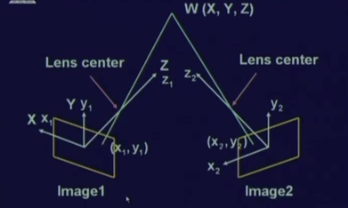
Stereo imaging
The image 1 is taken with help of 1 camera,
The image 2 is taken with the help of another camera. (or same camera but location is different)

Slide 20
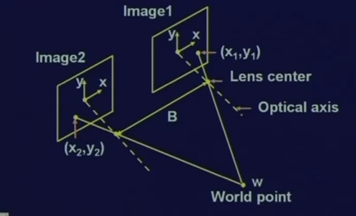
Stereo imaging
For both cameras, the image plane 1 and the image plane 2, they are in the same plane.

Slide 21
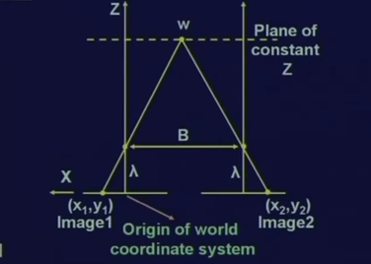
Co-ordinate measurements
It will have different values of the Z coordinate because the cameras are shifted or displaced only in the Z axis not in the X axis or Y axis.

Slide 22














Slide 23





Slide 24




Stereo correspondence problem complexity

Slide 25










Slide 26
Summery of the lecture
Calibration of the camera
Extracting the 3D point from 2 images which is also known as stereo images
Stereo correspondence problem complexity

Slide 27
References
Prof .P. K. Biswas Department of Electronics and Electrical Communication Engineering Indian Institute of Technology, Kharagpur
Gonzalez R. C. & Woods R.E. (2008). Digital Image Processing. Prentice Hall.
Forsyth, D. A. & Ponce, J. (2011).Computer Vision: A Modern Approach. Pearson Education.

