Slide 1
Digital Image Processing CCS331
Interpolation and Resampling

Slide 2
Summery of previous lecture
Calibration of the camera
Extracting the 3D point from 2 images which is also known as stereo images
Stereo correspondence problem complexity

Slide 3
Todays lecture
Why and when, do we need image interpolation and image resampling.
Interpolation operation
Algorithms for different image transformations and the needed interpolation operations.

Slide 6
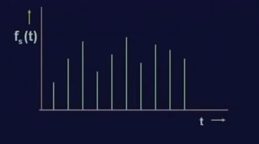
Interpolation and image resampling
1 dimensional signal which are represented by f _{S} (t).

Slide 7
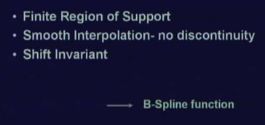
Properties of the interpolation
B spline function satisfies all these 3 properties we need

Slide 11
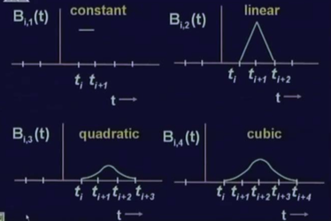
Nature of B spline functions
The region of support for this cubic function is 5 points
The region of support for quadratic function is 4 points
The region of support for the linear B spline is 3 points
The region of support for 1 is 2 points.
In all cases, the region of support is finite.

Slide 12
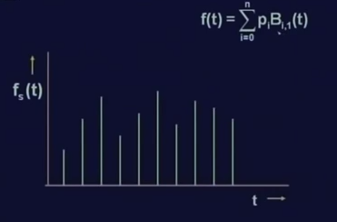
interpolation

Slide 13
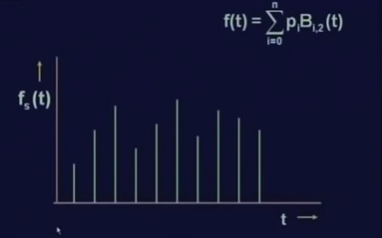
Interpolation

Slide 15
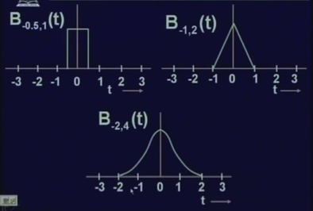
Change in shift

Slide 16
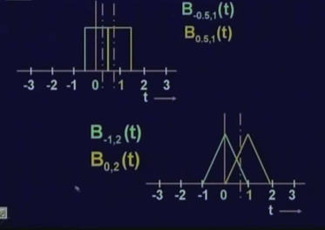
interpolating the function

Slide 17
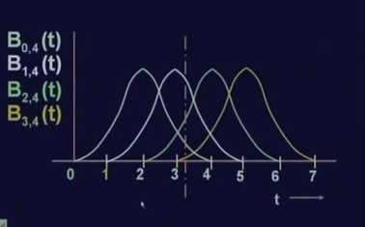
interpolating the function

Slide 18
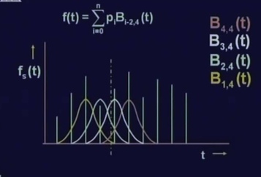
interpolating the function

Slide 19
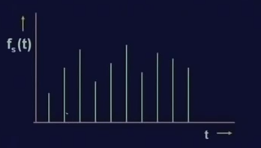
interpolating the function

Slide 20
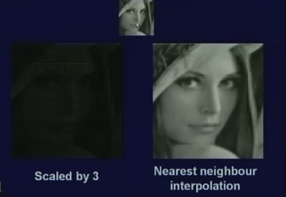
Results, constant interpolation

Slide 21
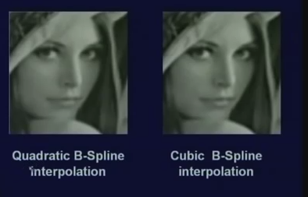
Results, constant interpolation

Slide 22
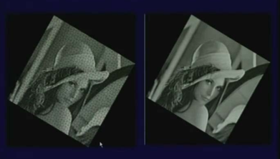
Results, cubic

Slide 23
Summery of the lecture
Why and when, do we need image interpolation and image resampling.
Interpolation operation
Algorithms for different image transformations and the needed interpolation operations.

Slide 24
References
Prof .P. K. Biswas Department of Electronics and Electrical Communication Engineering Indian Institute of Technology, Kharagpur
Gonzalez R. C. & Woods R.E. (2008). Digital Image Processing. Prentice Hall.
Forsyth, D. A. & Ponce, J. (2011).Computer Vision: A Modern Approach. Pearson Education.

