Slide 1
MedLink Hub
Results-driven solution to enhance partnership and relationships

Slide 2
MedLink Hub
Imagine having an intelligent system that changes the way healthcare service providers are found OR where healthcare services are most in demand
Provides correct mapping logic of existing a anonymized data to zip codes so medical staff can better understand potential patients and background
It is the google of HIPPA-compliant data.

Slide 3
MedLink Hub Components
Potential Patients (Clinics Search)
Clinics (Admin Lookup)

Slide 4
Clinics Search
App created for potential patients to lookup clinics for their special needs
The curated list is calculated based on needs of potential patients, distance to the clinics/hospitals, and patients-service score
The app identifies a patient-service score using the location of the patients (and other factors)

Slide 5
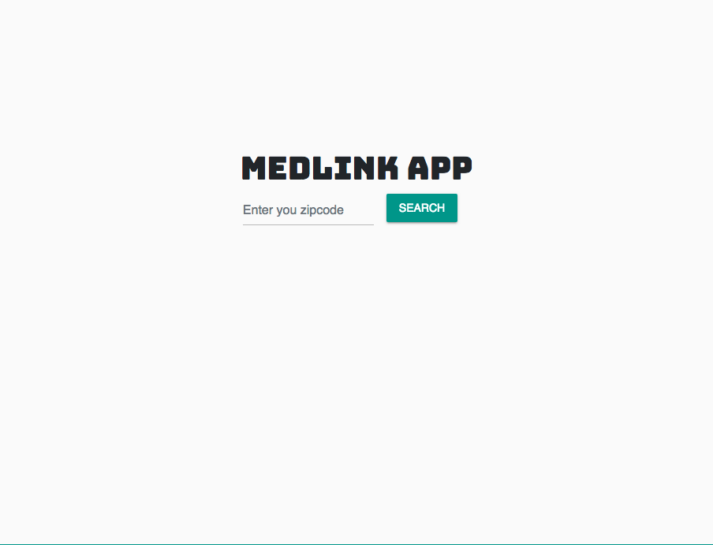

Slide 6
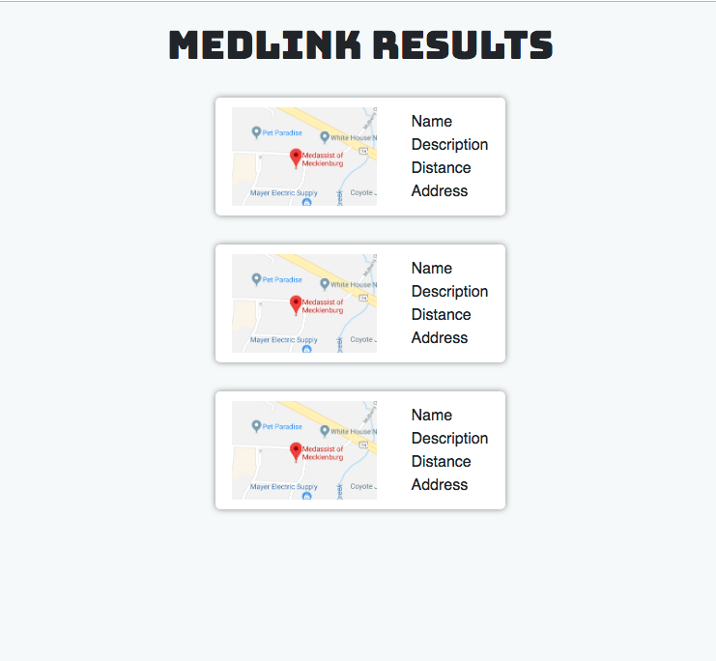

Slide 7
MedLink Clinics
The clinics use the anonymized data and Patients Service Score (PSS) to analyze if they are better serving their patients
PSS is also an indicator to highlight areas where patients aren’t been served (based on location and distance)

Slide 8
