Slide 1
Railway Animal Detection System
Communication and Alerting Layer
BTP Major (SSE) | Mid-Semester Progress Report
Apoorv Singh | 230021004
Space Science & Engineering, IIT Indore
Supervisor: Prof. Saurabh Das
Notes:
Hello, I'm Apoorv Singh, roll number 230021004, Space Science and Engineering, IIT Indore. This is my BTP Major mid-semester progress presentation under Prof. Saurabh Das, on the Railway Animal Detection System, specifically the communication and alerting layer.

Slide 2
Detection alone doesn't stop a collision
ONGOING EFFORTS
THE GAP
ALSO NEEDED
Detect
Alert the driver
Log the events
Cameras, PIR sensors and geophones at trackside nodes identify that an animal is present.
Get the information to the driver within seconds, in a form simple enough to act on.
Record every event so the control room can track patterns over time.
This project: a communication and alerting layer that takes trackside detections, decides how urgent each one is, and pushes it to a driver display and a control-room dashboard in real time.
Notes:
Animal-train collisions on Indian Railways cause wildlife deaths, occasional derailments and operational disruption. Many efforts focus on detection, using cameras, PIR sensors and geophones at trackside nodes. But detection alone doesn't prevent a collision. The real gap is getting that information to the driver fast enough, and in a form simple enough, to act on within seconds, while also logging it for a control room. That is the gap my part of the project addresses.

Slide 3
Three parts. This report covers one.
1 Trackside sensing hardware
MY SCOPE
ESP32-CAM, PIR sensor, geophone
3 Communication and alerting layer
Event ingestion
Severity scoring
Multi-node prioritisation
Data persistence
Driver and control-room interfaces
2 Detection model
81.5%
mAP50, YOLOv8-nano, trained separately on a wildlife dataset
Notes:
The overall system has three parts: trackside sensing hardware, meaning ESP32-CAM, PIR and geophone; a YOLOv8-nano detection model, trained separately to 81.5% mAP50; and the communication and alerting layer. That third part is my complete responsibility: event ingestion, severity scoring, multi-node prioritisation, persistence, and the driver and control-room interfaces.

Slide 4
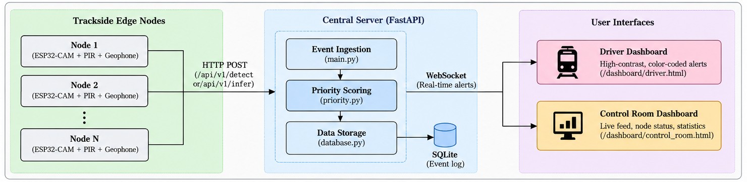
System architecture
One pipeline, two sources
Server-side inference
Score, rank, store, broadcast
Real ESP32-CAM events and simulator traffic share one path, so the system was built and demoed before hardware.
YOLOv8-nano runs on the server, since the ESP32-CAM cannot run it on-device.
Every event is scored, ranked, saved to SQLite and pushed over WebSocket.
Notes:
Events reach the system from a real edge node, an ESP32-CAM triggered by PIR, or, during development, from a simulator posting synthetic events over HTTP. Both converge on a single FastAPI pipeline. This was deliberate: I could build and demo the whole system before hardware was ready, with no change in behaviour once real hardware is plugged in. There are three endpoints: pre-scored JSON, raw image for inference, and heartbeat. Pydantic validates every payload. If an image arrives, the server runs YOLOv8-nano, since the ESP32-CAM can't run it on-device.

Slide 5
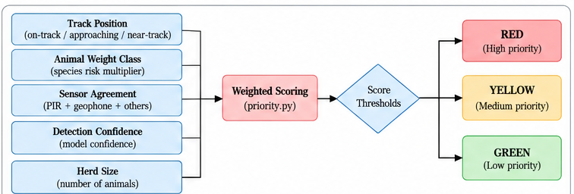
From detection to decision
Multi-node ranking
Events are ranked by severity and proximity. The driver sees the single most urgent one; others queue as secondary alerts.
Persistence
Every event is logged to SQLite for the control room and future path tracing.
Priority scoring logic (simplified). Weights are tunable and documented.
SERVER-SIDE PIPELINE
Receive
Validate
Infer
Score
Store
Broadcast
Notes:
Each event is scored on track position, animal weight class, sensor agreement, detection confidence and herd size, giving a RED, YELLOW or GREEN severity. Across multiple nodes, events are ranked so the driver always sees the single most urgent situation. Everything is stored in SQLite and broadcast over WebSocket.

Slide 6
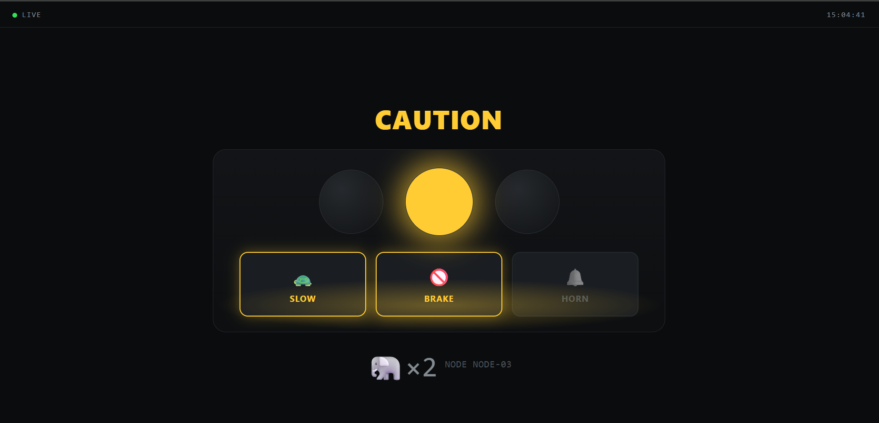
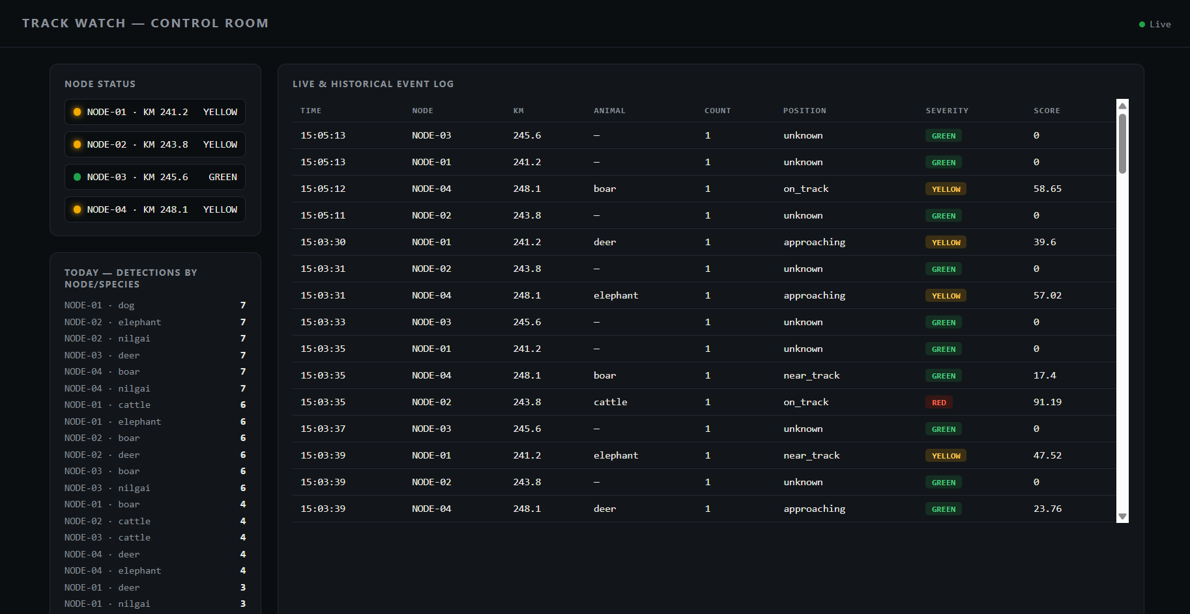
Live demo: end to end over WiFi
Driver dashboard
Control-room dashboard
CAUTION state: slow and brake highlighted, with animal and node shown.
Node status, live feed, per-node species counts, history with severity and score.
Events posted to FastAPI, updated live over WebSocket, across two separate devices on the same WiFi.
Notes:
Now the demo. This is the control-room dashboard: node status, a live event feed, per-node species counts and a historical log with severity and score. This is the driver dashboard, designed for sub-second readability: one colour, one action. I'm posting a detection now. The driver display goes to CAUTION, with slow and brake highlighted. This one is on the track with a larger animal, so it goes RED. The same events appear in the control-room log with their scores. This ran across two physically separate devices on the same WiFi network over a live WebSocket connection, so it's a real network boundary, not just localhost. (Tip: record the live demo on screen here, and use this slide as the still before or after.)

Slide 7
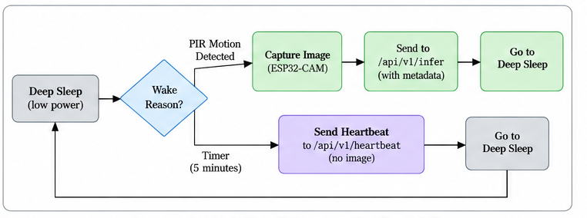
Hardware status and open items
Firmware not yet flashed
Desk-reviewed only. USB shield delayed; Arduino Mega 2560 as USB-serial bridge is the next task.
Geophone not procured
Absent from the hardware procured so far; its inclusion is still to be resolved.
ESP32-CAM node firmware
Deep sleep with two wake sources: PIR-triggered capture and send, or a periodic heartbeat.
Prototype security
Validated
CORS is open (allow_origins = *) for campus testing. Restriction and authentication are planned.
Full pipeline with simulated node traffic over a real WiFi network.
Notes:
On the hardware side, the ESP32-CAM firmware is written: deep sleep with two wake sources, PIR-triggered capture and transmit, and a periodic heartbeat so node status stays meaningful. It is desk-reviewed but not yet flashed on hardware, so the validated proof of concept today is simulator-driven. The geophone isn't in the hardware procured so far, and its inclusion is still to be resolved. On security, CORS is currently open, which is fine for controlled campus testing but not for production, so hardening is planned.

Slide 8
Plan for the rest of the semester
1
2
3
4
5
Flash and wire
Single-node end to end
Geophone
Campus demo
Harden
Flash ESP32-CAM via the Mega bridge, integrate PIR, set up the WiFi link to the server.
PIR, capture, transmit, inference, scoring, dashboard alert.
Wire and validate if available; feed it into multi-sensor scoring.
Physical nodes, server and both dashboards under realistic conditions.
Restricted CORS origins, authentication, secure communication.
Software layer: complete and validated over real WiFi. Next: the campus-ready hardware prototype.
Thank you
Notes:
For the rest of the semester: flash the firmware and integrate the PIR sensor, then validate the single-node pipeline end to end, from PIR detection to capture, transmission, inference, scoring and dashboard alert. After that, the geophone if available, a multi-node campus demonstration, and hardening with restricted origins and authentication. To summarise: the software layer is complete and validated over real WiFi, and the remaining goal is the hardware prototype. Thank you.

