Slide 1
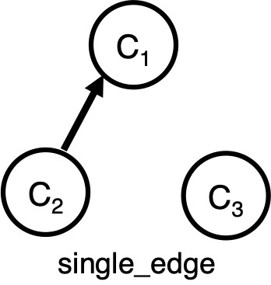
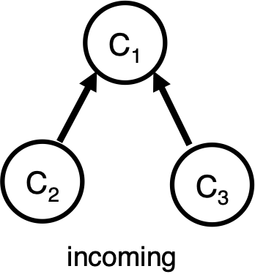
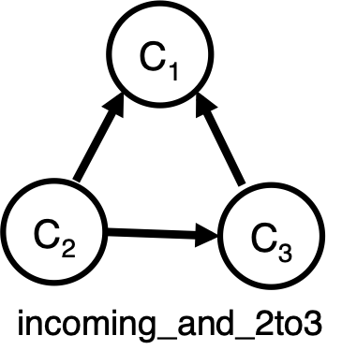
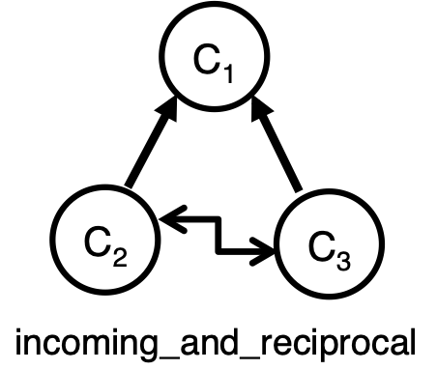
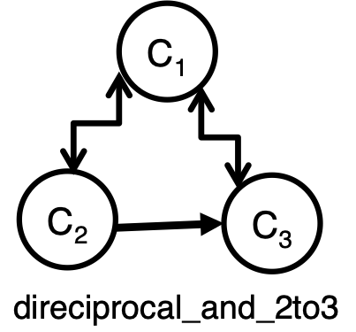
memymineown
This is spam it has gotten to the point where it should be removed like the links to SRS.
Affirmation
drinkthebleach
Every single thread with this crap, same guy too. It's not that I don't agree with it, I just hate seeing my favorite subreddit polluted with unrelated bullshit. You don't need to go the Jehova's Witness route, seriously, it doesn't help
Rebuttal
thingsarebad
It's not unrelated, and it's not spam. Just because you don't agree with it doesn't make it unrelated or not spam. Learn a little reddiquette. The presidential race will have significant effects on the path our country takes and our boys will suffer greatly if we elect a president that gets us involved in unnecessary wars. The only presidential candidate who respects the constitution is Ron Paul. Vote for anyone else and you're voting for more state-sanctioned misandry, it's that simple. It's **incredibly** stupid to claim that the results of the presidential race have no bearing on men's rights. Why is it every time I post something political all the ignorant partisan idiots come out of the woodwork to trash it? Grow up.
Affirmation
Rebuttal
Rebuttal of C3
drinkthebleach
By that logic, you should go x-post this to every subreddit here, every single one, because the race can impact all of them. Get to work.
C3’s response to rebuttal
thingsarebad
That's not logical. R/MR is one of few reddits where people don't buy into the mainstream bullshit view (that men are evil and women are all victims). Therefore it is a place where there will be some people who are smart enough and open-minded enough to realize that men's rights is part of a larger issue. Spending my time here is more valuable than going around posting links at every sub-reddit, obviously.
Rebuttal of C3
C3’s response
to rebuttal
drinkthebleach
MR is clearly the best place for it, especially judging by the fact that no one has agreed with you here, and the rest of the comments are complaining about how you spam the board.
thingsarebad
Luck of the draw. Ignorant people are concentrated here tonight. Nevertheless, it is on-topic and should not be receiving any down-votes.
memymineown
Why do you think people with different political views who are still Men's Rights Activists don't post things about their preferred political candidate here? Are you just smarter than all of them or do you have more balls?
C1’s response to
C3’s rebuttal
thingsarebad
Because they know they can't defend the candidate's position. They're cowards. I welcome everyone to post information on how another candidate will help men so that it may be thoroughly debunked. Unlike them, I welcome discussion because it will bring us closer to discussion. They prefer we don't talk about it at all because they are afraid.
memymineown
No, you are a fucking retard. Everyone knows they can defend their candidate's position. They don't post them here because they know it will turn into r/debateoverpresidents. And that diverts our attention from other things.
*C1’s response to
*C3’s rebuttal
C1 and C3 as in INCOMING
MensRights
t1_c2zdwxx

Slide 2
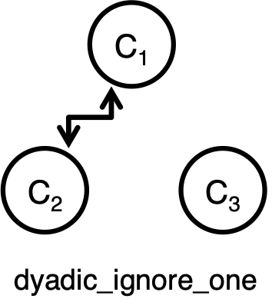
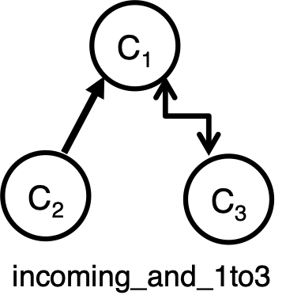
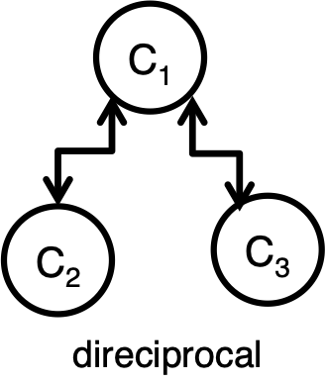
drinkthebleach
This forum has nothing to do with Ron Paul. Please stop talking about Ron Paul.
neofool
Agreed. If you really want to fight the war hungry government you'd be better off pushing for better education for boys so they don't have to resort to the military as a last resort.
Disagreement
thingsarebad
That's not a solution.
neofool
How so? The military needs soldiers to fight the wars and as income and job prospects increase fewer and fewer people are willing to risk their lives for politicians stupid ideas. Supporting an, at best, long shot candidate will do less than trying to stop the flow of young men going to their deaths.
Rebuttal
thingsarebad
The sheer stupidity of this argument hurts my brain. Maybe someone smart like Demonspawn will take the time to educate you but I really don't have the patience to spend an hour explaining things to you. Safe to say I'm not surprised someone as stupid as you is against this article submission.
Disagreement
Rebuttal
neofool
It's not that bad of an argument. Destroy the source pool from which the entity derives it's sustenance and push large cuts to the funding of the organization in general. Turn it from a tool of offense to one of defense.
Disagreement
overcontrol
No, you're better off picking a candidate that won't engage in frivolous wars.
Affirmation /
Camaraderie
thingsarebad
Care to answer this? http://www.reddit.com/r/MensRights/comments/maiiy/dont_want_a_president_who_will_take_us_to_war/c2zdu7i Honestly it's so stupid I can't stand to deal with it.
neofool
There are none. There are candidates that believe in the current wars and maybe one more and candidates that believe in an unlimited amount of wars. Ron Paul believes in no wars and no invasion of foreign soil period but he will never be elected because many people believe we need bases in every other country.
Rebuttal
Disagreement/
Rebuttal
Response
to rebuttal
thingsarebad
This forum has everything to do with men's rights, and sending men to die in war is a men's rights issue. Take your partisan anti-libertarian baloney outta here.
Affirmation / camaraderie
MensRights
t1_c2zdlxm

Slide 3
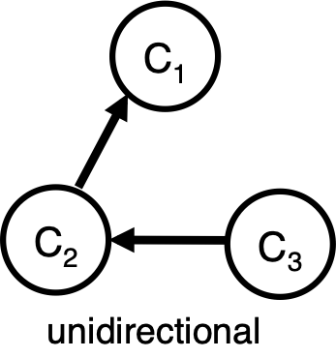
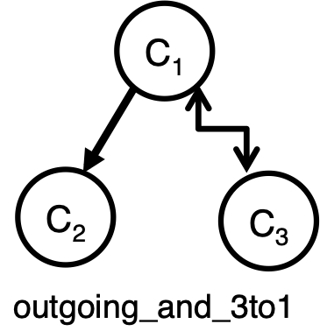
PoundnColons
Please do not make such assumptions unless you have provided another similar situation for us to compare. I don't know what would happen if you switched the genders. I know the public would view it different but that doesn't mean much since it's automatically assumed that boys enjoy and benefit from anything sexual(including statutory*edited* rape) while girls hate and are hurt by anything sexual. EDIT: To clarify I'm simply asking that posts aren't made making assumptions about what would happen if gender roles are swapped unless they are providing something to compare. EDIT: Make rape --&gt; statutory rape.
deathmuffin
&gt;I know the public would view it different but that doesn't mean much This mind-set is why /r/MensRights exists. Pointing out the double-standard. Until the public would **not** view it different there will be a need for this subreddit.
Accusatory
question
/ Rebuttal
PoundnColons This post was not pointing out a societal double standard but an institutionalized double standard. However incorrectly and with out back up, he is comparing this case to a hypothetical situation, one with swapped gender roles. I simply request that any such assumptions be compared to real situations eg. Produce a similar case in the same state with a man as the offender and prove that system is biased(I know it is but we still need solid evidence).
Accusatory qn /
rebuttal
Request for
Clarification /
Disagreement
Isthisnuf
"...it's automatically assumed that boys enjoy and benefit from anything sexual(including rape)" Where is it automatically assumed that boys enjoy and benefit from anything sexual ***(including rape)***?. That's absurd. Where is your proof that boys enjoy rape?
Request for clarification /
Disagreement
johnny_gunn
Where the hell did you get that quote..'enjoying rape' is an oxymoron in itself.
Defense of original author
isthisnuf
I was quoting PoundnColons comment.
Clarification
johnny_gunn
Sorry, I must've missed that line. While I agree that there's the tendency for underage women to be perceived more of a victim than underage boys, I wouldn't say it's 'automatically assumed' by anyone's standards.
Clarification
(note re-orient)
Response to
Accusatory qn
morris198 Just to play Devil's Advocate, I'm going to *assume* that he meant that boys could enjoy strictly *statutory* rape that would be otherwise considered consensual if he were not underage. ... if he meant anything *other* than this, then... *what the fuck?!*
Response to accusatory qn
PoundnColons
You miss the point I was making. I'm talking about the way society treats men's and women's sexuality in this situation. And I should have said statutory rape. The way society views it is if a boy is a victim of statutory rape it's not a big deal he enjoyed it he can brush it off because he is male. if the gender role is reversed it's treated as if the girl was horribly emotionally damaged, even if she was underage and consented, as opposed to the male version. Society treats male sexuality as if the male will like it no matter what, that was my point. Never did I claim boys enjoy rape please think about the entirety of my post before replying.
johnny_gunn
Why the downvotes on this guy? We can't just go around saying "this woman got away with this when CLEARLY a man wouldn't have". We can't compare a real situation to a hypothetical, to make a valid analysis we need to know how badly on average women are treated for this crime, and how badly on average men are, then we can compare.
Defense of original author
MensRights
t1_c301l05

Slide 4
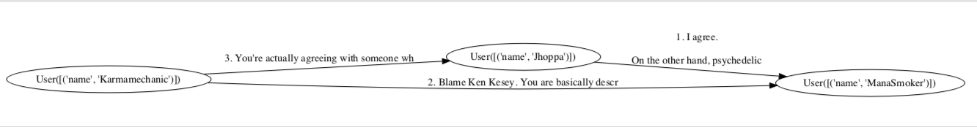
########################
NO_EDGE_TRIADS -> SINGLE_EDGE_TRIADS
User([('name', 'ManaSmoker')]) <- User([('name', 'Jhoppa')])
TEXT: I agree. On the other hand, psychedelic culture might not be what it is without him. Basically, he annoys me about 90% and the other 10% is in awe of his huge balls. (This utterance responds to a top-level-comment!)
########################
SINGLE_EDGE_TRIADS -> INCOMING_TRIADS
User([('name', 'ManaSmoker')]) <- User([('name', 'Karmamechanic')])
TEXT: Blame Ken Kesey. You are basically describing him. If you compared the two, you'd see that Leary was VERY tame compared to what Kesey would do. Upon review, your statements are hyperbole. Leary was very metric in his use of LSD. The binges should be attributed to the acid test movement. (This utterance responds to a top-level-comment!)
########################
INCOMING_TRIADS -> INCOMING_2TO3_TRIADS
User([('name', 'Jhoppa')]) <- User([('name', 'Karmamechanic')])
TEXT: You're actually agreeing with someone who is making grossly inaccurate statements. I'd like to see one example of Leary suggesting or taking part in an LSD binge. He was into large dose and experimented on himself with the drug, but that was nothing compared to those who would come after: Kesey's acid test, even The Grateful Dead are examples of unbridled use. The Bear approved of The Dead, but drew the line at Kesey and his irresponsible group of jesters.
t1_c2zksiq

Slide 5
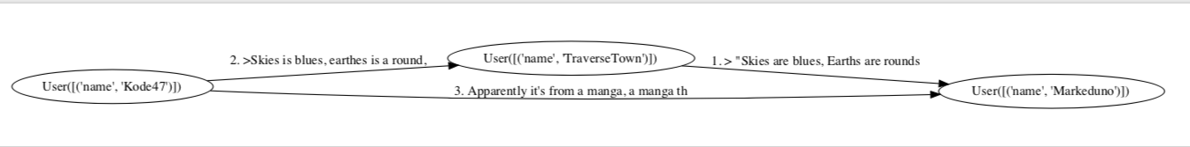
########################
NO_EDGE_TRIADS -> SINGLE_EDGE_TRIADS
User([('name', 'Markeduno')]) <- User([('name', 'TraverseTown')])
TEXT: &gt; "Skies are blues, Earths are rounds, birds flies."
FTFY
(This utterance responds to a top-level-comment!)
########################
SINGLE_EDGE_TRIADS -> UNIDIRECTIONAL_TRIADS
User([('name', 'TraverseTown')]) <- User([('name', 'Kode47')])
TEXT: &gt;Skies is blues, earthes is a round, Bird's flies
########################
UNIDIRECTIONAL_TRIADS -> INCOMING_2TO3_TRIADS
User([('name', 'Markeduno')]) <- User([('name', 'Kode47')])
TEXT: Apparently it's from a manga, a manga that spelled it properly nevertheless.
http://en.wikiquote.org/wiki/Trigun#Episode_11_-_Escape_from_Pain_2
(This utterance responds to a top-level-comment!)
t1_c7h1o29

Slide 6
########################
NO_EDGE_TRIADS -> SINGLE_EDGE_TRIADS
User([('name', 'kernel_kurtz')]) <- User([('name', '[deleted-t1_c33ijpo]')])
TEXT: He's a reporter, he reports. A reporter should not cast or be part of anything to get an outside view. I don't know where this hate comes from.
(This utterance responds to a top-level-comment!)
########################
SINGLE_EDGE_TRIADS -> OUTGOING_TRIADS
User([('name', 'jodon')]) <- User([('name', '[deleted-t1_c33ijpo]')])
TEXT: I don't like esports, I like starcraft.
If he is doing great things for e-sports as a whole, more power to him, I frankly don't give a shit. He consistently voices uninformed, and oft untrue opinions as *fact* and uses he position as an MLG Journalist to give himself credibility.
As an e-sports journalist I think he does a decent job, but his opinions about what players should do, at least for me, an unnecessary and unwanted one.
########################
OUTGOING_TRIADS -> INCOMING_2TO3_TRIADS
User([('name', 'jodon')]) <- User([('name', 'kernel_kurtz')])
TEXT: You're assuming that I don't know who Slasher is and that I've never watched any competitive gaming outside of starcraft. In both assumptions you are wrong. I also never said that I thought he was a random person trying to get famous, but in the context of SC2 he is a virtual nobody. By a nobody I mean that he is neither a high level player nor caster, yet he feels he is qualified to make statements like OP mentions.
t1_c33ijpo

Slide 7
########################
NO_EDGE_TRIADS -> SINGLE_EDGE_TRIADS
User([('name', '[deleted-t1_c2zj02g]')]) <- User([('name', 'LandOfFallenDreams')])
TEXT: considering he didn't specify dosage (neither did OP), he could be used to taking a small dose instead of the 180 or so most of us are most likely using.
########################
SINGLE_EDGE_TRIADS -> INCOMING_TRIADS
User([('name', '[deleted-t1_c2zj02g]')]) <- User([('name', 'daretoeatapeach')])
TEXT: I've never had any negative side effects coming off of MDMA, but I understand that most people do...and a trip certainly would emphasize whatever is there.
########################
INCOMING_TRIADS -> INCOMING_2TO3_TRIADS
User([('name', 'LandOfFallenDreams')]) <- User([('name', 'daretoeatapeach')])
TEXT: I don't know...a pill is a pill and a piece of paper is a piece of paper. Not sure how much punch is packed in each. A single serving has always been plenty for me.
########################
INCOMING_2TO3_TRIADS -> INCOMING_RECIPROCAL_TRIADS
User([('name', 'daretoeatapeach')]) <- User([('name', 'LandOfFallenDreams')])
TEXT: ah I forgot to specify that I mean 180mg of MDMA (I haven't tried LSD yet unfortunately as it's expensive in my area)
t1_c2zj02g

