Slide 1
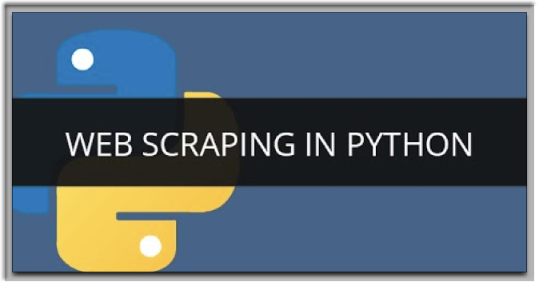
Python Meetup

Slide 2
There is more information on the Internet than any human can absorb in a lifetime. What we need is not access to that information, but a scalable way to collect, organize, and analyze it.
When web scraping with python, we can automatically extract data and present it in a format that we can easily make sense of. In our examples today, we will be using a sqlite database to load the data we extract.
Why Scrape Data?

Slide 3
Scraping Recommendations
Check a website’s Terms and Conditions before you scrape it. Be careful to read the statements about legal use of data. Usually, the data you scrape should not be used for commercial purposes. Also, check the robots.txt endpoint.
Do not request data from the website too aggressively with your script, as you may DDoS the website. Make sure your program behaves in a reasonable manner (i.e. acts like a human). One request for one webpage per second is good practice.
The layout of a website may change from time to time, so make sure to revisit the site and rewrite your code as necessary.

Slide 4
The Basics - we need to look at the elements of the DOM to examine what we want to extract from the site
Elements of the DOM
<!DOCTYPE html>
<html>
<head>
</head>
<body>
<h1> Web Scraping </h1>
<p> Hello World </p>
<body>
</html>

Slide 5
<!DOCTYPE html> : HTML documents must start with a type declaration.
The HTML document is contained between <html> and </html>.
The meta and script declaration of the HTML document is between <head> and </head>.
The visible part of the HTML document is between <body> and </body> tags.
Useful tags include <a> for hyperlinks, <table> for tables, <tr> for table rows, and <td> for table data.
HTML tags sometimes come with id or class attributes. The id attribute specifies a unique id for an HTML tag and the value must be unique within the HTML document. The class attribute is used to define equal styles for HTML tags with the same class. We can make use of these ids and classes to help us locate the data we want.

Slide 6
Let’s Get Started…
make sure you have python3 installed (these scripts will fail with python2), and clone project at https://github.com/dwmorrison33/python-meetup, and follow read.me instructions
lets make sure your machines are up and running correctly.
To make sure everything works with Selenium lets execute the selenium_test_scraper.py script…YAY, it works, lets move on and make sure our db is working too.

Slide 7
A little about databases…
Give us a way to store our data in a relational or non-relational database. In our examples, we will be using a fast, reliable, relational db called sqlite. There is no setup with sqlite, like Postgres or MySQL.
sqlite allows us to CRUD - Create, Read, Update, Delete
Create - Insert into table
Read - Select from table, Ex. select * from <table_name>;
Update - update row in table, Ex. update <table_name> set <column_name> = ‘whatever’ where id = 1;
Delete - Delete from table; Ex. delete from <table_name> where id = 1;

Slide 8
Databases Cont…
Let’s make sure your sqlite databases are up and running.
Let’s take a look at create_db.py
Execute the script called create_db.py
Next lets view the data from our terminal (there is a GUI available for sqlite if you are interested in using that, but my preference is doing everything from the command line)…from the command line type: sqlite3 python_meetup.sqlite
To view our tables, type: .tables
type: .headers on
type: .mode column
query: SELECT * from meetup_data;
Everything work? AWESOME…Now we can extract data and store it in our sqlite3 database

Slide 9
BeautifulSoup-some common uses for extracting data
Docs at : https://www.crummy.com/software/BeautifulSoup/bs4/doc/
r = requests.get(“http://somepage.com”)
soup = BeautifulSoup(r.text, “html.parser")
find links: links = soup.find_all(“a")
find all tags with class, tags = soup.find_all("li", class_=“search-result”)
find tag with id, tag = soup.find("div", id=“bar”)
nested patterns: tags = soup.find("div", id="search-results").find_all("a", “external-links")
find tag by css selector tags = soup.select(“.external-links")

Slide 10
When to use only BeautifulSoup..
When you can programmatically manipulate the url that you are requesting data from..ie..iterate over many pages of simply by changing www.example.com/page1 to www.example.com/page2
An example is the finviz_scraper.py file, lets go to the site www.finviz.com
Lets examine the code and the website and see how it all works together….

Slide 11
When to use both Selenium and BeautifulSoup
When you are dealing with Javascipt heavy websites, you will notice from our example script how the url does not change when we click on buttons…this is an indication that the data is being served from an AJAX GET request.
Selenium will help us click on buttons and whatever else we want to on the webpage so then we can extract the data we desire with BeautifulSoup…
Lets dive into the script python_meetup.py
check your database and make sure you data has been collected.
Also note, Selenium is great for TDD. Documentation at http://selenium-python.readthedocs.io/getting-started.html

Slide 12
Now that everything works, we can all be happy and …

Slide 13
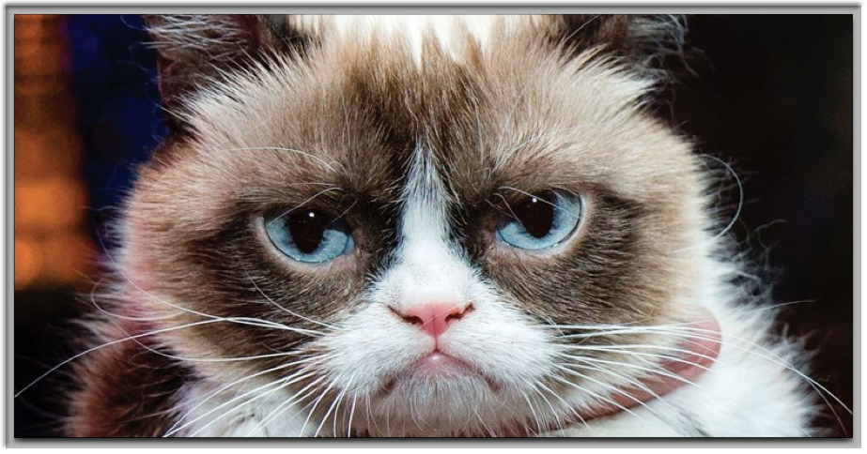
look at funny pics of cats!

