Slide 1
Time Series Forecasting for Bentleys Stocks
Orange

Slide 2
Introduction
Artificial Intelligence has become a perfect candidate for time series prediction in situations where manual data analysis is not applicable and relationships among different entities are not obvious.
Machine learning develops algorithms automatically improve themselves with experience.

Slide 3
TSF Algorithms
Machine Learning:
Linear Regression
SMOreg
MLP
Gaussian Process
Random Forest
Mannual:
ARIMA (Autoregressive Integrated Moving Average) Model
Random Walk

Slide 4
Accuracy Measurement
In TSF, the accuracy measure is obtained by the difference between the predicted value and actual value at time t.
Mean Absolute Error (MAE)
Mean Squared Error (MSE)
Root Relative Squared Error (RRSE)
Root Mean Squared Error (RMSE)
Normalized Mean Squared Error
Document in details

Slide 5
Input Dataset

Slide 6
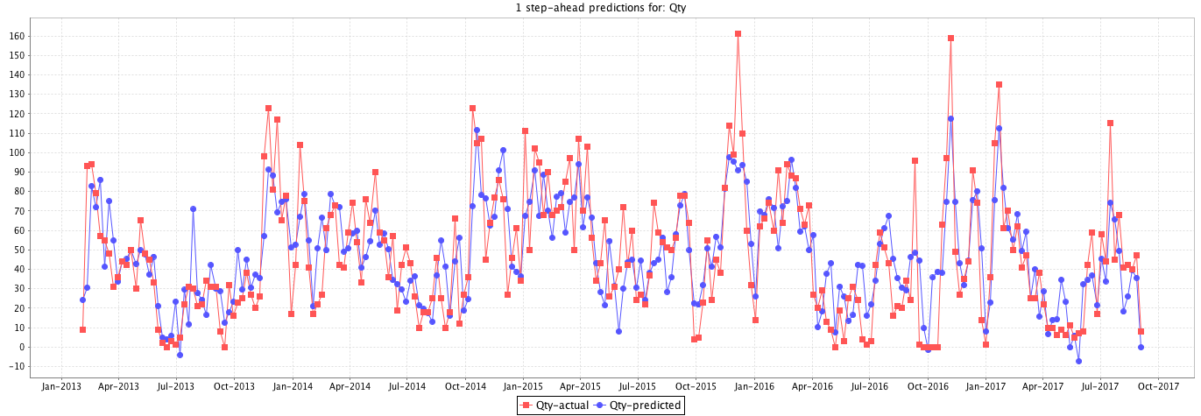
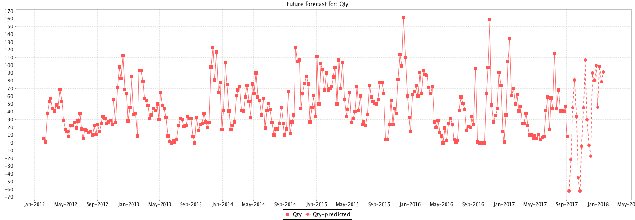
Linear Regression
Fitting
Forecasting
==Evaluation on Training Data==
MAE: 15.8418
RRSE: 68.1458
RMSE: 20.2104
MSE: 408.4618

Slide 7
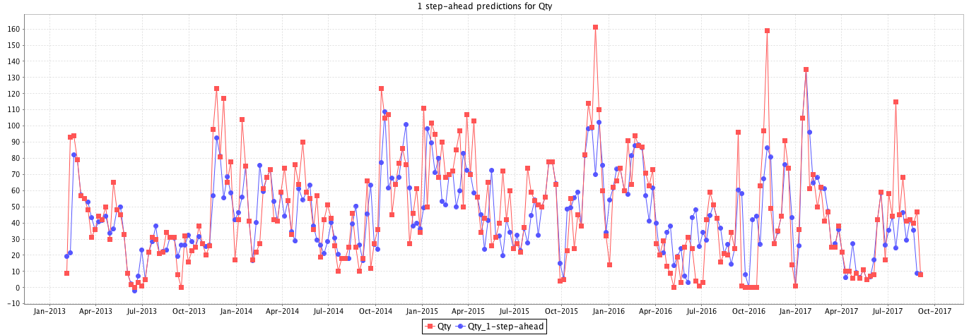
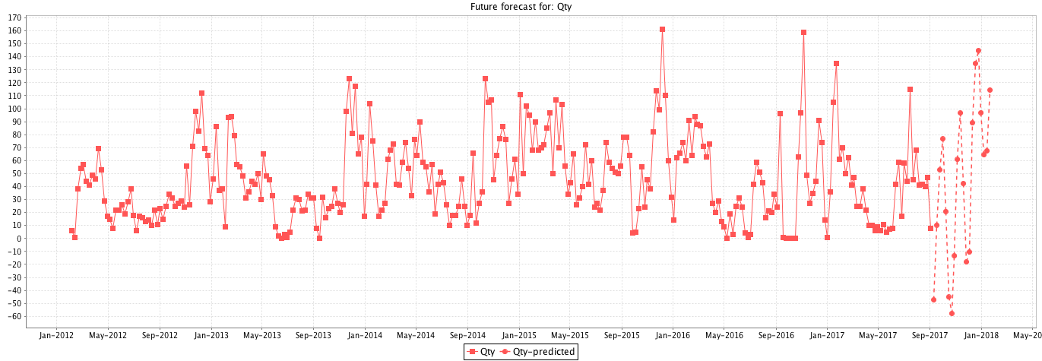
SMOreg (SVM for Regression)
Fitting
Forecasting
==Evaluation on Training Data==
MAE: 13.7704
RRSE: 74.8349
RMSE: 22.1776
MSE: 491.8438

Slide 8
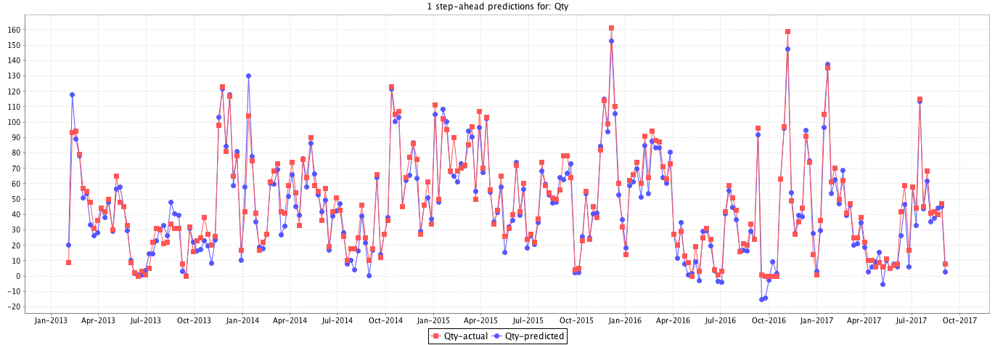
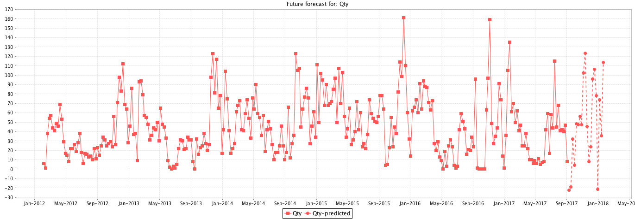
MLP Multi-Layer Perceptron
Fitting
Forecasting
==Evaluation on Training Data==
MAE: 5.2334
RRSE: 23.0063
RMSE: 6.8528
MSE: 46.9604

Slide 9
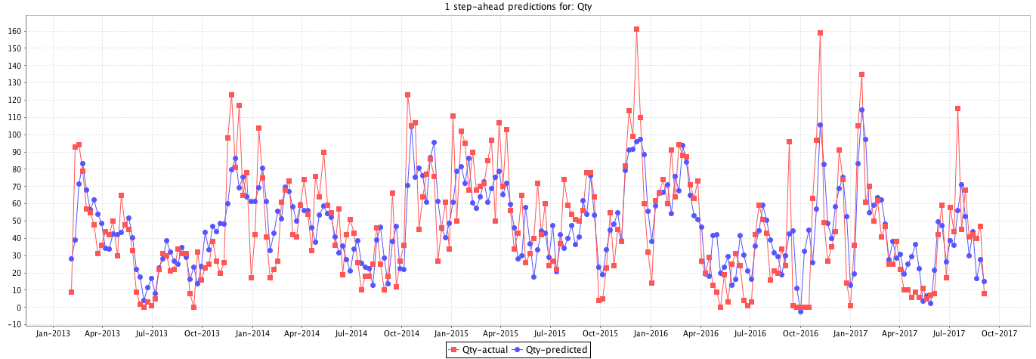
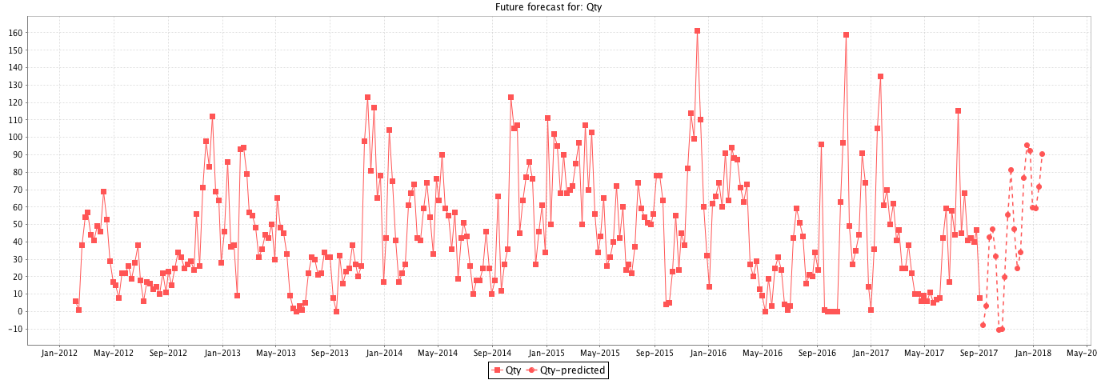
Gaussian Process
Fitting
Forecasting
==Evaluation on Training Data==
MAE: 7.5714
RRSE: 33.3133
RMSE: 9.8961
MSE: 97.9327

Slide 10
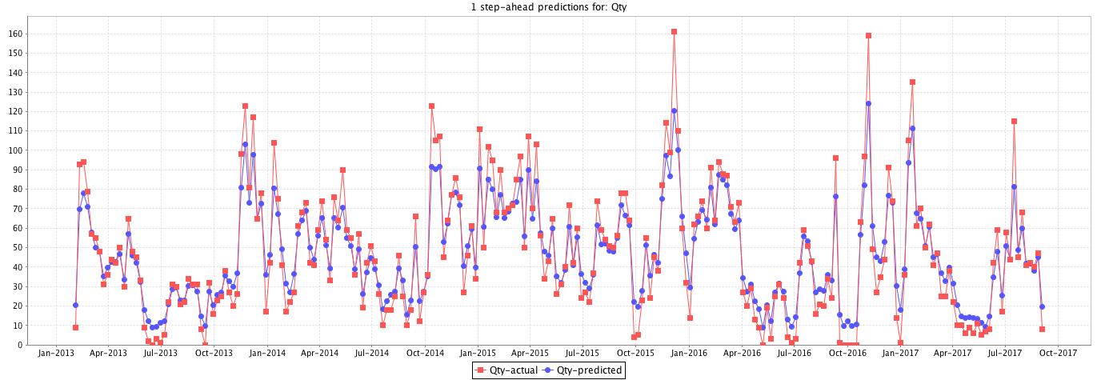
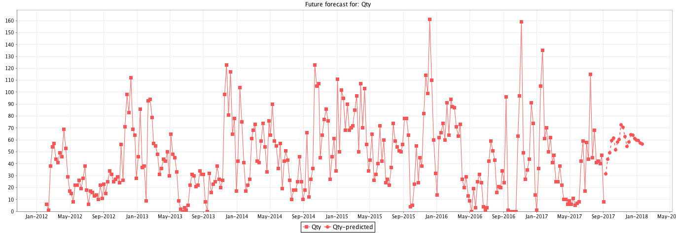
Random Forest
Fitting
Forecasting
==Evaluation on Training Data==
MAE: 7.5714
RRSE: 33.3133
RMSE: 9.8961
MSE: 97.9327

Slide 11
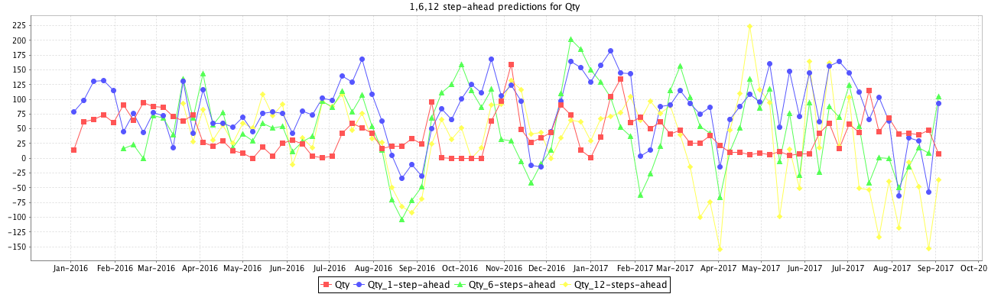
Multi-Step Forecasts
Linear Regression

