Slide 1
Time Series Forecasting for Bentleys Stocks
Orange

Slide 2
Introduction
Problem Definition
Data Preparation
Data Exploration
Modeling
Evaluation
Deployment
All the documentations and codes in my GitHub repository:
https://github.com/OranginaGaoZhao/Time-Series-Forecasting

Slide 3
1. Problem Definition
Understanding the project objectives and requirements from a business perspective
Convert this knowledge into a data mining problem definition with a preliminary plan designed to achieve the objectives.
For Bentley’s Stock Forecasting, it is a time series forecasting problem.

Slide 4
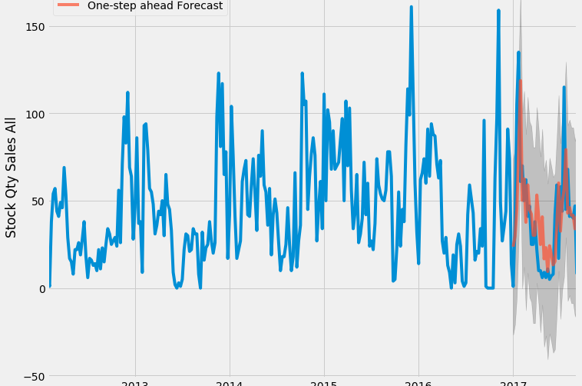
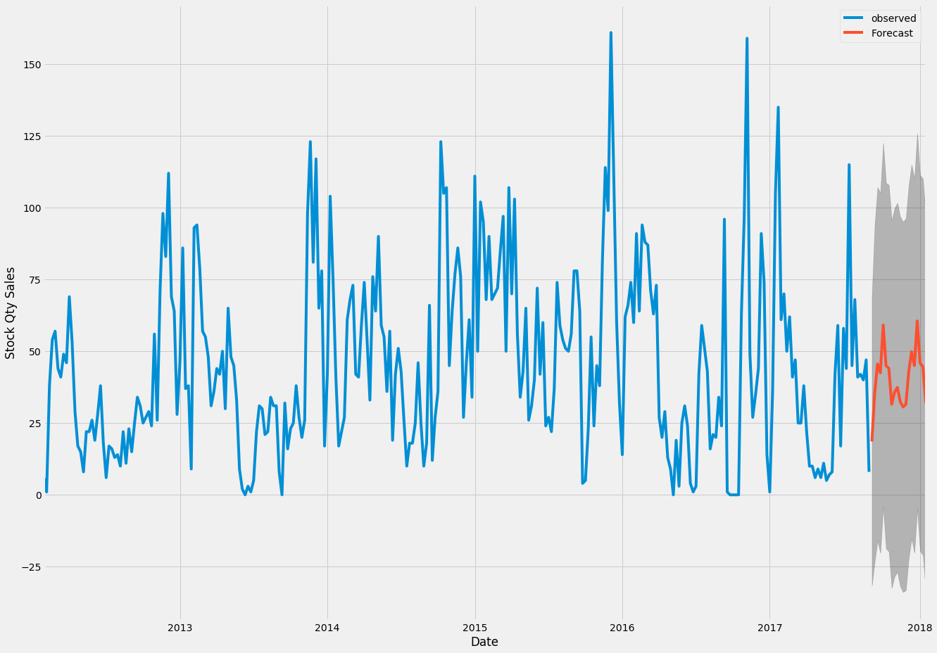
2. Data Preparation
Cleaning, aggregation and transformation and taking care of missing values, invalid values and outliers
Train/Validation/Test Split
The important step for this project is to check data’s predictability.

Slide 5
2.1 White Noise -- Check the Predictability
If your time series is white noise, then, by definition, it is random. You cannot reasonably model it and make predictions.
Some tools that can use to check if time series is white noises:
Create a line plot. Check for gross features like a changing mean, variance, or obvious relationship between lagged variables.
Calculate summary statistics. Check the mean and variance of the whole series against the mean and variance of meaningful contiguous blocks of values in the series (e.g. days, months, or years).
Create an autocorrelation plot. Check for gross correlation between lagged variables.
Details in the document: white noise with explanation

Slide 6
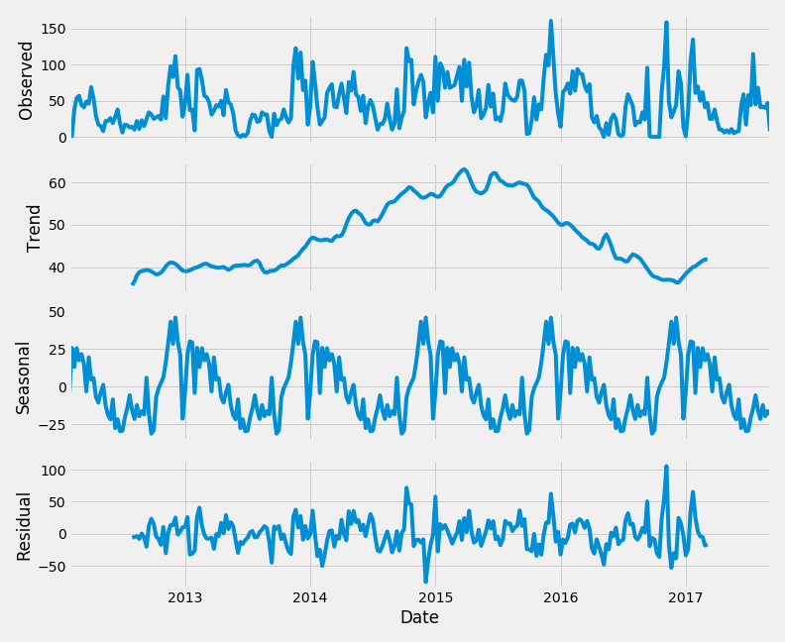
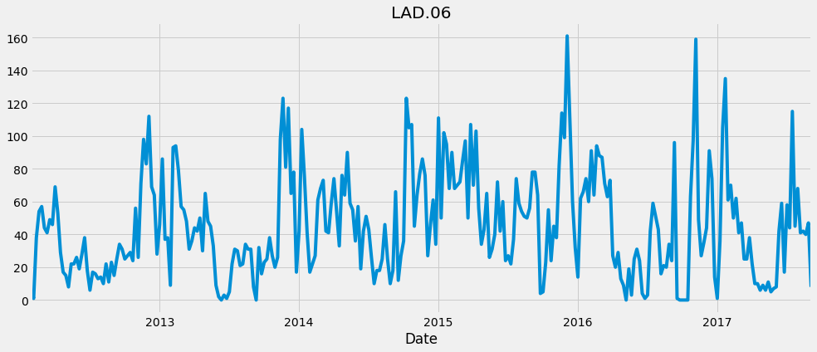
3. Data Exploration
Decomposition

Slide 7
4. Modeling - TSF Algorithms
Machine Learning:
Linear Regression
SMOreg
MLP
Gaussian Process
Random Forest
Mannual:
ARIMA (Autoregressive Integrated Moving Average) Model
Random Walk

Slide 8
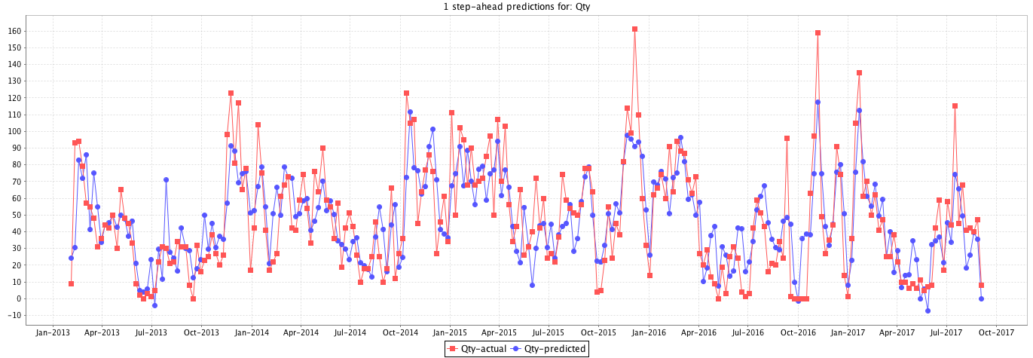
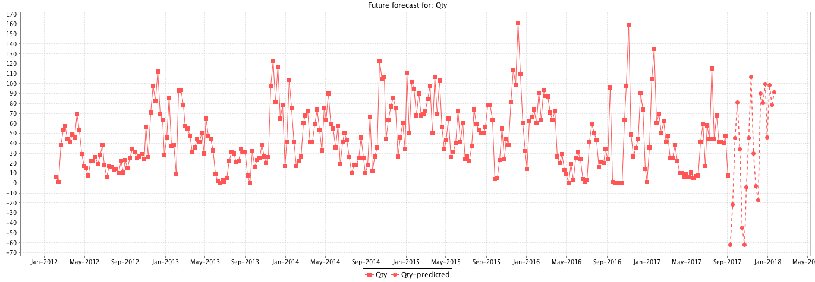
Linear Regression
Fitting
Forecasting
==Evaluation on Training Data==
MAE: 15.8418
RRSE: 68.1458
RMSE: 20.2104
MSE: 408.4618

Slide 9
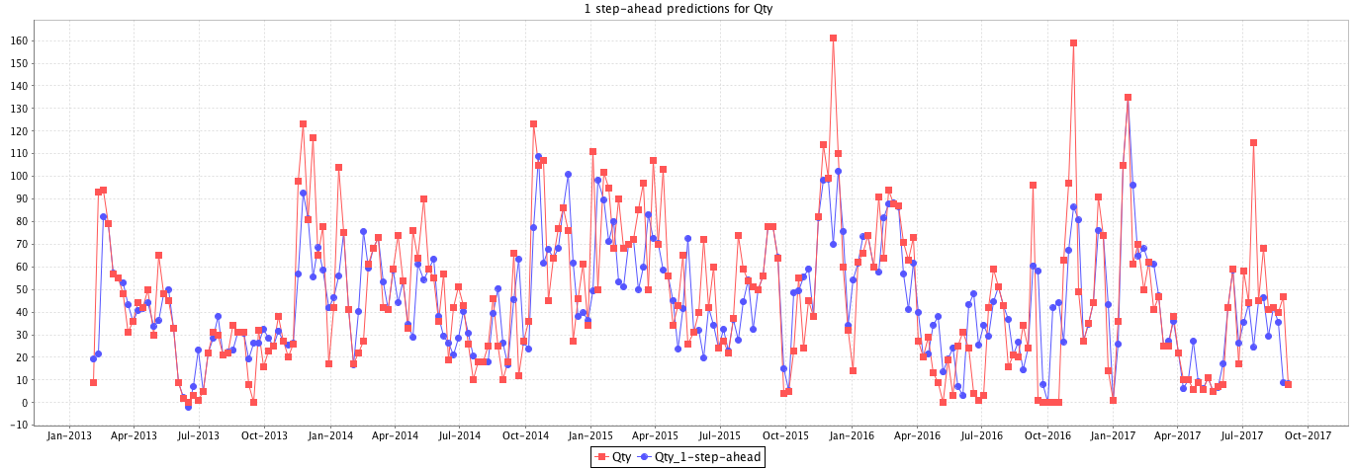
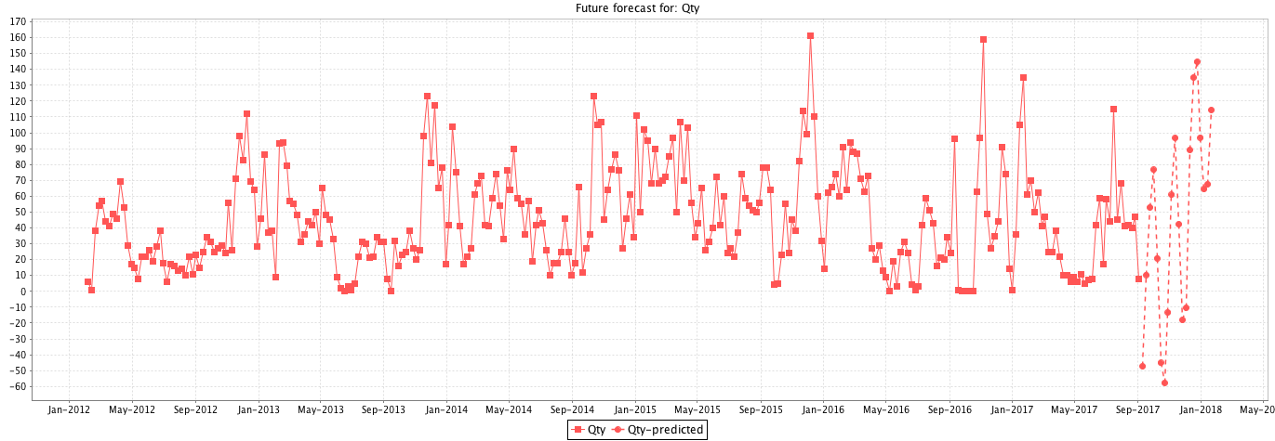
SMOreg (SVM for Regression)
Fitting
Forecasting
==Evaluation on Training Data==
MAE: 13.7704
RRSE: 74.8349
RMSE: 22.1776
MSE: 491.8438

Slide 10
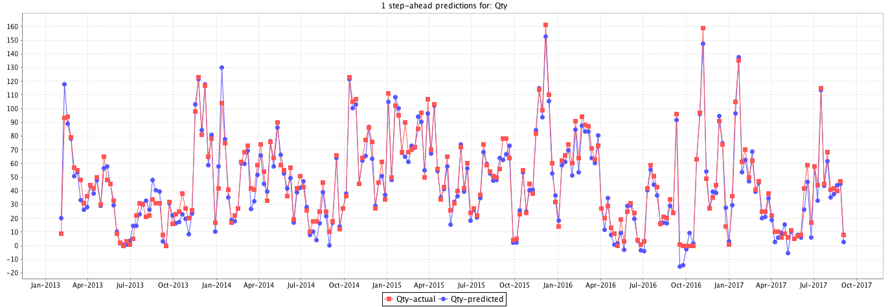
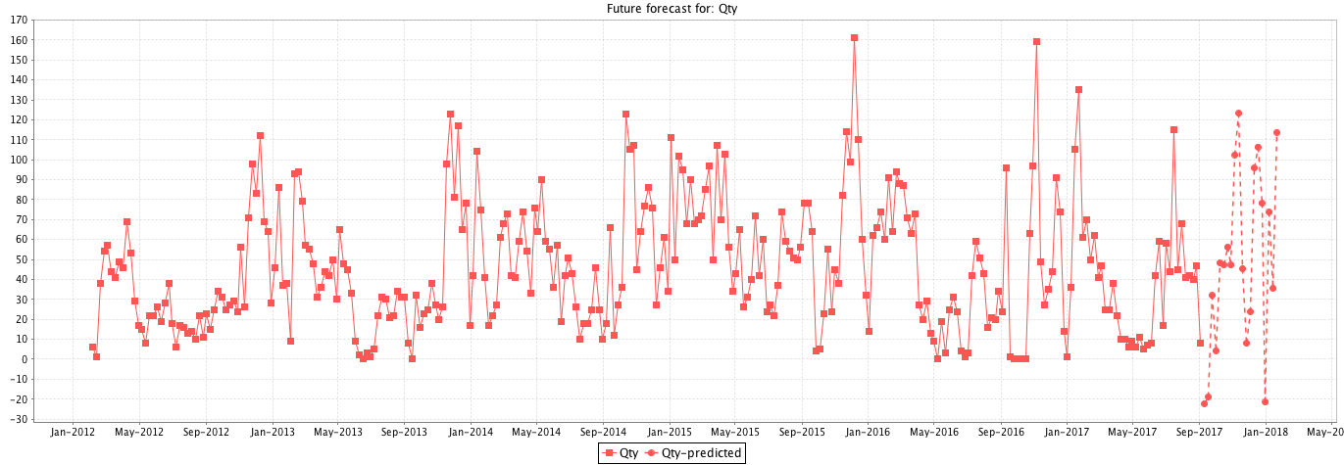
MLP Multi-Layer Perceptron
Fitting
Forecasting
==Evaluation on Training Data==
MAE: 5.2334
RRSE: 23.0063
RMSE: 6.8528
MSE: 46.9604

Slide 11
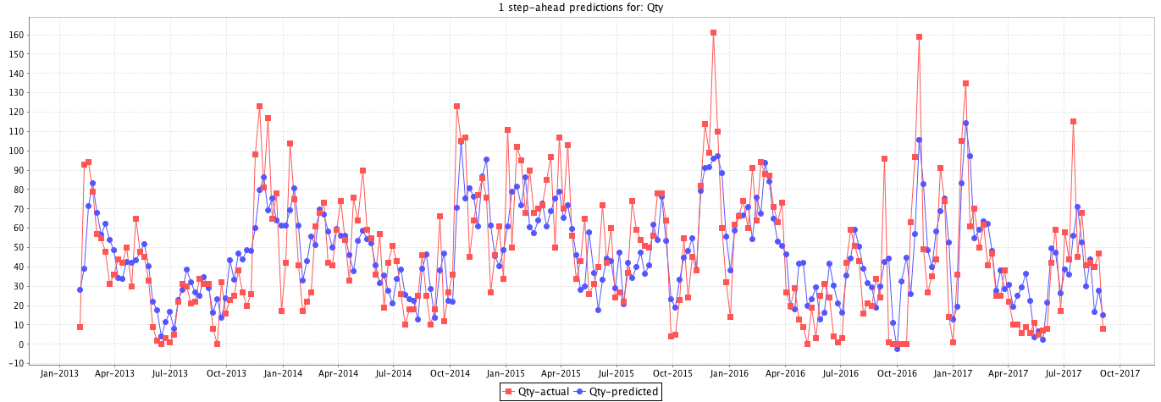
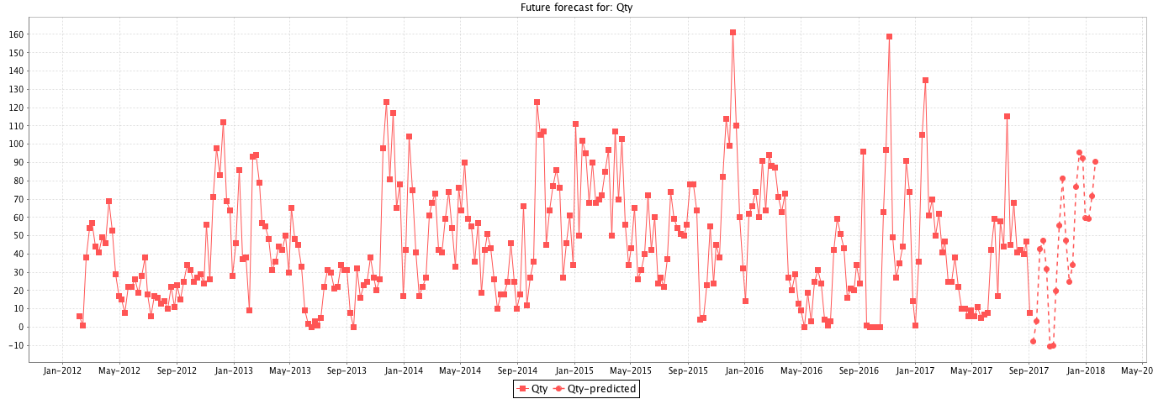
Gaussian Process
Fitting
Forecasting
==Evaluation on Training Data==
MAE: 7.5714
RRSE: 33.3133
RMSE: 9.8961
MSE: 97.9327

Slide 12
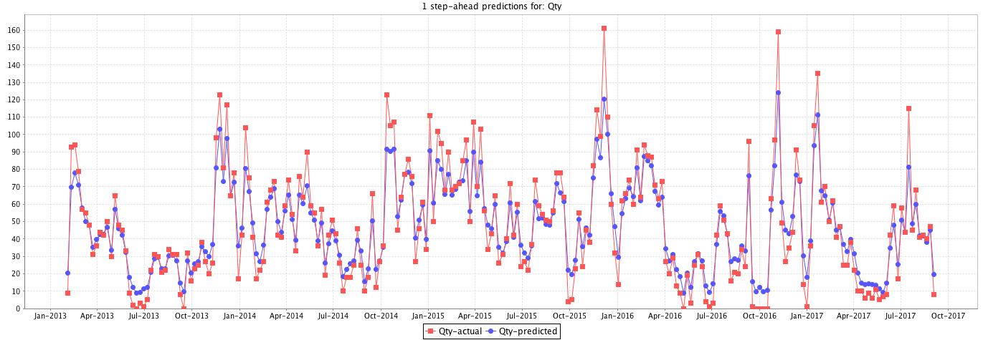
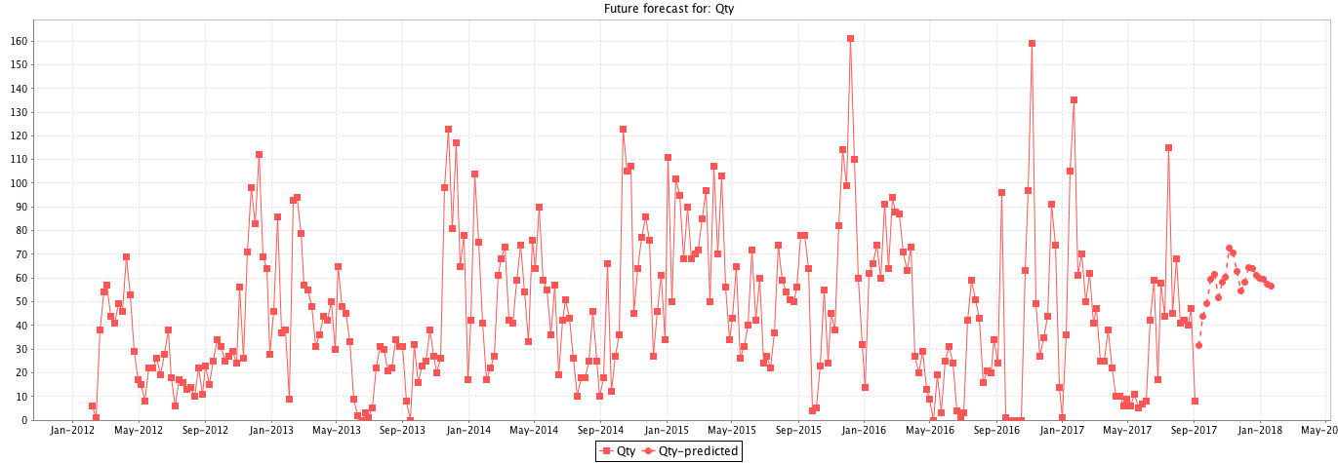
Random Forest
Fitting
Forecasting
==Evaluation on Training Data==
MAE: 7.5714
RRSE: 33.3133
RMSE: 9.8961
MSE: 97.9327

Slide 13
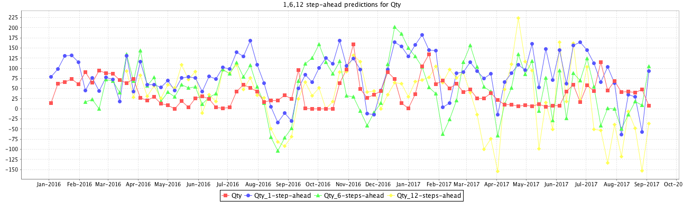
Multi-Step Forecasts
Linear Regression

Slide 14
5. Evaluation and Model Diagnostics
5.1 Evaluation: Accuracy Measurement
In TSF, the accuracy measure is obtained by the difference between the predicted value and actual value at time t.
Mean Absolute Error (MAE)
Mean Squared Error (MSE)
Root Relative Squared Error (RRSE)
Root Mean Squared Error (RMSE)
Normalized Mean Squared Error

Slide 15
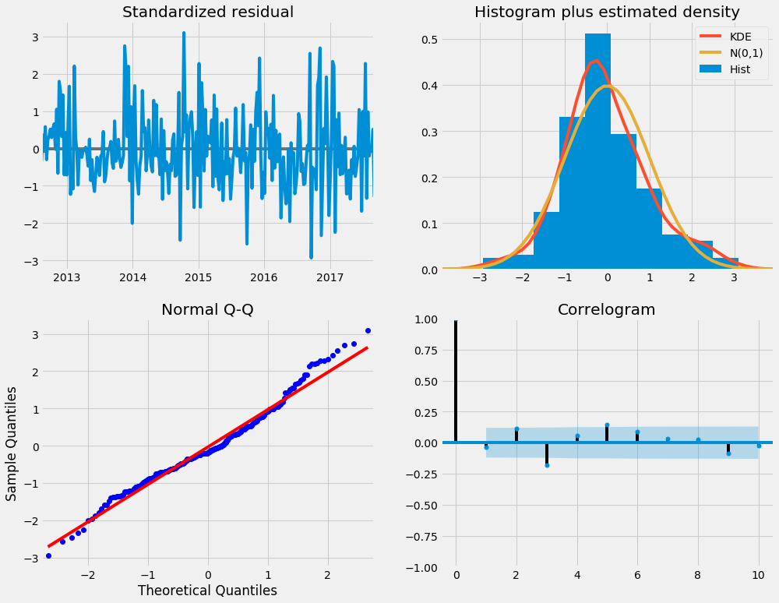
5.2 Model Diagnostics
the series of errors from a time series forecast model should ideally be white noise.
When forecast errors are white noise, it means that all of the signal information in the time series has been harnessed by the model in order to make predictions. All that is left is the random fluctuations that cannot be modeled.
Notes:
Our primary concern is to ensure that the residuals of our model are uncorrelated and normally distributed with zero-mean. If the seasonal ARIMA model does not satisfy these properties, it is a good indication that it can be further improved.
In this case, our model diagnostics suggests that the model residuals are normally distributed based on the following:
In the top right plot, we see that the red KDE line follows closely with the N(0,1) line (where N(0,1)) is the standard notation for a normal distribution with mean 0 and standard deviation of 1). This is a good indication that the residuals are normally distributed.
The qq-plot on the bottom left shows that the ordered distribution of residuals (blue dots) follows the linear trend of the samples taken from a standard normal distribution with N(0, 1). Again, this is a strong indication that the residuals are normally distributed.
The residuals over time (top left plot) don't display any obvious seasonality and appear to be white noise. This is confirmed by the autocorrelation (i.e. correlogram) plot on the bottom right, which shows that the time series residuals have low correlation with lagged versions of itself.
Those observations lead us to conclude that our model produces a satisfactory fit that could help us understand our time series data and forecast future values.

Slide 16
6. Deployment
Future Work

