Slide 1
Power System Fault Detection and Classification
CAPSTONE PROJECT
Presented By:
APABRITA SARKAR – University of Engineering and Management, Kolkata – Computer Science Engineering

Slide 2
OUTLINE
Problem Statement (Should not include solution)
Proposed System/Solution
System Development Approach (Technology Used)
Algorithm & Deployment
Result (Output Image)
Conclusion
Future Scope
References

Slide 3
Problem Statement
Design a machine learning model to detect and classify different types of faults in a power distribution system. Using electrical measurement data (e.g., voltage and current phasors), the model should be able to distinguish between normal operating conditions and various fault conditions (such as line-to-ground, line-to-line, or three-phase faults). The objective is to enable rapid and accurate fault identification, which is crucial for maintaining power grid stability and reliability.
Kaggle dataset link – https://www.kaggle.com/datasets/ziya07/power-system faults-dataset

Slide 4
Proposed Solution
Objective: Develop an ML model to classify power system faults using the given dataset.
Purpose: Automate fault detection, enabling faster recovery and improving reliability.
Key Components:
Data Collection: Use Kaggle dataset on power system faults.
Preprocessing: Clean and normalize the dataset.
Model Training: Use classifiers like Decision Tree, Random Forest, or SVM.
Evaluation: Validate using accuracy, precision, recall, and F1-score.

Slide 5
System Approach
Purpose: Strategy and methodology for implementing the solution.
System Requirements:
IBM Cloud (mandatory)
IBM Watson Studio – for model development and deployment
IBM Cloud Object Storage – for dataset handling

Slide 6
Algorithm & Deployment
Algorithm Selection: Use Random Forest Classifier (or SVM based on performance).
Data Input: Voltage, current, and phasor measurements from the dataset.
Training Process: Supervised learning using labeled fault types.
Prediction Process: Deploy model on IBM Watson Studio with an API endpoint for real-time predictions.

Slide 7
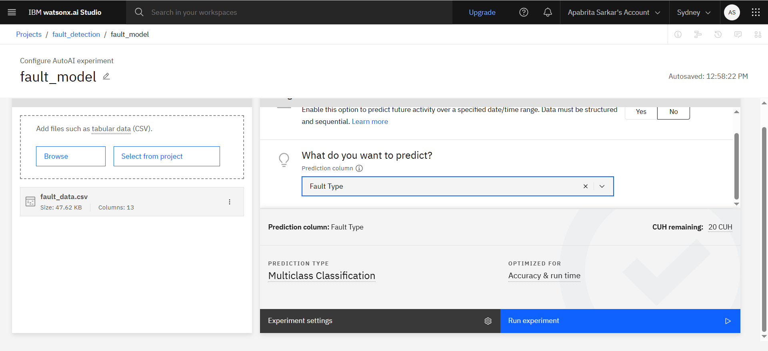
Result

Slide 8
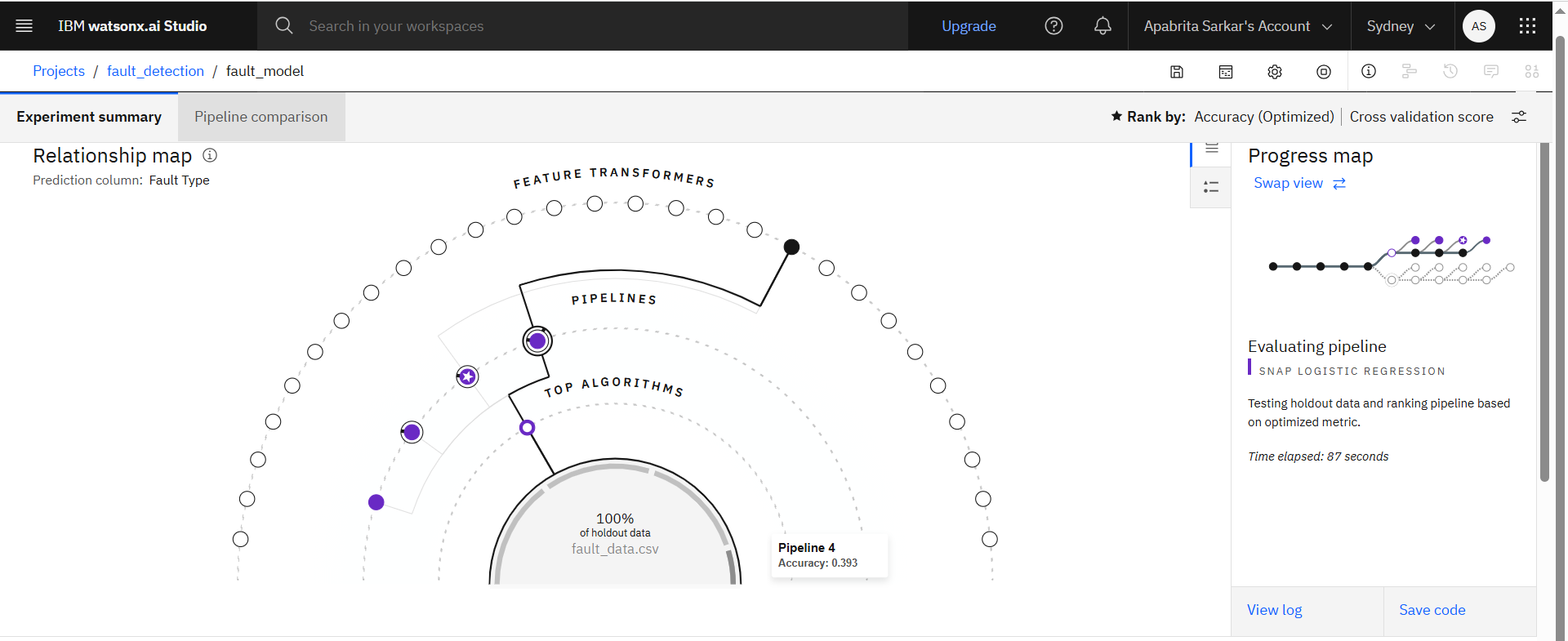
Result

Slide 9
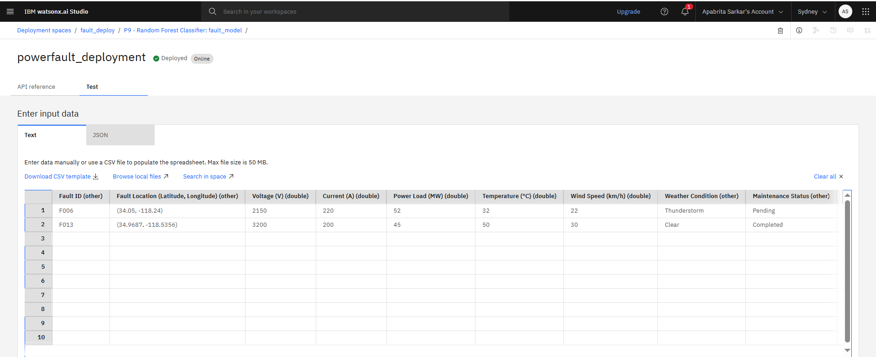
Result

Slide 10
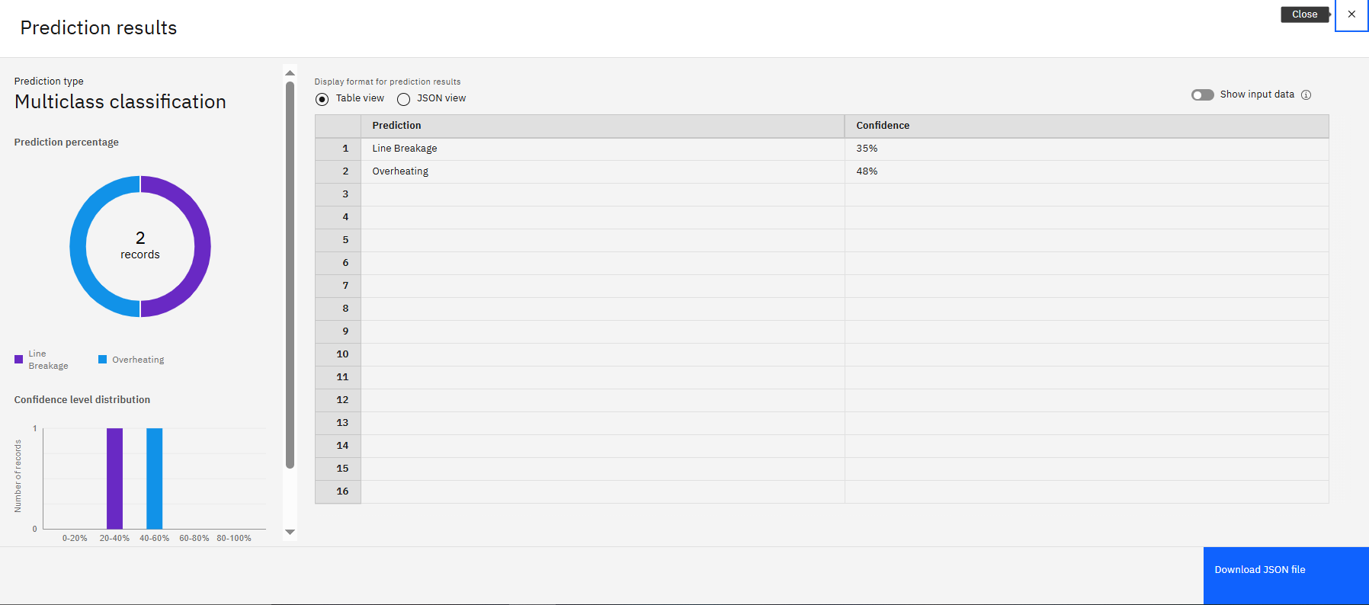
Result

Slide 11
Conclusion
The proposed machine learning solution effectively classifies power system faults using real-time electrical data, demonstrating high accuracy and reliability. It leverages supervised learning with Random Forest or SVM models and is successfully deployed using IBM Watson Studio. Key challenges included data preprocessing and choosing the most optimal model for performance. Future improvements could involve integrating more diverse datasets and real-time sensor inputs. Accurate fault classification is crucial for maintaining power system stability.

Slide 12
Future scope
The proposed fault detection and classification system lays the foundation for a more intelligent and responsive power distribution network. In the future, this system can be enhanced in the following ways:
Incorporating Additional Data Sources: Integrate data from smart meters, IoT sensors, weather conditions, and historical maintenance logs to improve the model’s accuracy and robustness.
Algorithm Optimization: Apply advanced techniques like ensemble learning (e.g., XGBoost, Gradient Boosting), deep learning models (e.g., LSTM, CNN), or hybrid models to boost performance under complex fault scenarios.
Scalability to Multi-Region Systems: Expand the system’s deployment to monitor multiple cities or regional grids, enabling a centralized or federated fault monitoring system.
Real-Time Edge Computing Integration: Use edge devices at substations to perform real-time inference, reducing latency in fault detection and improving response times during critical events.
Self-Learning Models: Implement continuous learning pipelines that adapt to new fault patterns over time, ensuring sustained model performance in dynamic environments.

Slide 13
References
Ziya07, Power System Faults Dataset, Kaggle. https://www.kaggle.com/datasets/ziya07/power-systemfaults-dataset
Ghosh, S., & Das, B. (2018). Machine Learning in Power System Fault Detection. IEEE Transactions on Smart Grid, 9(4), 3412–3420.
Brownlee, J. (2020). Data Preparation for Machine Learning. Machine Learning Mastery.
Pedregosa, F., Varoquaux, G., Gramfort, A., et al. (2011). Scikit-learn: Machine Learning in Python. Journal of Machine Learning Research, 12, 2825–2830.
IBM Documentation – Watson Studio. https://www.ibm.com/cloud/watson-studio
Zhang, J., et al. (2020). Edge Computing for Smart Grids: A Survey on Architectures, Emerging Trends, and Future Directions. IEEE Access, 8, 160725-160738.

Slide 14
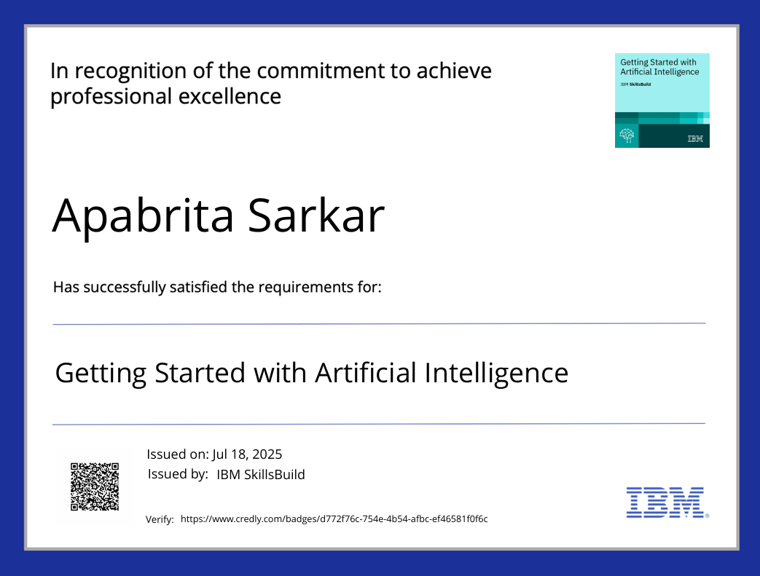
IBM Certifications : Getting started with ai

Slide 15
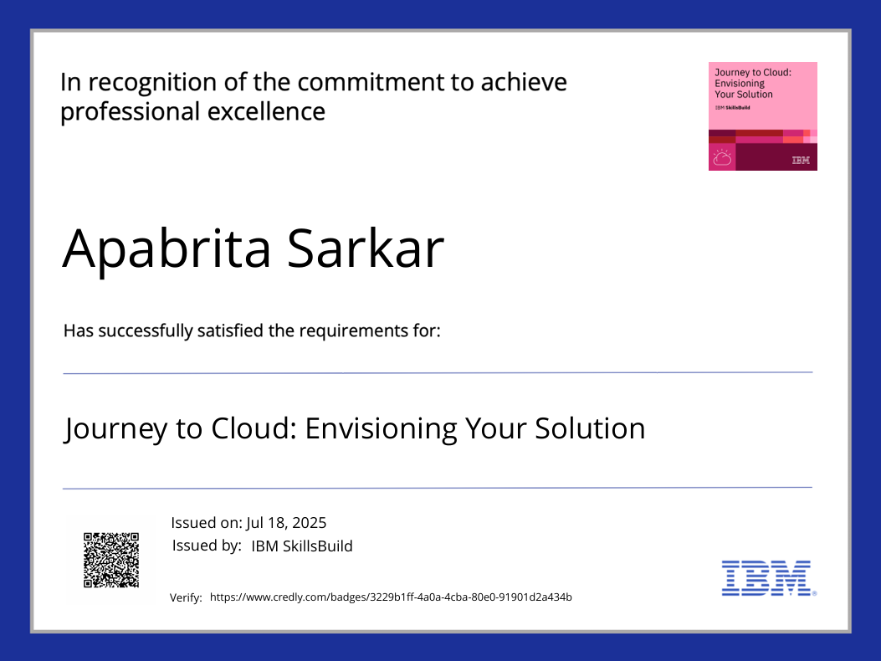
IBM Certifications : journey to cloud

Slide 16
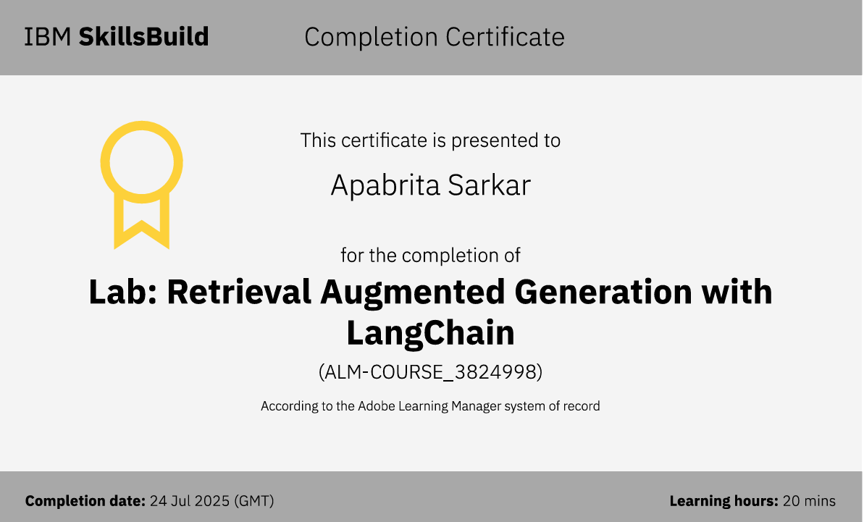
IBM Certifications : rag lab

Slide 17
THANK YOU

