Slide 1
Zowe [PRESENTATION TITLE]
Notes:
Closing Slide

Slide 2
Table of Contents
Section 00
Item 1 00
Item 2 00
Section 00
Item 1 00
Item 2 00
Section 00
Item 1 00
Item 2 00
Section 00
Item 1 00
Item 2 00

Slide 3

Headline
Text goes here
Font type is Gill Sans - Light
OMP Color Pallet
Official Zowe logo → https://ibm.box.com/s/ct38y2oyyv2q1dgepmdq9ah7nqj9t843
Zowe Color Pallet
R 60
G 40
B 180
R 45
G 79
B 127
R 0
G 0
B 0
R 63
G 79
B 127

Slide 4
Headline
Text goes here

Slide 5
Headline
Text/pic goes here
Text/pic goes here

Slide 6
Headline
Subhead
Text goes here
Subhead
Text goes here
Subhead
Text goes here
Subhead
Text goes here

Slide 7
Headline
Pic/Text
Pic/Text
Subhead
Text goes here
Pic/Text
Pic/Text

Slide 8

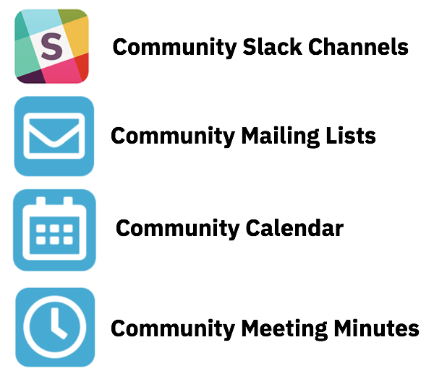
Getting Started with …
Project Community site
https://zowe.org
Access to Beta Download
https://zowe.org/download
Review Zowe squads, missions and activities
https://zowe.org/contribute/
Code Guidelines
https://zowe.org/code-guidelines/
Project Governance
https://zowe.org/about-us/
GitHub
https://github.com/zowe
Project Documentation (includes user and install guides)
https://zowe.github.io/docs-site/
Developer Tutorials
https://zowe.github.io/docs-site/guides/intro.html
https://developer.ibm.com/tutorials/zowe-step-by-step-tutorial/

Slide 9



Get involved in the Zowe community
Join Open Source Community @ https://www.openmainframeproject.org/projects/zowe
PROJECTS
Participate in and contribute to the Zowe developer community at zowe.org
Learn how your organization can become a steward and supporter of this project with Open Mainframe Project membership at openmainframeproject.org/about/join
DEVELOPER
COMMUNITY
PLATFORM
PARTICIPATION
Ecosystem
PROFITS
PRODUCTS
PROMOTION
SOFTWARE
Notes:
Closing slide

