Slide 1
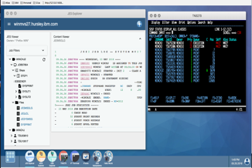
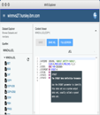
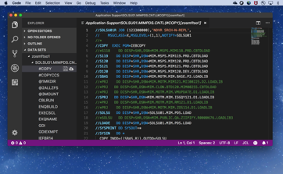
Zowe - Today
Ravi (DevOps)
Michelle (App Dev)
Tyler
(System Administrator)
Isabelle (Operator)
Zowe App Framework Browser GUI
Zowe Mobile App (Incubation*)
Zowe Explorer
Code Editor Extension
Zowe CLI build | deploy | test
Apps
Extensions**
CODE
DEPLOY
Plugins
PLAN
BUILD
RELEASE
OPERATE
TEST
MONITOR
Packages
Zowe Client SDK (Incubation*)
API Mediation Layer
*Incubation sub-projects are research and prototypes not ready for general consumption
**Extensibility of Zowe Explorer is in development
Microservices

Slide 2
Zowe - Future
Ravi (DevOps)
Michelle (App Dev)
Tyler
(System Administrator)
Isabelle (Operator)
Zowe App Framework Browser GUI
Zowe Mobile App (Incubation*)
Zowe Explorer
Code Editor Extension
Zowe CLI build | deploy | test
Apps
Extensions**
Plugins
CODE
DEPLOY
PLAN
BUILD
RELEASE
OPERATE
TEST
MONITOR
Packages
Zowe Client SDK (Incubation*)
API Mediation Layer
*Incubation sub-projects are research and prototypes not ready for general consumption
**Extensibility of Zowe Explorer is in development
Microservices

