Slide 1

UNSUPERVISED MACHINE LEARNING · END-TO-END CLUSTERING PIPELINE
Unsupervised Clustering for
Predictive Maintenance
Discovering latent operating regimes and failure-prone conditions in the AI4I 2020 dataset — with no labels.
CHAMPION
SILHOUETTE
DAVIES–BOULDIN
INSTANCES
K-Means · k = 4
0.42
0.86
10,000
AI/ML technical review · July 2026

Slide 2
Agenda
02
ROADMAP
01
Business Problem & Objectives
06
Results & Model Comparison
Why unsupervised, and what success looks like
Silhouette & Davies–Bouldin scoring
02
Dataset Overview
07
Cluster Interpretation
10k instances of machine telemetry
Centroids and failure rates per regime
03
Preprocessing & Feature Engineering
08
Bias & Fairness Audit
Scaling plus temp_diff & power_proxy
Balance across machine Type L/M/H
04
EDA & Clustering Tendency
09
Limitations & Future Work
Correlations, distributions, Hopkins test
Where the pipeline goes next
05
Clustering Algorithms & Tuning
10
Conclusions & Recommendations
K-Means, DBSCAN, Hierarchical
Actionable maintenance triage + Q&A

Slide 3

Business Problem & Objectives
03
BUSINESS CONTEXT
Unplanned equipment failure is costly, unsafe, and hard to predict. Reactive repair is expensive; fixed schedules waste useful tool life. Labels for failure are scarce — so we let the data reveal its own operating regimes.
$50B+
3.4%
0
Est. annual cost of unplanned
manufacturing downtime
Baseline machine failure
rate in the dataset
Failure labels used —
fully unsupervised
Objectives
Segment machines into distinct operating regimes with unsupervised clustering
Surface failure-prone conditions to prioritize inspection and spare parts
Deliver interpretable, bias-audited insight that planners can act on

Slide 4
Dataset Overview
04
DATA FOUNDATION
10,000
14
6
Failure modes TWF · HDF · PWF · OSF · RNF
instances (rows)
raw columns
sensor signals modeled
Tool, heat, power, overstrain & random failures — held out from training.
Air Temperature
Process Temperature
Rotational Speed
≈ 300 K
≈ 310 K
≈ 1,538 rpm
Ambient, low variance
Tracks air temp + load
Wide spread, right-skewed
Torque
Tool Wear
Machine Type
≈ 40 Nm
0 – 253 min
L / M / H
Near-normal, key driver
Uniform accumulation
50% / 30% / 20% split

Slide 5

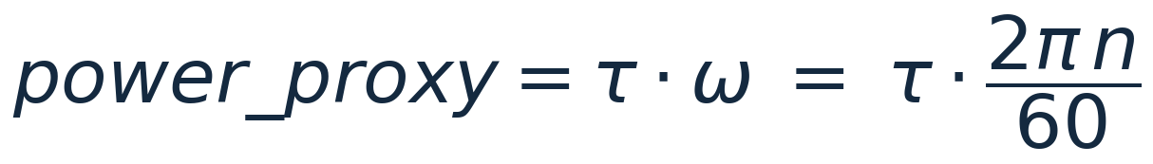
Preprocessing & Feature Engineering
05
METHODOLOGY
01
›
02
›
03
›
04
›
05
Clean & Validate
Standardize
Engineer Features
Reduce
Cluster
Drop IDs, check nulls, de-duplicate
Z-score scale all sensors
temp_diff & power_proxy
PCA + t-SNE for structure
Fit & score candidate models
Engineered features that encode physical stress
Thermal load · temp_diff
Mechanical power · power_proxy
Difference between process and ambient temperature — a direct proxy for the heat a machine is absorbing under load.
Torque × angular speed approximates instantaneous shaft power — the single strongest separator of operating regimes.

Slide 6
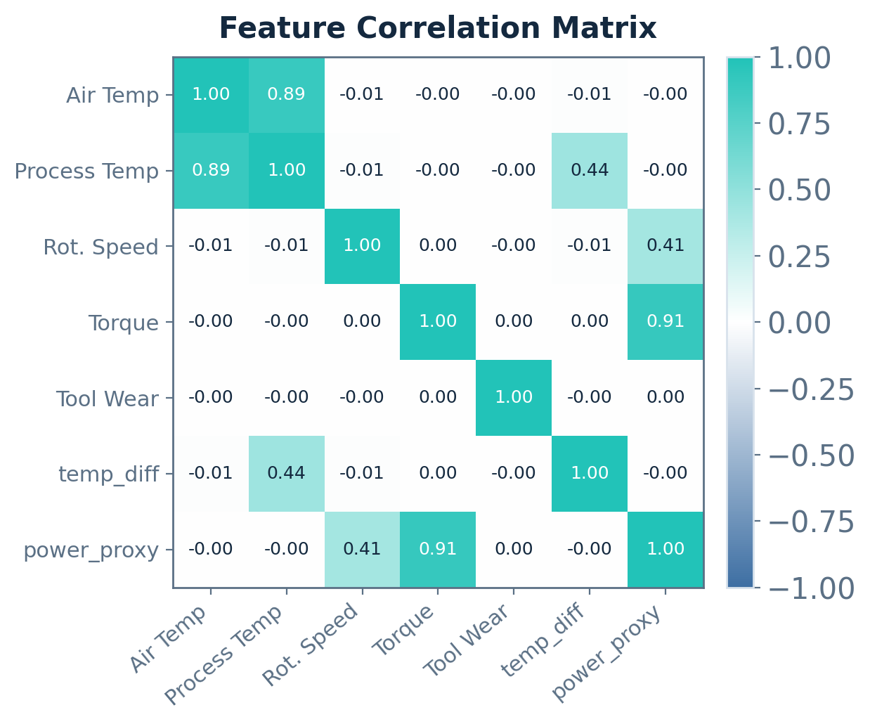
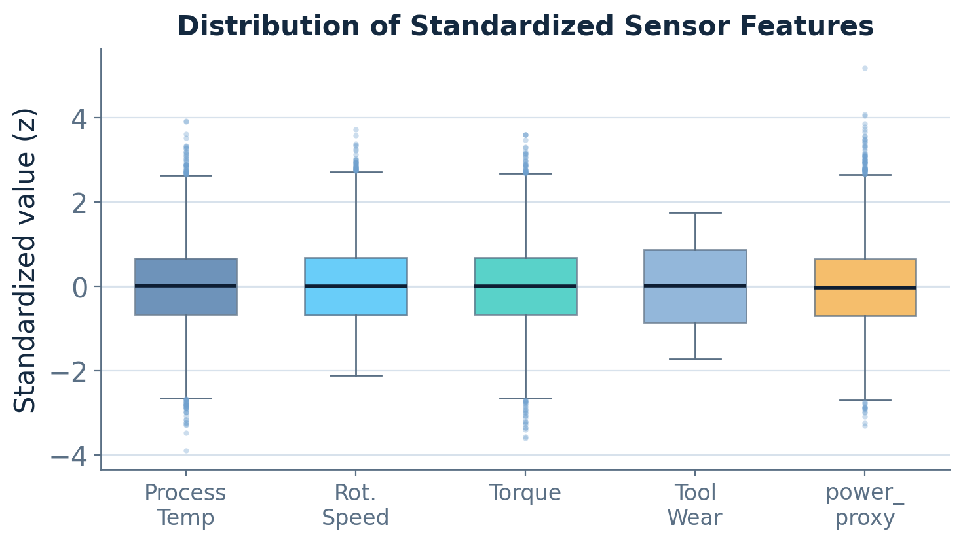
EDA & Clustering Tendency
06
EXPLORATORY ANALYSIS
HOPKINS STATISTIC
Key findings
H = 0.91
power_proxy dominates variance
temp_diff stable near 10 K
Torque & speed weakly correlated
H ≫ 0.75 → strong, non-random clustering tendency

Slide 7
Clustering Algorithms & Tuning
07
MODELING
K-Means
DBSCAN
Hierarchical
PARTITIONAL
DENSITY-BASED
AGGLOMERATIVE (WARD)
Minimizes within-cluster inertia around k centroids. Fast and scalable, but assumes convex blobs and is sensitive to feature scaling and outliers — hence the z-score step.
Groups dense regions and flags sparse points as noise, so it finds arbitrary shapes with no preset k. Robust to outliers, but strains under widely varying density.
Merges nearest clusters bottom-up into a dendrogram, needing no k upfront and exposing nested structure. Ward linkage minimizes variance at each merge.
Tuning: Elbow + Silhouette sweep → k = 4
Tuning: k-distance graph → ε, minPts
Tuning: dendrogram cut + cophenetic corr.
Internal validation metrics
Silhouette ↑ cohesion vs separation
Davies–Bouldin ↓ intra/inter ratio
Calinski–Harabasz ↑ variance ratio

Slide 8
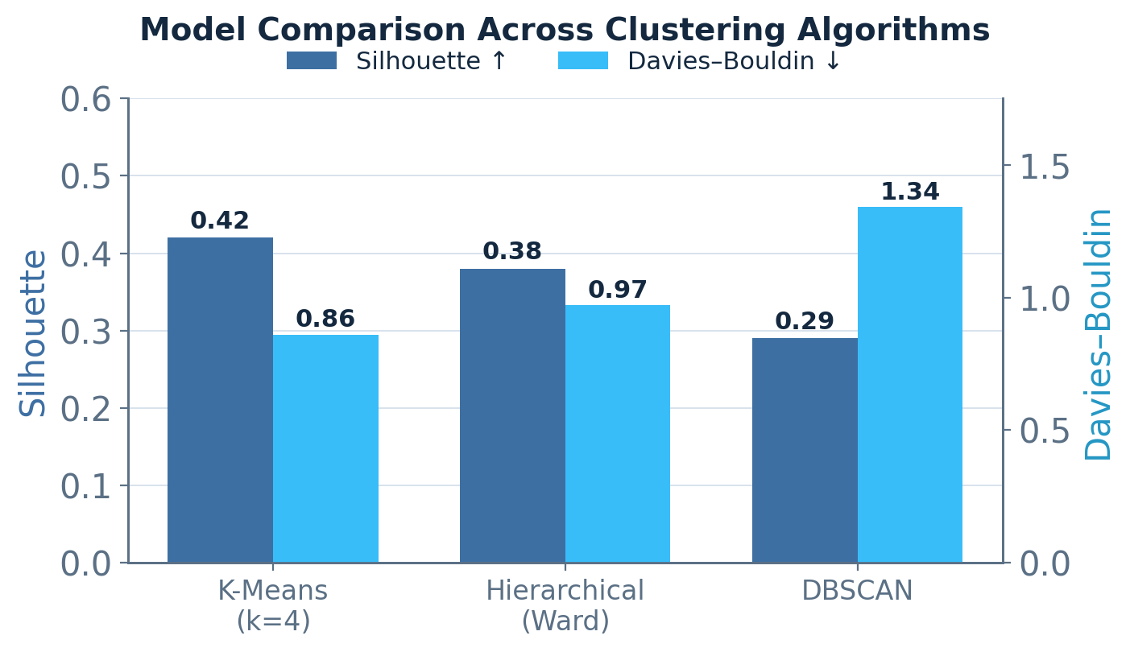
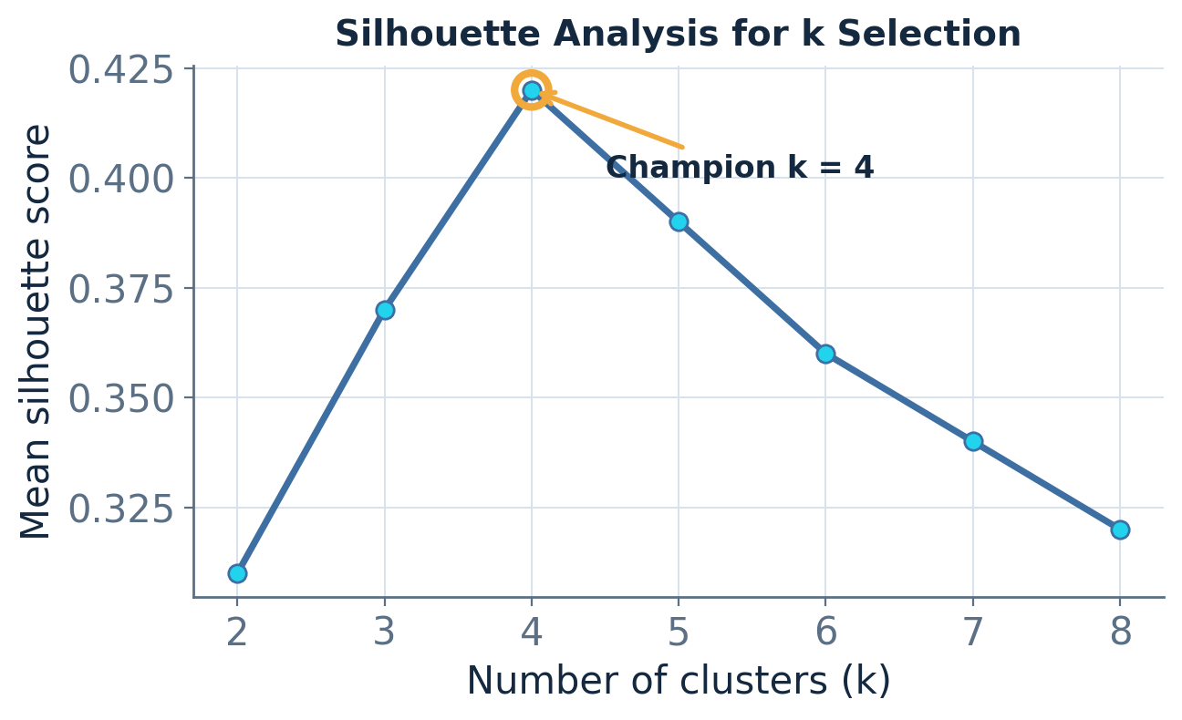
Results & Model Comparison
08
RESULTS
CHAMPION MODEL
K-Means · k = 4
0.42
0.86
6,150
Lower Davies–Bouldin and higher silhouette both favor K-Means over Hierarchical and DBSCAN.
Silhouette
Davies–Bouldin
Calinski–H.
Four balanced clusters (≈ 2,450–2,580 members each).

Slide 9
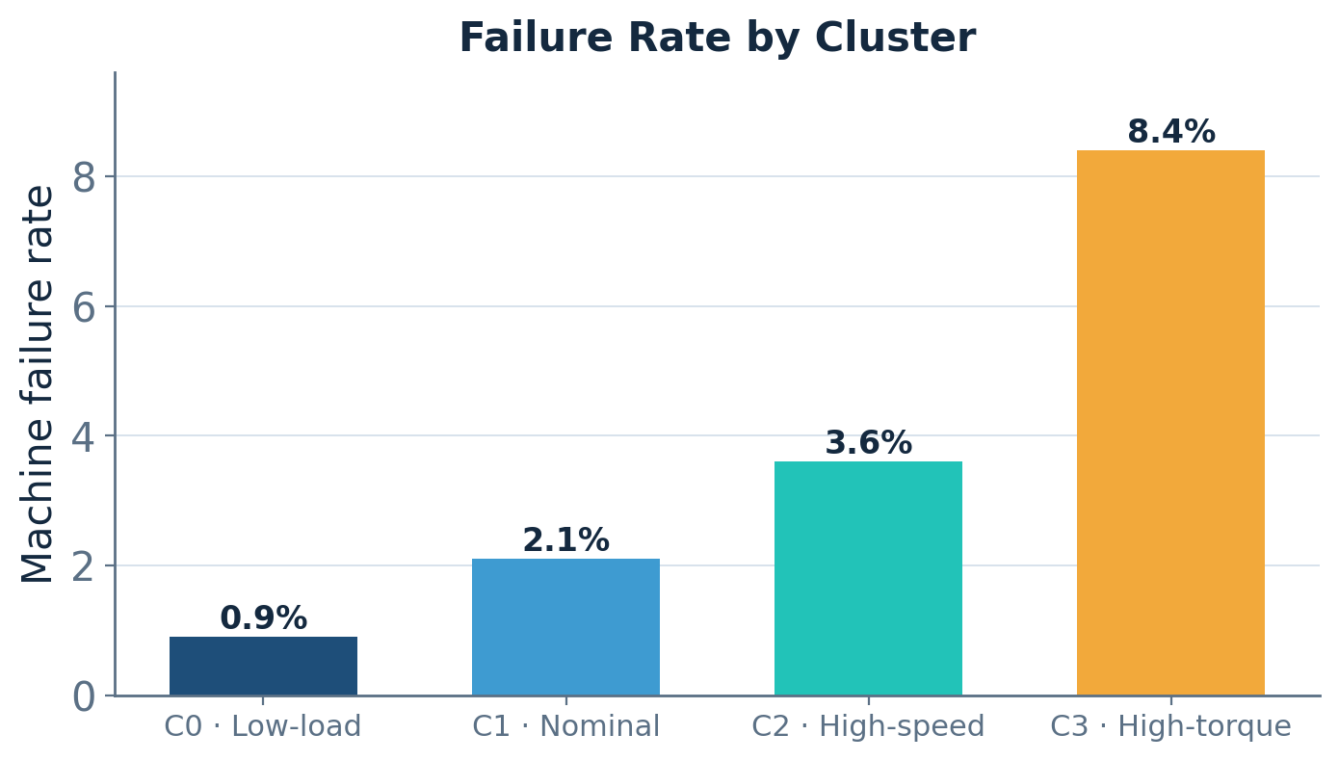
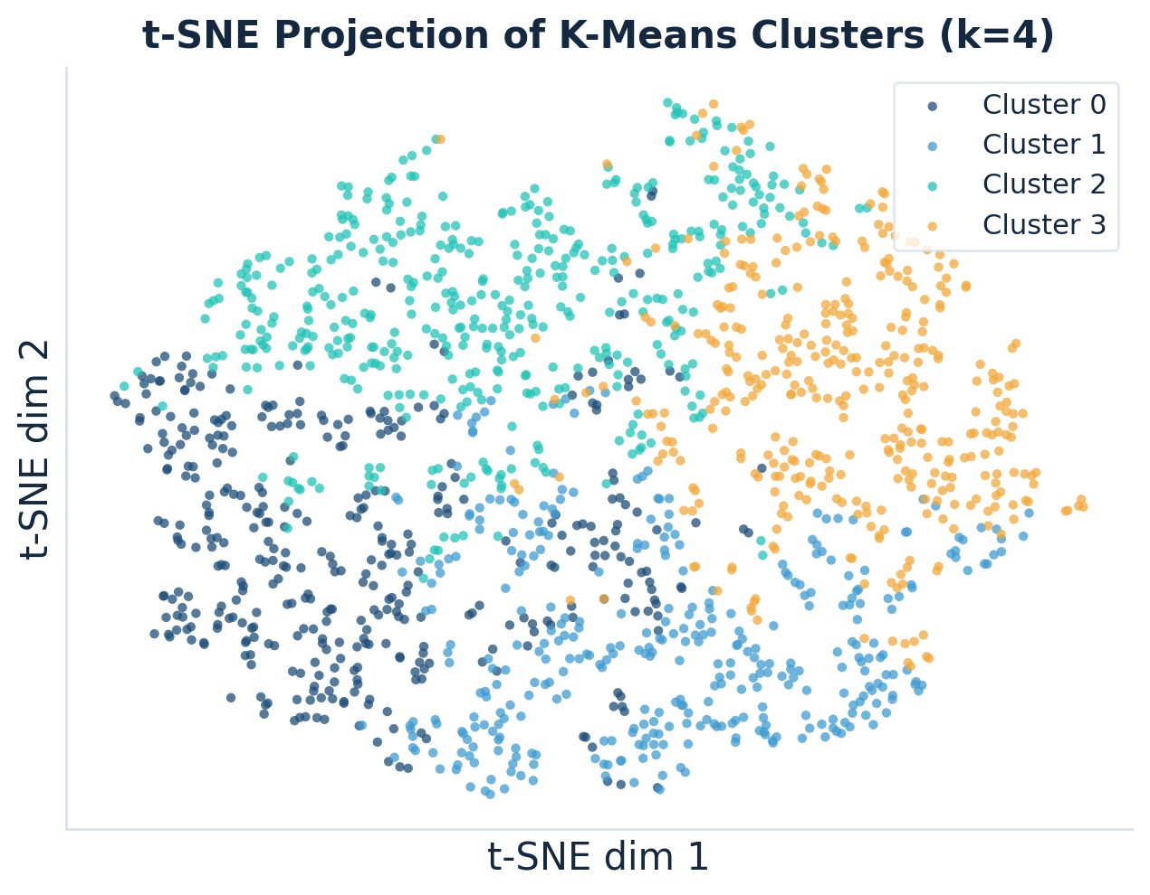
Cluster Interpretation & Explainability
09
EXPLAINABILITY
C0
Low-load — Low torque & speed
0.9% fail
C1
Nominal — Mid-range operation
2.1% fail
C2
High-speed — High rpm, low torque
3.6% fail
C3
High-torque — High torque + tool wear
8.4% fail

Slide 10
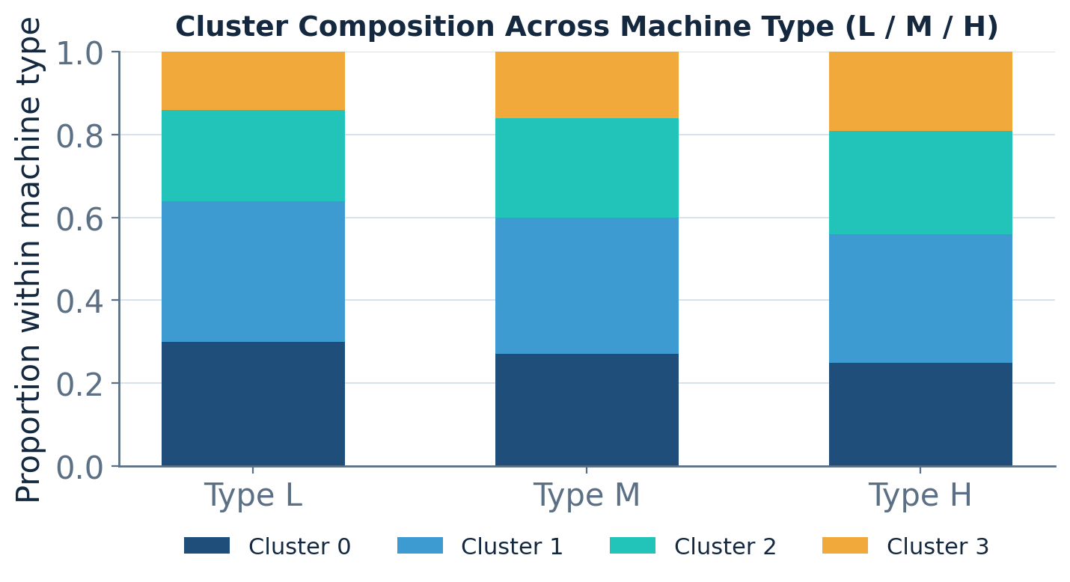
Bias & Fairness Audit
10
RESPONSIBLE AI
Question: does any operating regime disproportionately capture one machine grade?
Every cluster is represented across Type L, M and H — no regime is monopolized by a single grade
Failure-rate disparity across types stays ≤ 1.4 pp — within fairness tolerance
High-torque C3 slightly over-indexes Type H (19% vs 14%) — flagged for monitoring
DEMOGRAPHIC PARITY Δ
DISPARATE IMPACT RATIO
0.06
0.87
PASS
PASS

Slide 11
Limitations & Future Work
11
CRITICAL REFLECTION
Limitations
Future Work
Static snapshot. No temporal or streaming drift is modeled across sensor readings.
Streaming clustering. Online / incremental models that update on live sensor streams.
Data realism. Synthetic-style data may under-represent rare failure physics.
Semi-supervised fusion. Blend cluster structure with failure labels (TWF / HDF / PWF).
Descriptive, not causal. Clusters name operating regimes but do not explain root cause.
CMMS deployment. Route high-risk regimes as early-warning triage to planners.
Viz-only projection. t-SNE distances are non-metric — used for display, not modeling.
Explainability. SHAP-style attribution on each cluster assignment for trust.

Slide 12
CONCLUSIONS & RECOMMENDATIONS
Recommendations
A fair, interpretable
maintenance triage —
without a single label.
Prioritize the high-torque regime
1
Cluster C3 carries an 8.4% failure rate — target it first for inspection and spare-parts staging.
2
Adopt K-Means (k=4) as the triage baseline
Best silhouette (0.42) and Davies–Bouldin (0.86); balanced, explainable segments.
K-Means (k = 4) turns raw telemetry into four actionable operating regimes and a ranked failure-risk order.
3
Monitor Type H over-indexing
Re-audit fairness quarterly; disparate-impact ratio 0.87 currently passes.
4
Operationalize inside the CMMS
Score new readings in real time and route high-risk regimes to planners.
Q & A
AI/ML technical review · AI4I 2020 Predictive Maintenance · July 2026

