Slide 1



Movie ratings
Brought to you by: Anthony Palacios, Osamu Alder,
Sergio barsuto, & Michael diaz

Slide 2
Description
Purpose:
Our project focuses on creating a movie recommendation tool using Machine-Learning (ML) techniques to optimize recommendations to users based on preferred interests, likes, and genres.
Sources:
https://grouplens.org/datasets/movielens/
Requirements:
Python, Tableau, SQL, Google Co-lab, HTML, Jupyter Notebooks, AWS

Slide 3

Description cont…
With the plethora of streaming services that exist such as Amazon Prime, HBO Max, Hulu, and of course Netflix, the overwhelming amount of titles can lead to users of these platforms often choosing a movie based on that platform's recommendations. However, those platforms can only base their recommendations on what users have previously consumed. With users having many different interests and with different movies existing solely on certain platforms, this archaic habit creates an oversight with many great movies and recommendations being left out. Our ML tool looks to fix that pain point by allowing users to get their base recommendations from over 1 million titles based on preferences according to genre, era, and actors.

Slide 4
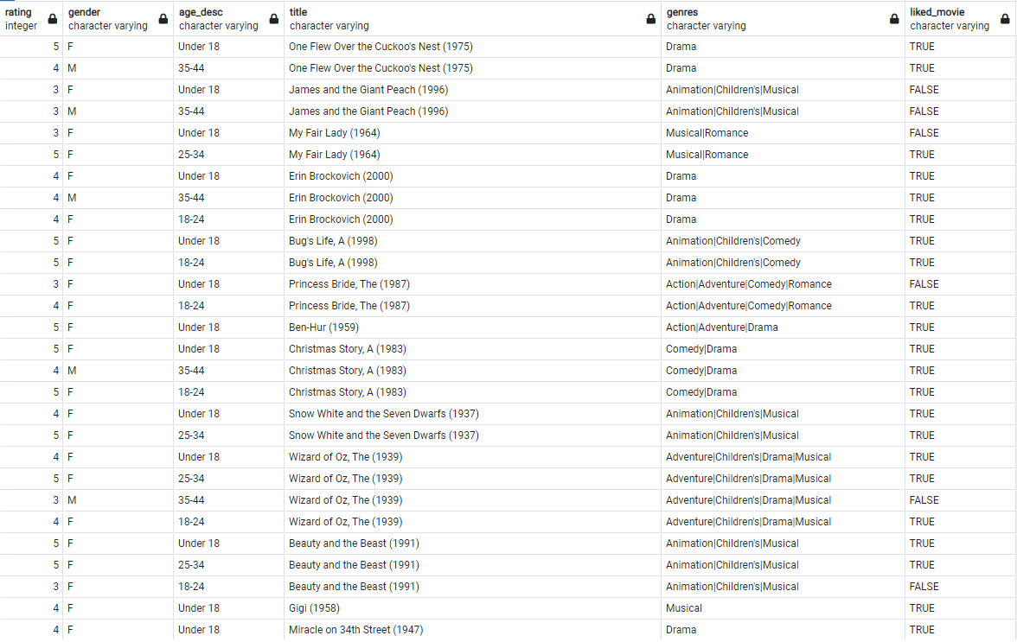
Let’s look at the Ratings…

Slide 5
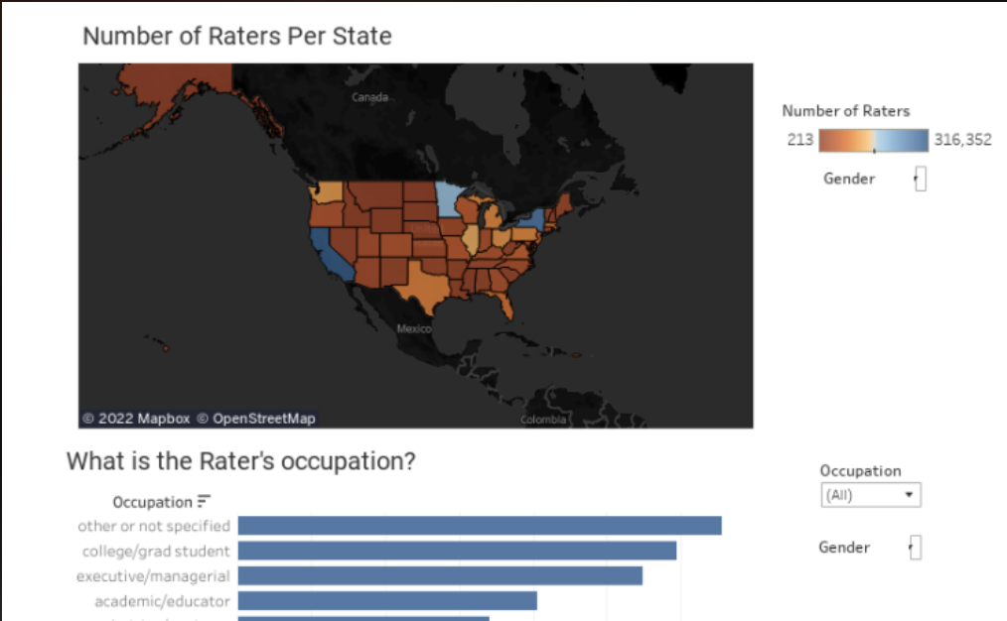
Tableau
https://public.tableau.com/views/MovieDatabaseProject_16640532831450/Project4Dashboard2?:language=en-US&:display_count=n&:origin=viz_share_link

Slide 6
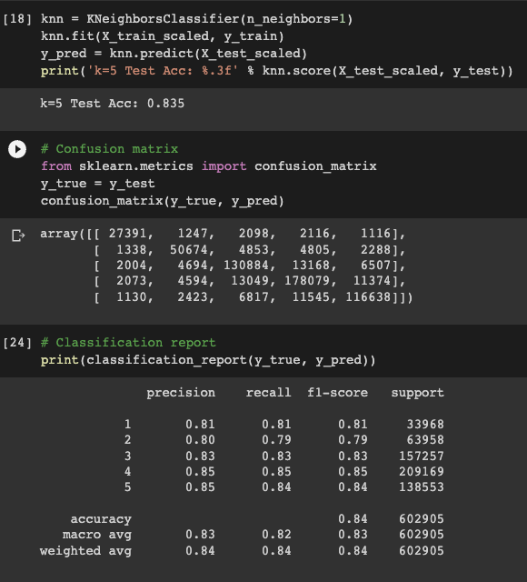
KNN report…
About our model:
We built a movie recommendation system using collaborative filtering by implementing the K-Nearest Neighbors algorithm.
What is collaborative filtering?
This filtering method is usually based on collecting and analyzing information user’s behaviors, their activities or preferences, and predicting what they will like based on the similarity with other users.
A key advantage of the collaborative filtering approach is that it does not rely on machine analyzable content and thus it is capable of accurately recommending complex items such as movies without requiring an “understanding” of the item itself.
The model does not learn from the demographics of users, instead it’s solely based on the ratings of the same titles from different users.
When a user visits the homepage, the system should recommend movies based on both:
Similarity to movies the user has liked in the past.
Movies that similar users liked.
How the algorithm works:
It is not based on the demographics data of users.
It is based solely off ratings on the same titles from different users.

Slide 7
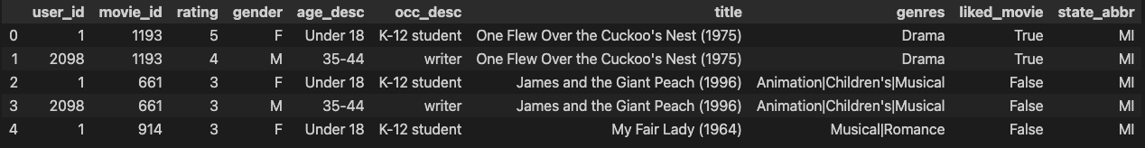
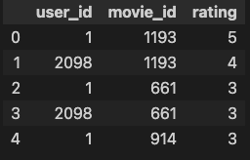
ML Model Cont… Our hypothesis and our actual results

Slide 8
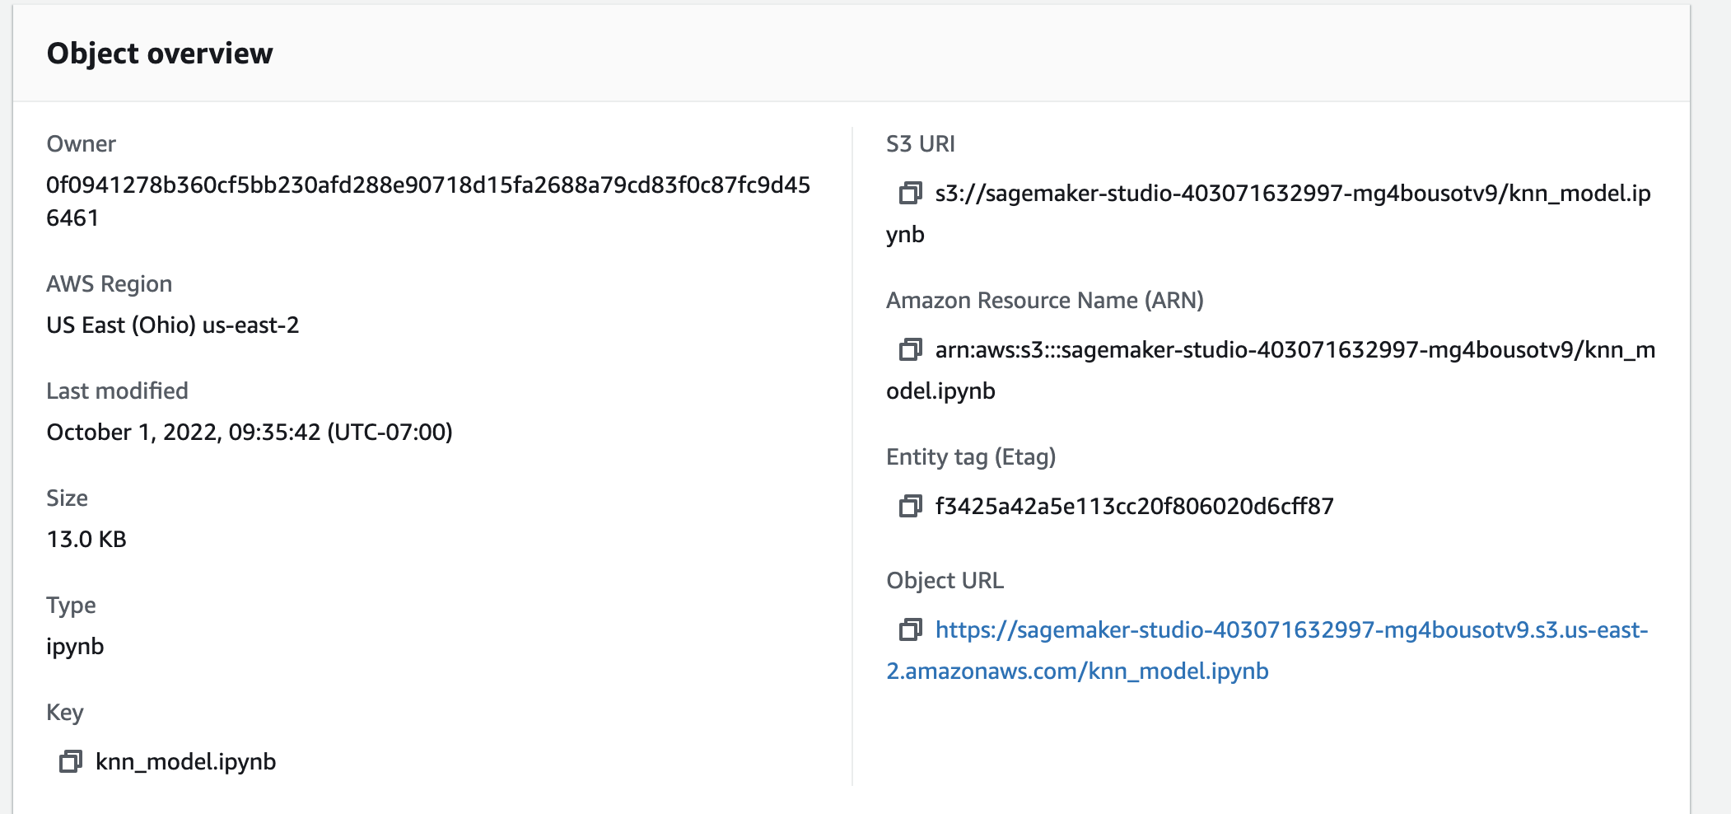
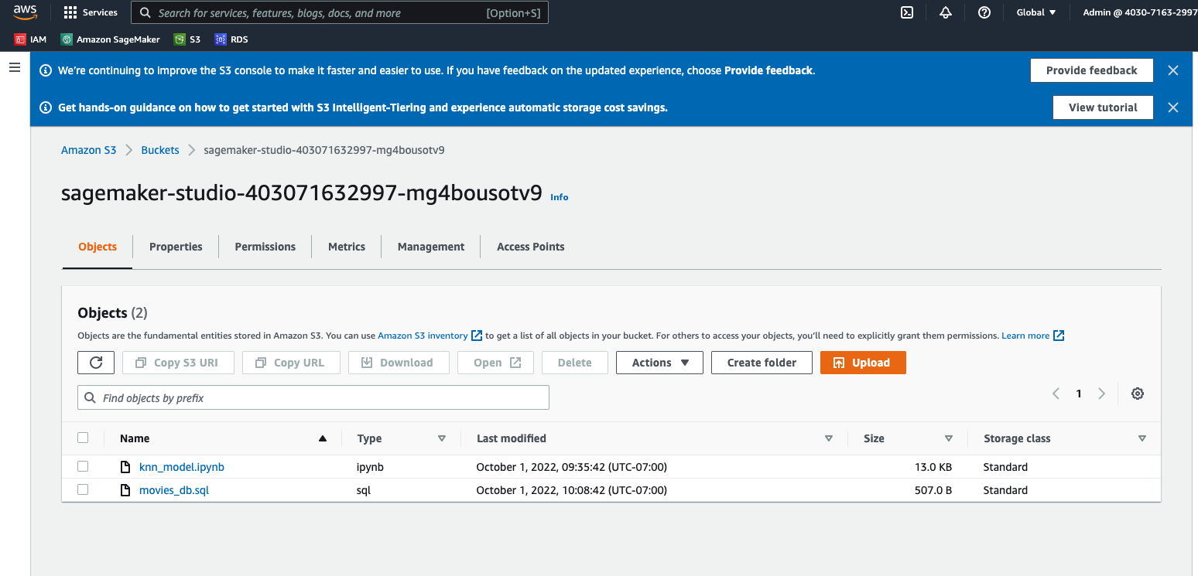
AWS Deployment
Once we had our ML, Tableau, and SQL refined, we were able to deploy our project to Amazon Web Services (AWS).
By deploying to AWS’s Sagemaker, hosting the model with endpoints allows us to have quick and accessible access to our project.

Slide 9

Thanks for listening

