Slide 1
DATA ANALYTICS / PORTFOLIO CASE STUDY
CUSTOMER SIGNALS
CUSTOMER
TOTAL REVENUE
SHOPPING
$233,081
BEHAVIOR
REVENUE BY AGE
Turning 3,900 purchase records into actionable customer insights
PYTHON
POSTGRESQL
POWER BI
Young adult
Middle-aged
Adult
Senior
TRANSACTIONAL ANALYSIS • CUSTOMER STRATEGY

Slide 2
01 / EXECUTIVE SNAPSHOT
Four numbers tell the opening story
A descriptive view of purchase volume, revenue, order value, and subscription participation.
3,900
$233,081
$59.76
27.0%
Purchase records
Recorded revenue
Average purchase
Subscribed
18 attributes analyzed
Across all transactions
USD per purchase
1,053 of 3,900 records
Revenue is not evenly split by gender
A sizable subscription audience remains
Male-tagged purchases account for 67.7% of recorded revenue. This does not measure spend per person.
73.0% of records are non-subscribed, while subscriber and non-subscriber average order values are similar.
Business question: How can we convert demand into more durable, profitable customer relationships?
CUSTOMER SHOPPING BEHAVIOR / ANALYTICS CASE STUDY
Source: project report
02

Slide 3
02 / DATA FOUNDATION
What we analyzed
Transactional attributes span customer profiles, purchase context, and shopping habits.
DATASET SIZE
CUSTOMER PROFILE
01
Age • Gender • Location • Subscription
3,900
purchase records
PURCHASE DETAILS
02
Item • Category • Amount • Season • Size • Color
18
data columns
SHOPPING BEHAVIOR
03
37 missing review ratings
Discount • Frequency • Prior purchases • Rating • Shipping
CUSTOMER SHOPPING BEHAVIOR / ANALYTICS CASE STUDY
Source: project report
03

Slide 4
03 / METHODOLOGY
A reproducible Python → SQL → Power BI workflow
Cleaning and feature engineering happen before structured business queries and visualization.
01
02
03
04
05
Load & inspect
Clean the data
Engineer fields
Analyze in SQL
Visualize
pandas, df.info(),
summary statistics
Category-median rating
imputation; snake_case
Age groups and
purchase-frequency days
PostgreSQL queries,
segments and rankings
Power BI dashboard
and recommendations
Consistency check: discount_applied and promo_code_used were redundant; promo_code_used was removed.
CUSTOMER SHOPPING BEHAVIOR / ANALYTICS CASE STUDY
Source: project report
04

Slide 5
04 / REVENUE PROFILE
Where does the revenue come from?
Revenue by recorded gender label; totals describe transactions, not per-customer value.
REVENUE BY GENDER
SHARE OF TOTAL REVENUE
$157,890
67.7%
Male
$75,191
Male-tagged transactions
Female
32.3% female
Gender labels are attributes in the source dataset; group sizes are not shown here.
CUSTOMER SHOPPING BEHAVIOR / ANALYTICS CASE STUDY
Source: project report
05

Slide 6
05 / SUBSCRIBER BEHAVIOR
Subscriptions have headroom to grow
The dataset contains far more non-subscribed than subscribed purchase records.
SUBSCRIPTION MIX
AVERAGE PURCHASE AMOUNT
73.0%
$59.87
Not subscribed
Non-subscribers
$59.49
No · 2,847 records
Yes · 1,053 records
Subscribers
Only $0.38 separates the two averages.
CUSTOMER SHOPPING BEHAVIOR / ANALYTICS CASE STUDY
Source: project report
06

Slide 7
06 / CUSTOMER SEGMENTATION
“Loyal” dominates the purchase-history segments
Customers were classified as New, Returning, or Loyal based on their prior-purchase history.
SEGMENT DISTRIBUTION
79.9%
Loyal
79.9%
Loyal segment
Returning
18.0%
3,116 of 3,900 records
New
2.1%
Segmentation uses a historical purchase field; it does not establish retention over time.
Among records with >5 prior purchases, 958 are subscribed and 2,518 are not (27.6% subscribed).
CUSTOMER SHOPPING BEHAVIOR / ANALYTICS CASE STUDY
Source: project report
07

Slide 8
07 / DEMOGRAPHIC PERFORMANCE
Revenue is spread across age segments
The top age band leads, but the four groups contribute relatively similar revenue totals.
REVENUE BY AGE GROUP
TOP GROUP
$62.1K
$59.2K
$56.0K
$55.8K
26.7%
of total revenue
Only $6.4K separates the highest and lowest revenue age groups.
Young adult
Middle-aged
Adult
Senior
CUSTOMER SHOPPING BEHAVIOR / ANALYTICS CASE STUDY
Source: project report
08

Slide 9
08 / PRODUCT DEMAND
Best sellers differ by category
Top product counts are ranked within each merchandise category.
ACCESSORIES
CLOTHING
FOOTWEAR
OUTERWEAR
Jewelry
Blouse
Sandals
Jacket
171
171
160
163
purchases
purchases
purchases
purchases
ALSO HIGH-RANKING
ALSO HIGH-RANKING
ALSO HIGH-RANKING
ALSO HIGH-RANKING
Sunglasses
161
Pants
171
Shoes
150
Coat
161
Belt
161
Shirt
169
Sneakers
145
CUSTOMER SHOPPING BEHAVIOR / ANALYTICS CASE STUDY
Source: project report
09

Slide 10
09 / PRODUCT SIGNALS
High ratings and discount reliance are different signals
Product satisfaction and the use of promotions should be managed separately.
HIGHEST AVERAGE REVIEW RATINGS
HIGHEST DISCOUNT USAGE RATES
Gloves
3.86
Hat
50%
Sandals
3.84
Sneakers
49.66%
Boots
3.82
Coat
49.07%
Hat
3.80
Sweater
48.17%
Skirt
3.78
Pants
47.37%
Average review rating, scale 1–5
Discount usage rate among that product’s purchases
CUSTOMER SHOPPING BEHAVIOR / ANALYTICS CASE STUDY
Source: project report
10

Slide 11
10 / BASKET BEHAVIOR
Express shipping is linked to a slightly larger basket
A descriptive comparison of the average purchase amount by selected shipping type.
AVERAGE PURCHASE BY SHIPPING TYPE
AVERAGE DIFFERENCE
+$2.02
Standard
$58.46
Express
$60.48
DISCOUNT BEHAVIOR
839
discounted records above the overall average purchase
Observed order value; this is an association, not an effect of shipping choice.
CUSTOMER SHOPPING BEHAVIOR / ANALYTICS CASE STUDY
Source: project report
11

Slide 12
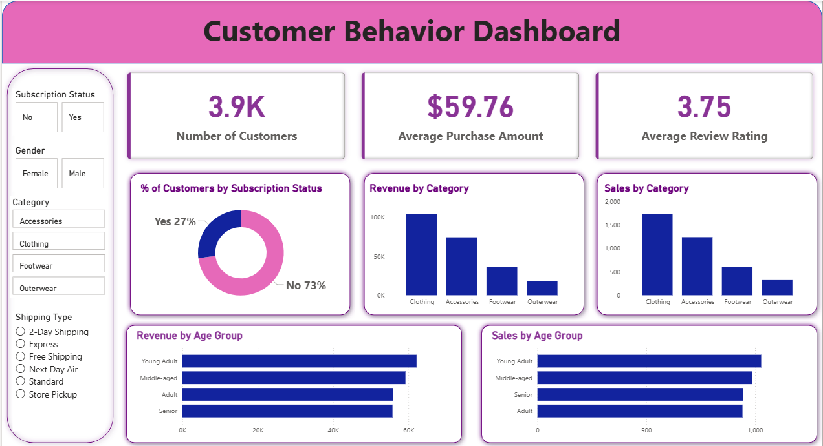
11 / BUSINESS INTELLIGENCE
The analysis comes together in Power BI
The source project presents an interactive dashboard for filtering and communicating the findings.
DASHBOARD KPIS
3.9K
Customers
$59.76
Avg. purchase
3.75
Avg. review
Dashboard screenshot reproduced from the original project report.
CUSTOMER SHOPPING BEHAVIOR / ANALYTICS CASE STUDY
Source: project report
12

Slide 13
12 / RECOMMENDATIONS
Turn descriptive patterns into testable actions
Five targeted initiatives connect the findings to measurable commercial outcomes.
Grow subscription adoption
73% of records are non-subscribed.
Pilot a compelling sign-up benefit and track conversion.
01
Develop loyalty journeys
3,116 records fall into the Loyal segment.
Reward repeat behavior and monitor return frequency.
02
Feature strong products
Gloves rate 3.86; Jewelry and Blouse rank #1.
Test top-rated and popular products in campaigns.
03
Audit discount economics
Hat purchases use discounts 50% of the time.
Compare promotion lift with contribution margins.
04
Test targeted creatives
Young adults contribute $62.1K in revenue.
Compare age-targeted messaging and conversion.
05
CUSTOMER SHOPPING BEHAVIOR / ANALYTICS CASE STUDY
Source: project report
13

Slide 14
13 / CLOSING PERSPECTIVE
FROM INSIGHT
TO IMPACT.
The next step is to validate which actions improve conversion, retention, and margin.
01
Measurement
02
Interpretation
03
Next data
37 missing review ratings were imputed by category median.
Comparisons are descriptive; they do not establish causality.
Add profitability, time-series behavior, and experiment outcomes.
PYTHON → POSTGRESQL → POWER BI
CUSTOMER SHOPPING BEHAVIOR / ANALYTICS CASE STUDY
14

