Slide 1

BI-Bot: QA System in Healthcare Domain
Candidate Name : Mr. Apar Garg
Enrollment Number : E17CSE112
Mentor Name : Mr. Swetank Gupta
Company Name : D Cube Analytics

Slide 2

About the Company
Internship at D Cube Analytics
Helps brands make confident and timely data driven decisions.
Deliver precise and predictive insights using Data Science.
Specialties-
Healthcare Analytics
Payer Provider Analytics
Pharma Commercial Analytics

Slide 3
Introduction
Problem
Accessing a database to get specific information can be a stressful and time-consuming task if one doesn’t have the much-needed technical skills.
Solution
Medical domain-specific knowledge-based QA system, which can answer the queries related to sales and marketing of drug from a given database.
Provide real-time responses to the common business queries of any employee.
Quick access and easy usage with the help of a messaging service like Facebook Messenger or Slack.

Slide 4
Tools & Technology
Programming Language- Python
Platform- Jupyter Notebook
Python Frameworks-
Data Manipulation- numpy, pandas
Data Visualization- seaborn, matplotlib
NLP- re, nltk, spaCy, gensim
Slack API interface- slacker

Slide 5
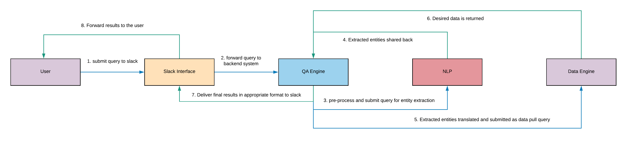
System Architecture

Slide 6
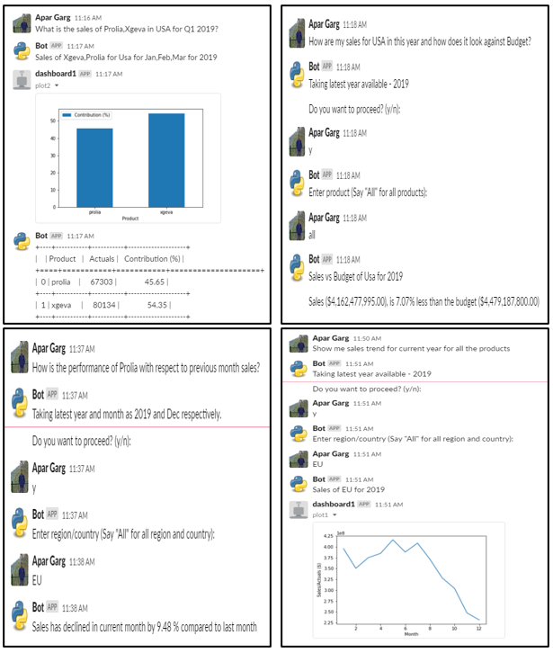
Results (Output for Business Type queries)

Slide 7
Results (Output for Business Type queries)

Slide 8
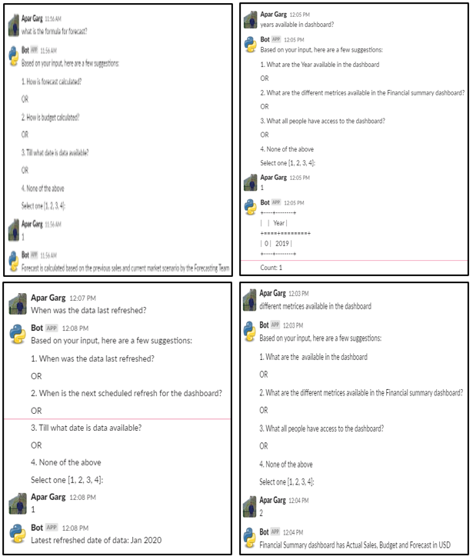
Results (Output for Technical Type queries)

Slide 9
Results (Output for Technical Type queries)

Slide 10
Conclusion and Future Work
The goal of this work was to build a QA system in the medical domain which can provide real-time responses to the common business queries of any employee in a healthcare company by removing unwanted dependencies on the analytics teams.
The QA system makes use of advanced NLP techniques like NER and text pre-processing, etc. to understand and answer complex user queries.
My future goal is to work on Boolean questions expecting a yes/no answer and other types of factual questions. Another future goal is to develop augmented intelligence that identifies the type of question and gives more insights around that question.

Slide 11
Learnings
Technical Learnings
Perform Pre-processing and EDA on different datasets in the pharma domain.
Text data manipulation and processing techniques.
Custom NER for given data.
Integration of chatbot with a messaging service like Slack.
Other Learnings
Function effectively as a member of an organization.
Write Minutes of Meeting (MoM).
Write Status Update mail at the end of the day.
Develop a timeline for a project.

Slide 12
Challenges
Technical Challenges
Augmented Insights - Developing augmented intelligence that identifies the type of question and giving more insights around that question.
Execution Time - Developing efficient code. Preprocessing the question and extracting entities from it is quite computationally expensive.
Other Challenges
KT sessions - Intensive KT sessions on fundamentals of pharma and healthcare were difficult to grasp initially due to limited prior knowledge in the field.
NLP Course - Had to take up a course in Chatbot Systems. Managing the course with day-to-day internship tasks was pretty exhaustive.

Slide 13
Thank You

