Slide 1

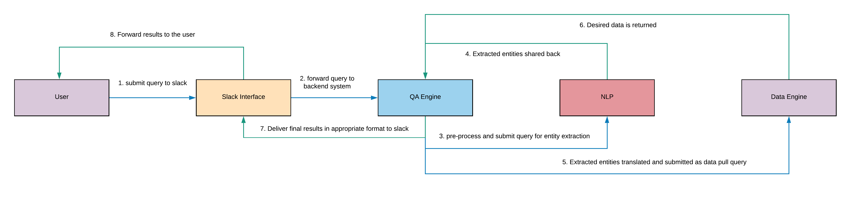
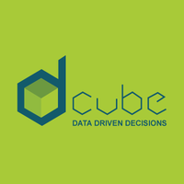
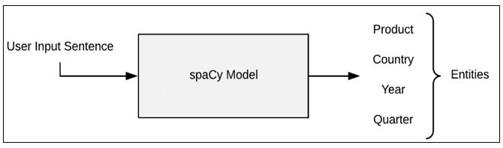
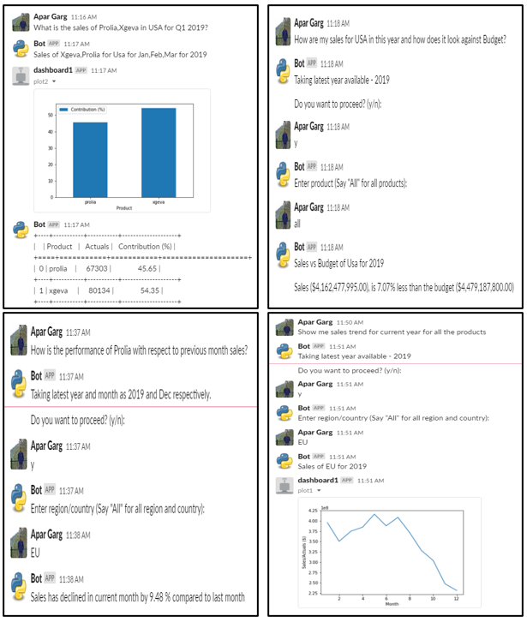
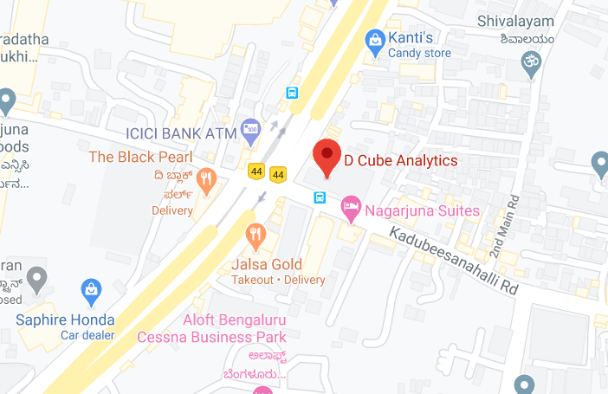
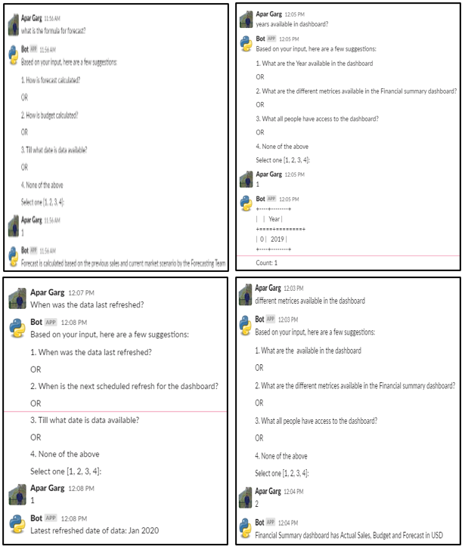
BI-Bot: QA System in Healthcare Domain
Apar Garg
E17CSE112
Abstract
Proposed Methodology
In this work, I present a medical domain-specific QA system, which can provide real-time responses to any employee's standard business queries in a healthcare company by removing unwanted dependencies on the analytics team. The QA system uses NLP and DL techniques for NER and text pre-processing, etc.
About the Company
Experimental Results and Discussion
Output to Business Type queries
D Cube Analytics. US-based company with a branch located in Bangalore, India.
Helps brands make confident and timely data driven decisions.
Deliver precise and predictive insights using Data Science.
Output to Technical Type queries
Introduction
Conclusions
Problem
Accessing a database to get specific information can be a stressful and time-consuming task if one doesn’t have the much-needed technical skills.
Solution
Medical domain-specific knowledge-based QA system, which can answer the queries related to sales and marketing of drug from a given database.
Provide real-time responses to the common business queries of any employee.
Quick access and easy usage with the help of a Slack messaging service.
The goal of this work was to build a QA system in the medical domain which can provide real-time responses to the common business queries of any employee in a healthcare company.
The QA system makes use of advanced NLP techniques like NER and text pre-processing, etc. to understand and answer complex user queries.
My future goal is to work on Boolean questions expecting a yes/no answer and other types of factual questions.
Another future goal is to develop augmented intelligence that identifies the type of question and gives more insights around that question.

