Slide 1
BI-BOT Business Intelligence in Healthcare
Presented by:
Apar Garg

Slide 2
Introduction
Medical domain specific knowledge-based chatbot, which can answer the queries related to sales and marketing of drug from a given database.
Provide real-time responses to the common business queries of any employee in a healthcare company hence, removing unwanted dependencies on the analytical teams.
Addressed factual questions expressed by WH pronoun “What”.
Answer can just be a table or combination of table and bar plot(s).

Slide 3
overview
Design a chatbot for Healthcare Domain: A deep learning based chatbot is designed to understand queries related to healthcare. It extracts entities and establishes a correspondence between multiple instances of entities. Hence, we have proposed an end-to-end system to understand user query and generate the response using data engine.
Collection of domain specific data: No sample query data is available for healthcare chatbot research. We have collected data for different types of sample questions, each with unique functionality, for the purpose of training and testing.
Customized training: We have custom trained spaCy model for Named Entity Recognition.

Slide 4
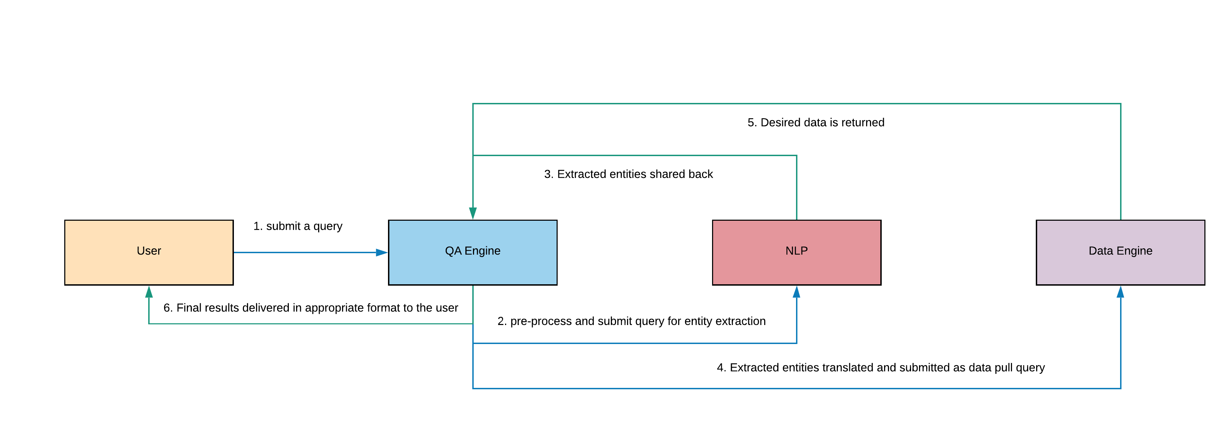
FLOW OF EXECUTION

Slide 5
Flow of Execution
User query: A user can submit multiple type of queries, to the chatbot , one at a time.
Pre-processing: The pre-processing of user query was done in three steps: Noise Removal, Lowercasing and Normalization. In Noise Removal, the punctuations were removed from the query. In Normalization, the terms in query were transformed into standard form as in Data Engine.
Named Entity Recognition (NER): We have trained a blank spaCy model using annotated training data to recognize four custom entities from the user query: product, country, quarter and year.
Spell check: We have used edit distance technique, to rectify spelling errors in extracted entities.
Retrieve Data: The translated entities are mapped to entries in the database to fetch data in the form of dataframe and bar plot(s).

Slide 6
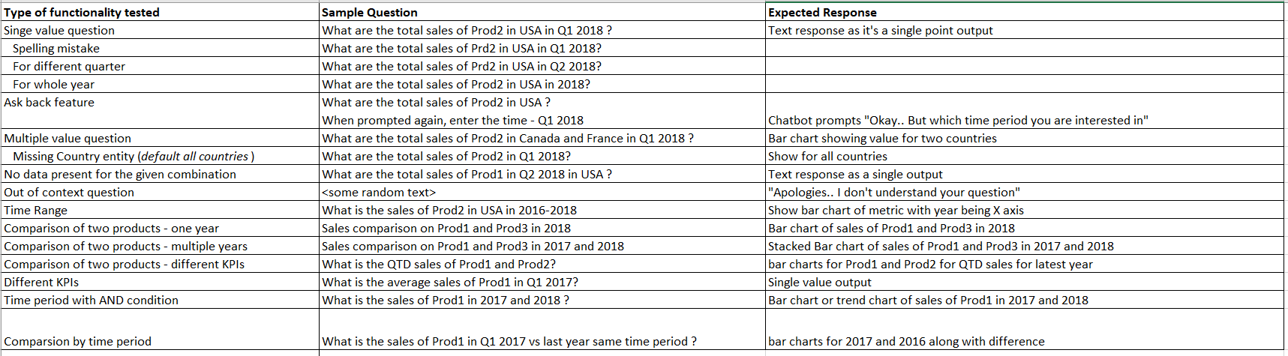
SAMPLE QUERIES

Slide 7
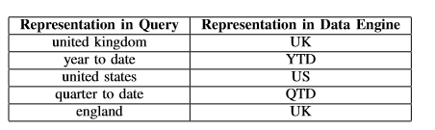
QUERY PRE-PROCESSING
Noise Removal
Removal of punctuation, extra spaces etc.
Lowercasing
Normalization
Synonyms and acronyms mapped to words in the data engine.

Slide 8
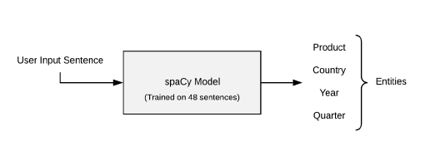
spaCy for NER
Open-source library for advanced NLP
The NER component in spaCy pipeline is a deep learning model utilizing CNN and LSTM architectures.

Slide 9
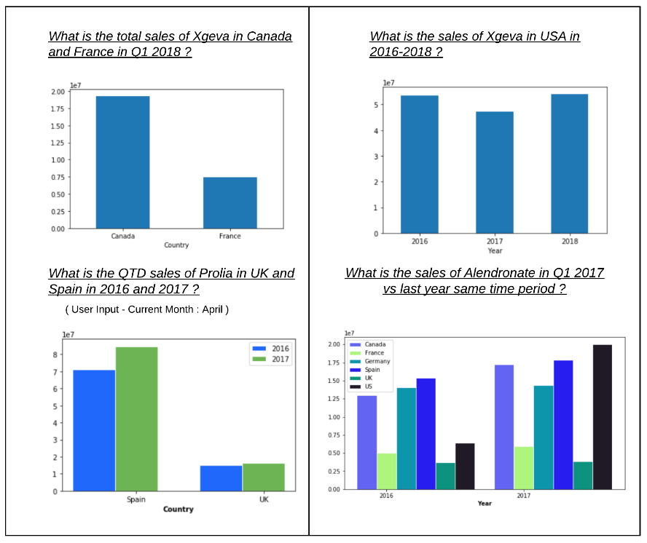
OUTPUT GRAPHS

Slide 10
FUTURE WORK
Work on Boolean questions expecting a yes/no answer and other types of factual questions.
Work on dependency parsing of a sentence which will be helpful to determine the dependency of entities on one-another.

Slide 11


Thank You

