Slide 1

COVBOT: INTELLIGENT AI CHATBOT FOR COVID-19
Presented by:
GROUP 10
Apar Garg (A0231539E)
Lin Qianqian (A0231438J)
Liu Jing (A0231403Y)
Yang Mingrun (A0231344R)
Zhu Junkun (A0231471N)
Submitted to:
INSTITUTE OF SYSTEMS SCIENCE
NATIONAL UNIVERSITY OF SINGAPORE, SINGAPORE

Slide 2
01
02
Introduction
FAQ Answering
04
05
Covid Screening Using Cough
User Interface
Outline
03
Fake Tweet Detection
06
References

Slide 3
Introduction
Background
Coronavirus 2019 (COVID-19), an infectious disease caused by severe acute respiratory syndrome coronavirus type 2 (SARS-CoV-2), has caused an ongoing outbreak that has become one of the deadliest pandemics in human history [1].
Business Case
COVID-19 has yielded a fast development of articles and scientific publications. Finding answers on the internet to get answers to all queries, can be very frustrating and overwhelming since the information is spread across different web pages [2].
COVID-19 has been accompanied by a large amount of misleading and false information about the virus, especially on social media. In a world with millions of messages either removed or being published every minute, it is not feasible to annotate and segregate manually [3].
Gold standard for COVID-19 testing is RT-PCR, which always takes a long time to produce results and costs a lot . A cheaper and faster diagnosis solution is the need of the hour [4, 5, 6].

Slide 4
Introduction (contd.)
Solutions
Medical domain-specific chatbot system using techniques like signal processing, machine learning, natural language processing, and deep learning.
FAQ Answering - Answer questions about COVID-19. Take questions from the users as input and generate the most accurate responses consisting of a single line answer.
Fake Tweet Detection - Detect if a tweet related to COVID-19 is authentic or fake. Highlight which part/words of the fake tweet contributes most to the result.
Covid Screening Using Cough - Predict the presence of COVID-19 using the subject’s cough audio recording.

Slide 5
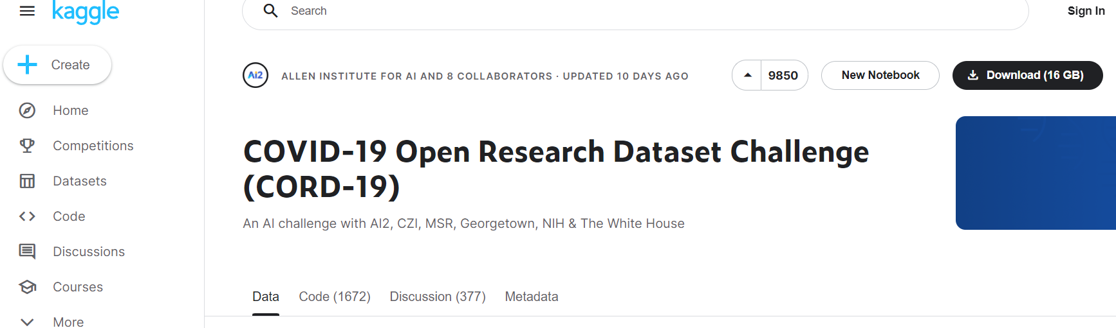
FAQ Answering
Dataset Description
COVID-19 Open Research Dataset (CORD-19) [7].
Made by White House and a coalition of leading research groups.
Contains thousands of medical institution papers and other related articles on the subject of COVID-19.
Figure 1: CORD-19 dataset on Kaggle

Slide 6
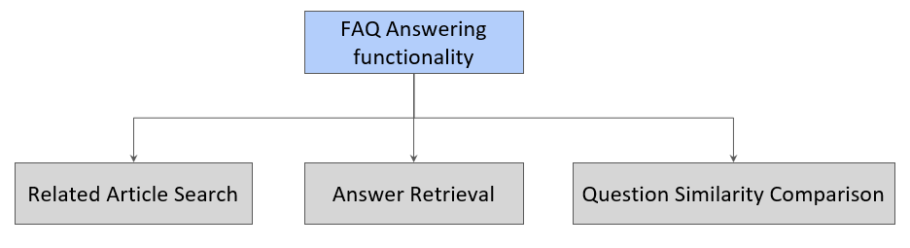
FAQ Answering (contd.)
Methodology
Extractive QA method
Extractive QA method consists of two steps:
Related Article Search - Find the relevant article content from the article library.
Answer Retrieval - Extract the related answers from the article content.
Figure 2: Parts of FAQ Answering System

Slide 7
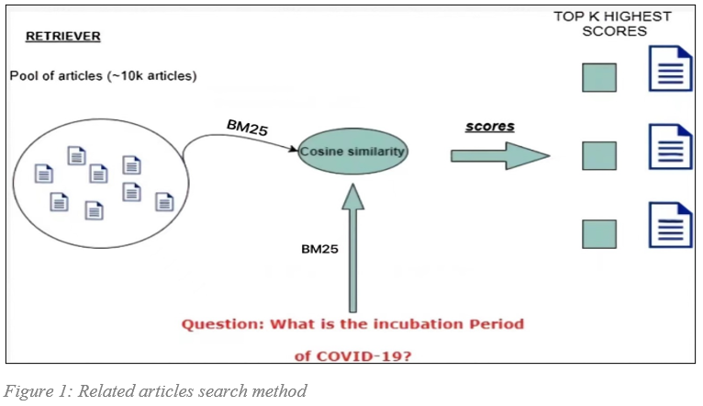
FAQ Answering (contd.)
Methodology
Related Article Search
Found articles from the article library most relevant to the user question.
Used Okapi BM25 [8] which is a ranking function used by search engines to estimate the relevance of documents to a given search query.
Figure 3: Related article search method

Slide 8
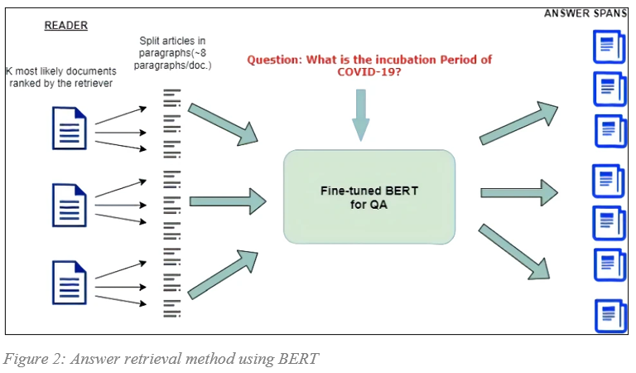
FAQ Answering (contd.)
Methodology
Answer Retrieval
Used BERT [9] model (fine-tuned on SQuAD dataset) for question answering.
For each article (context) and the same user query pair, asked the pre-trained and pretty-powerful transformer model what is the part of the context that better represents the query.
Figure 4: Answer retrieval method using BERT

Slide 9
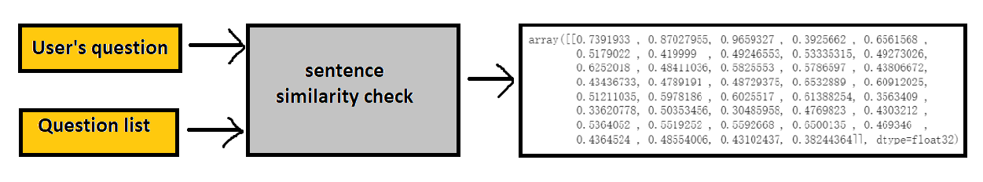
FAQ Answering (contd.)
Methodology
Question Similarity Comparison
Prepared 38 relevant questions in advance and successfully generated a question list by using the above two-part model.
Checked the similarity between the existing questions and user’s question.
Selected the most similar question and showed its answer to the user.
Figure 5: Question Similarity Comparison method

Slide 10
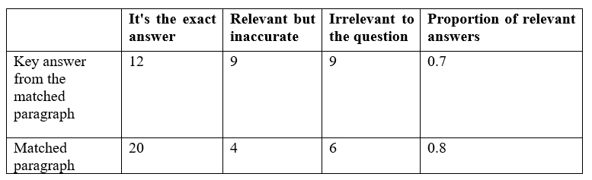
FAQ Answering (contd.)
Results
To evaluate the performance of our FAQ Answering functionality, we collected 30 questions (with a similarity degree higher than 0.75) about COVID-19 from the internet, including how it is transmitted, how it can cause infection, and how to protect against it.
Table 1: Performance of FAQ Answering functionality
Figure 6: Example of answers for FAQ Answering functionality

Slide 11
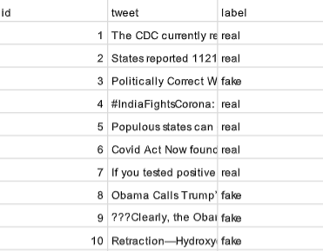
Fake Tweet Detection
Dataset Description
Open-source labelled Kaggle dataset [10].
Consists of a training dataset and a test dataset.
Includes 3 columns: id, tweet, and label.
Table 2: Number of tweets per class
Class | Training dataset | Testing dataset | Total
Real | 3360 | 1120 | 4480
Fake | 3060 | 1020 | 4080
Total | 6120 | 2140 | 8240
Figure 7: First 10 rows in training dataset

Slide 12
Fake Tweet Detection (contd.)
Methodology - Classification
Dataset Preparation
Encoded categorical data
Removed URLs, symbols, emojis, HTML tags, unnecessary blank text between words, duplicate data, etc.
Lemmatization
Stop words removal
Feature Extraction
TF-IDF
Word2Vec
GloVe

Slide 13
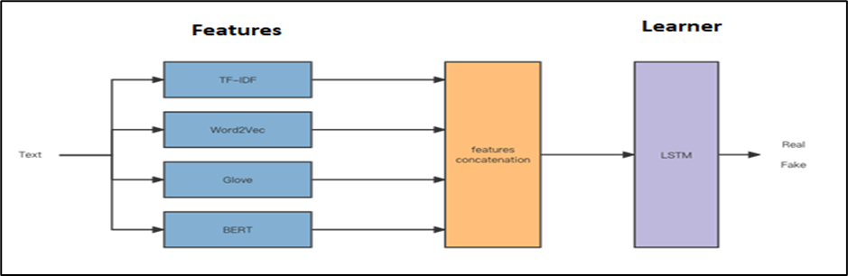
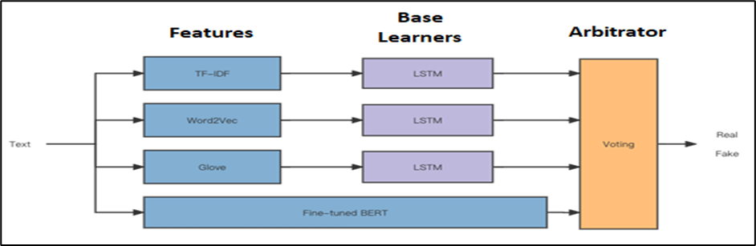
Fake Tweet Detection (contd.)
Methodology - Classification
Modeling
TF-IDF + Naïve Bayes
TF-IDF + 2DCNN
TF-IDF + LSTM
Word2Vec + LSTM
GloVe + LSTM
Fine-tuning BERT
Early Fusion
Late Fusion
Figure 9: Late Fusion Model
Figure 8: Early Fusion Model

Slide 14
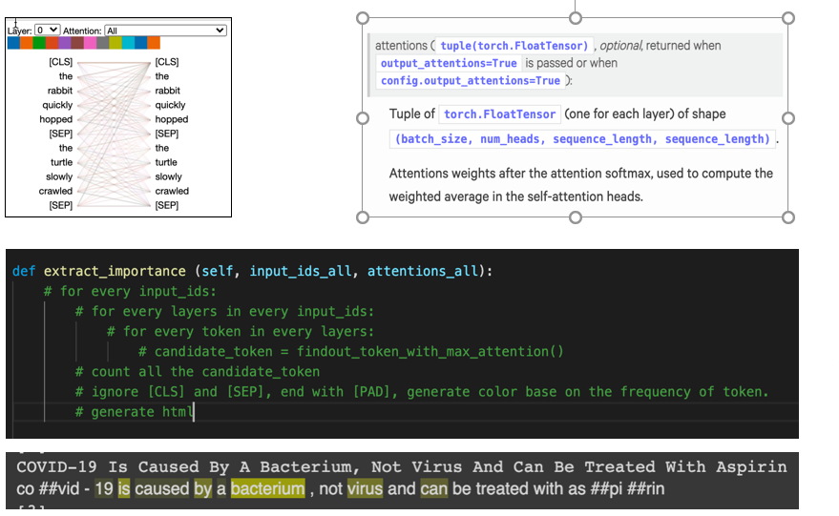
Fake Tweet Detection (contd.)
Methodology – Fake Information Extraction
Figure 10: Fake Information Extraction output

Slide 15
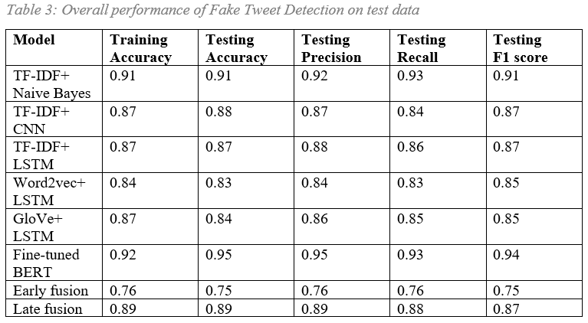
Fake Tweet Detection (contd.)
Results - Classification
Table 3: Overall Performance of Fake Tweet Detection on test data

Slide 16
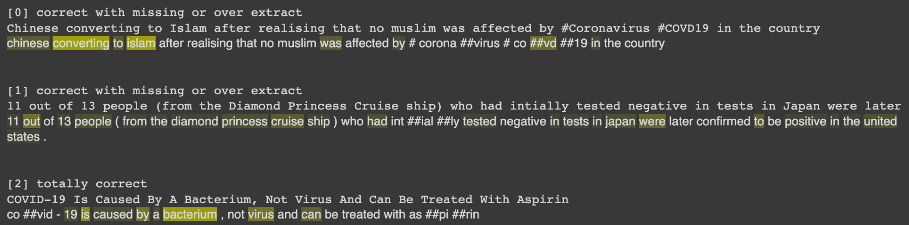
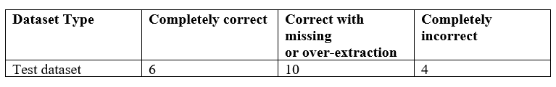
Fake Tweet Detection (contd.)
Results - Fake Information Extraction
Figure 11: Fake Information Extraction evaluation example output
Table 4: Performance of Fake Information Extraction functionality

Slide 17
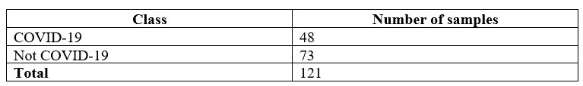
Covid Screening Using Cough
Dataset Description
Virufy COVID-19 Open Cough Dataset [11].
121 segmented cough samples from 16 patients.
Audio samples donated by patients from multiple countries.
Table 5: Number of audio samples per class in Virufy dataset

Slide 18
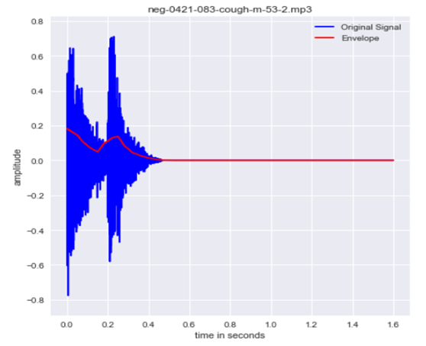
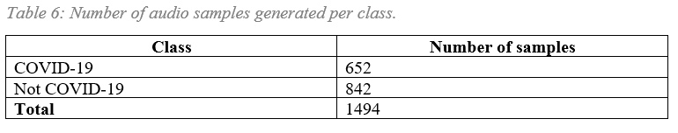
Covid Screening Using Cough (contd.)
Methodology
Data Preparation
Resampling from 48000 Hz to 16000 Hz.
Silence removal by extracting the signal envelope and thresholding it.
Segmentation and augmentation. Chose a random audio sample from the dataset according to their probability distribution (based on the duration of audio files) and then cropped a random duration of 1/10 sec from the chosen audio sample.
Table 6: Number of audio samples generated per class
Figure 12: Signal envelope example

Slide 19
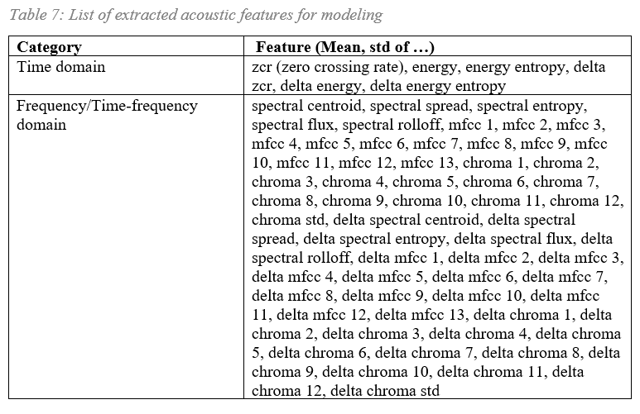
Covid Screening Using Cough (contd.)
Methodology
Feature Extraction
13 MFCCs (2D array) from every 1/10 sec audio file.
Mean, std of 68 acoustic features (time domain and frequency/time-frequency domain) from every 1/10 sec audio file.
Table 7: List of extracted acoustic features for modeling

Slide 20
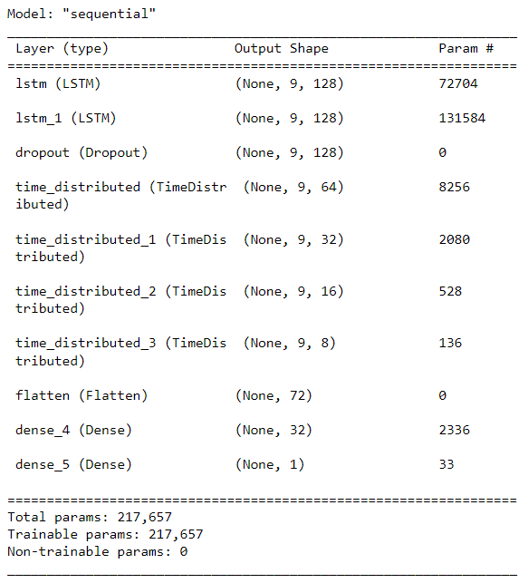
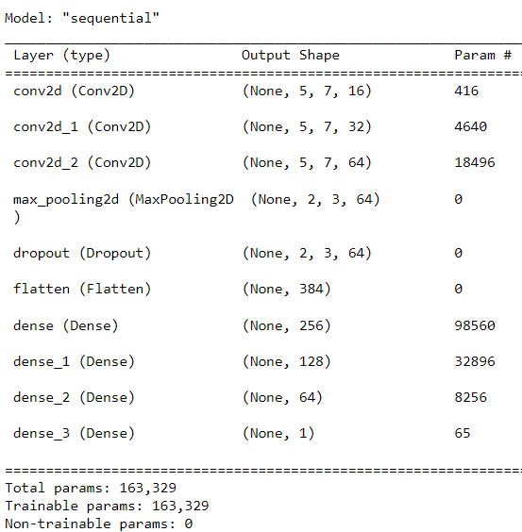
Covid Screening Using Cough (contd.)
Methodology
Modeling
13 MFCC + LSTM
13 MFCC + 2DCNN
Mean, Std of Acoustic Features + Naive Bayes
Mean, Std of Acoustic Features + Random Forest
Mean, Std of Acoustic Features + Gradient Boosting
Mean, Std of Acoustic Features + Logistic Regression
Mean, Std of Acoustic Features + KNN
Mean, Std of Acoustic Features + SVM
Figure 13: Proposed LSTM model architecture
Figure 14: Proposed 2DCNN model architecture

Slide 21
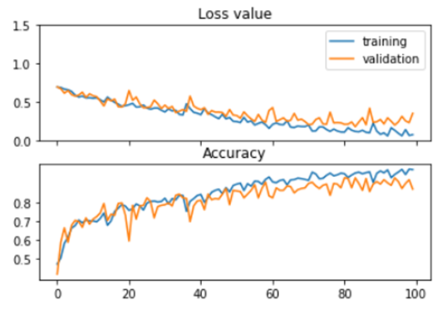
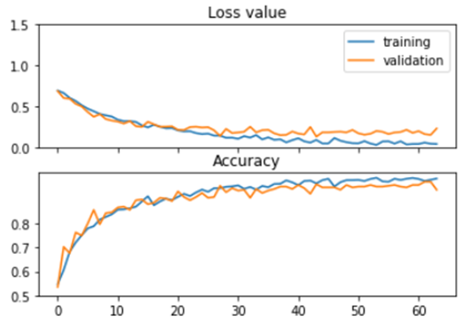
Covid Screening Using Cough (contd.)
Results
13 MFCC + LSTM
13 MFCC + 2DCNN
Figure 15: Loss and accuracy curves for LSTM trained on MFCC features
Figure 16: Loss and accuracy curves for 2DCNN trained on MFCC features
Approx. 0.97 and 0.92 on training and validation datasets resp.
Approx. 0.98 and 0.94 on training and validation datasets resp.
Tested models on 4 additional cough audio files (2 positive and 2 negative) taken from Coughvid [12] dataset, and the model classified all 4 cases correctly.

Slide 22
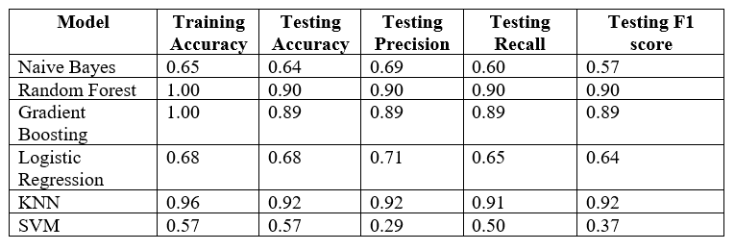
Covid Screening Using Cough (contd.)
Results
Mean, Std of Acoustic Features + ML Models
Table 8: Overall performance of COVID-19 Screening Using Cough on test data

Slide 23
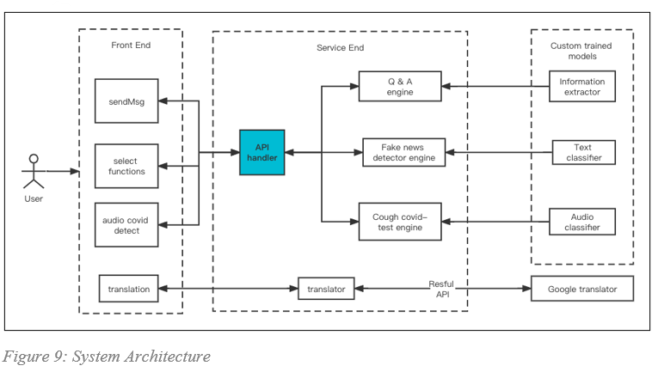
User Interface
System Architecture
Figure 17: System Architecture

Slide 24
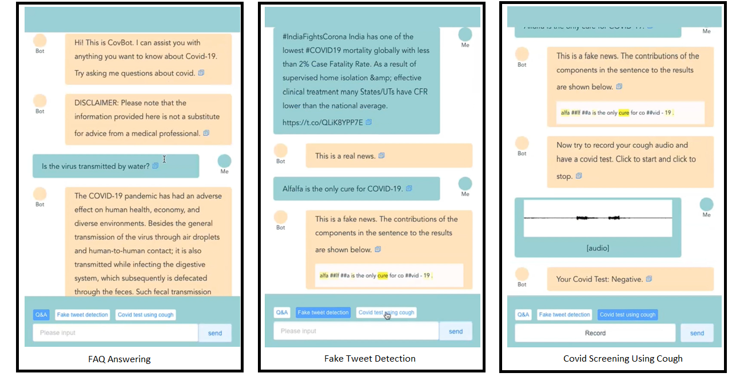
User Interface (contd.)
UI Mockup
Figure 18: UI example outputs

Slide 25

User Interface (contd.)
UI Demo Video

Slide 26
References
[1] https://www.sciencedirect.com/science/article/pii/S0140673620301835
[2] https://link.springer.com/article/10.1007/s10238-020-00650-3
[3] https://pesquisa.bvsalud.org/global-literature-on-novel-coronavirus-2019-ncov/resource/pt/covidwho-1320
[4] https://pubs.acs.org/doi/10.1021/acsnano.0c02624
[5] https://www.who.int/news/item/13-12-2017-world-bank-and-who-half-the-world-lacks-access-to-essential-health-services-100-million-still-pushed-into-extreme-poverty-because-of-health-expenses
[6] https://www.nytimes.com/2020/06/16/upshot/coronavirus-test-cost-varies-widely.html
[7] https://www.kaggle.com/datasets/allen-institute-for-ai/CORD-19-research-challenge
[8] https://www.analyticsvidhya.com/blog/2021/05/build-your-own-nlp-based-search-engine-using-bm25/
[9] https://arxiv.org/abs/1810.04805
[10] https://www.kaggle.com/datasets/elvinagammed/covid19-fake-news-dataset-nlp
[11] https://www.frontiersin.org/articles/10.3389/fpsyg.2021.644801/full
[12] https://github.com/virufy/virufy-cdf-coughvid

