Slide 1
NON-NATIVE ENGLISH ACCENT DETECTION
Presented by
APAR GARG (E17CSE112)
Submitted
to
DEPARTMENT OF COMPUTER SCIENCE ENGINEERING
BENNETT UNIVERSITY, GREATER NOIDA, 201310, UTTAR PRADESH, INDIA

Slide 2
OUTLINE
Introduction
Related Work
Contributions
Proposed Methodology
Results
Conclusion and Future Work
References

Slide 3
Introduction
Home assistants (Apple Siri and Google Home etc.) - integral part of our lives.
Problem
Non-native English speakers frequently face problems with these automated assistants.
Accented speech - phones or sounds that are not typical in normal pronunciation.
Solution
user speech
Classify accent
Convert into native English accent
Home Assistant
native English
non-native English

Slide 4
Related Work
A lot of research has been done in accent classification. Some of the existing literature is mentioned below.
Chu et. al. [1] implemented several models to classify five accents. They used MFCCs, deltas of MFCC, and FBank features for training the models. The overall test accuracies ranged between 28.4% and 39.8%.
Chionh et. al. [2] trained a 2-layer and a 3-layer CNN for accent classification in the 4 English accents and found that the 2-layer CNN performed best, with a training accuracy of 81.4% and a test accuracy of 77.9%.

Slide 5
Contributions
There are two main contributions to this study:
Comparison of performance of various spectral feature sets on model accuracy.
Comparison of manual ML with AutoML models.

Slide 6
Proposed Methodology
System Specifications
Table 1: Hardware and Software specifications of Laptop
Programming Language - Python
Platform – Jupyter Notebook, Sublime Text Editor
Item | Value
Processor | IntelI Core I i5-8250U CPU @ 1.60GHz, 1800 Mhz, 4 Core(s), 8 Logical Processor(s)
Total Physical Memory | 7.89 GB
Total Virtual Memory | 31.9 GB
System type | x64-based PC
OS Name | Microsoft Windows 10 Home Single Language
OS Version | 10.0.18363 Build 18363

Slide 7
Dataset Used
Proposed Methodology
The Speech Accent Archive [4].
2140 speech samples. All unique speakers.
Speakers have 214 distinct native languages and come from 177 countries.
Demographic information of speakers given (6 columns).
Table 2: Data Type of each demographic column in the dataset.
Unbalanced Target variable.
Table 3: Number of audio samples per accent class.
Data Type | Columns
Discrete (Numerical) | age, age onset
Nominal (Categorical) | birthplace, sex, country
Accent | Number of samples
Native accent | 373
Non-native accent | 1767
Total | 2140

Slide 8
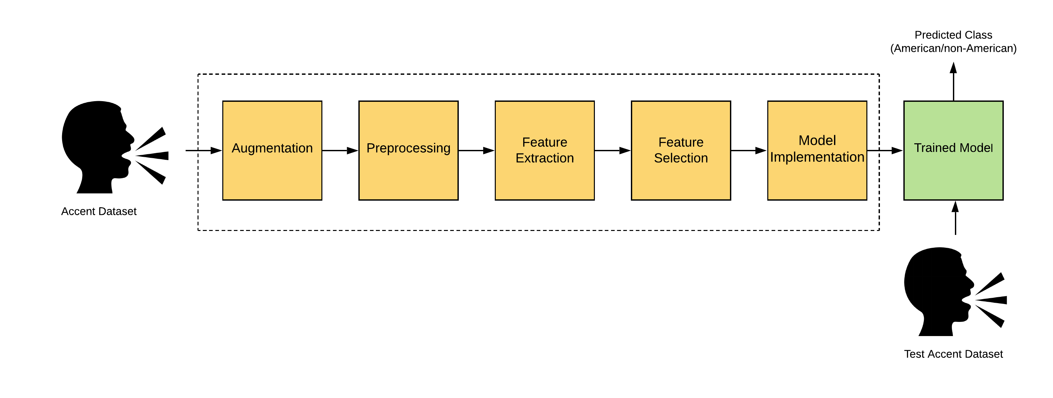
Proposed Methodology (contd.)
Accent Classification
noise injection
time shift
pitch change
speed change
6 unique spectral features (total 18 features)
Manual ML and AutoML
Trim and pad to 20 sec
Segment to 4 sec
Correlation-Based FS
Selected 16 features

Slide 9
Results
Manual ML - ANN (79.3% test accuracy)
AutoML - Extra Trees Classifier (86.67% test accuracy)
Table 4: Confusion matrix for Extra Trees Classifier
Predict Actual | non-native | native
non-native | 2169 | 245
native | 325 | 1569

Slide 10
Conclusion and Future Work
Conclusion
Experimented with different acoustic feature sets and ML models.
Best results on MFCC+Other spectral features.
Best results on Standardized dataset.
AutoML gives better accuracy by 7.46%.
Future Work
Work on open-source dataset with > 10k audio samples.
Apply other neural networks like RNN, RCNN.
Use Transfer Learning on spectrogram images for accent classification.

Slide 11
References
Chu, A., Peter Lai and Diana Le. “Accent Classification of Non-Native English Speakers.” .
Chionh, Keven, Raymond Song, and Yue Yin. "Application of Convolutional Neural Networks in Accent Identification.“

Slide 12
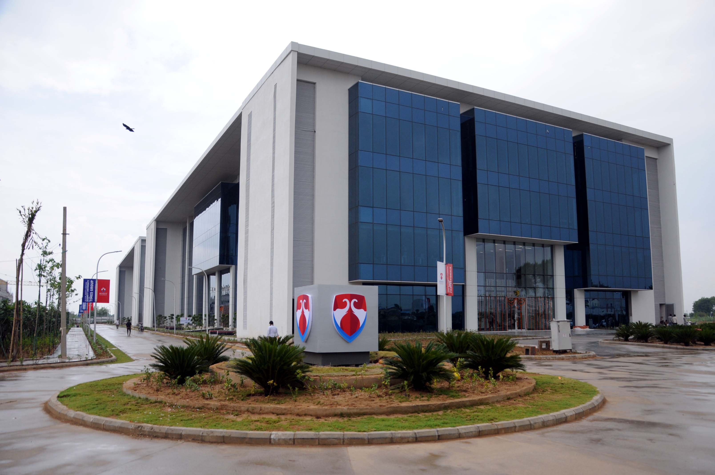
Thank You

