Slide 1

Melanoma skin cancer detection using stacked ensemble model
Presented by
GROUP 10
Apar Garg (A0231539E)
Gopan Ravikumar Girija (A0231541U)
Sarah Elita Shi Yuan Wong (A0231507N)
Submitted
to
INSTITUTE OF SYSTEMS SCIENCE
NATIONAL UNIVERSITY OF SINGAPORE, SINGAPORE

Slide 2
Outline
Introduction
Proposed Methodology
Results
User Interface
References

Slide 3
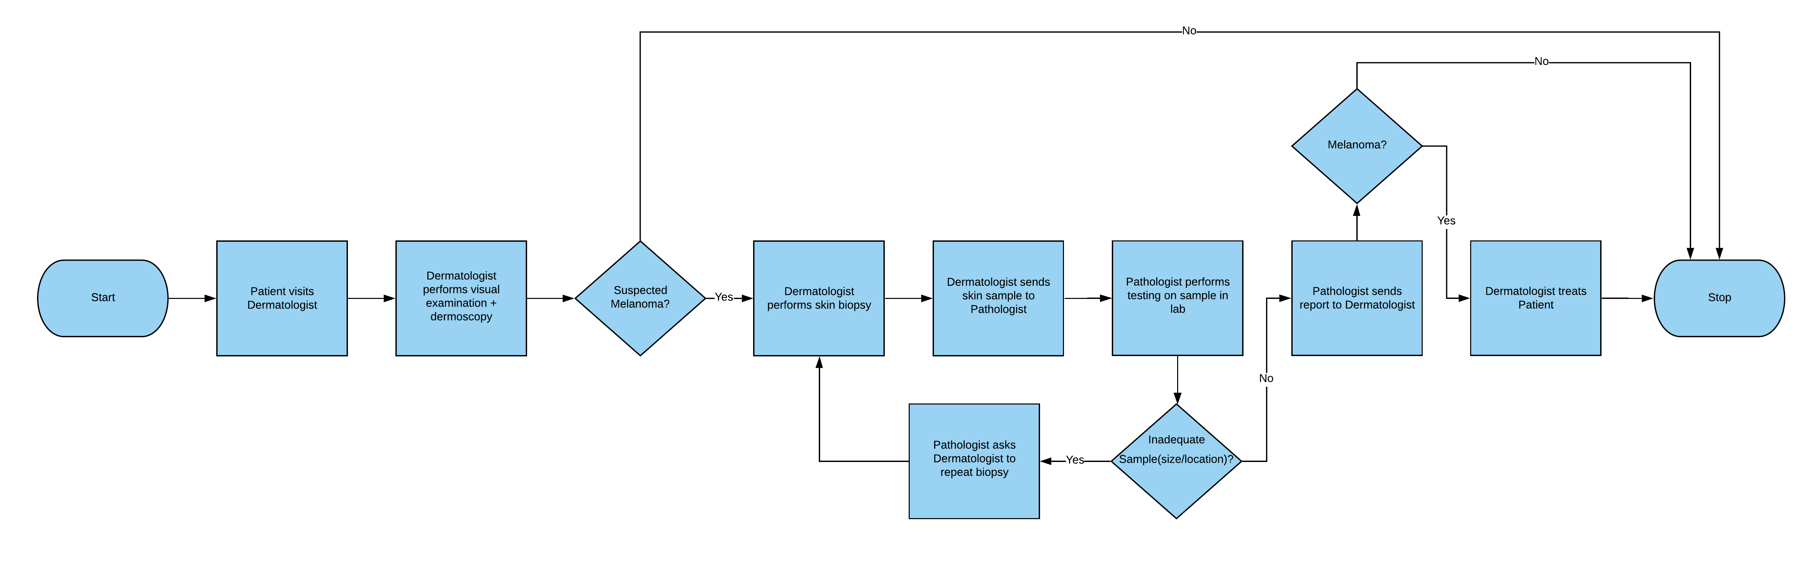
Introduction
Background
Melanoma is the deadliest type of skin cancer. Although it is responsible for only about 1% of all skin cancers diagnosed in the U.S., it makes up most skin cancer deaths [1].
Early diagnosis and treatment give patients a significantly higher chance of survival.
The diagnosis process for melanoma is illustrated in the flowchart below: ​

Slide 4
Introduction (contd.)
Problem
False Negatives (FN) - Patient has melanoma but the dermatologist concludes otherwise based on the dermoscopy he has performed.​
Dermatologist only sends suspected cases for lab-testing. Since the sensitivity of dermoscopy can range from 60% to 100% [2], some unsuspected cases, which are in fact melanoma, will be left out for lab-testing. This may cause late diagnosis and treatment.
False Positives​ (FP) - Patient does not have melanoma but the dermatologist suspects it as melanoma and performs biopsy as a further check.
Skin biopsy is an invasive (removal of a small part of the skin) process, which can leave a scar [3].
The typical cost of a skin biopsy without insurance is 120 – 450 USD. Lab evaluation fees may add extra fees from 50 – 350 USD [3].

Slide 5

Introduction (contd.)
Solution/Objective
To provide an image-based classification solution for melanoma detection during the early screening stage that can help dermatologists reduce False Negatives (FN) and False Positives (FP).

Slide 6
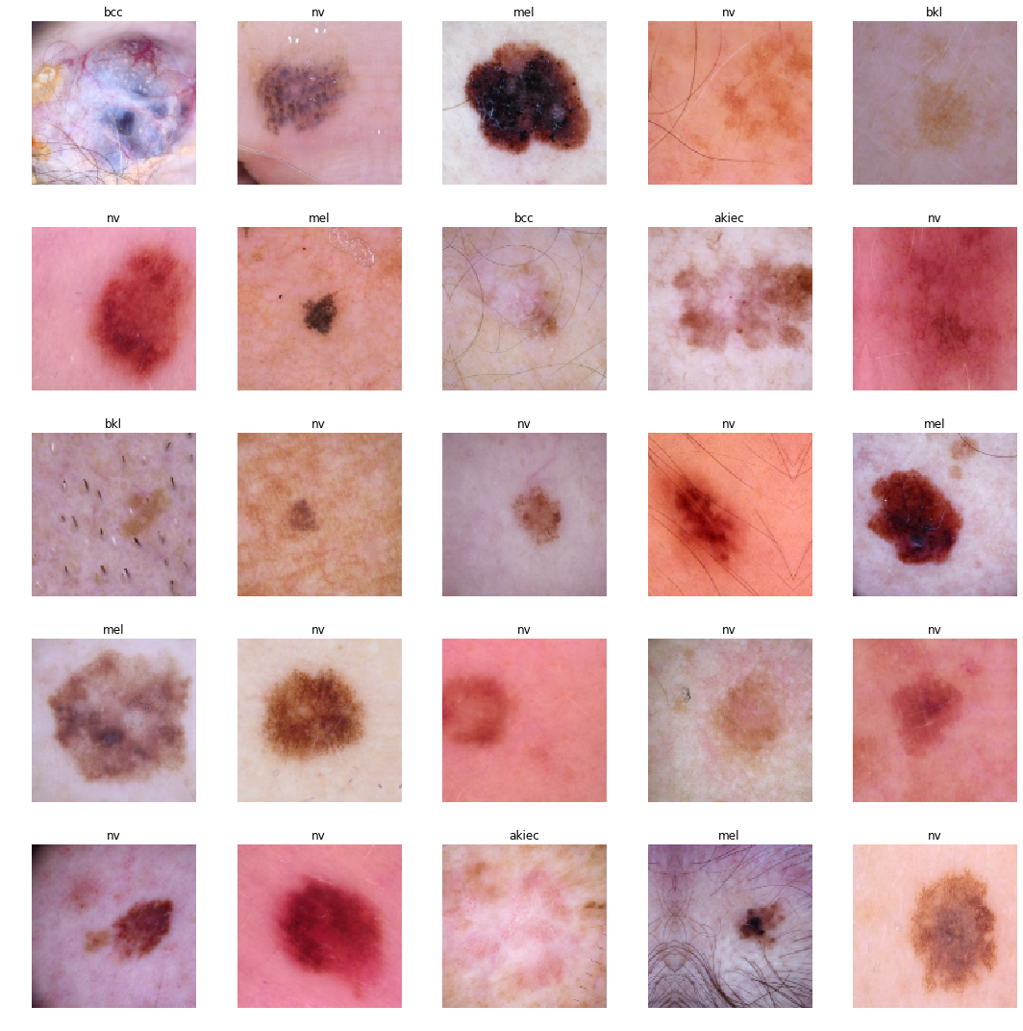
Dataset Used
Using HAM10000 [5] dataset which contain 10015 skin lesion images with ground truth segmentation map to train and test models.
In addition to that we are using derm-7-pt [6] dataset which consist of blue white veil ground truth label to train one of the base learners.

Slide 7
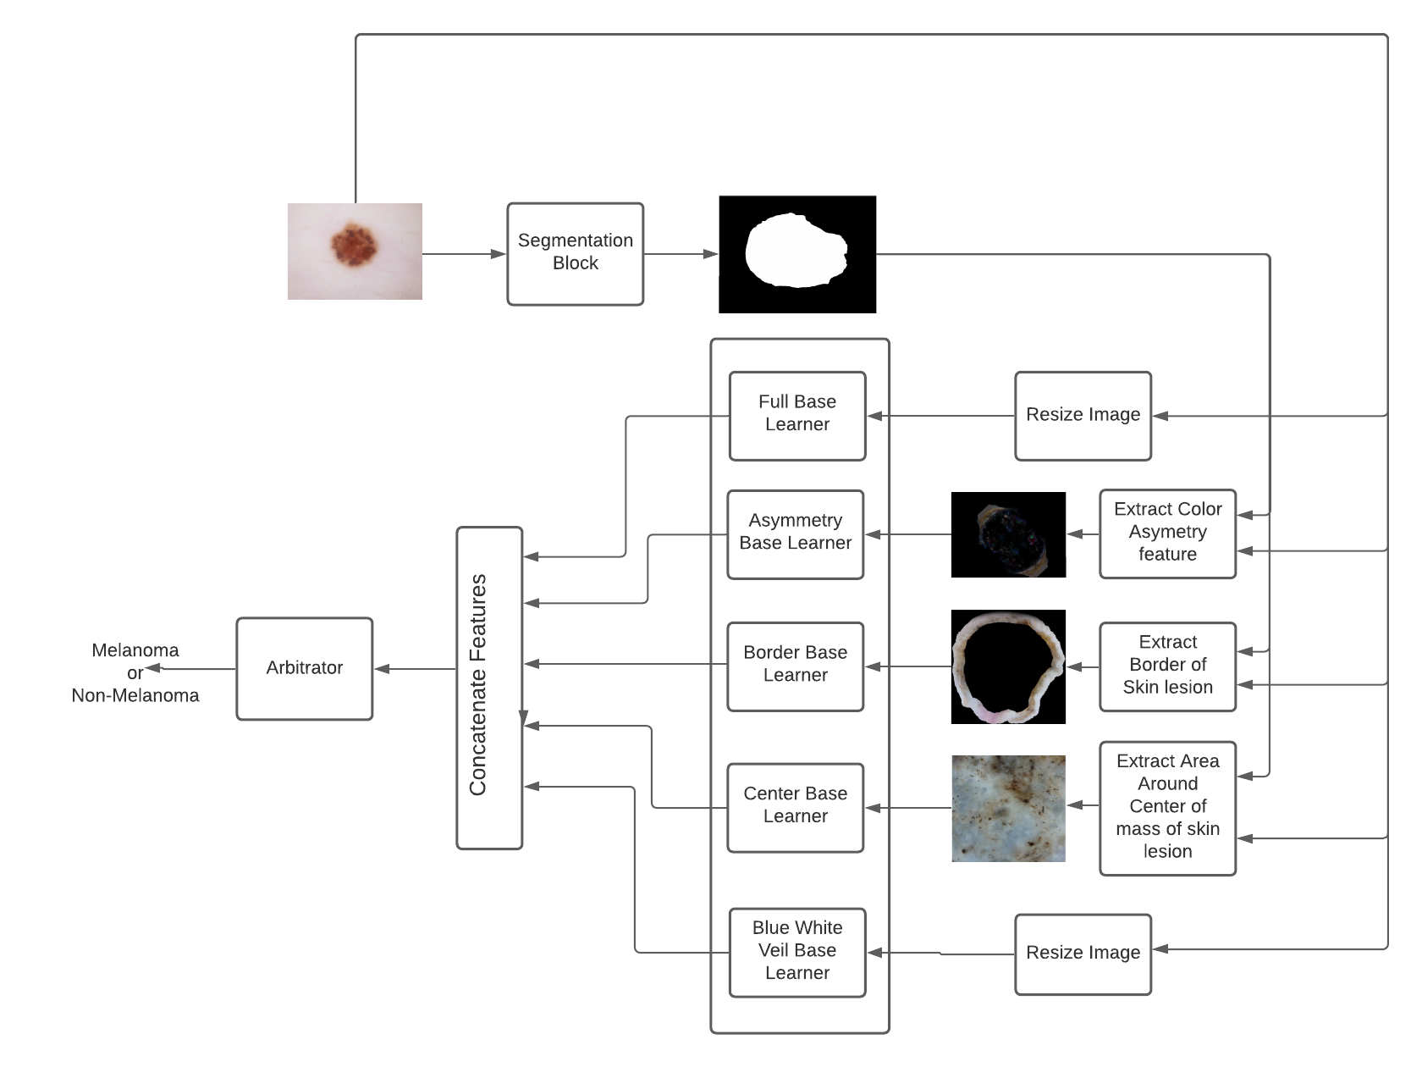
Proposed Methodology
Image Segmentation
After image segmentation using image processing techniques, we obtain a mask for the lesion. This mask is used in 4 of the subsequent image pre-processing blocks to get a highlighted Region of Interest (ROI)

Slide 8
Proposed Methodology (contd.)
4 Preprocessing blocks highlight different characteristics of images:
Colour/Shape Asymmetry
First, we obtain the center of mass, and major and minor axes of the segmentation mask
Next, for each of the major and minor axis, the absolute differences in RGB values of masked image are obtained between the original image and the image reflected along that axis. A third set of RGB differences is also obtained from reflecting the original image over both axes. The average value of these 3 sets then form the output image
All pixels outside the lesion are also replaced with the average colour of the lesion parameter, to ensure that only lesion pixels contribute to the asymmetry
Border
The border of the lesion is obtained by taking 5 pixels outwards and 20 pixels inward along the mask perimeter. All other pixels are masked out
Centre pixels
After obtaining the center of mass of the lesion, based on the segmentation mask, a 256 x 256 pixel region is taken around that center from the full resolution original image
This captures the fine details of the lesion, which might be lost during image rescaling

Slide 9
Proposed Methodology (contd.)
Full Base Learner:
Input: cropped skin lesion
Trained to predict Melanoma/Non-melanoma using entire skin lesion structure
Asymmetry Base Learner:
Input: Color Asymmetry information
Trained to predict Melanoma/Non-melanoma using color asymmetry information
Border Base Learner:
Input: Border Information
Trained to predict Melanoma/Non-melanoma based on border
Center Base Learner:
Input: Center of skin lesion
Trained to predict Melanoma/Non-melanoma based on information in the area surrounding the center of mass of the skin lesion
Blue White Veil Base Learner:
Input: Resized image of skin lesion
Trained to predict if white blue veil is present or not

Slide 10
Proposed Methodology (contd.)
Concatenate Features
Output layers of all the CNN base learners are removed and the features from the previous layers are concatenated
Melanoma/Non-melanoma Classifier
Input: Concatenated Feature Vector
Trained to predict final classification of Melanoma/Non-melanoma using input features from previous block

Slide 11
Results
Segmentation block
Tested on the 1002 images in the test split of HAM1000 dataset
101 melanoma
891 non-melanoma
Model | IoU | Dice Coefficient
U-net Segmentation Network | 90.03 | 96.03

Slide 12
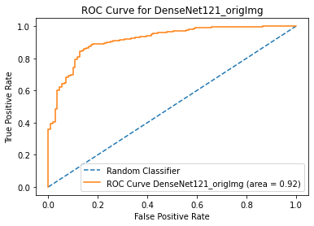
Results (contd.)
Whole Image Base Learner
Tested on the 1002 images in the test split of the HAM10000 dataset
111 melanoma
891 non-melanoma
At threshold = 0.5
Accuracy | Precision (melanoma) | Recall (melanoma) | Precision (non-melanoma) | Recall (non-melanoma)
90.02 % | 0.54 | 0.62 | 0.95 | 0.93

Slide 13
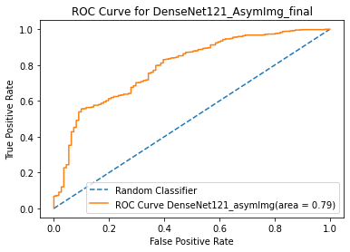
Results (contd.)
Asymmetry Base Learner
Tested on the 1002 images in the test split of the HAM10000 dataset
111 melanoma
891 non-melanoma
At threshold = 0.5
Accuracy | Precision (melanoma) | Recall (melanoma) | Precision (non-melanoma) | Recall (non-melanoma)
88.22 % | 0.46 | 0.36 | 0.92 | 0.95

Slide 14
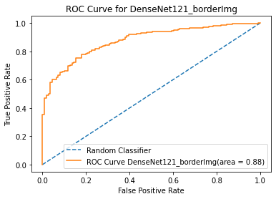
Results (contd.)
Border Base Learner
Tested on the 1002 images in the test split of the HAM10000 dataset
111 melanoma
891 non-melanoma
At threshold = 0.5
Accuracy | Precision (melanoma) | Recall (melanoma) | Precision (non-melanoma) | Recall (non-melanoma)
89.22 % | 0.52 | 0.33 | 0.92 | 0.96

Slide 15
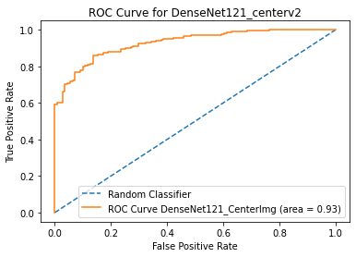
Results (contd.)
Center Base Learner
Tested on the 1002 images in the test split of the HAM10000 dataset
111 melanoma
891 non-melanoma
At threshold = 0.5
Accuracy | Precision (melanoma) | Recall (melanoma) | Precision (non-melanoma) | Recall (non-melanoma)
90.12 % | 0.54 | 0.66 | 0.96 | 0.93

Slide 16
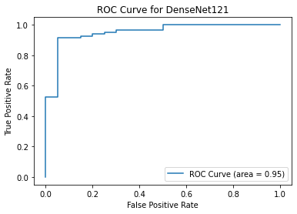
Results (contd.)
Blue-White Veil Base Learner
Tested on the 102 images in the test split of the derm7pt dataset
20 with blue-white veil features
82 without blue-white veil features
At threshold = 0.5
Accuracy | Precision (blue-whitish) | Recall (blue-whitish) | Precision (non-blue-whitish) | Recall (non-blue-whitish)
90.20 % | 0.78 | 0.7 | 0.93 | 0.95

Slide 17
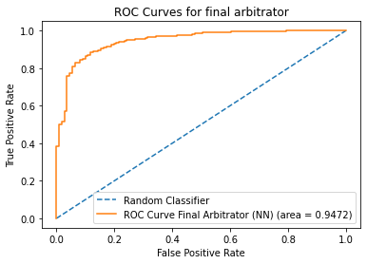
Results (contd.)
Final Inference
Tested on the 1002 images in the test split of the HAM10000 dataset
111 melanoma
891 non-melanoma
At threshold = 0.5
Accuracy | Precision (melanoma) | Recall (melanoma) | Precision (non-melanoma) | Recall (non-melanoma)
91.92 % | 0.60 | 0.79 | 0.97 | 0.93

Slide 18
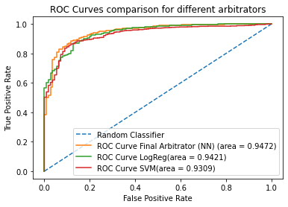
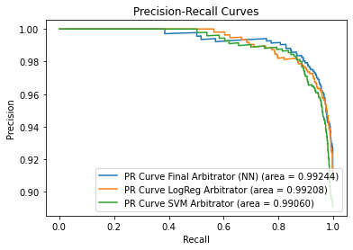
Results (contd.)
Arbitrator Comparison
Other arbitrators we have tested
Logistic Regression
Support Vector Machine (SVM)
Neural network arbitrator performed the best and is used in the final system !!

Slide 19
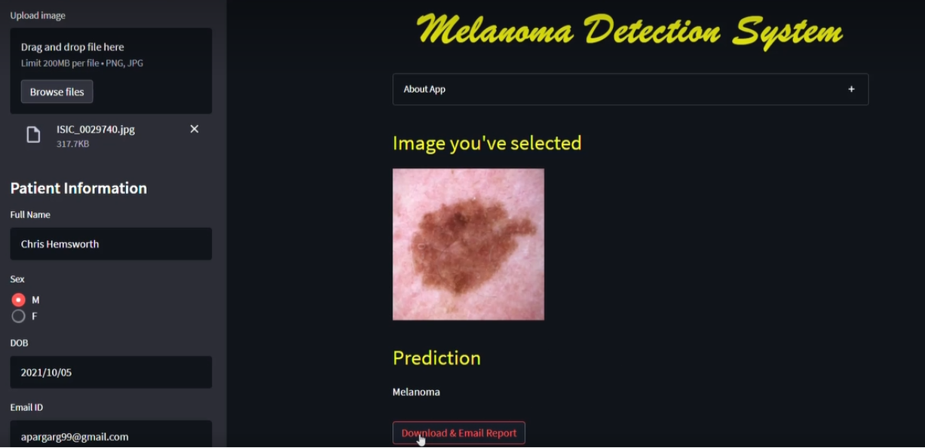
User Interface
Key Features:
Inference with Deep Learning model
Report Generation
Sending Emails

Slide 20
References
[1] https://www.cancer.net/cancer-types/melanoma/statistics
[2] https://jamanetwork.com/journals/jamadermatology/fullarticle/392759
[3] https://www.mcdermatology.com/biopsy.html
[4] http://www.drmarkseraly.com/how-long-does-it-generally-take-to-receive-skin-biopsy-results.html#:~:text=It%20generally%20takes%203%2D5,longer%20for%20a%20final%20report.
[5] https://dataverse.harvard.edu/dataset.xhtml?persistentId=doi:10.7910/DVN/DBW86T
[6] https://derm.cs.sfu.ca/Welcome.html

